Slide 1
An Incentive-based Resource Allocation Protocol
For Wireless P2P Network
By Di Chen

Slide 2
Introductions
1. What is wireless P2P network?
Each node in the system plays dual roles: client and server.

Slide 3
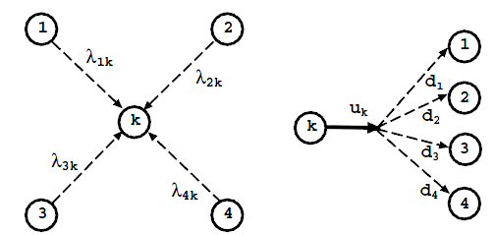
Introductions
2. General resource distribution model
For figure (a), node 1 to node 4 are clients. Node k is the server. $λ_{1k}\sim λ_{4k}$ are the requests of each node.
For figure (b), $u_{k}$ is the physical upload bandwidth of node k while $d_{1}\sim d_{4}$ are the requesting download bandwidth of each node.
(a)
(b)

Slide 4
Introductions
3. Problems
If $u_{k}≥\sum_{i=1}^{4}{d_{i}} at a certain time, then {it}^{′}s ok, no problems.$
If $u_{k}<\sum_{i=1}^{4}{d_{i}}$ at a certain time, then some nodes’ requests will not be satisfied. The problem comes.

Slide 5
Introductions
4. Possible solutions
First-come-first-serve
Can lead to long waiting time
Evenly distribution
Not fair and inefficiency of resource exploit

Slide 6
Incentive-based protocol
1. General variables
All nodes in P2P network are equal to each other.
Variables | $$d_{i}$$ | $$\left.C_{i}(t\right)$$ | $$\left.x_{i}(t\right)$$ | $$\left.U_{i}(θ_{i},x_{i}\right)$$
Meanings | The requesting download bandwidth of node i. | The cumulative contribution of node i at time t. | The bandwidth allocated to node i. | The utility function of node i.

Slide 7
Incentive-based protocol
2. Characteristics of incentive-based protocol
1.
2.
should reach its maximum value
3.

Slide 8
Incentive-based protocol
2. Definition of utility function $U_{i}$
As discussed before, $U_{i}$ is the function dependent of the required download bandwidth and the allocated download bandwidth.
Intuitively, the bigger ${x_{i}}/{d_{i}}$ is, the larger the utility should be.

Slide 9
Incentive-based protocol
3. Contribution-based Allocation(CA) algorithm
Let $R_{i}=\frac{x_{i}+d_{i}}{C_{i}^{r}}$, where r is a constant positive value, with $x_{i}=0$ and $R_{i}≤R_{j}$ if $i<j$
Increase $R_{1}$, which has the lowest value.
If $R_{1}=R_{2}$ during the allocating process, increase $R_{1}$ and $R_{2}$ simultaneously.
Repeat 2 and 3 for i>2.
For any $x_{i}=d_{i},$stop allocating bandwidth to it.
If $u_{k}=0$, end the process.

Slide 10
Contribution update
1. Definitions
x=$\left(x_{1},x_{2},...,x_{N}\right)$, the solution of CA algorithm considering contributions.
y=$\left(y_{1},y_{2},...,y_{N}\right)$, the solution of CA algorithm with the contribution of all nodes equal to 1.
The social gain for a server k
The social pay for client i

Slide 11
Contribution update
2. Contribution Update(CU) algorithm
If x=y, end of the algorithm.
Find the maximum value $x_{i}−y_{i}$ of x$−$y. Calculate $P_{i}$, decrease the contribution value of node i by $P_{i}$
$u_{k}=u_{k}−x_{i}$, and delete node i from the system and repeat step 1 and 2.

Slide 12
Remaining works
The order of the protocols
Simulations
The security problems

Slide 13
Thank you

