Slide 1
Simulation and Analysis Mobility Models for Vehicle Ad hoc Networks(VANETs)
Fang Yizhou
5080309323
Electronic Engineering

Slide 2
Contents of slides
1. Introduction to Vehicle Ad hoc Networks(VANETs)
2. Analysis of three existing mobility models for VANETs
2.1 Greedy Perimeter Stateless Routing(GPSR) for VANETs
2.2 Movement Aware Greedy Forwarding(MAGF) for VANETs
2.3Movement-Based Routing(MORA) for VANETs
3. A self-designed mobility model for VANETs
------Score-based Routing(SBR)
4. Simulation and Comparison Results for GPSR,MORA,MAGF and SBR
5. Future work

Slide 3
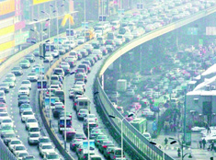
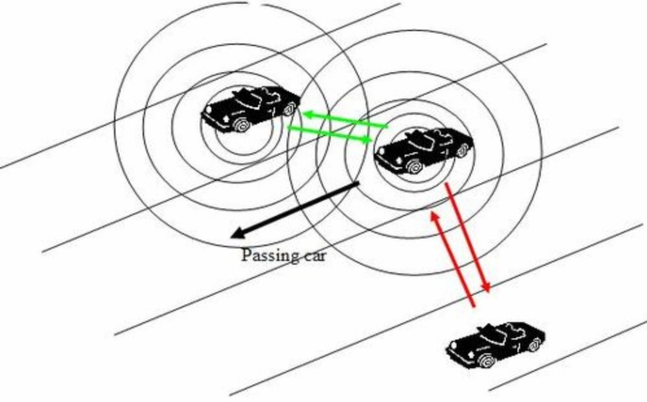
Introduction to Vehicle Ad hoc Networks(VANETs)
Vehicle Ad hoc Networks (VANETs) are a specific
instance of Mobile Ad hoc NETworks (MANETs) where nodes
are vehicles. In VANETs, vehicles have no energy resource
constraint which could extend coverage and network lifetime, but
have a high mobility patterns that cause frequent and fast
topology changes. Consequently, VANETs have particular
research interests, like dedicated MAC and routing optimization.
A daily traffic situation
Intermediate for VANETs

Slide 4
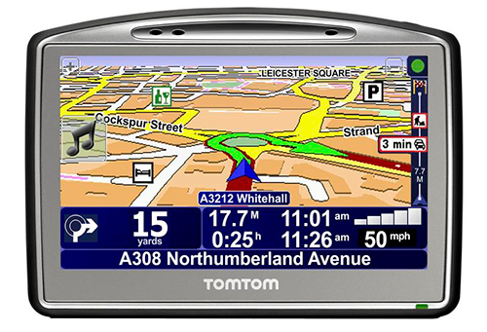
Introduction to Vehicle Ad hoc Networks(VANETs)
Features for VANETs
1.By using GPS or GALILEO,able
to get its own geographic position, thus its movement
information (position, speed, movement direction).
2.Non-random mobility of the
vehicles; roads are mapped and digitally available, and driving
rules can be electronically represented as well.
GPS device for vehicle
1,121.910049,30.858386,121.915823,30.860735,1,<(3,e)><(2,e)>
2,121.898412,30.882789,121.915794,30.860735,1,<><(1,e)>
3,121.884609,30.878717,121.910049,30.858431,1,<(16,s)(20,e)(17,e)><(1,s)(4,e)>
4,121.897587,30.853319,121.910049,30.858416,1,<(5,e)><(1,s)(3,e)>
5,121.883829,30.867036,121.897617,30.853185,1,<><(4,s)(6,e)>
6,121.887114,30.849009,121.897676,30.853066,1,<(7,e)><(5,e)(4,s)>
7,121.838320,30.850109,121.887114,30.849009,1,<(8,e)(10,e)><(6,s)>
8,121.868458,30.856725,121.878284,30.850054,1,<(9,e)><(7,s)(10,e)>
9,121.867885,30.866655,121.868458,30.846725,1,<(14,e)(15,s)><(8,s)>
.........
Electronical information

Slide 5
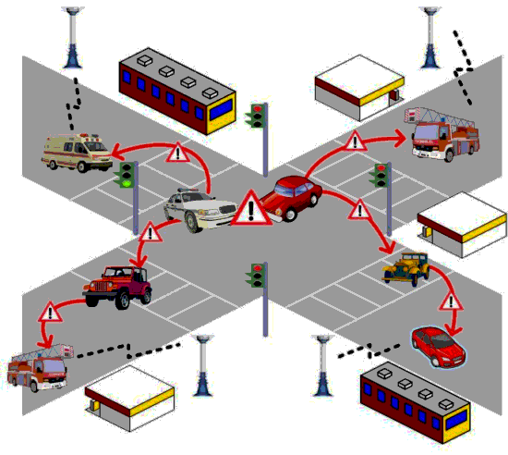
Introduction to Vehicle Ad hoc Networks(VANETs)
Features for VANETs
-----High speed of vehicles causes dynamic topology changes
The network behavior is greatly affected by these characteristics and many challenges have to be addressed while deploying the a safety and comfort applications. One major challenge relates to designing an efficient routing protocol for vehicular environment since a reliable route should be ensured to send data from a source to a destination under changing link connectivity.

Slide 6
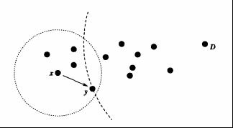
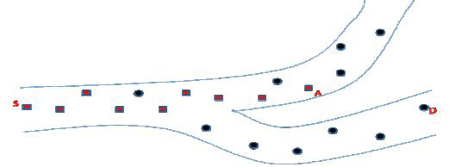
Analysis of three existing mobility models for VANETs
Greedy Perimeter Stateless Routing(GPSR) for VANETs
Greedy forwarding:
Information is obtained with the help of a location service(GPS). With all these information, a node forwards incoming packets to neighboring nodes that are geographically closer to the destination.
Problems for simple Greedy forwarding:
A packet send from node S is forwarded to a node A closer to the destination D but from which a local maximum and could not be recovered. As a result, the packet is not able to progress towards D although a valid path is available from the source to the destination.

Slide 7
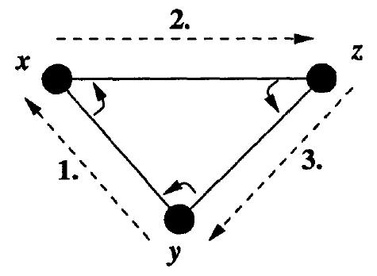
Analysis of three existing mobility models for VANETs
Greedy Perimeter Stateless Routing(GPSR) for VANETs
Right-hand rule
The right-hand rule traverses the interior of a closed polygonal region (a face) in clockwise edge order{in this case, the triangle bounded by the edges between nodes x, y, and z, in the order (y → x → z → y).

Slide 8
Analysis of three existing mobility models for VANETs
Movement Aware:
Movement Aware is the extension of the Greedy Forwarding (MAGF) which includes the speed and the direction of vehicle’s movement in order to make optimal routing decisions. It also exploits the lifetime concept to address the inaccuracy of traditional position-based routing.
There are mainly two types of Movement Aware Mobility Models for VANETs. The first is the Movement Aware Greedy Forwarding(MAGF) and the second is the Movement-Based Routing(MORA)
MAGF takes into consideration the position ,speed and direction of vehicles. MORA is based on position and direction

Slide 9
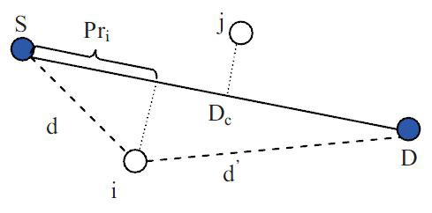
Analysis of three existing mobility models for VANETs
Movement Aware Greedy Forwarding(MAGF) for VANETs:
It is designed to match the high mobility requirements and to perform even in cases of pure Greedy Forwarding failure. The core idea of this approach is to define a function:
with
Variable declaration:
and
and

Slide 10
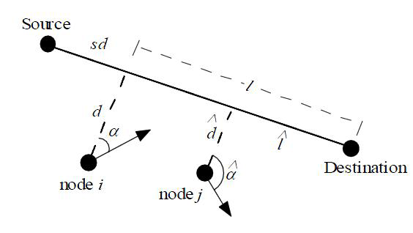
Analysis of three existing mobility models for VANETs
Movement-Based Routing(MORA) for VANETs:
The core idea of the approach is to
develop a functional which depends on the distance of forwarding car from the line connecting the source and the destination, sd, and on the node’s movement direction. This functional is required to be implemented in a distributed way allowing any vehicle to calculate it. The target functional should reach its absolute maxima in the case the node is moving on sd and it should decrease as the distance from sd increases.

Slide 11
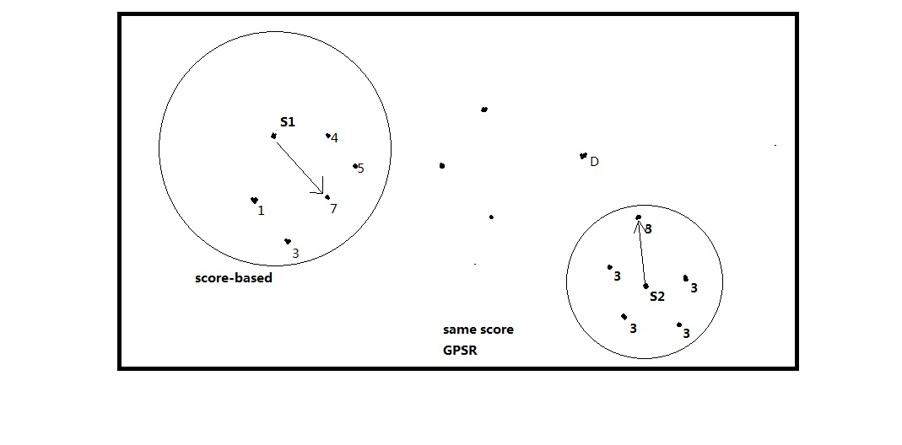
Analysis of a self-designed mobility models for VANETs
Score-based Mobility Model
How to score:
If a vehicle has successed in functioning as a intermediate node, it has
1 score plus.

Slide 12
Analysis of a self-designed mobility models for VANETs
Score-based Mobility Model
This is enlightened by MORA and MAGF, both using a function to choose intermediate node. This function gives a weighted factor to each node and the node with the biggest weighted factor is the choice. So I think I can give a weighted factor to each node. This weighted factor is based on the node's past performance. If a node successfully functioned as a intermediate, then we add 1 to it. A source node searches for all the intermediate node in its transmitting range and compare their factors.The node with the biggest factors is chosen. However, I think there must be a complementary explanation. When all the nodes in the transmitting range have small factor or they have the same factors, it is not proper to judge with weighted factor. I think in this condition, we should choose the node with GPSR model.

Slide 13
Simulation and Comparison Results for GPSR,MORA,MAGF and SBR
With regard to the simulation of VANET, ns2 and Glomosim are the most usually used software. As a new starter in this eld, I choose JAVA to do the simulation.The simulation setting is shown in the following table.
Simulation Setting
Time unit | 1ms,10ms,100ms
Simulation time | Self-designed(longer,better)
Speed | 10m/s-30m/s
Packet Size | 1-10
Vehicle Density | 1 per km,2 per km,3 per km
Transmission range | 100m,300m,500m,800m

Slide 14
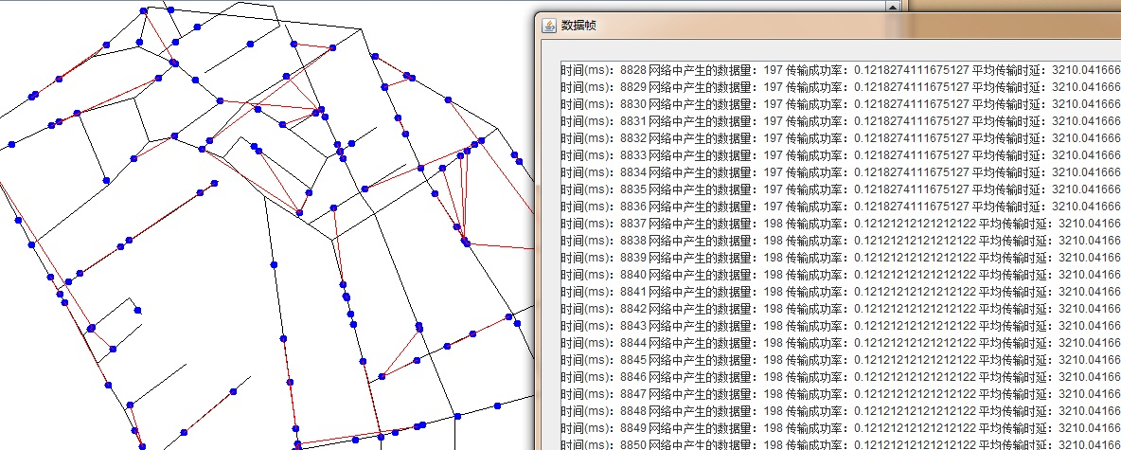
DEMO

Slide 15
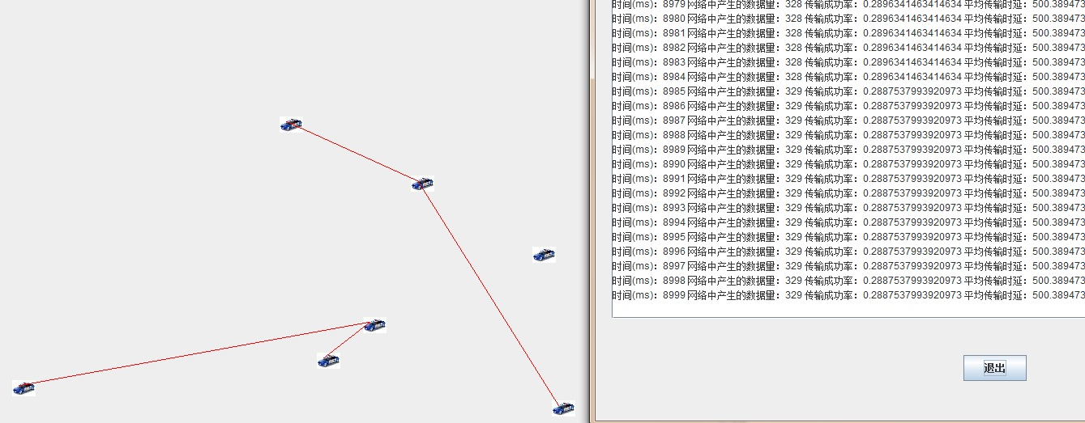
DEMO

Slide 16
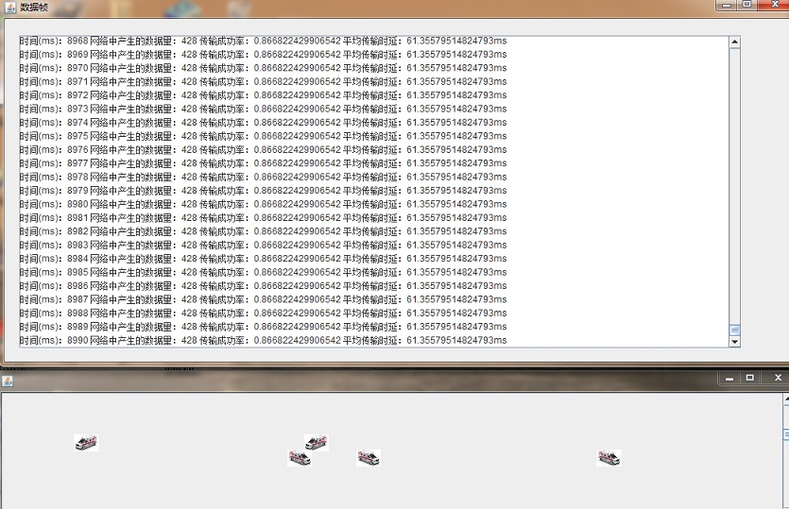
DEMO

Slide 17
Simulation and Comparison Results for GPSR,MORA,MAGF and SBR
There are several points to explain before I give my simulation results.
1).My simulation researches into the impact of vehicle density and range on
end-to-end delay .As shown in the above table ,the simulation time is 30s
and the time unit is 1ms.So I have done 30000 test during my simulation.
2).Because the region is large in simulation,there is a huge number of cars .vehicle density above is of statistic average.
3).The simulation has concentrated only on transmission range and vehicle
density. Other factors are considered same or ignored in order to simplify
the simulation and get better results with regard to the two key factors.

Slide 18
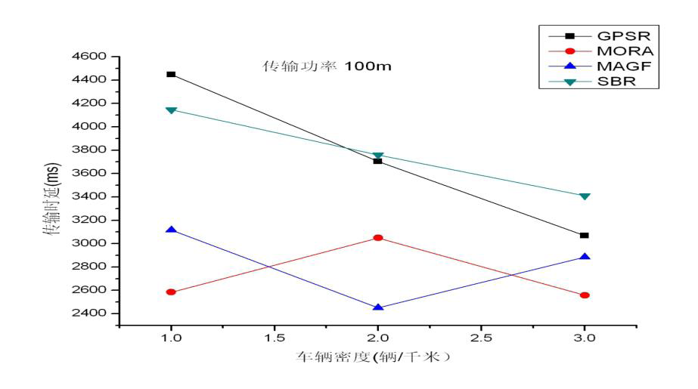
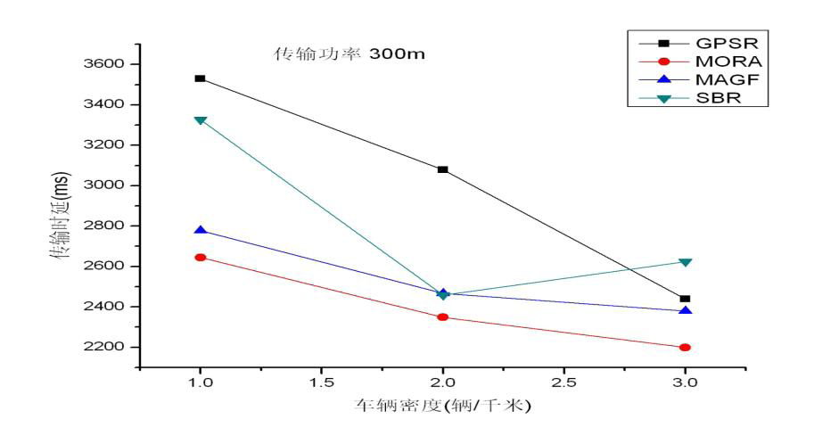
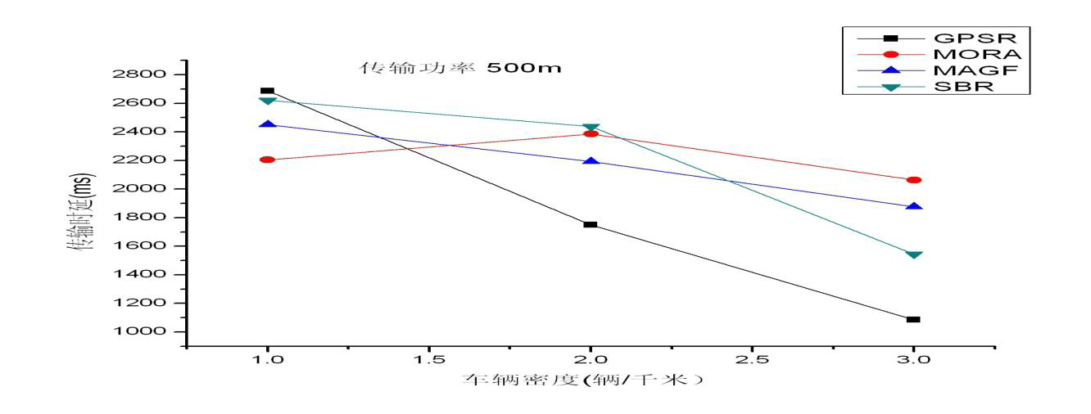
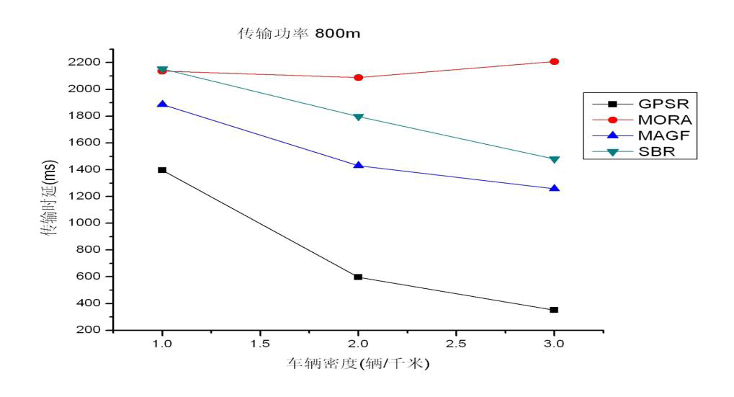
Simulation and Comparison Results for GPSR,MORA,MAGF and SBR
The following four figures show the impact of vehicle density on delay.

Slide 19
Simulation and Comparison Results for GPSR,MORA,MAGF and SBR
Analysis of the impact of vehicle density on delay
1). With the increase of vehicle density, the delay decreases.
2). GPSR performs the worst in case of small range and low vehicle density. However, GPSR becomes the first choice in case of big range and high vehicle density. This is easy to explain according the above theory.Greedy forwarding is less likely to fail in case of high density and big range.
3).SBR has higher delay in all the four figures, and its advantage is not clear in this case.

Slide 20
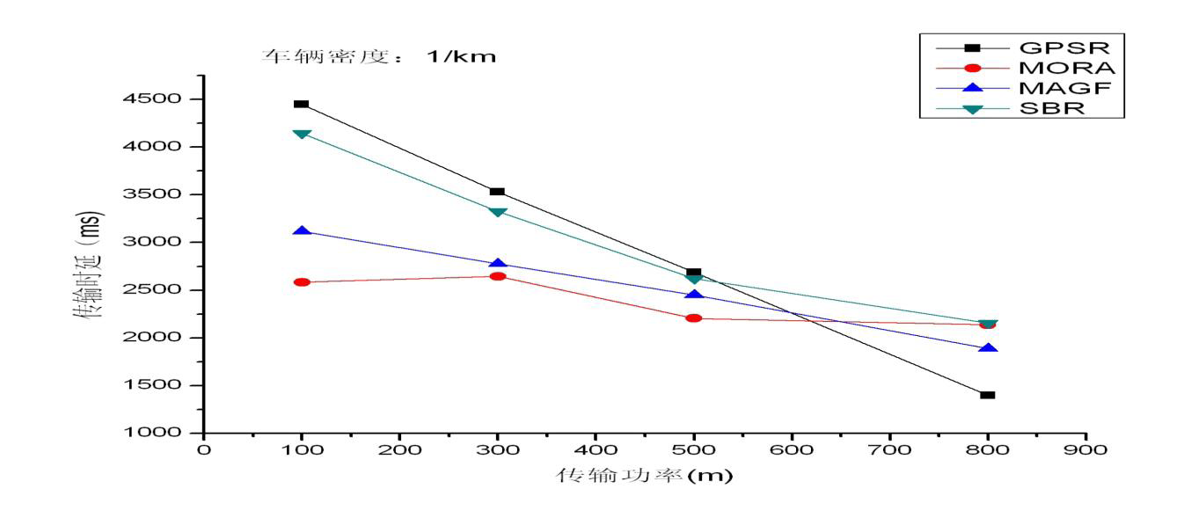
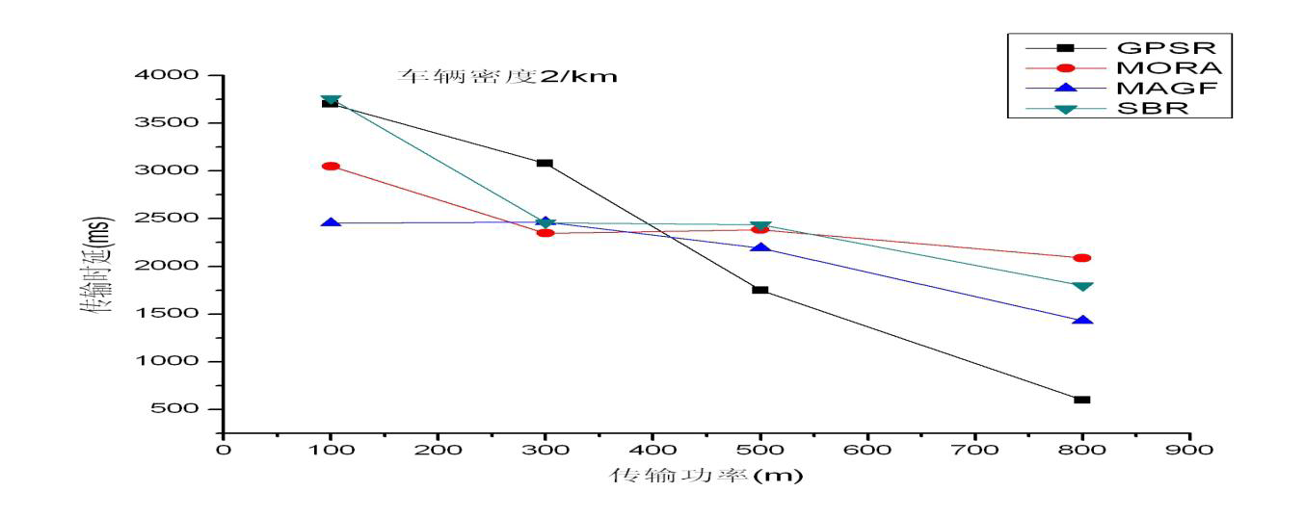
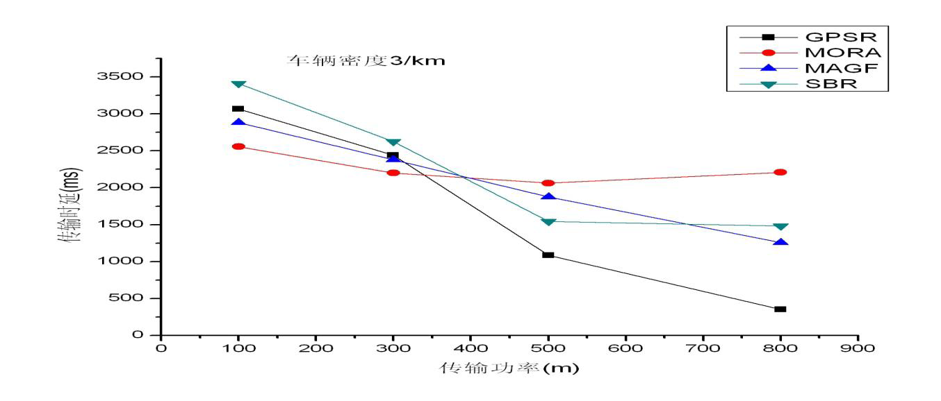
Simulation and Comparison Results for GPSR,MORA,MAGF and SBR
The following three figures show the impact of range on delay

Slide 21
Simulation and Comparison Results for GPSR,MORA,MAGF and SBR
Analysis of the impact of range on delay
1).With the increase of range, the delay decreases.
2).The increase of range has more impact on GPSR than on MORA and MAGF.This is easy to explain because GPSR is only position related,MORA is position and direction related,and MAGF is position,speed and direction related.
3).GPSR and SBR has similar simulations, especially in low vehicle density. This has demonstrated we apply to GPSR for SBR under same scores.

Slide 22
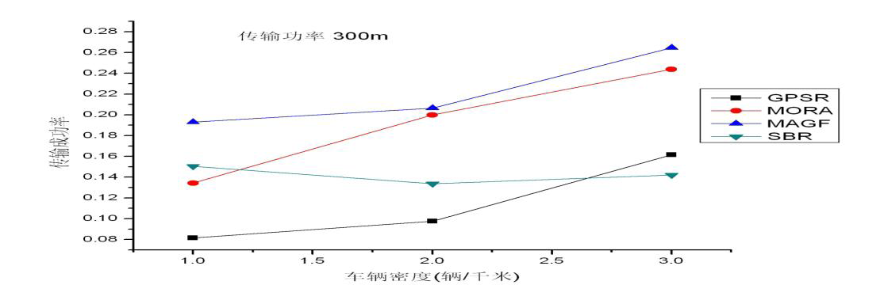
Simulation and Comparison Results for GPSR,MORA,MAGF and SBR
The following three figures show the impact of vehicle density on packet delivery ratio

Slide 23
Simulation and Comparison Results for GPSR,MORA,MAGF and SBR
Analysis of the impact of vehicle density on packet delivery ratio
1).With the increase of vehicle density, the packet delivery ratio has increased.
2).With the increase of vehicle density, GPSR has higher delivery ratio than other mobility modeles.

Slide 24
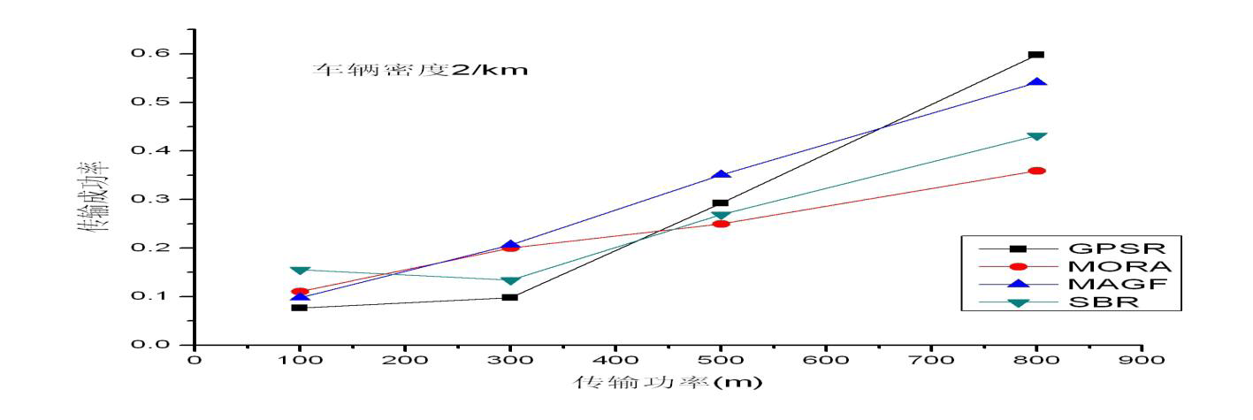
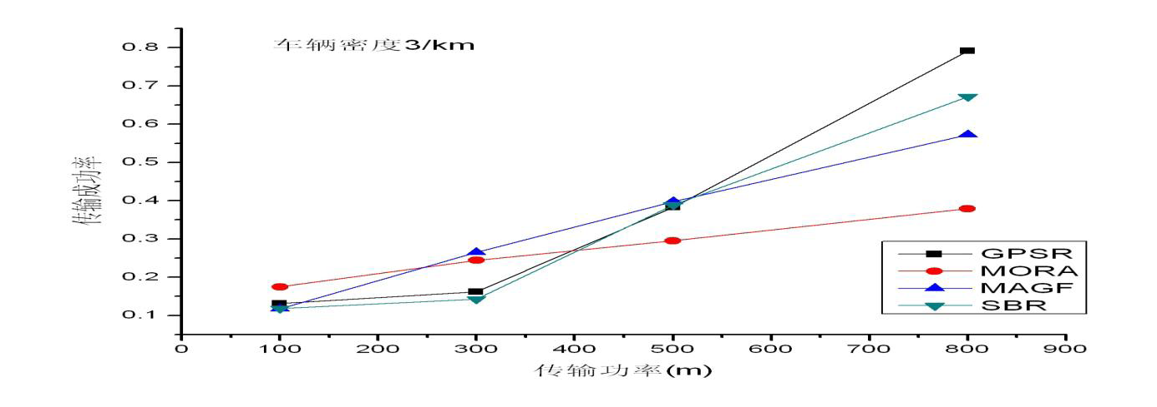
Simulation and Comparison Results for GPSR,MORA,MAGF and SBR
The following three figures show the impact of range on packet delivery ratio

Slide 25
Simulation and Comparison Results for GPSR,MORA,MAGF and SBR
Analysis of the impact of range on packet delivery ratio
1).With the increase of range, the packet delivery ratio is higher
2).With the increase of range, SBR and GPSR has better performance than other mobility models

Slide 26
Future work
The simulation environment should be more. In this initial simula
tion, I design a city road model. But I think there should be more complex simulation models, for example, highway road which is a very popular simulation environment. A highway road model is shown below.

Slide 27
Thank you

