Slide 1
Sensor network MAC protocol
5080309135姚曜

Slide 2
Sensor network
Consist of many nodes, all nodes can send or receive packets
All nodes using the only one channel
Node need to save energy

Slide 3
MAC protocol
MAC protocol determines which node can send packets, which node can receive and which node to wait
The most crucial designing goal is energy-efficiency

Slide 4
Duty-cycle
Every node has 4 states:
Sending
Receiving
Sleeping(close the wireless function to save energy)
detecting ( be awaked to measure whether the channel’s state is busy or not)
When node is idle:
Sleeping
Detecting
Sleeping
Detecting
Sleeping

Slide 5
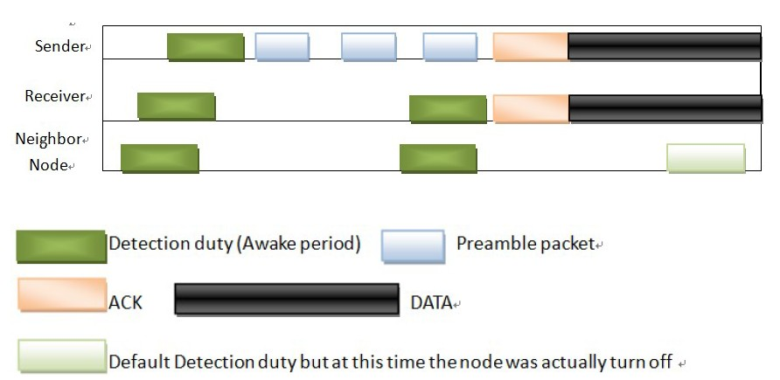
When node is working
Sleeping
Sleeping
Sleeping

Slide 6
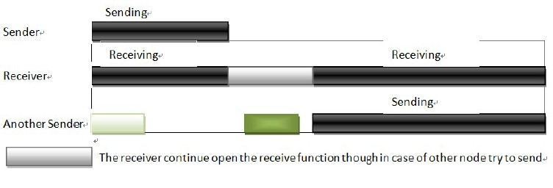
Continue sending

Slide 7
Thank you!

