Slide 1
Spatio-temporal Gaussian Process Based
Radio Map Reconstruction
韩雨桐 2016/6/3

Slide 2
Road Map
Raise the Question
Gaussian Process
Our Model
Future Work

Slide 3
Introduction
Wi-Fi has been used in indoor localization
RSSI-Based Localization
Triangulation
Fingerprint
Notes:
Over the past decade, the increasing use of Wifi technology has been implemented in real-world location based applications, especially in localizing clients holding
mobile devices in indoor environments.
There are many algorithm to solve this problem, one of the most popular solution is based on the RSSI
from multiple access points, which also abbreviated as AP.
Wi-Fi triangulation’s goal is to map RSSI as a function of distance. This method requires a steep linear characterization curve in order to be properly implemented. Functions
describing these curves are then used with live RSSI values as
input to generate an (x,y) location prediction.

Slide 4
Fingerprinting
Offline Phase
Collect RSS from AP
Result in a radio map
Online Phase
Get the RSS of mobile clients from AP
Search radio map to estimate client’s location
Notes:
Fingerprint wireless localization techniques is performed
on two phases;
During the offline phase, the signal strength received from the access
points at selected locations are stored in a database, resulting in a radio map.
During the online phase, the system use the signal strength samples of mobile clients from the
access points to search radio map to estimate the client’s location

Slide 5
Fingerprinting
Offline Phase
Collect RSS from AP
Result in a radio map
Online Phase
Get the RSS of mobile clients from AP
Search radio map to estimate client’s location
Notes:
Fingerprint wireless localization techniques is performed
on two phases;
During the offline phase, the signal strength received from the access
points at selected locations are stored in a database, resulting in a radio map.
During the online phase, the system use the signal strength samples of mobile clients from the
access points to search radio map to estimate the client’s location

Slide 6
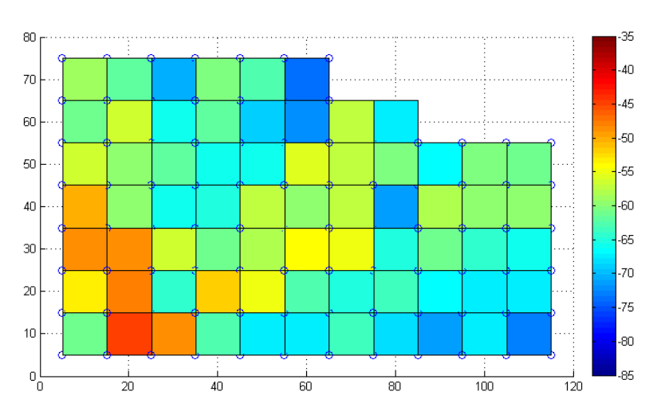
Radio Map example
A radio map of the one of the Routers
Color indicates RSS
Notes:
Here is a visualization example of radio map,
This is the radio map of one of the routers,
We divide the whole space into several block, as the picture shown
And the color of each blocks indicates the RSS of the access point
Also as this Radio map shows us, if we want to construct this kind of radio map in our classroom, a place about 100 square meters. We have to collect the RSS value in at least 100 blocks. So, how about the place we want to localize is a supermarket, or a big factory ?

Slide 7
Problem of fingerprinting localization
Difficult to construct the radio map of large environment
True radio map change over time
Hardware device variance
Notes:
So the first problem is when we want to localize in a large environment, we may pay a large effort to construct the radio map of the environment.
Another challenges with fingerprints techniques is that they are vulnerable to several dynamic factors in
locations.
The first kind of factors are inherent factors, such as wireless channels changes over time when the client is standing at a fixed location.
Another kind of factors are external factors, such as hardware device variance problem: the device (training device) used to construct radio maps during the offline phase
differ from the tracking devices used during the online phase, the variance between these two device can make us collect different fingerprint at same position in the same environment.
So the last two factors will both influence the accuracy of our localization.
To handle such factors it is imperative to first understand
the impact of these factors. The experiments described later
indicate how these factors influence the accuracy of localization. Further, we also consider these factors into our indoor
localization system model.

Slide 8
Our aim
Use part of the data to reconstruct the whole radio map
Use these data to predict the radio map
Construct the transfer function model between different device

Slide 9
Road Map
Raise the Question
Gaussian Process
Our Model
Future Work

Slide 10
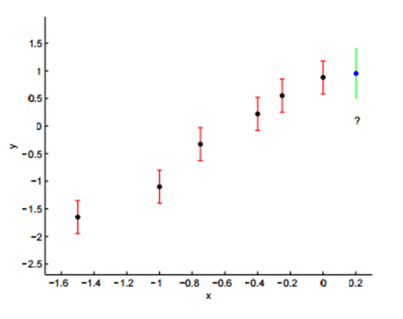

Motivation
Given a training set $D=\left\{\left(x_{i},y_{i}\right)\right|i=1,…,n\}$
How to calculate the output $y_{∗}$ for a new input $x_{∗}$
Linear regression?
– Least Square Method
Nonlinear regression?
-- Gaussian Process

Slide 11
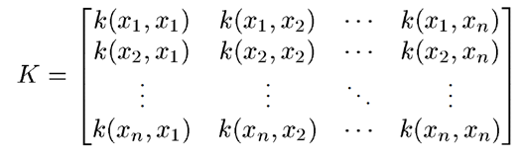

Definition
Assume $y=\{y_{1},y_{2},…,y_{n}\}$ obey multivariate Gaussian Distribution
$\left(\begin{matrix}y_{1} \\ ⋮ \\ y_{n}\end{matrix}\right)\sim N\left(0, K\right)→y\sim N\left(0, K\right)$
Where

Slide 12
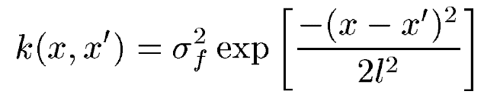

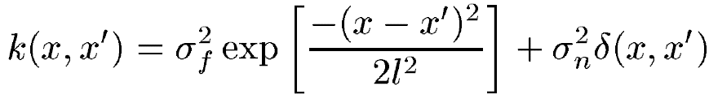
Definition
Covariance Function ---- kernel
Noise

Slide 13
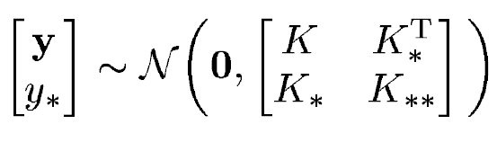
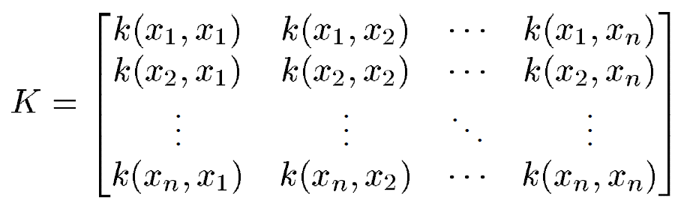


Regression
For new input $x_{∗}$
where

Slide 14



Regression
For new input $x_{∗}$
We get
Mean：
Variance：

Slide 15


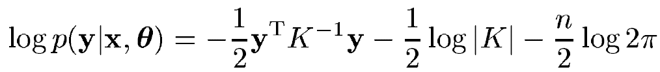
Find Parameters
Using Maximum Likelihood
Max

Slide 16
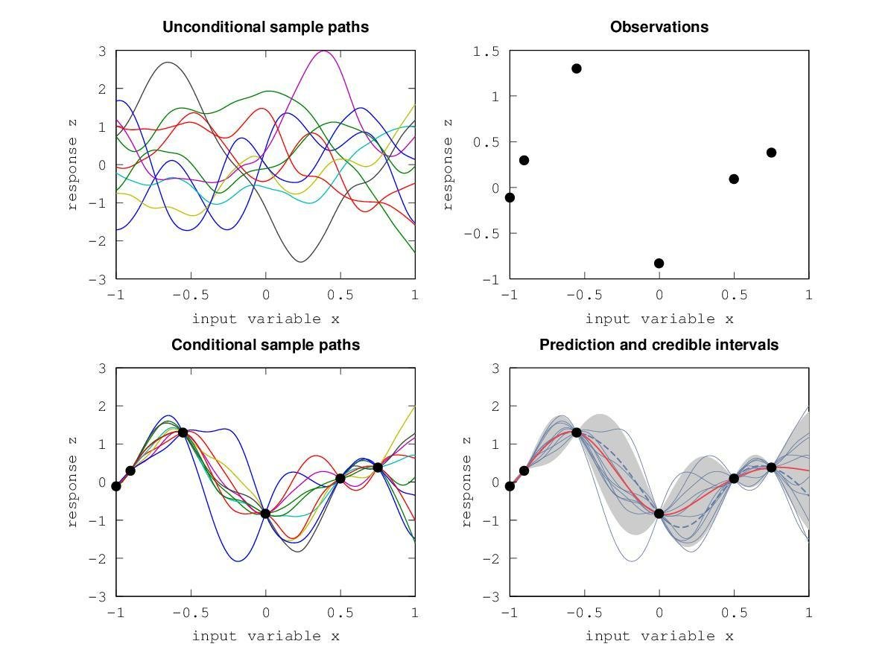
GPR example

Slide 17
Road Map
Raise the Question
Gaussian Process
Our Model
Future Work

Slide 18
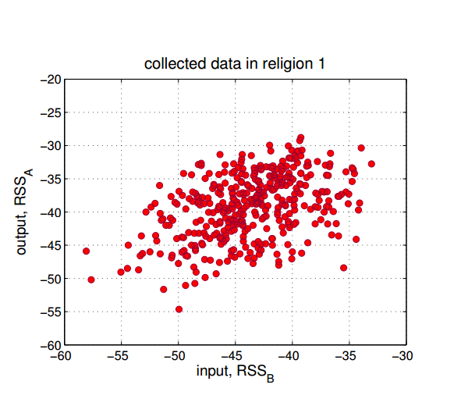
Transfer Function
Device A is the standard device.
Device B get the RSS from the same AP
Notes:
Suppose device A is the standard device.In a given location, device A and another device B all get the RSS from
the same AP. We suppose that the RSSA is the standard
value, and RSSB should be mapped to RSSA collected by
device A.

Slide 19
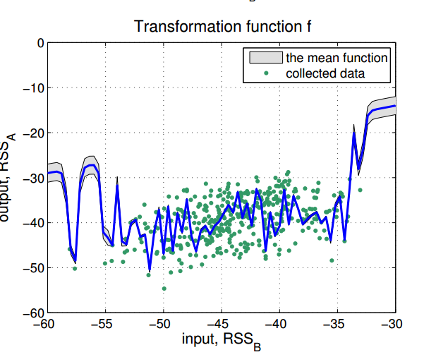
Transfer Function

Slide 20
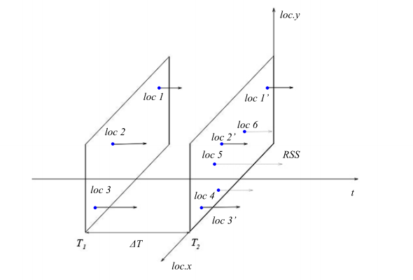

Spatio-temporal model
$$k\left(x,x^{′},t,t′\right)=k_{s}\left(x,x^{′}\right)k_{t}(t,t′)$$

Slide 21
Road Map
Raise the Question
Gaussian Process
Our Model
Future Work

Slide 22
Future work
Using new data to evaluate our model
Combine the GPR model

Slide 23
Q & A

