Slide 1
Access Points Deployment
5130309297 赵忆漠

Slide 2
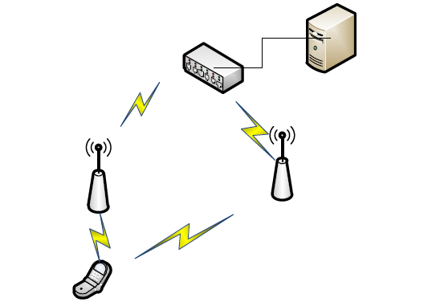
Outline
1.Background
2.Principle
3.Experiment

Slide 3
RSSI not stable
reflection or refraction
⇨ less accruacy
interference from phone or move
......

Slide 4
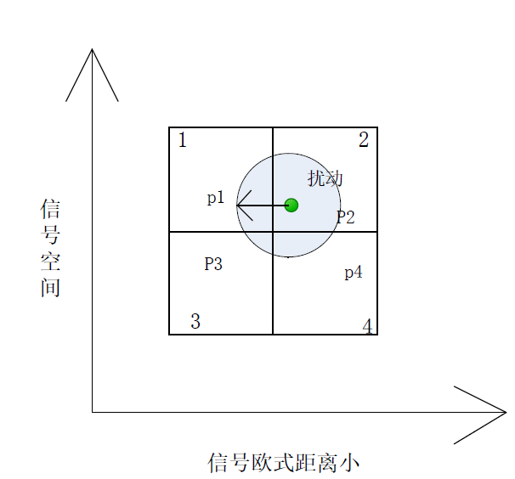
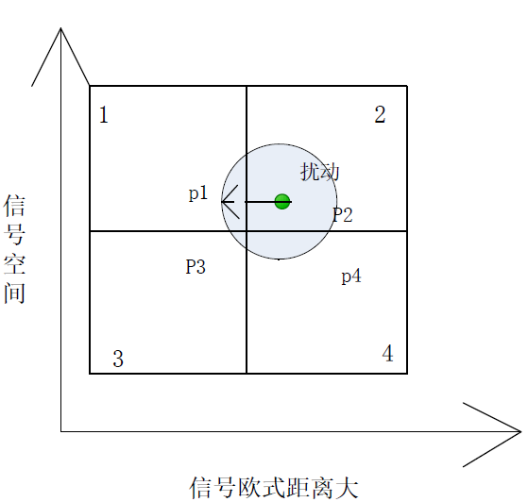
Principle
Algorithm :
The error probability of positioning will decrease,if the Euclidean distance of the reference point increase within a certain range.

Slide 5
Fading statistics of the signal
the signal of the AP:
b(t):the baseband data
c(t):spread spectrum sequence
f₀:carrier frequency

Slide 6
after the reflection and the refraction the received signal:
R(t):complex fuzzy stochastic process
when no optical route(a₀=0),R(t)can be represented as:

Slide 7
obey the reihly distribution

Slide 8
Experiment
based on the GA
use matlab to find out the number and the appropriate position of APs
the mathematical model of signal

Slide 9
Process1:AP num
1 set the objective function and the constraint condition
2.set the origion and the number of the reference points
3.AP_num = 0
4.set the parameters of GA
5.set the initial population and coding
6.AP <- AP+1
7.calculate the value of he objective function
8.judgement,if it fits the requirement.
9.choose,crossover and mutation
10.replace the incommensurate parent
11.find the unit which have highest fitness value record all the value of the objective function,return to 6.
12.record the best individual and its value of objective function

Slide 10
Process2：appropriate position
1 set the objective function and the constraint condition
2.set the origion and the number of the reference points
3.set the parameters of GA
4.set the initial population and coding
5.calculate the value of he objective function
6.judgement,if it fits the requirement.
7.choose,crossover and mutation
8.replace the incommensurate parent
9.find the unit which have highest fitness value record all the value of the objective function,return to 7.
10.record the best individual and its value of objective function

Slide 11
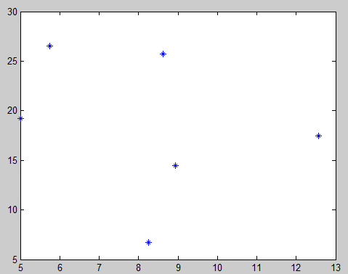
Some Results
AP = 6
Area | AP_num | Difference of the Euclidiean distance and the standard deviation | AP_loc
8 * 16 | 3 | 2.73 | (2.06,6.19),(5.94,2.06),(4.90,11.87)
16 * 16 | 4 | 2.34 | (3.10,6.19),(12.90,6.80),(9.81,6.09),(6.19,13.94)

Slide 12
Thank you!
Q&A

