Slide 1
Socialization on Acemap
By Bolin Lai
Network Group

Slide 2
Outline
1
Why do we need to make acemap social
2
Socialization on acemap
3
Future work

Slide 3
Outline
1
Why do we need to make acemap social
2
Socialization on acemap
3
Future work

Slide 4
Development
20 years ago, academic website mainly focused on academics itself.
In 1992, Richard Jensen built H-Net academic social website for historian.
In 21th century, many academic social websites have been built, such as Academia, Research Gate.

Slide 5
Outline
1
Why do we need to make acemap social
2
Socialization on acemap
3
Future work

Slide 6
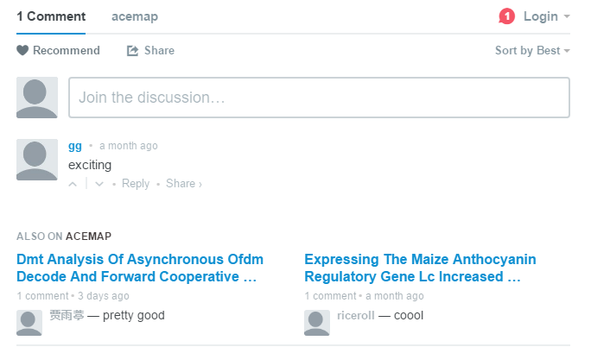
Comments
Agree or disagree other comments
Papers with most comments

Slide 7
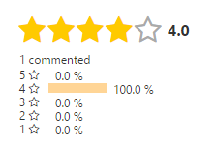
Score
From 1 star to 5 stars
Count the score and rank all the paper
Recommend based on comments and score

Slide 9
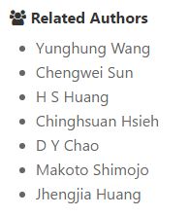
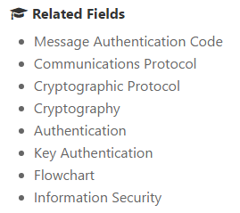
Related authors & fields

Slide 10
Field
Author1
Related Fields
Author2
Author2
Paper
Institution
Related Authors
Author3

Slide 11
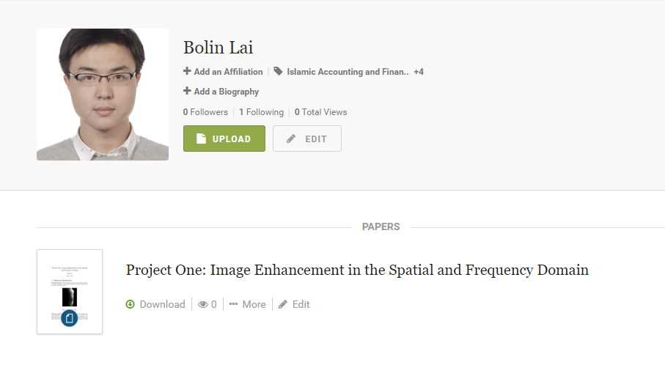
User Page
Academia

Slide 12
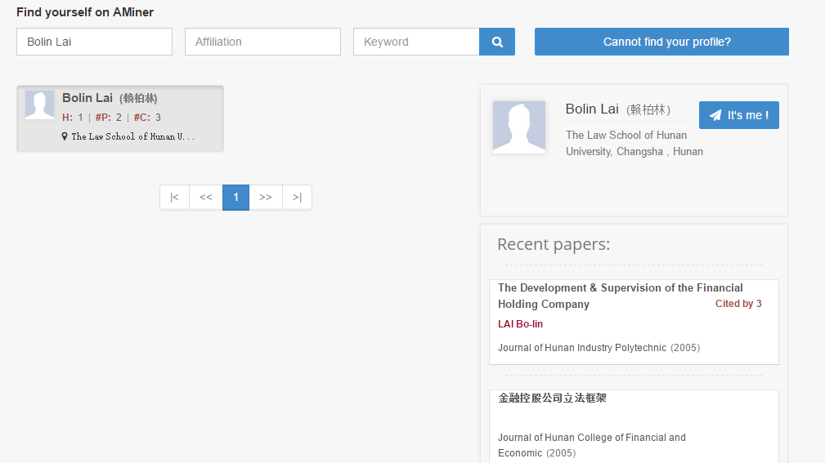
User Page
Aminer

Slide 13
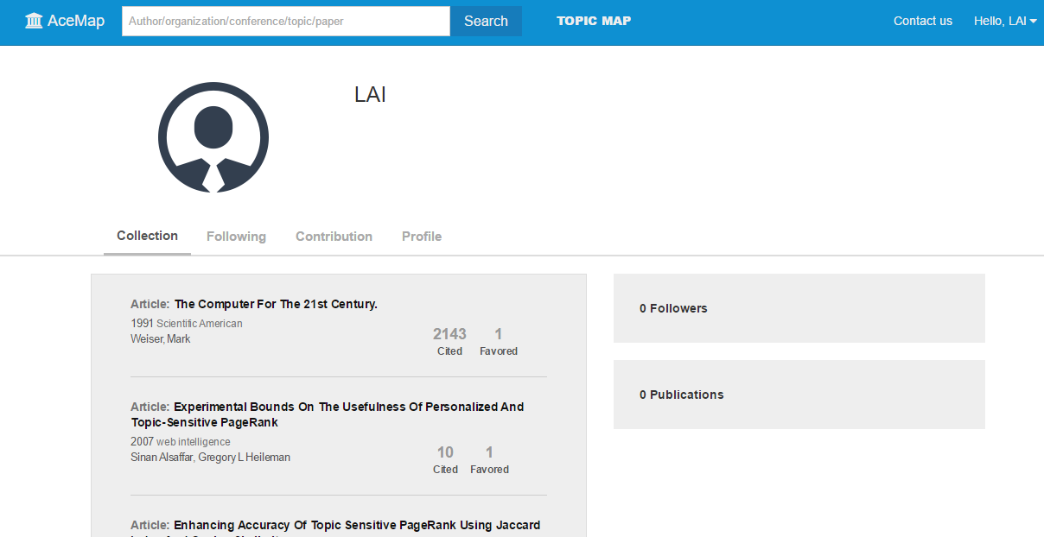
User Page

Slide 14
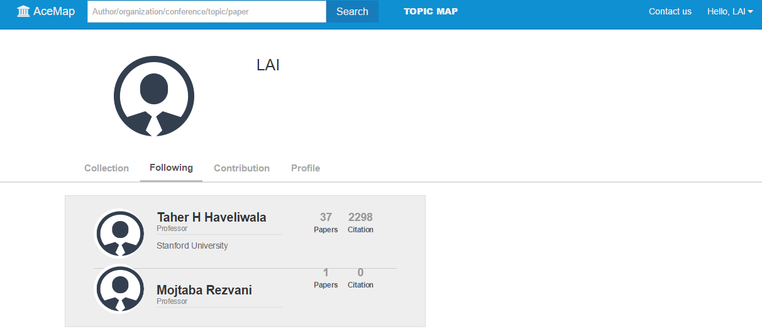
User Page

Slide 15
Outline
1
Why do we need to make acemap social
2
Socialization on acemap
3
Future work

Slide 16
Future Work
Recommend based on saved paper and comments
Paper list

Slide 17
Q&A

Slide 18
Thank you

