Slide 1
Social Crowdsourcing to Friends:
Fair and Efficient Multi-Resource Sharing
in Social Networks
Presented by Zhang Jian

Slide 2
OUTLINE
Introduction
Model Foundation
Resource Allocation of Idle Users
——Users Level
Task Distribution by Platform
——Platform Level
Simulation
Conclusion
1
Notes:
Then the outline of the paper is as follows. First introduction, then the author introduces the social crowdsourcing framework.
……

Slide 3
INTRODUCTION
The data is accumulated with an explosive speed and till 2017 the annual amount of global data will be 7.7 ZB.
So how to deal with it?
(apparently many tasks can’t be afford
by a single device)
1.Cloud computing
2.Social crowdsourcing
3.Others maybe…
2

Slide 4
INTRODUCTION
High maintenance costs & data/device centralization
(Cloud computing)
Massive potential & a large amount of idle resources
(social crowdsourcing)
clumsy
for scientific computing, collaborative sensing, etc.
efficient
3

Slide 5
INTRODUCTION
The major work of this paper is to build a credit market-based service framework to realize charge-free computing resource sharing in social networks.
How can we accomplish the system with no charge?
(Of course, taking no account of the maintenance cost or other expenses of labor)
4

Slide 6
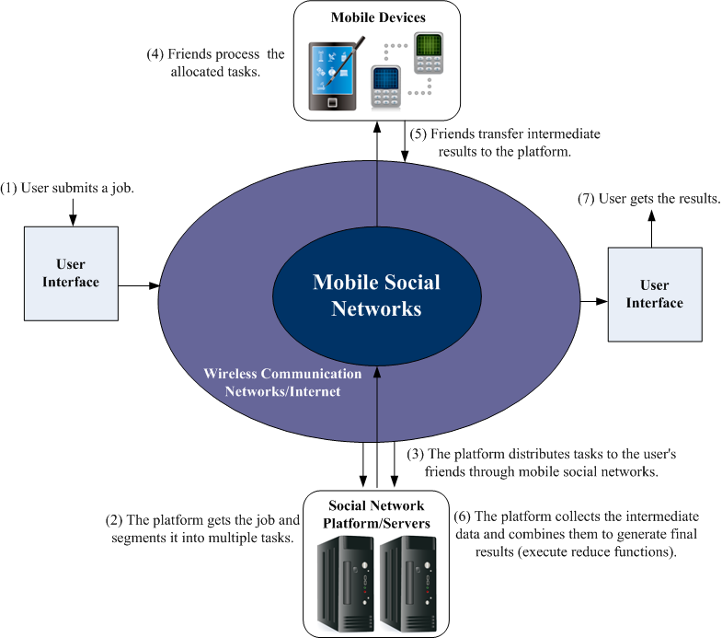
MODEL FOUNDATION
5
Notes:
In this paper, we only show the case where friends connect to the SNS platform through mobile devices. However, our scheme can also apply to wired connections and more traditional equipment like PCs and laptops as only a simplified version of this framework.

Slide 7
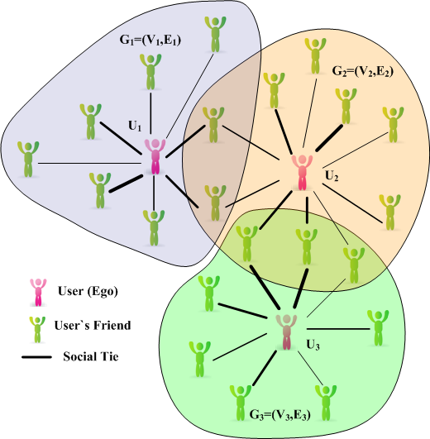
MODEL FOUNDATION
n users
Each user’s ego network is denoted by a graph
6
Notes:
Gi could be either directed or undirected, depending on the context. For example, real-world traces of Facebook provided in correspond to an undirected structure while the ego networks in Google+ and Twitter are mostly directed.

Slide 8
MODEL FOUNDATION
The set of users who have friendship with node v
The tie strength between v and U_{i}
User Ui’s demand for resource k per task
Node v’s idle resources within the sharing period
The credit system using symbol and
7
Notes:
Two assumptions for job division:
we assume that job division segments a job requirement into multiple small tasks requiring the same amount of resources.
2.we assume that job division segments job requirement in a way that each user’s single task consumes a similar cost.
users take a risk to provide the information of their idle resources to SNS platform. Moreover, sharing idle resources may deplete remaining battery power sooner than expected since most mobile devices today are battery-constrained. Furthermore, users may pay extra money for network overhead. And totally free service may cause the problem of “free-riding behaviour”

Slide 9
MODEL FOUNDATION
For the platform, they need to balance fairness (i.e. fair resource allocation) and efficiency (i.e. achieve workload balance)
The maximum number of tasks that Ui gets at node v
The amount of normalized resources that Ui receives from node v is
The concept of Dominant Resource Fairness (DRF)
8
Notes:
Briefly, DRF achieves the max-min fairness of users’ dominant shares (i.e., shares of their most highly demanded resource among all types)
However, the heterogeneity of users’ tie strength with friends could make traditional DRF undesirable.

Slide 10
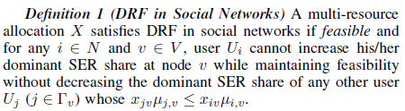
MODEL FOUNDATION
Fairness
DRF is not exactly fitted, we must introduce a new concept called SER (Socially Equivalent Resources) to modify it.
The amount of type-k SER share from v to Ui is
The dominant SER share required by user Ui to process one divided task at node v is
So the exact type-k resource is called dominant resource
9
Notes:
For instance,……
Generally, SER reflects users’ perceived amount of allocated resources from friends.
π(α(k)iv , ϕvi) is increasing with α(k)iv so that more real allocations can correspond to more SER shares, and this function also decreases with ϕvi to ensure that users having stronger ties with their friends can be allocated more real resources.
and then μivxiv is Ui’s total dominant SER share obtained at v.

Slide 11
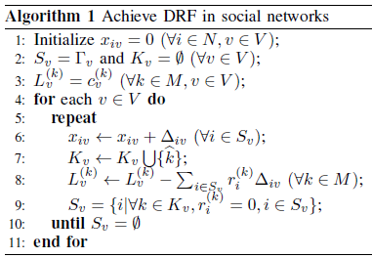
Resource Allocation of Idle Users
Here is a simple algorithm to calculate the task distribution.
The overall time complexity is O(|V|)
10
Notes:
Algorithm 1 constantly allocates an equal dominant SER share to all users who have social ties with v and do not use any saturated resources until all users have a bottleneck resource at v. In each “Repeat-Until” loop of node v, Kv is the set of resources that have been used up, Sv is the set of users who have social ties with node v and do not demand any saturated resources k ∈ Kv, and L(k)v is the left amount of idle resources of type k at node v

Slide 12
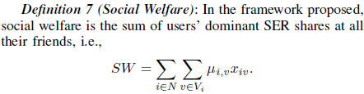

Resource Allocation of Idle Users
Efficiency
Proposition above demonstrates that the efficiency of DRF is relatively low, in terms of social welfare. So we introduce a new but similar concept called ε-DRF.
11

Slide 13

Resource Allocation of Idle Users
12
Notes:
Specifically, ϵ = 0 achieves the exact DRF while ϵ = maxv,i π(1, ϕvi) is efficiency-optimal.
To explain why ϵ -DRF can improve the efficiency, there is an example:

Slide 14
Resource Allocation of Idle Users
One instance:
Suppose node C has 18GB idle ROM and 9 units of CPU
C’s friend A requires <8GB ROM, 3-unit> per task
C’s friend B requires <1GB ROM, 3-unit> per task
C has social ties of the same strength with A and B, SER share is normalized by divided 2.
13

Slide 15
Resource Allocation of Idle Users
14
Notes:
Here we come to the results.
For ϵ = 0 ,the SER share result is <4/7,4/7>, because xac=9/7,xbc=12/7
Then the optimal SER share result is the intersection point of two constraint lines.
ϵ-DRF satisfies PE, but it is not always SI, EF, SP
So there is a tradeoff between fairness and efficiency

Slide 16
Simulation
A trace-driven simulation using the dataset from Facebook:
Ten user’s ego networks which partially overlap with each other, each user has hundreds of friends.
An undirected and weighted graph, and the edge weight is determined by 42 features via profile and the number of common friends.
10 Mobile phones: resources are CPU,RAM and ROM, even with power constraint.
15

Slide 17
Simulation
The figure shows the efficiency of the ε-DRF by observing the social welfare.
When ε reaches , the optimal result is obtained, then stabilized at the peak.
16
Notes:
Note that in our simulations, even traditional DRF is also relatively efficient (above 90% of the optimal result), which might be occasional due to the obtained traces.

Slide 18
Simulation
The figure shows the influence of ε on the allocation results. Apparently, larger ε sacrifices the social fairness.
17
Notes:
Here, my problem is whether the unfairness factor brought by the increasing of ε has a bad impact on social welfare due to the decreasing sharing aspiration?

Slide 19
Conclusion
Design a crowdsourcing service which fully utilizes the computing potential of mobile devices and social networks.
Design a low-complexity algorithm for idle resource allocation and workload distribution within social network.
The algorithm achieves a lot, not only the fairness, but also many ideal propositions.
Develop an extended demonstration to improve the efficiency at the cost of a certain degree of fairness.
18

Slide 20
Thank
You!

Slide 21
Q
&
A

