Slide 1
DeepDive and Crawler
Li Tianchu
Notes:
Hello everyone, I am litianchu and today I will introduce what projects I have done this term and how I achieve those projects to you .

Slide 2
Content
• Website of DeepDive
• Crawler
Notes:
What I have done this term is mainly center on two projects, one is DeepDive and another is Crawler for papers.

Slide 3
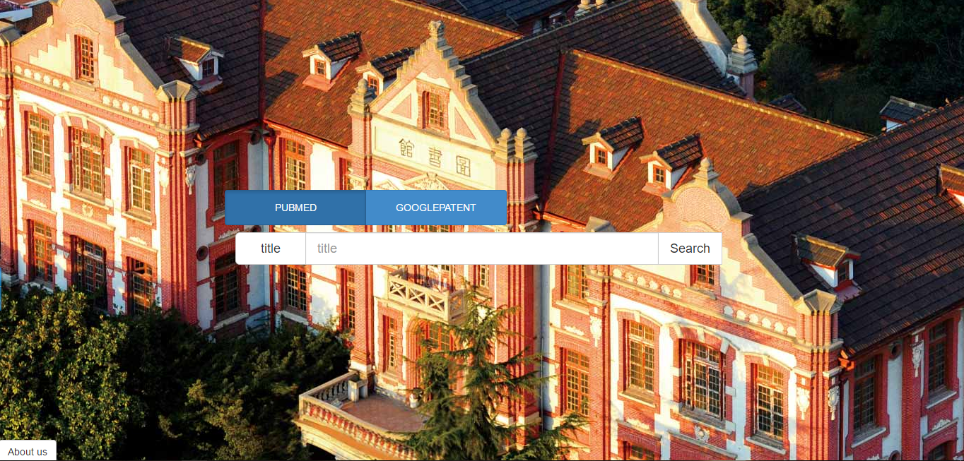
Notes:
As for deepdive, this is the home page of it and the basic function of it is to find out the paper you want from the available databases.
You can search the paper by title, author or catalog.

Slide 4
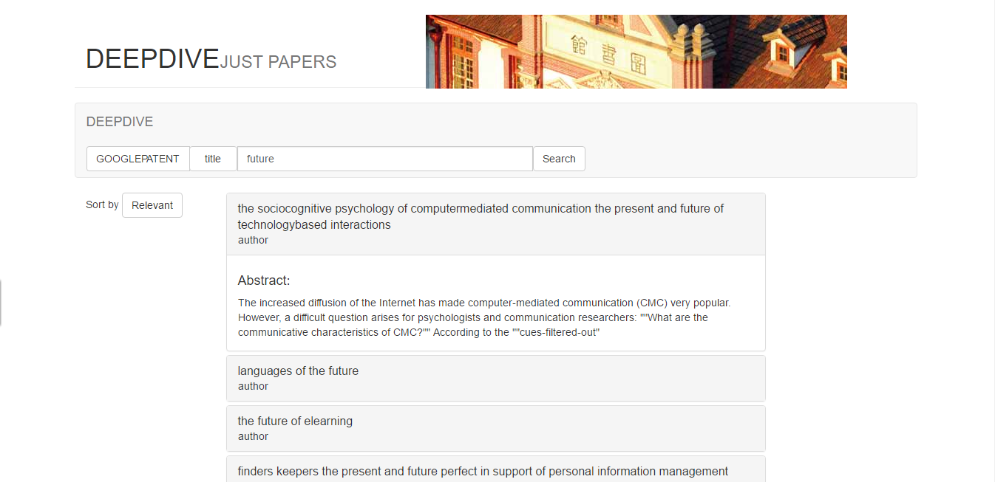
Notes:
You can put mouse on the title to see the abstract, click which you will enter the paper page.
Concerneing it is designed to be a simple website for paper search, I don’t add many other functions on the web and it just give the paper you want from the database, or in other words, is a visual database..

Slide 5
Tools used in DeepDive construction:
HTML, CSS for static page
Javascript for dynamic page
Web.py for web backend
Notes:
Here are the main tools I use to achieve these pages. Because I think it is easy for everyone here to build a such website in few weeks, I won’t keep on talking about DeepDive.

Slide 6
• Design for search engine
Crawler
• Plugin
• Convenient for distributed crawler
Notes:
Next thing I do, which the main thing I focus on is paper crawler. At the begin of this term, I work on crawler with Xue Yunfeng. At that time we choose Nutch, a famous general crawler frame written by JAVA, to crawl. Why we choose nutch is based on its characteristic. It is designed for search engine, which is just the main task of my group and almost two thirds of it is about search. Besides nutch has a lot of plug-ins to improve the accuracy of the crawler. What’more, it’s easy to combine nutch with Hadoop, hbase to realize distribute crawler. That make it efficient to collect millions of papers information.

Slide 7
Segment N
Crawl_generate
Crawl_fetch
Content
Crawl_parse
Parse_data
Parse_text
Generator
CrawlDB
Fetcher
Parse segment
CrawlDB update
LinkDB
invertlinks
LinkDB
Indexer
Lucene
index
Notes:
The principle of nutch is as this diagram shows.
In this flow chart,
CrawlDB stores urls to crawl.
LinkDB save source url and its derived urls.
Segments contain specific data

Slide 8
Disadvantages of Nutch
• Low speed
• Inaccuracy
• Hard to develop plug-in
• Hard to secondary develop
Notes:
However, during experiment, we find Nutch doesn’t work as ideal as expected. Because Nutch focus on distribute crawler with Hadoop (Hadoop will take a lot of time), it will be slower than single crawler when there are few slave machines. Besides, it has no API for accurate extraction plug-in and total API for plug-in is only six, most of which are for search part.

Slide 9
• Get url
• journal url
• paper url
• Webpage parser
• static page
• dynamic page
→ BFS
→ Tree structure
Notes:
So to improve the data quality, we then use python to write crawler instead of Nutch. In this case, there are two choice for us, one is use exsisting frame like scrapy, another is to write a crawler by ourselves and I choose the latter.

Slide 10
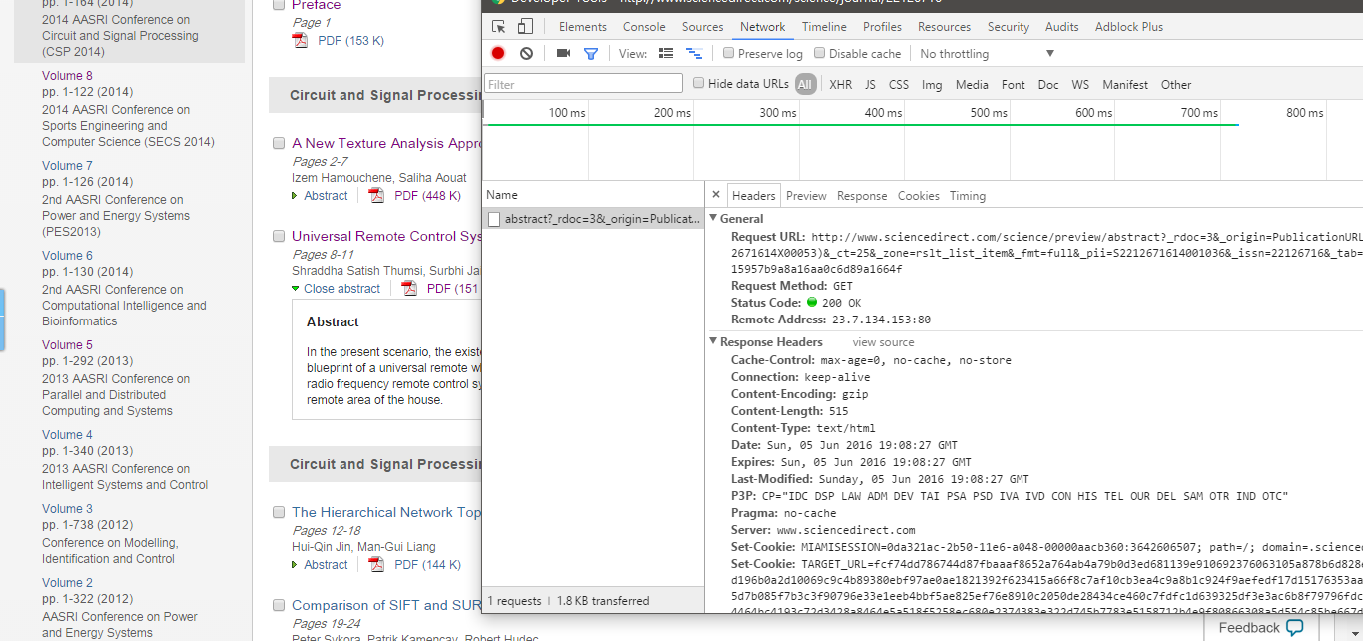

Slide 11
Tools used in python crawler:
Python library:
• re, beautifulsoup4, sys for page parser
• Queue, requests/pycurl for net request
• Gzip, threading, multiprocessing, for efficiency
Gevent, socket
• Json, redis, Postagedb for store
Notes:
Here are the main tools I use to achieve these pages. Because I think it is easy for everyone here to build a such website in few weeks, I won’t keep on talking about DeepDive.

Slide 12
How to accelerate a crawler
• gzip/deflate support
Notes:
Of course, just according to the basic principle to realize a crawler is bound to be at a low speed. The key of crawler is how to speed your crawler up while avoid ip blocked. If you use the simplest crawler, you will find that it is less than one hundred thousand paper crawled per day. That’s really unbearable. To accelerate our crawl, first we need to know what takes most time during crawl is network congestion of waiting for requests and response from the website. Other operation like parse will just complete in few millisecond So we can use gzip, a kind of compression. For example, with gzip, the response of the website I crawl will reduce by 70%, meaning that it will cost 30% of origin time to receive the response.

Slide 13
How to accelerate a crawler
• gzip/deflate support
• multithreading/asynchronous IO
Notes:
Gzip is the easiest way to raise the speed with lines of code, but its effect is slight.
To accelerate more, the most efficient way is multithreading. It like that to open many crawlers at the meanwhile, but the difference is that it cost less CPU and memory resource. Besides, asynchronous IO is also a great choice. As the name shows, asynchronous IO can switch to other coroutine named greenlet when the current greenlet meet IO congestion to gurantee that there are always greenlet running, and through experiments, it’s proved that speed using asynchronous IO is higher than using multithreading.

Slide 14
How to accelerate a crawler
• gzip/deflate support
• multithreading/asynchronous IO
• multiprocessing
Notes:
What’s more, because the standard thread of python don’t really support multi-core CPU. We can use multiprocessing to run crawler
on all cores of CPU. However, multiprocessing is seem to be not support asynchronous IO.

Slide 15
How to accelerate a crawler
• gzip/deflate support
• multithreading/asynchronous IO
• multiprocessing
• distribution
Notes:
The final way I use is distribute crawler. In brief, the simplest distribute crawler is just crawl url in master, then distribute these urls to slaves to parse and store data in database. To realize the distribute crawler, I use redis to store urls and postagedb to store the data. What’s more, I use bloom filter for url deduplication. It bases on hash and can find whether url already in set with time complexity of 1.

Slide 16
How to avoid being banned
• Disguise as a browser
• Use proxy
• ……
Notes:
Disguised as a browser by changing the request headers you send to website to be the same as a real browser performs. Or you can just use procxy to cover your ip. And the most effective way is to make crawler act as a human, but this can realize at a low speed. After all, no one can visit a website one hundred times per second.

Slide 18
Q & A

