Slide 1


Best strategy for location determination
徐冬
2016.5.27

Slide 2
Outline
Background
Former work
Our work

Slide 3
Outline
Background
Former work
Our work

Slide 4
Background
Fingerprint localization
AP selection
Notes:
Fingerprint 欧式距离 选哪些AP好
Firstly, I will show you the background of this strategy. In this paper, author used the fingerprint localization. That is, we first establish a database using the fingerprint. We choose a room as our experiment environment with several aps. We divided the room into many sections and put the mobile phone in each section to get the rss value of different places. The mobile phones all have applications to get the rss. In the localization phase, users with mobile phones also have a rss from different aps. We calculate the Euclidean distance between the mean value of the rss and the database, While the nearest place is where the user is localized.
However, collecting the training data from all possible Aps could be laborious and expensive for any single entity, moreover ,how the fingerprints from those Aps in unknown locations can be utilized to achieve the most accurate location determination is challenge.

Slide 5
Outline
Background
Former work
Our work

Slide 6
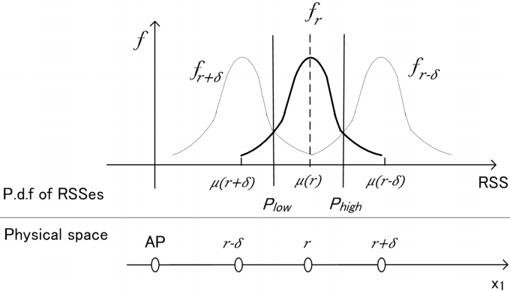
Former work
Localization in one-dimensional space
Fig. 1. Integration domain for one-dimensional localization with single measurement for single AP.
Notes:
主要介绍如何确定定位位置和reliability one ap one measurement
We come to the localization in one-dimensional space. What the figure shows is single ap with single measurement. We have learned in the principle of communication, the distribution of signal is Gaussian. As shown in the figure, the rss between Plow and Phigh is localized in the location r.Because in this region , the probability of being localized in the place r is larger than any other place. if we do the integration we can get the reliability.

Slide 7

Former work
Localization in one-dimensional space
Notes:
This is how we calculate the reliability.

Slide 8


Former work
Localization in one-dimensional space
  By the rule of MLE, the event that the system will estimate the user to be in Q is:
ALL outcomes in E satisfy the following inequality:
Notes:
One ap multiple measurement 式子：expression / formula
Next is the single ap with multiple measurement case. Q is the region centered on the right point with radius delta. Same principle as the last figure.
Then we will simplify the calculation using the coordinate rotation based on this inequality.

Slide 9
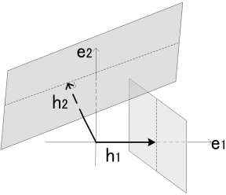

Former work
Localization in one-dimensional space
Notes:
Rotate the coordinate 原本是phigh和Plow间积分，现在h1 h2以后就在e1和e2上面积分

Slide 10
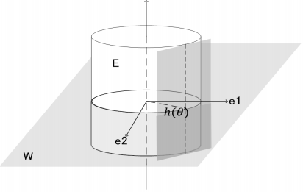
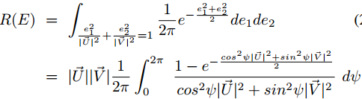
Former work
Localization in two-dimensional space
Notes:
多个AP，相当于把Phigh和Plow旋转，得到圆柱 cylinder

Slide 11

Former work
Best strategy
Consider the intersection between event E(c) and event E(hyper-cylinder)
Notes:
U is the accuracy
Now

Slide 12

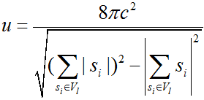
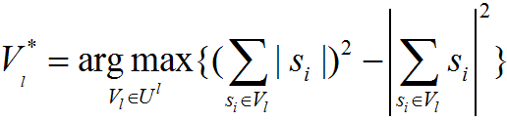
Former work
Best strategy
Let {AP_{i}} be the set of all APs that can be sensed by the users’ mobile device, and we use complex parameter
to characterize APi
Notes:
U is the accuracy
The question is how to choose the best L APs from all the m Aps denominator分母

Slide 13
Outline
Background
Former work
Our work

Slide 14
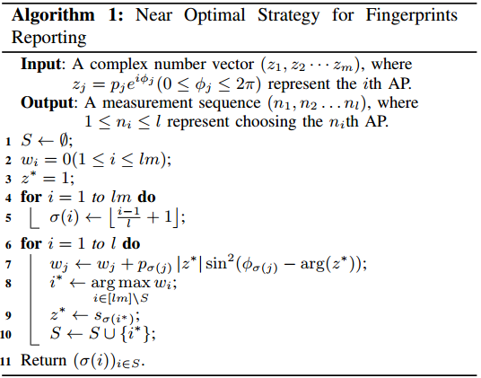
Our work
Algorithm

Slide 15
Our work
Algorithm
  It's totally an original theoretical work.
  In our proof, we take advantage of objective function‘s super modularity and some other interesting properties.
  We prove that the approximation ratio of our algorithm is a constant.

Slide 16
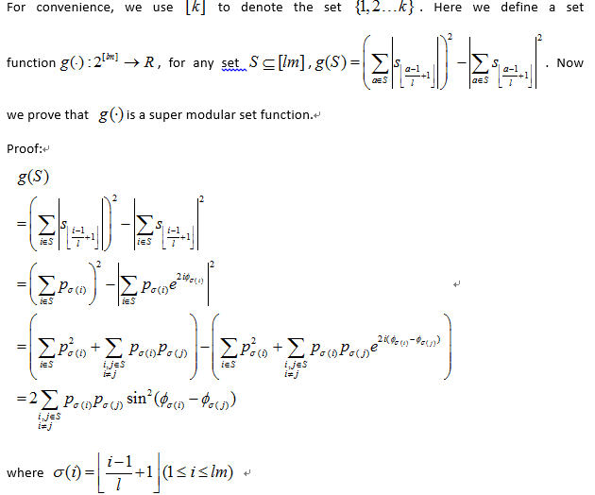
Our work
Sketch of the proof

Slide 17
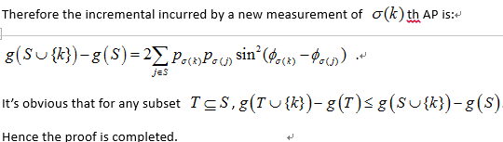
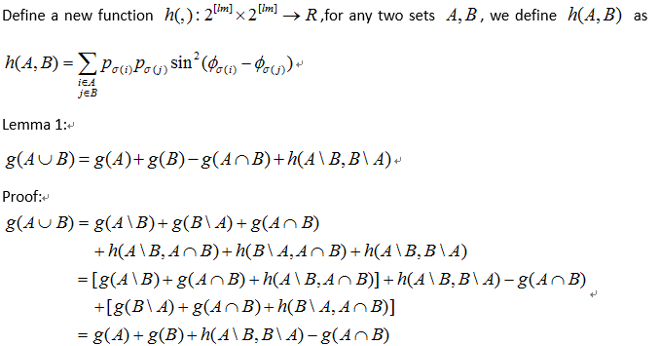
Our work
Sketch of the proof

Slide 18
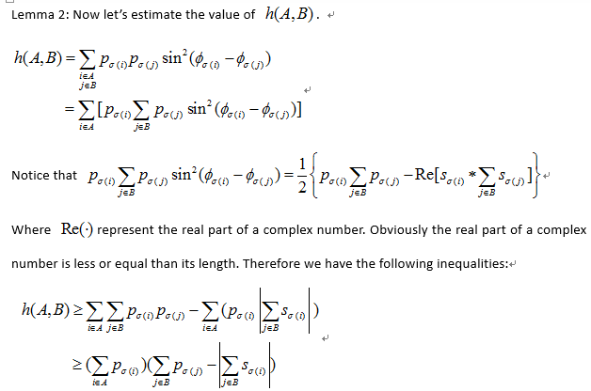
Our work
Sketch of the proof

Slide 19

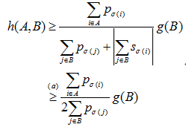
Our work
Sketch of the proof

Slide 20
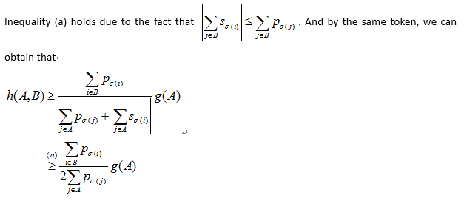
Our work
Sketch of the proof

Slide 21
Our work
Going on
  Experiment
  Paper writing
Future plan
  Submit to TMC

Slide 22
Thanks!
Q&A

