Slide 1
Optimization of Information Diffusion in Mobile Social Network Using Community Structure
Wenyu Zhang
From Social Network Group
5130309496

Slide 2
Outline
Background and Motivations
Model and Problem Formulation
Mobile Social Network Model
Independent Cascade Diffusion Model
Main Problem: Influence Maximization
One Reasonable Method
Community Detection
Supportive Reasons
Evaluation Index of the Method
Summary
Future Work
References
Notes:
This this my outline.
I will focus on the model formulation and support of my method, which is community detection.

Slide 3
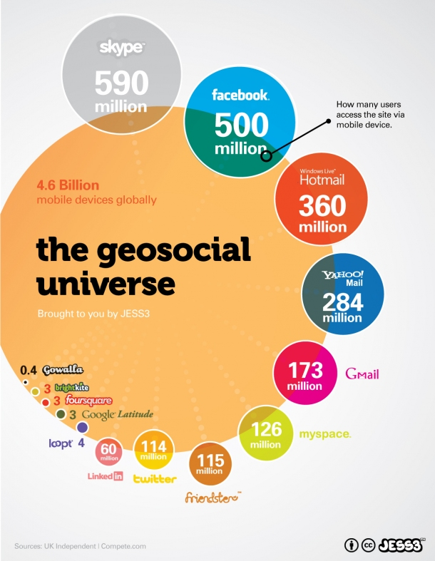
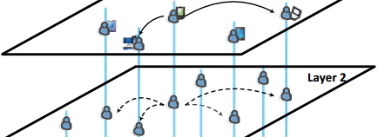
Background and Motivations
Two Main Evolutions
Online social network
(large scale geosocial network)
Proliferation of smart mobile devices
(high mobility in social and physical scale)
Notes:
First of all, let’s take a look at the background.
1.Nowadays, social networks have been evolving to online social networks such as Facebook, Twitter, and from this graph we can see more and more people using online social network to communicate with each other.
2. With the proliferation of smart mobile devices, the mobility and geolocation should be taken into consideration.

Slide 4
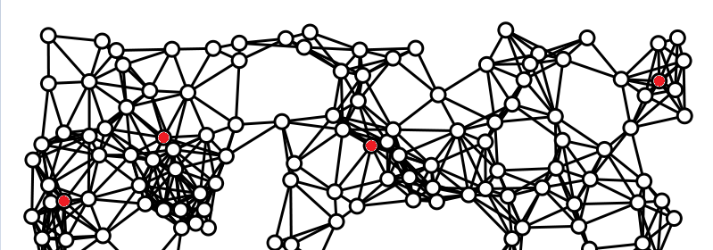

Background and Motivations
A Marketing Motivation
A company has an innovation to propagate
Select $k$ nodes on OSNet as seeds who originally take the message
More nodes receive the message -> more profits to get
Notes:
Assuming that a company want to spread a message of their innovative product to people.
They can only have a certain number of seeds who firstly know the innovation.
Here comes a problem: which nodes should be chosen as nodes to maximize the influence, which is closely related to their profits.

Slide 5
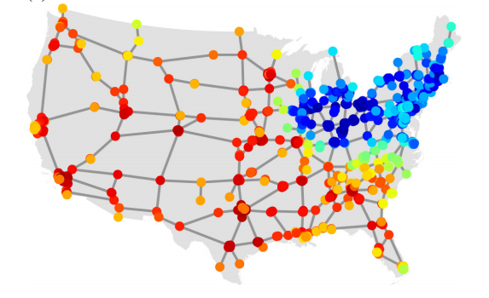
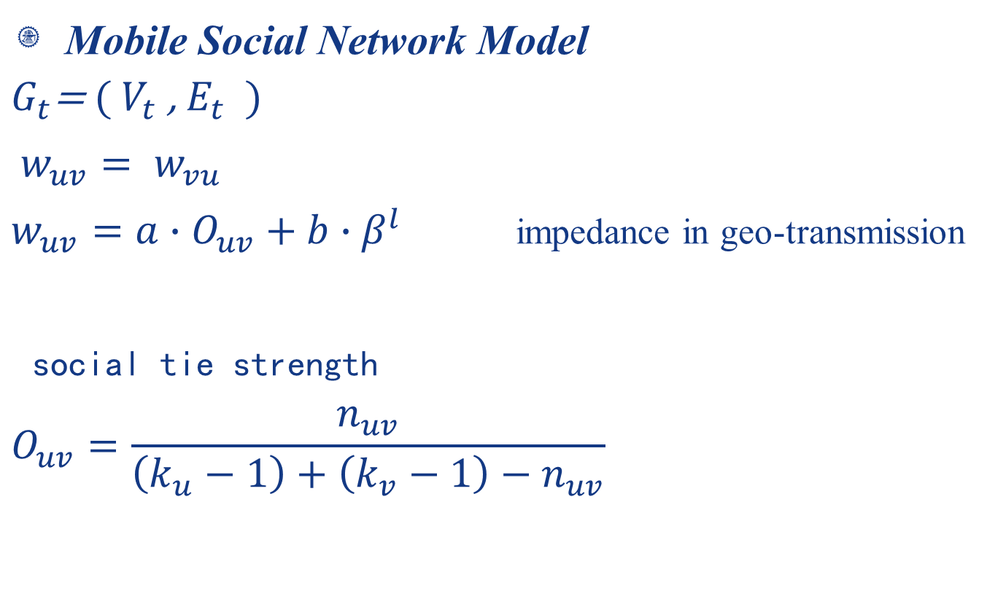
Model and Problem Formulation
Mobile Social Network Model
$$G_{t}\text{= }\text{(} V_{t} \text{,} E_{t} \text{ )}$$
$w_{uv}= w_{vu}$
$w_{uv}={{a∙O}_{uv}+b∙β}^{l }$ impedance in geo-transmission
social tie strength
$$O_{uv}=\frac{n_{uv}}{\left(k_{u}−1\right)+\left(k_{v}−1\right)−n_{uv}}$$
A new definition of weight
Notes:
Gt is a dynamic geo-social graph at time step t
$β$: damping parameter
$l$: geo distance between node $u,v$
$O_{uv}$: the strength of social tie, which may represent the frequency of contacts between two users
As the result of big data analysis, the stronger the tie between two users, the more their friends overlap, a correlation that is valid for about 95% of the links.
where nuvis the number of common neighbors of u and v, and ku (kv) denotes the degree of node u(v)

Slide 6
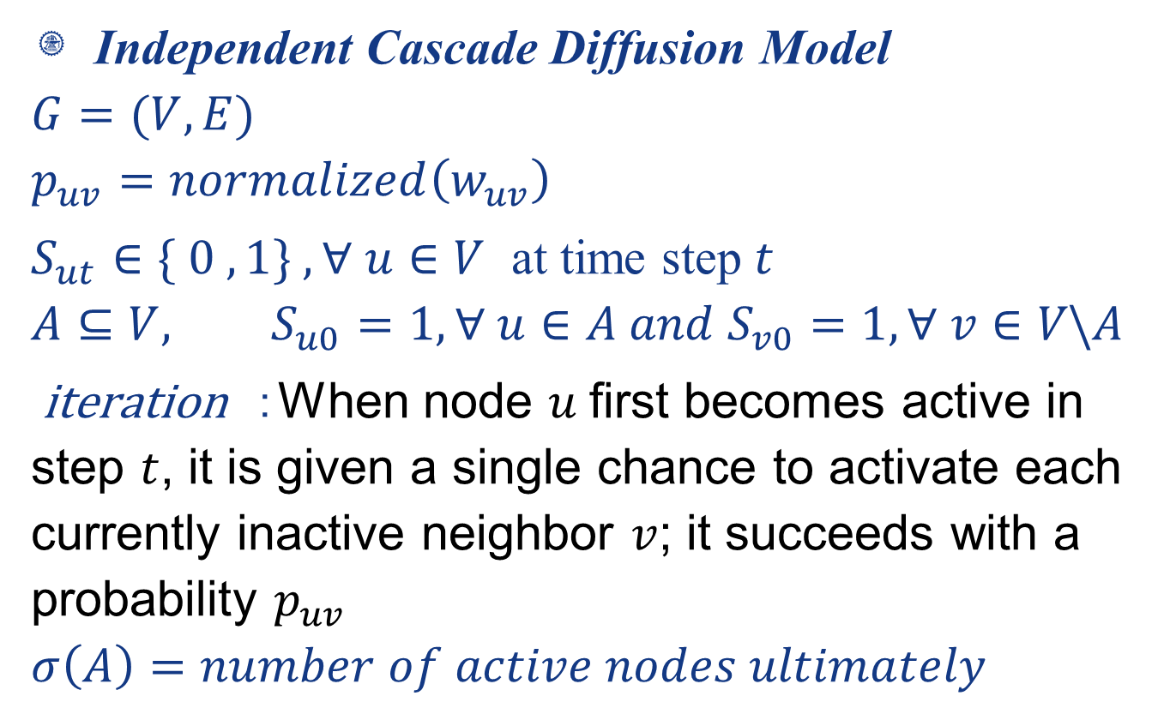
Model and Problem Formulation
Independent Cascade Diffusion Model
$$G=(V,E)$$
$$p_{uv}=normalized\left(w_{uv}\right)$$
$S_{ut}∈\{ 0 , 1\} , ∀ u∈V$ at time step $t$
$$A⊆V, S_{u0}=1,∀ u∈A and{ S}_{v0}=1,∀ v∈V\backslash A$$
iteration :When node $u$first becomes active in step $t$, it is given a single chance to activate each currently inactive neighbor $v$; it succeeds with a probability $p_{uv}$
$$σ\left(A\right)=number of active nodes ultimately$$
Notes:
This is the model of our diffusion.
Sut is the state of node u at time t, which can be either 0 or 1. 0 represents inactive and 1 represents active
Initially, there are some nodes active as seeds. And at every time step, the new active nodes spread messages to their inactive neighbors with only one chance, which had success probability of puv.
And this function is…, which represents the influence extent

Slide 7
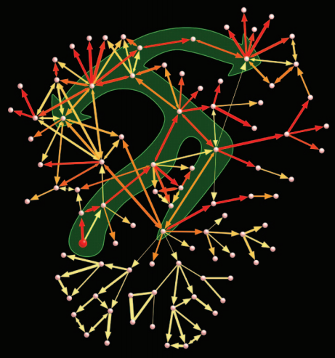
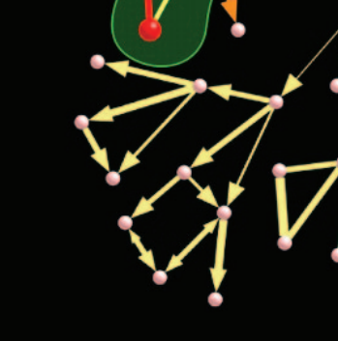
Model and Problem Formulation
Independent Cascade Diffusion Model
Notes:
Here is part of the diffusion process. The arrow represents the direction of message transmission. And one node may have more than one chance to be activated,

Slide 8

Model and Problem Formulation
Main Problem: Influence Maximization
Given $G_{t}\text{= }\text{(} V_{t} \text{,} E_{t} \text{ )}$ and number of initially active nodes $\left|A\right|$
Targeting $A$, to maximize $σ\left(A\right)$
NP hard
Notes:
Based on the model formulated before, our main problem is to target A in the whole network, and then maximize$σ\left(A\right)$
This is a NP hard problem, which is very complicated.
There have been some approximation algorithms like greedy algorithms trying to significantly reduce the complexity of targeting on the premise of influence assurance.

Slide 9
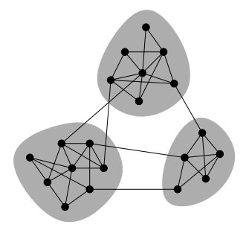
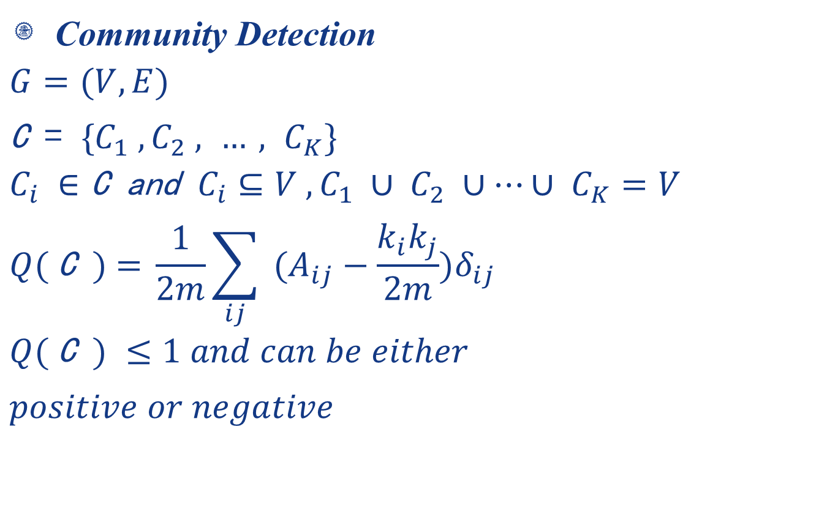
One Reasonable Method
Community Detection
$$G=(V,E)$$
$\text{C} \text{= }\text{\{}C_{1} , C_{2} , …, C_{K}\}$
$$C_{i} ∈\text{C} \text{and} C_{i}⊆V ,C_{1} ∪ C_{2} ∪…∪ C_{K}=V$$
$$Q( \text{C} \text{) = }\frac{1}{2m}\sum_{ij}{ (A_{ij}−\frac{k_{i}k_{j}}{2m})δ_{ij}}$$
$$Q( \text{C} \text{)} ≤1 and can be either$$
$positive or negative$
Notes:
Different from those algorithms. I come up with the idea that we can use community detection to optimize the influence maximization problem.
Community detection is dividing the nodes into some communities, nodes in the same community have closer relationships

Slide 10
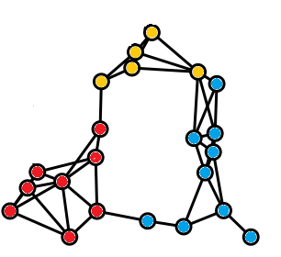
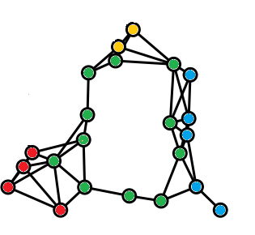


One Reasonable Method
Community Detection
Meaning of evaluation index$Q( \text{C}\text{ )}$
high $Q( \text{C}\text{ )}$ | low $Q( \text{C}\text{ )}$
more edges in communities(intra-community links) | more edges between communities(inter-community links)

Slide 11
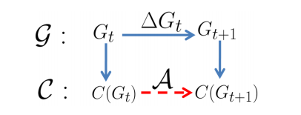
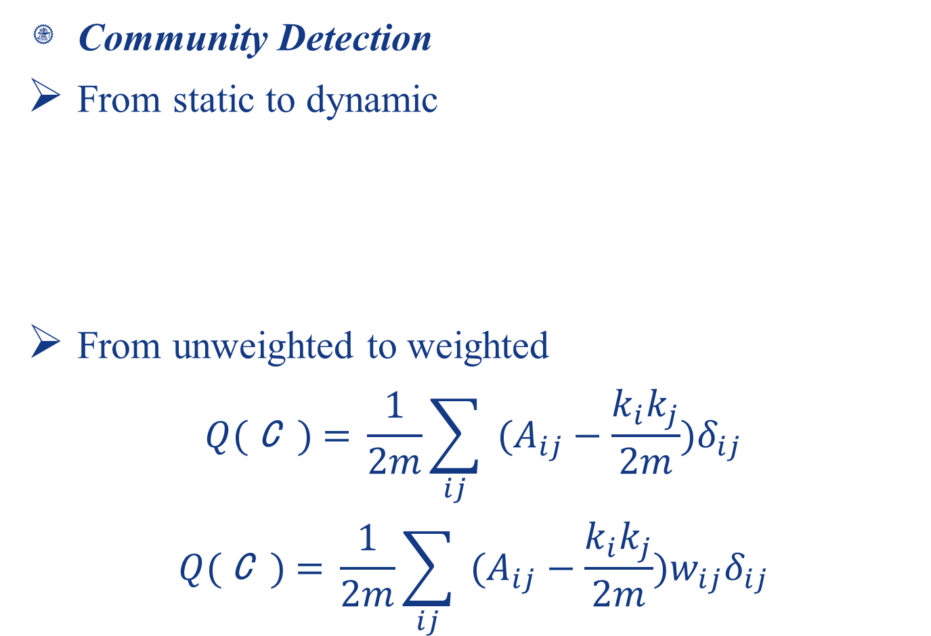
One Reasonable Method
Community Detection
From static to dynamic
From unweighted to weighted
$$Q( \text{C} \text{) = }\frac{1}{2m}\sum_{ij}{ (A_{ij}−\frac{k_{i}k_{j}}{2m})δ_{ij}}$$
$$Q( \text{C} \text{) = }\frac{1}{2m}\sum_{ij}{ (A_{ij}−\frac{k_{i}k_{j}}{2m})w_{ij}δ_{ij}}$$
Notes:
To adapt to the mobile social network, we should consider the dynamic and weighted circumstance

Slide 12
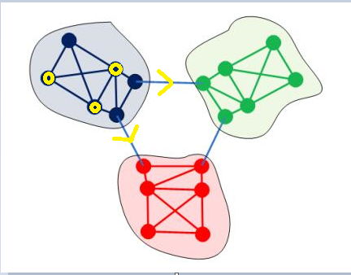
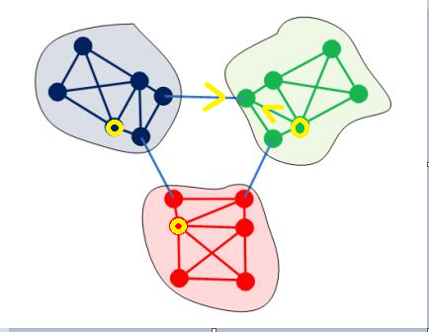
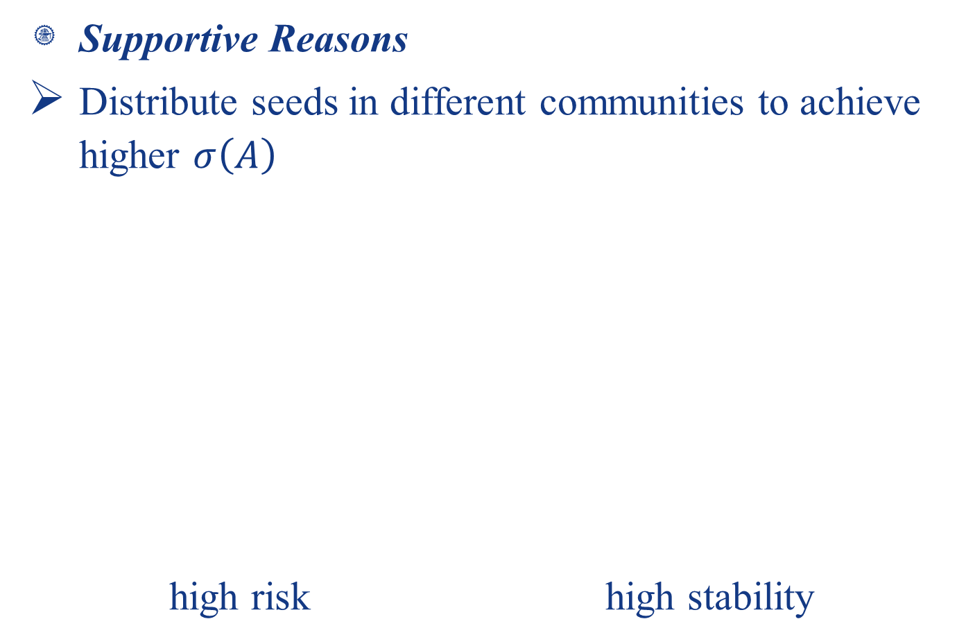
One Reasonable Method
Supportive Reasons
Distribute seeds in different communities to achieve higher $σ\left(A\right)$
high risk high stability
Notes:
We should let most of inactive nodes have more chances to be activated.
In the left graph, all three seeds are in one community, as we already know, the ties between communities is weak ties because of low weight, so there is a high probability that message can’t transfer to the other two communities, which means all the nodes in the left two communities is impossible to be activated.
The targeting of the right graph is much more stable.

Slide 13
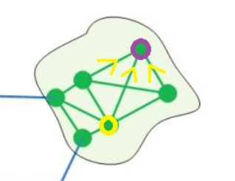
One Reasonable Method
Supportive Reasons
More intra-community links, means more chances to get activated

Slide 14
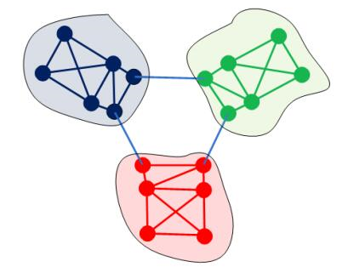

One Reasonable Method
Supportive Reasons
smaller targeting scale
$O(N^{k})$ $3∙O({\left(\frac{N}{3}\right)}^{k})$ $i^{1−k}$
Notes:
Reduce the complexity of targeting if k>1

Slide 15
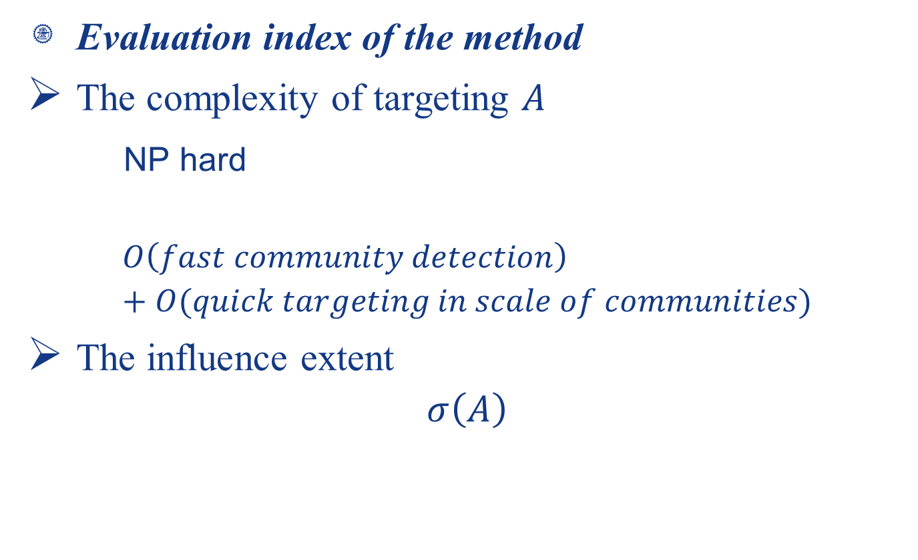
One Reasonable Method
Evaluation index of the method
The complexity of targeting $A$
NP hard
$$O\left(fast community detection\right)+O(quick targeting in scale of communities)$$
The influence extent
$$σ\left(A\right)$$
Notes:
As the problem of finding the most influential nodes is NP hard, we come up with the idea that we first use the heuristic algorithm to make fast community detection, and then use another algorithm to make quick targeting in every community, which has a much smaller searching scale than the whole network. We can further analyze the sum of the complexity of this two approximation algorithms, which is definitely less than NP hard.
We also need to examine the validation of our method, which can be formulated as given the number of originally active nodes, we should use less time to activate all the nodes in the network or activate more nodes in a certain time period.

Slide 16
Summary
Two main parts of my work
A diffusion model in mobile network which considers both social tie strength and geo-transmission impedance
Using community detection as a reasonable method to solve the NP-hard influence maximization problem
Notes:
To conclude, two characteristics can distinguish my work from former researchers.
First, I …, which can make the model more realistic
Second, I come up with the idea of using community detection…

Slide 17
Future work
Algorithms
Experiments
Other circumstances (e.g. overlap of communities)
Other diffusion problem (e.g. influence maximization with time limit/time minimization)
Notes:
Algorithms for community detection and targeting in community
Experiments with realistic network data

Slide 18
References
[1] Nam P. Nguyen, Thang N. Dinh, Ying Xuan, My T. Thai “Adaptive Algorithms for Detecting Community Structure in Dynamic Social Networks” in INFOCOM
[2] J.-P. Onnela, J. Sarama ki, J. Hyvo nen, G. Szabo, D. Lazer, K. Kaski, J. Kerte ´sz, and A.-L. Baraba ´si
“Structure and tie strengths in mobile communication networks” in PNAS
[3] David Kempe, Jon Kleinberg, Ev ´ a Tardos “Maximizing the Spread of Influence through a Social Network” in ACM
[4] M. E. J. Newman “Modularity and community structure in networks” in PHYSICS
[5] Dashun Wang, Dino Pedreschi, Chaoming Song, Fosca Giannotti, Albert-László Barabási “Human Mobility, Social Ties, and Link Prediction” in ACM

Slide 19

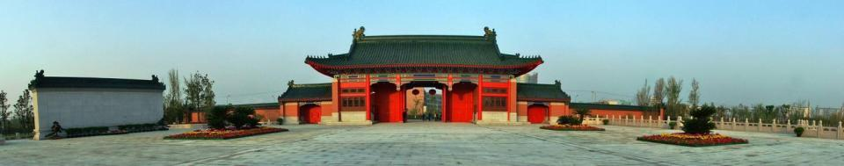

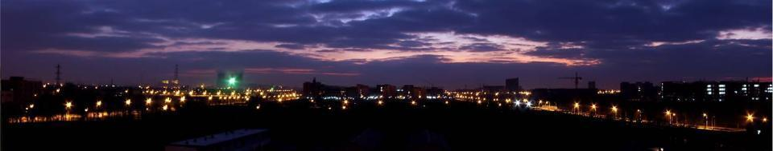
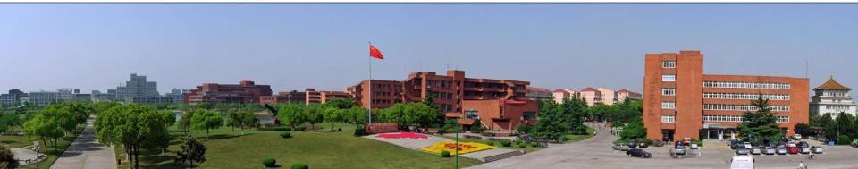
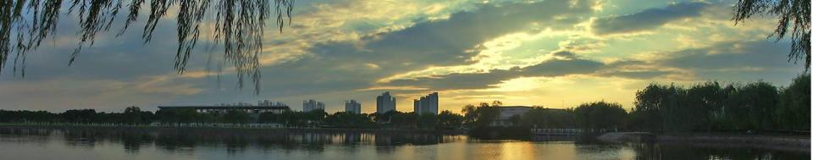
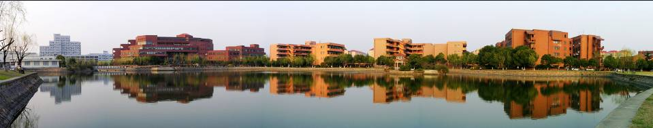

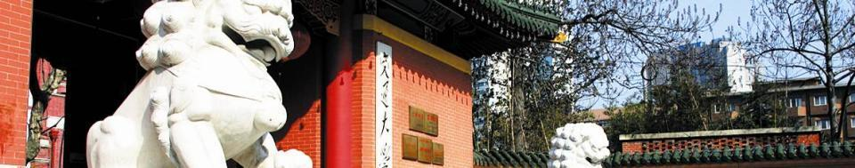
Thank you！

