Slide 1
Make Pages Practical
effective Improvements on website pages
Sun wei 5130309115
Notes:
Make pages practical.
Our website has been built for nearly 2 years. However, there are still many defects.
In this terms, we have focused on many effective improvements on the website pages to make it easier to use in different aspects.

Slide 2
OUTLINE
Web Security
New User page
Evaluation Index
Comments and Scoring System
Info. Visualization

Slide 3
OUTLINE
Web Security
New User page
Evaluation Index
Comments and Scoring System
Info. Visualization

Slide 4
Web SEcurity
SQL Injection Attack
Nefarious SQL statements are inserted into an entry field for execution
Example:
Accept a variable from user such as $variety = $_POST['variety’]
Insert the variable into a SQL statement: $query = "SELECT * FROM Authors WHERE AuthorName='$variety’
Submit the query and return the result
When user inputs Xinbing Wang‘ or 1=‘1, the dangerous SQL statement is
SELECT * FROM Authors WHERE variety=‘Xinbing Wang’ or 1= ‘1’ .
Notes:
We do many query on the Acemap and it is important to prevent sql injection attack, which inserts nefarious sql statements into an entry field for attack.
We can understand it by a simple example. It is normal query, transmitting the variable to the statement to get the result.
But when we use such a variable and you can get such a statement. This part is always true.
If this is delete, update instead of select, there will be a disaster。

Slide 5
Web SEcurity
A real attack
Injection Point:
http://acemap.sjtu.edu.cn/author/page?AuthorID=8191A61F
Use an application and command
sqlmap -u "http://acemap.sjtu.edu.cn/author/page?AuthorID=8191A61F" --dbms=mysql --users –password
Get password:
password hash: *B0CDA9B76CD7126F61078F34AC32CB009A34C38E
66666
password hash: *CA152FE89A4802A433254162E1AF06A16FB2531D
wikipedia
Notes:
We tried a web application to attack the author page and get such information.

Slide 6
Web SEcurity
Prevent the potential risk of SQL Injection Attack by filtering the query
Need to eliminate more security vulnerability to improve the security of Acemap in the future work
Notes:
Filter the query especially single quote. Maybe we have not considered of all conditions so we still need to eliminate more security vulnerability to improve the security of Acemap in the future work

Slide 7
OUTLINE
Web Security
New User page
Evaluation Index
Comments and Scoring System
Info. Visualization

Slide 8
New user page
Modify avater
More info. about user
Paper details
Count of Citations and favors
Notes:
We have implement new user page with different style as a trial.
The user page before is too simple and not elegant. And we use a new style to rebuild the user page.
Show more information of user in a good layout
Many details need to be improved in the next step and we are going to apply the style of user page to other pages

Slide 9
OUTLINE
Web Security
New User page
Evaluation Index
Comments and Scoring System
Info. Visualization

Slide 10
Evaluation INdex
Science Citation Index(SCI)
Including world's leading journals of science and technology, because of a rigorous selection process
Preferring natural science and creative work
Covering 3746 Journals this year
EI Compendex
Indexing scientific literature pertaining to engineering materials
Covering 4895 sources (16/04/25)including journals, conferences and trade publications which can only be matched less than 60% in our database.

Slide 11
Evaluation index
Computing the data online with optimized SQL statement
Viewing data dynamically
EI may be not precise
Need more precise data support by crawlling the website.
Notes:
Computing the data online with optimized SQL statement. It is not slow.

Slide 12
Evaluation index
J-Index
Our unique evaluation index
The value is quite unbalanced and not easy to understand
Use rank percent to in all the IEEE papers which have J-Index more than 0
It is better to use J-Index to rank when recommending papers or sum up for each author
Notes:
We can observe the distribution of IEEE papers with J-index

Slide 13
Evaluation index
J-Index example

Slide 14
OUTLINE
Web Security
New User page
Evaluation Index
Comments and Scoring System
Info. Visualization

Slide 15
Comment and scoring system
You can write comments and score the paper now!
Necessary components for a research community
Collecting feedback used for recommendation

Slide 16
OUTLINE
Web Security
New User page
Evaluation Index
Comments and Scoring System
Info. Visualization

Slide 17
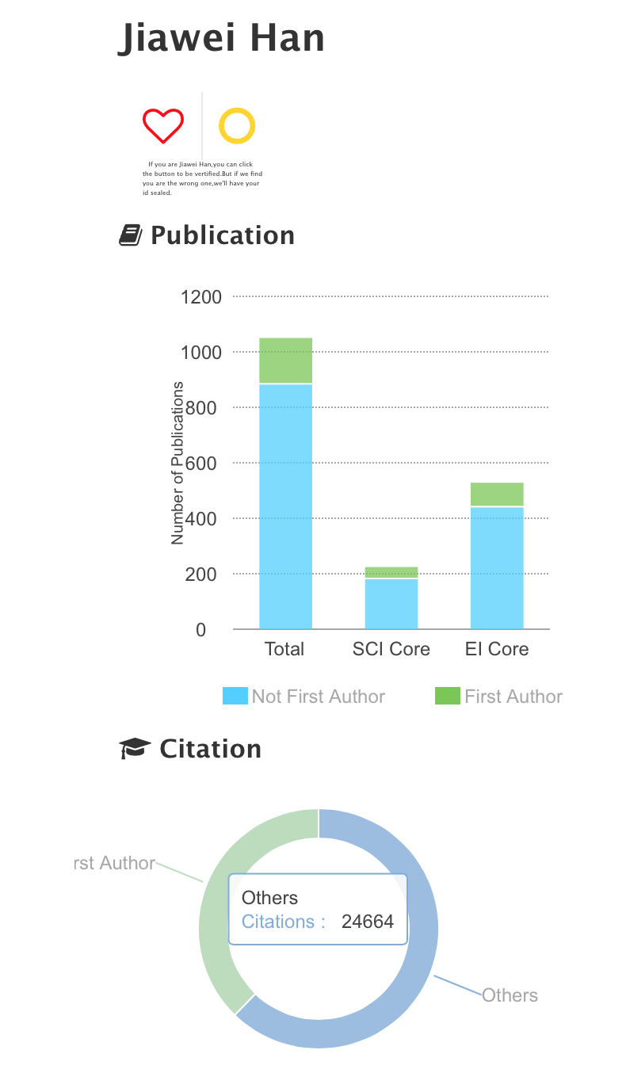
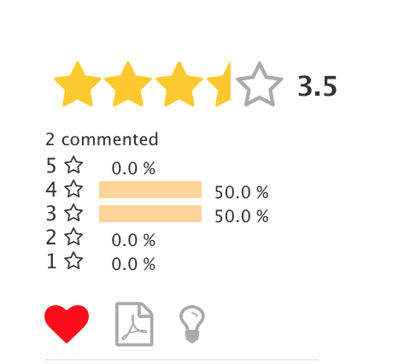
info. visualization
Notes:
These are all very important. Otherwise the page will seem boring.

Slide 18
COnclusion
Improve websites in many aspects to be more practical
Need to optimize the system in many aspects
Speed up the response time
Unify style of different pages
Complete every function in details
Add component to record users’ trails in Acemap
There is still a long way to go for the whole system
Notes:
There is still a long way to go for the whole system and we should keep on making Acemap better and better

Slide 19
Q&A

Slide 20
Thank You!

