Slide 1
Exploring the Dependency Relationship Among Topics
Junxian He
05/24/16

Slide 2
What’s the dependency relationship
How does it work in a corpus
Why does it matter
Notes:
I think this title will raise 3 questions
What features can we utilize to uncover this dependency relationship
Why does it matter
1.
First, the dependency relationship, it is very easy to understand since the phenomenon that often occurs.
2.
How does it work, As Newton says, we stand on the shoulders of giants, When we write a paper, we often cite many references, or our work depends on these previous work. Therefore, this dependency relationship pattern is naturally hidden in this citation network.
3.
Why does it matter, interesting, it’s easy for a researcher to get started in a new field,

Slide 3
Robot Navigation
Robot Navigation
Robot localization
Robot motion planning
Pattern recognization

Slide 4
Outline
Introduction
Model & Inference
Experiment
Future Work
Notes:
Simple introduction about some basic knowledge in our work, it might help you understand our work

Slide 5
Two kinds of clusters
Translation
Machine
Statistical
System
Evaluation
Systems
Abstract
language
Moses: Open Source Toolkit for Statistical Machine Translation
Minimum Error Rate Training In Statistical Machine Translation
Bleu: A Method For Automatic Evaluation Of Machine Translation
Statistical Phrase-Based Translation
What’s the relationship？
Notes:
I would like to call this kind of topic word-topic, and the other doc-topic.
But what’s the relationship between them. Actually, I gave a very special example here since the two topics are very similar, but given 100 word-topics and 100 citation-topics, how can we automatically describe the relationship.
OK, maybe you are a little confused why I talk about this, because the dependency between topics is not between two word-topics but between word-topic and doc-topic. In fact, this setting is more effective since we can not only catch the dependency between topics. On the other hand, such a setting can build a bridge between words and documents so we can carry out other tasks like recommendation

Slide 6
Dependency between word cluster and document cluster
Doc-topic:
Robot Navigation
Word-topic:
Robot Navigation
Doc-topic:
Robot localization
Doc-topic:
Robot motion planning
Doc-topic:
Pattern recognization

Slide 7
Outline
Introduction
Model & Inference
Experiment
Future Work

Slide 8
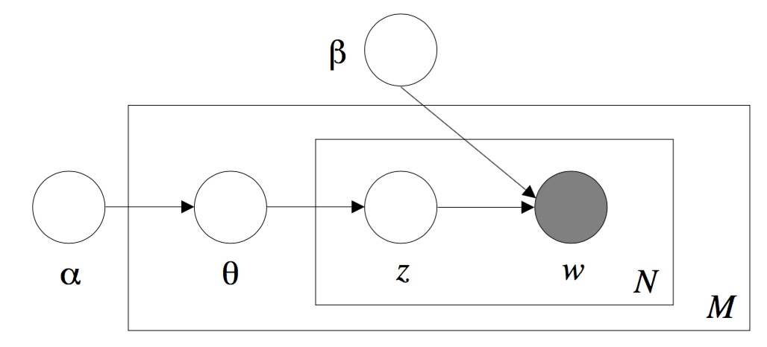
Model
LDA

Slide 9
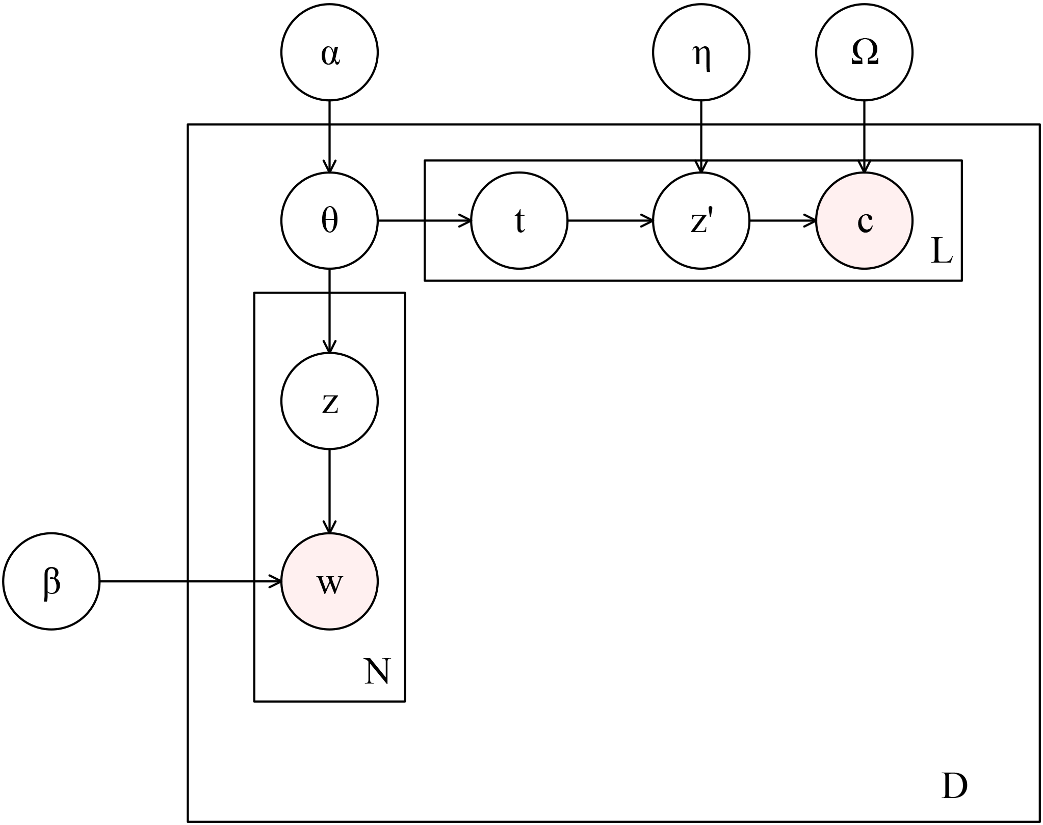
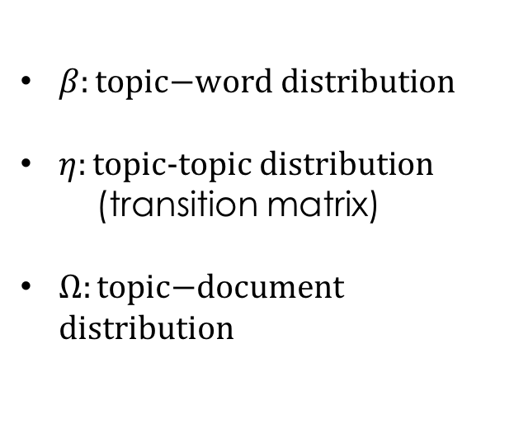
Our model: Dependency-LDA
$β:\text{topic}\text{−}\text{word} \text{distribution}$
$η:\text{topic}\text{−}\text{topic} \text{distribution}$
(transition matrix)
$Ω:\text{topic}\text{−}\text{document} \text{distribution}$
Notes:
When an author cites references, he comes up with a word topic first, the word-topic is t, and he finds a citation-topic z in terms of t. And finally the citation-topic determines the citations.
Eta is very crucial in our model, it is used to quantify the relationship between word-topic and citation-topic. OK, in the next several slides I will illustrate why eta can be used to explore the co-occurrence pattern.
You now undertand our title
Question

Slide 10
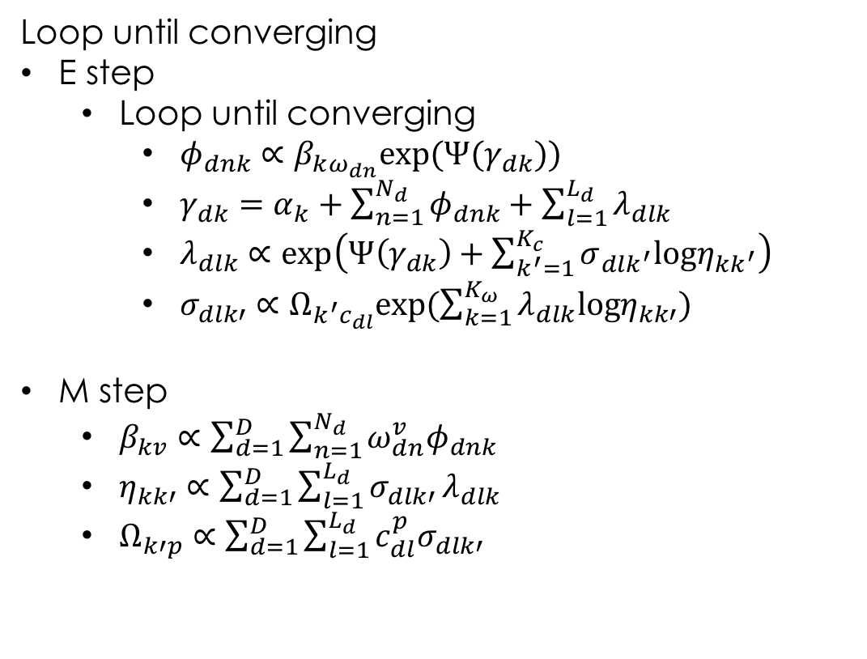
Variational EM procedure
Loop until converging
E step
  Loop until converging
    $φ_{dnk}∝β_{kω_{dn}}\text{exp}\text{(}Ψ(γ_{dk}))$
    $γ_{dk}=α_{k}+\sum_{n=1}^{N_{d}}{φ_{dnk}+\sum_{l=1}^{L_{d}}{λ_{dlk}}}$
    $λ_{dlk}∝exp\left(Ψ\left(γ_{dk}\right)+\sum_{k^{′}=1}^{K_{c}}{σ_{dlk^{′}}logη_{kk^{′}}}\right)$
    $σ_{dlk′}∝Ω_{k^{′}c_{dl}}exp(\sum_{k=1}^{K_{ω}}{λ_{dlk}logη_{kk′})}$
M step
  $β_{kv}∝\sum_{d=1}^{D}{\sum_{n=1}^{N_{d}}{ω_{dn}^{v}φ_{dnk}}}$
  $η_{kk′}∝\sum_{d=1}^{D}{\sum_{l=1}^{L_{d}}{σ_{dlk′}}λ_{dlk}}$
  $Ω_{k′p}∝\sum_{d=1}^{D}{\sum_{l=1}^{L_{d}}{c_{dl}^{p}σ_{dlk′}}}$
Notes:
Inefficient in time
Outer loop and inner loop
If you are interested in the inference, you can refer to some papers about variational inference and EM method.

Slide 11
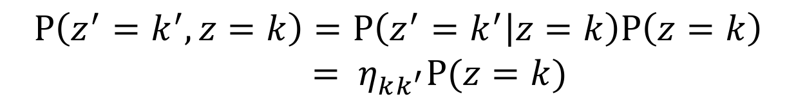
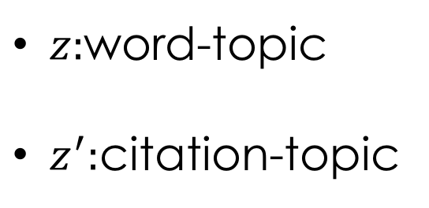
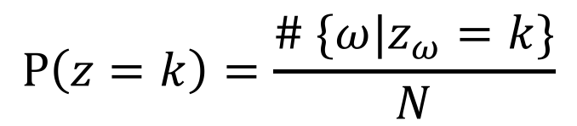
Co-occurrence probability
$z:$word-topic
$z^{′}:$citation-topic
$$P\left(z^{′}=k^{′},z=k\right)=P\left(z^{′}=k^{′} | z=k\right)P\left(z=k\right)$$
$={ η}_{kk^{′}}P(z=k)$
$$P\left(z=k\right)=\frac{\# \{ω|z_{ω}=k\}}{N}$$
Notes:
After we get eta, we can compute the co-coccurrency probability
What feature in the data can results in large eta. Obviously, in our training set, when the words in word-topic k occures in some documents, many of these documents cites the papers in citation-topic k'. In this case, we can obtain large nkk'.
From the mathematical perspective, we can compute the co-occurrence probability through very simple formular.
the numerator is the number of words assiged with word-topic k
Do you have any question？
OK，later I will also refer to this probability as dominance.

Slide 12
Outline
Introduction
Model & Inference
Experiment
Future Work

Slide 13
Experiment Setting
Datasets
  ACL Anthology Network(AAN) : Natural language process. 20989 documents and 125934 citations.
  CiteseeX: Computer and information science. 60000 documents and 50000 citations.
Experiments
  Dependency relationship between topics
  Quality of learned topics
  Link predictive ability
Notes:
Two datasets,
Our experiments mainly divided into three parts.
:identify
:recommend paper based on
:measure the link predictive ability of our model
First is the occurrence pattern, a figure

Slide 14
Notes:
White & black
Line Thickness
Size dominance importance
Group
frequent words
outer circles without any link to other nodes

Slide 15
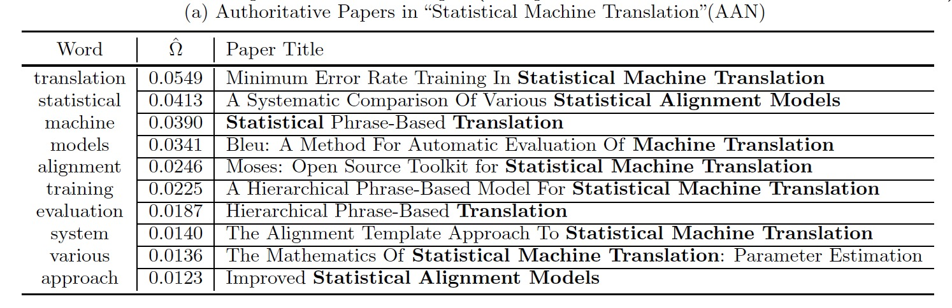
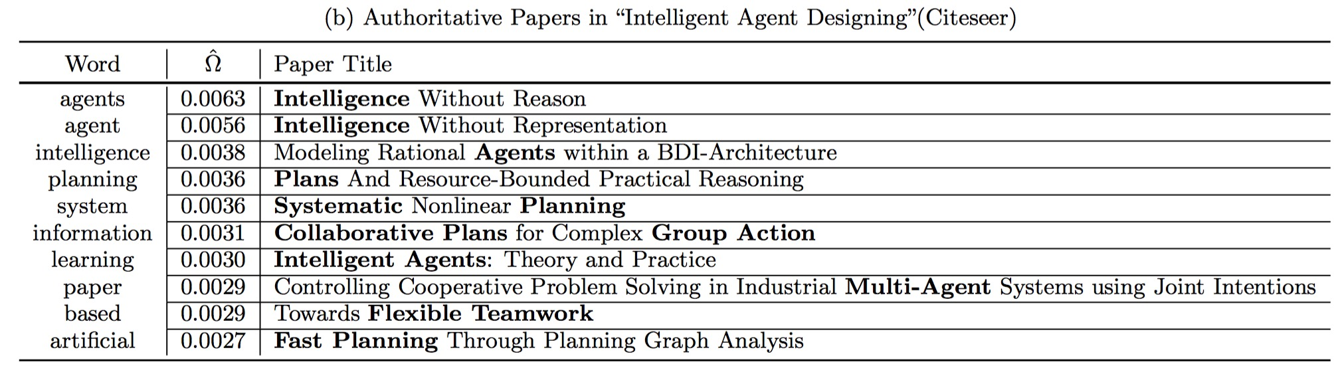
Topic-based paper recommendation
Notes:
Topic based paper recommendation
The first topic is from AAN
The second is Intelligent Agent Designing from Citeseer

Slide 16

Link Prediction ability
Recall=$\frac{\#\text{correct} \text{prediction}}{\#\text{all} \text{references}}$
Notes:
7 different measures
Two or three baselines
outperform greatly

Slide 17
Quality of Learned Topics
Word Intrusion
Dog Cat Pig Apple Snake

Slide 18
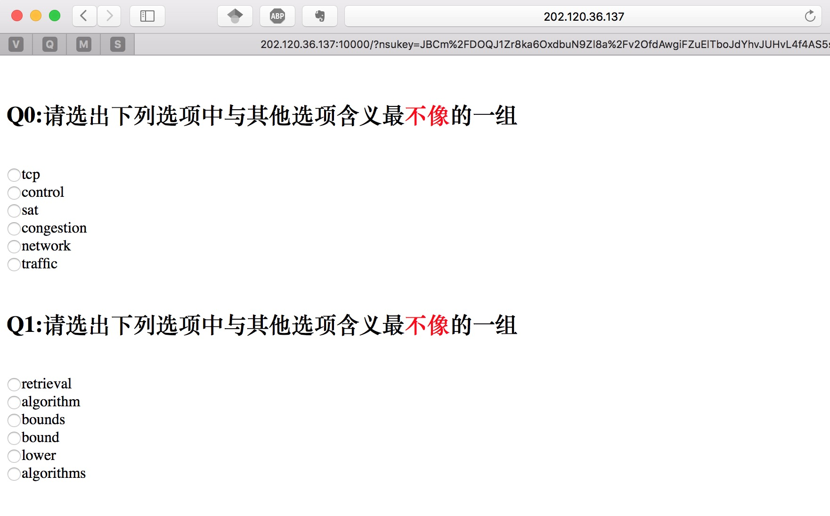
Quality of Learned Topics
We need volunteers ! ! !

Slide 19
Outline
Introduction
Model & Inference
Experiment
Future Plan

Slide 20
Future Plan
Complete the Experiment
Submit the paper to ICDM 2016

Slide 21
Q & A

Slide 22
Thank You

