Slide 1
Data Group in this semester
Present by Xiangyuan Ren
May,24, 2016
Notes:
I ask 佳琪 to make me the very
do the pre

Slide 2

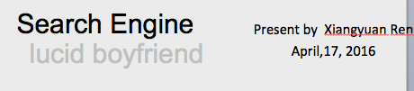


Slide 3
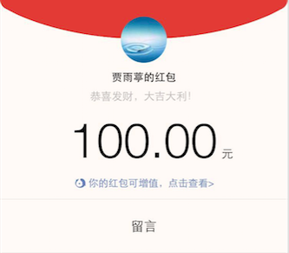
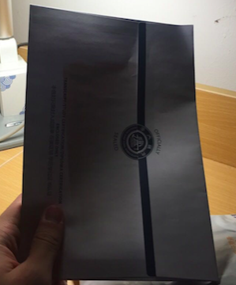
Award
Notes:
Let’s stop brag
Solid work

Slide 4
Outline
Deepdive
Search Engine
Crawler

Slide 5
Guide
Deepdive
Search Engine
Crawler

Slide 6

Deepdive —— as a child

Slide 7
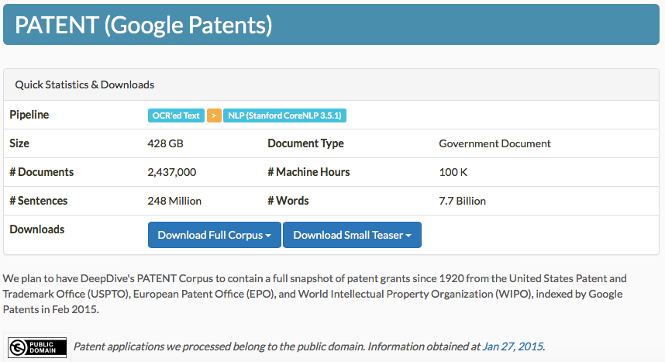
Deepdive
http://202.120.36.28:8833

Slide 8
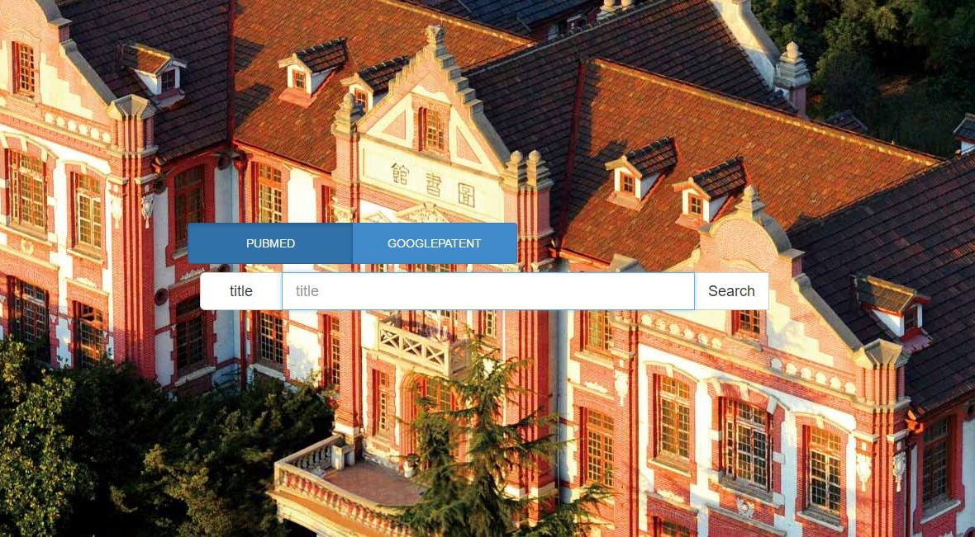
Deepdive —— as an adult

Slide 9
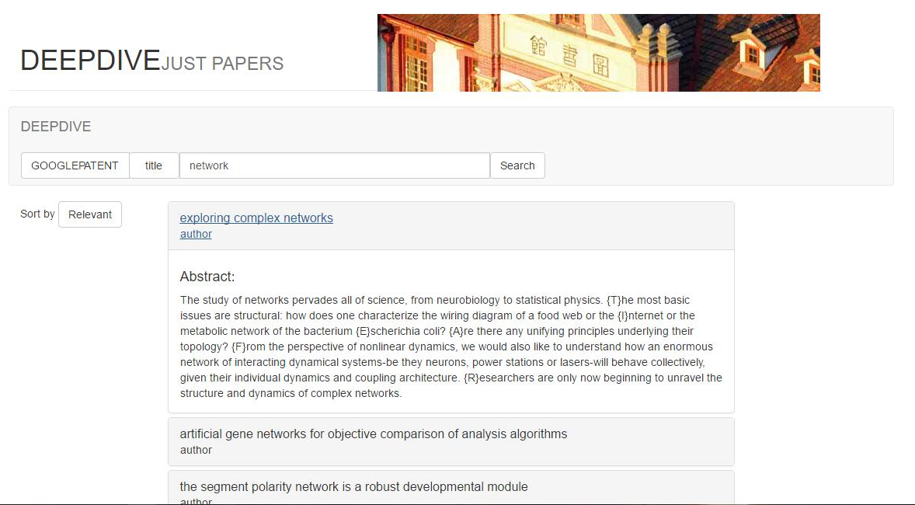
Deepdive
Notes:
Acemap can only search the title to match what you have input
We add something like abstract into it, so you can get more papers.

Slide 10
Guide
Deepdive
Search Engine
Crawler

Slide 11
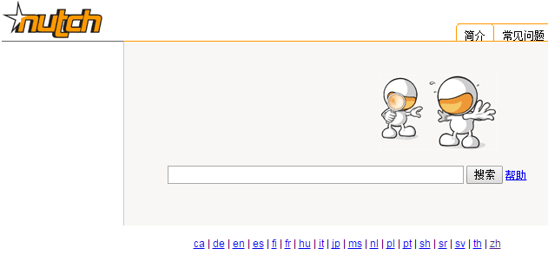
Search Engine
Bad boyfriend
http://202.120.36.28:8080/nutch-1.1/zh/

Slide 12
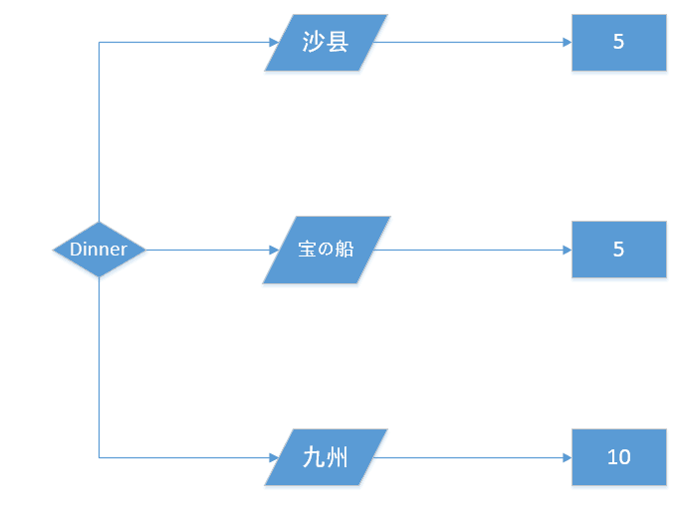
Search Engine lucid boyfriend
Notes:
Personal tailer for acemap

Slide 13
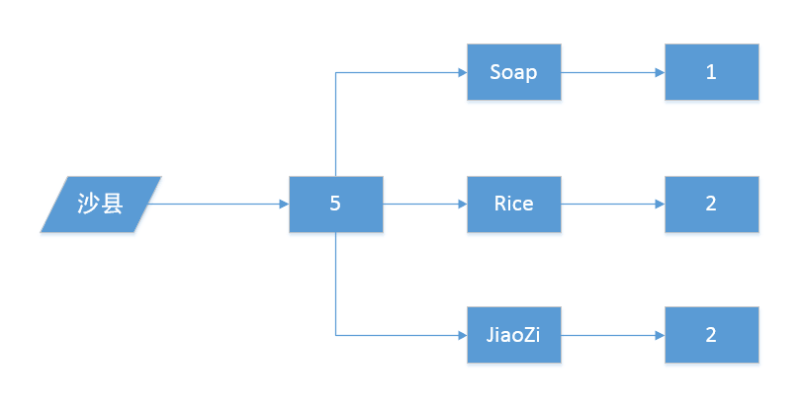
Search Engine lucid boyfriend

Slide 14
Guide
Deepdive
Search Engine
Crawler

Slide 15
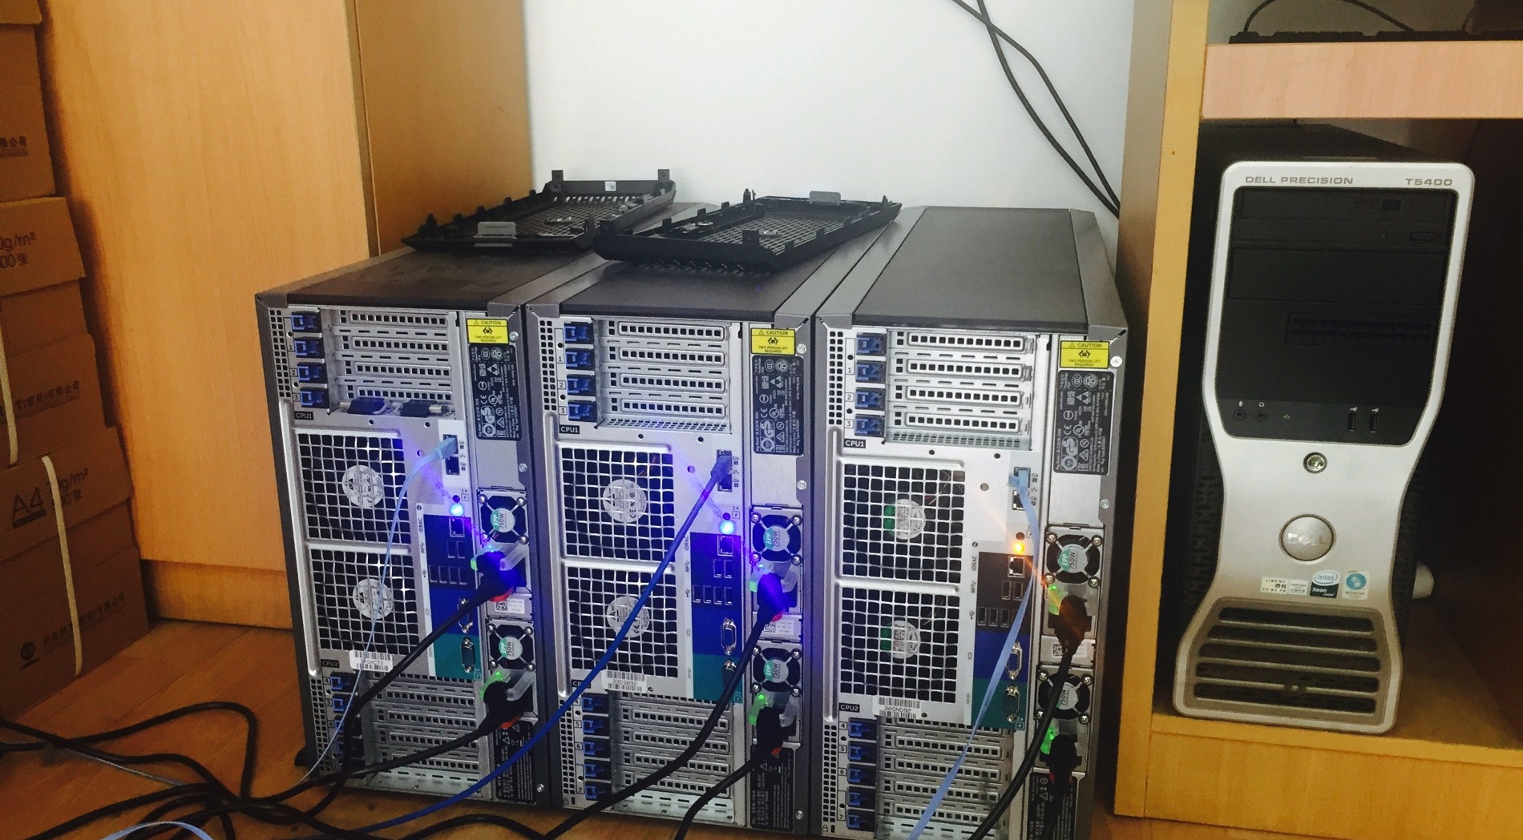
Crawler Higher Taller Stronger
Notes:
434
姚远will talk about the implementation of distributed system later.

Slide 16
Search Engine
Bad boyfriend
http://202.120.36.28:8080/nutch-1.1/zh/

Slide 17
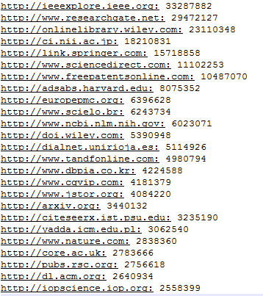
Crawler

Slide 18
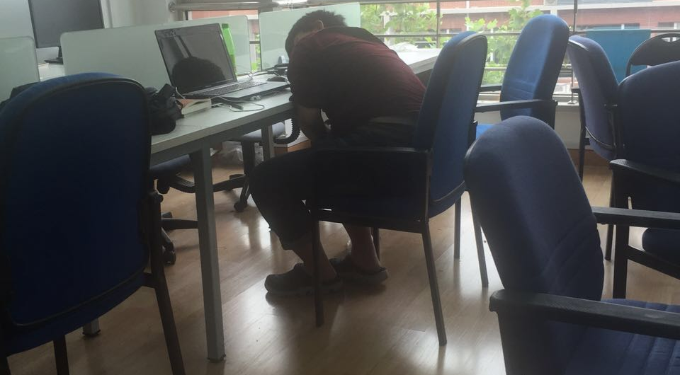
What to say
Notes:
We are the only group that half of the group members stay up late all night to work in the lab.
Actually, somebody calls me devil
Please show some respect.

Slide 19
Thank You!
Q&A

