Slide 1
Deep Belief Nets and Ising Model-Based Network Construction
Lecturer: Bo Chen

Slide 2
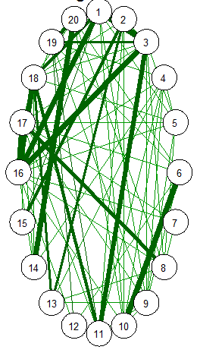
Network Construction
Social , academic ,etc.
Several users(nodes)
A line means a connection between two users(nodes)
Weights of the line indicates the strength of connection

Slide 3
What can it do?
1. Prediction: predict the information source
2. Recommendation: movie, paper , music
3. Other applications

Slide 4
How?
1. Information collection
2. Feature extraction
3. Construction based on features

Slide 5
How?
Information
Collection
Various
Information
Feature Extraction
Features
Network Construction

Slide 6
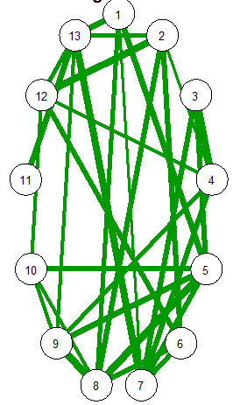
Our Model
Information
Deep
Belief
Nets
Features
Weights
Ising Model

Slide 7
Deep Belief Nets
Constructed by Restricted Boltzmann Machine layer by layer greedily
h3
h2
h1
data

Slide 8
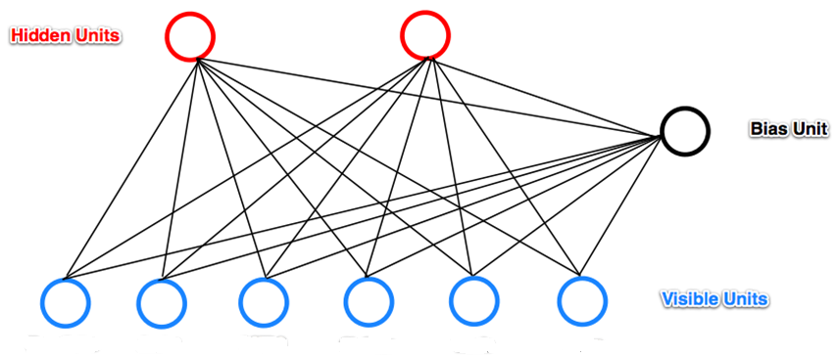
Restricted Boltzmann Machine

Slide 9
Restricted Boltzmann Machine
1. Undirected or bidirected
2. One layer of visible units
3. One layer of hidden units
4. No connection between hidden units
5. No connection between visible units
6. The hidden units are conditionally independent given the visible units
hidden
j
i
visible

Slide 10
Terminology in RBM
Weights and biases: weights refer to the connection between units and biases refer to each unit

Slide 11
Terminology in RBM
Energy:
v: visible units, vector, each usually take 1 or 0
h: hidden units, vector, each usually take 1 or 0
a: biases of visible units
b: biases of hidden units
w: weights

Slide 12
Terminology in RBM
Probability:
The probability of a configuration over both visible and hidden units:
partition function

Slide 13
I & O in RBM
Input: visible units
Output: weights and biases (generative model)

Slide 14
Return to Deep Belief Nets
Steps to train a DBN.
1. Use the parameters to extract a layer of features (the first hidden layer) from raw data
2. Treat the activations of the features as the input for the second hidden layer
3. Repeat step2 to train multiple layers of RBM

Slide 15
Return to Deep Belief Nets
The third hidden layer
h3
The third RBM
The second hidden layer
h2
The second RBM
The first hidden layer
h1
The first
RBM
data

Slide 16
A Brief Review
1. How to construct a network
2. Our model
3. The introduction of RBM
4. To train deep belief nets
Now we have a considerable number of features!!!

Slide 17
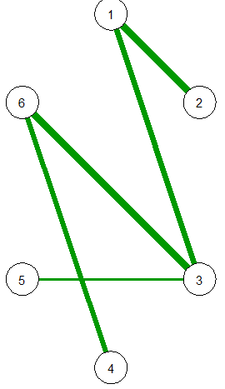
Ising Model
 | User1 | User2 | User3 | User4 | User5 | User6
Feature1 | 0 | 1 | 1 | 0 | 1 | 0
Feature2 | 1 | 1 | 0 | 1 | 0 | 1
Feature3 | 0 | 0 | 1 | 0 | 0 | 1
Feature4 | 1 | 1 | 0 | 1 | 1 | 1
Ising Model

Slide 18
Ising Model
What will Ising Model do?
1. Treat every user as a node in an Ising Model
2. Treat every feature as one observation of their interaction
3. Infer the interaction between them from all the observations ( features )

Slide 19
Ising Model
What is Ising Model?
An energy-based model
The energy of a configuration(Hamiltonian Function)
Configuration σ (a set of users)
Interaction $J_{ij}$ (connection strength between users)
External field effect $h_{j}$

Slide 20
An Illustration
External field effect
Interaction
Configuration

Slide 21
Ising Model
The configuration probability given by Boltzmann Distribution is
where
and the normalization constant

Slide 22
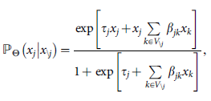
Ising Model
The conditional probability of $X_{j }$given all other nodes $X_{\backslash j}$ :
Configuration
Node parameter
Pairwise interaction
x1 | x2 | … | xi | … | … | xj | … | …
t1 | t2 | … | ti | … | … | tj | … | …
Null | … | β1i | … | β1j
… | … | … | … | …
βi1 | … | Null | … | βij
… | … | … | … | …
βj1 | … | βji | … | Null

Slide 23
How?
Step1(lasso): Find possible neighbors for each
Step2(EBIC): Choose the best set of neighbors
Step3(AND rule or OR rule ): Determine the final edge
Step4: Take the average of the weights

Slide 24
Experiment
Not yet…
BUT…

Slide 25
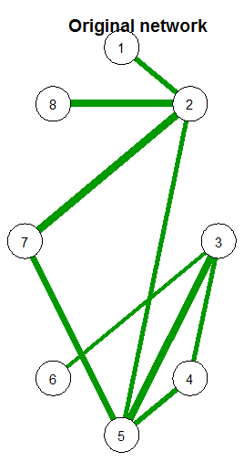
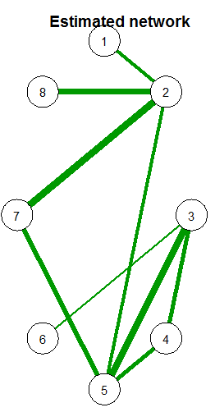
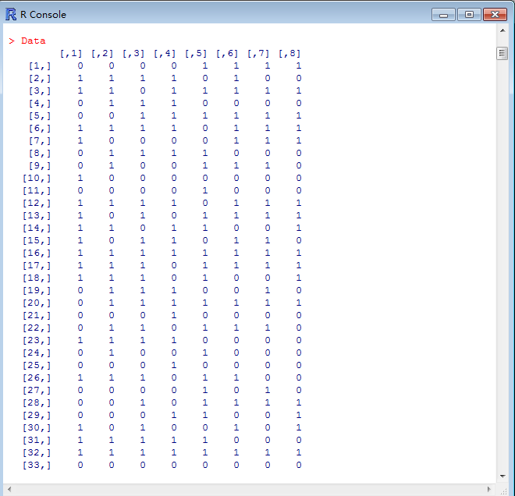
An Example
An example of using Ising model to reconstruct a graph
Sample
Reconstruct

Slide 26
Thanks！

Slide 27
Q&A

