Slide 1
3-Dimentional Cellular Positioning based on HAPs
5120309700 Kun Qian

Slide 2
outline
1. brief idea of HAPs
2. cellular positioning
3. simulation

Slide 3
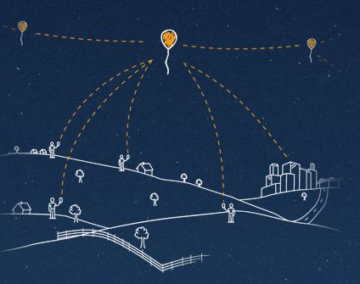
Google’s Project Loon
Motivation: make the world connected
Key words: stratosphere, LTE, cellular

Slide 4
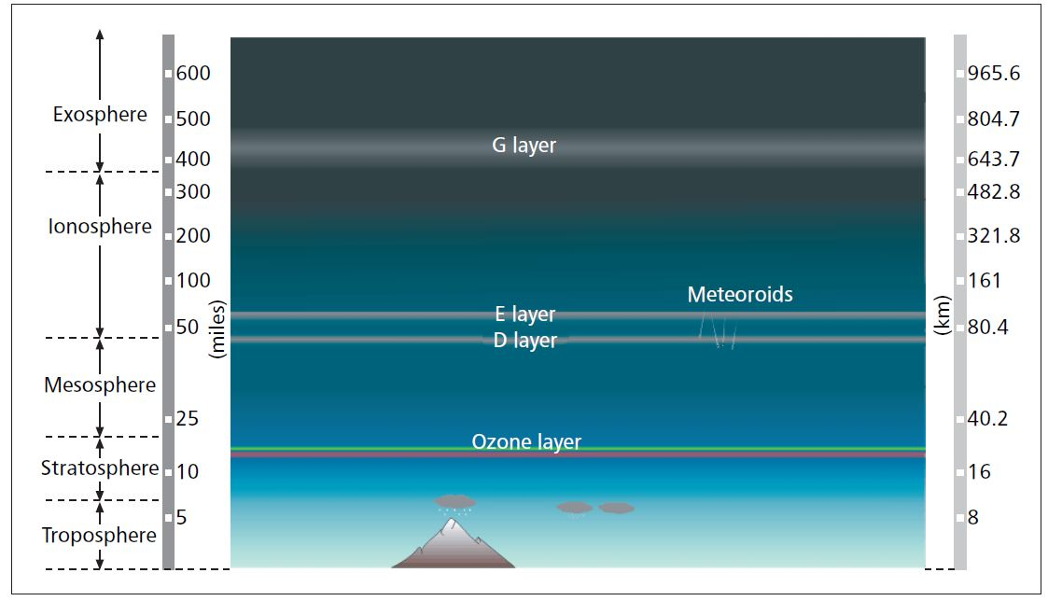
High Altitude Platform Station(HAPs)
Basic idea：
Airships or aircraft positioned in the stratosphere between 17 and 22km.
Combined the network with the ground control equipment, entrance equipment and a variety of wireless terminal to constitute a complete, self-contained system of mobile communication network
Notes:
airships or aircraft positioned in the stratosphere between 17 and 22
km. HAPs can be considered as a novel solution for providing telecommunications
services.

Slide 5
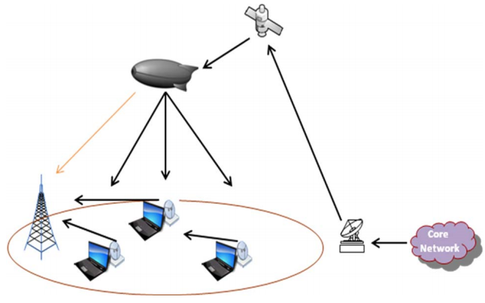
HAPs networking

Slide 6
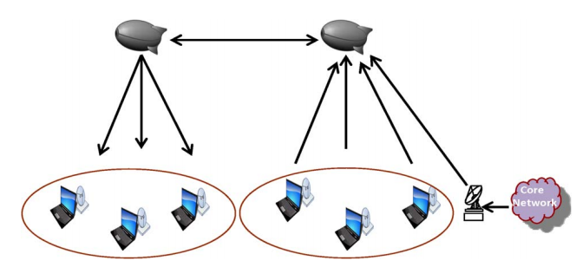
HAPs networking

Slide 7
Main feature of HAPs
Issue | Satellite | High Altitude Platform
Propagation delay | Causes noticeable impairment in voice communications in GEO | Low
Deployment timing | Service cannot start before the entire system deployed | One platform and ground support is enough for the basic service
Radio channel quality | Free-space-like channel with Ricean fading; path loss roughly 20 dB/decade; GEO distance limits spectrum efficiency | Free-space-like channel at distances comparable to terrestrial
Indoor coverage | Generally not available | Substantial coverage possible
cost | More then $200 million for a GEO system; Some billion for a LEO system. | less than the cost required to deploy a terrestrial network with many base stations
Notes:
Obviously it has a lots of advantages over both the satellite system and the terrestrial communication system

Slide 8
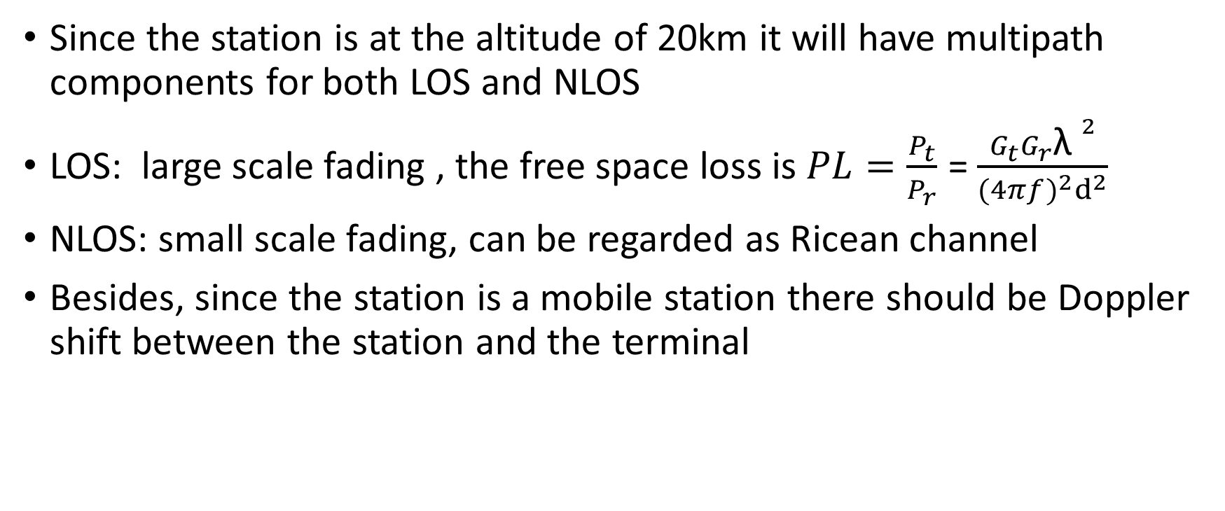
HAPs Channel modeling
Since the station is at the altitude of 20km it will have multipath components for both LOS and NLOS
LOS: large scale fading , the free space loss is $PL=\frac{P_{t}}{P_{r}}$ = $\frac{G_{t}G_{r}{\text{λ} }^{2}}{{(4πf)}^{2}d^{2}}$
NLOS: small scale fading, can be regarded as Ricean channel
Besides, since the station is a mobile station there should be Doppler shift between the station and the terminal

Slide 9
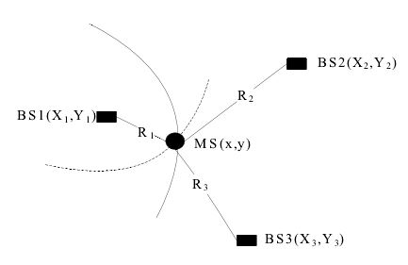
Cellular-positioning: TDOA
2-dimentional TDOA
The core concept of TDOA is to calculate the time difference from the MS to two different BS, then based on the dt to calculate the differential distance and solve the positioning equation.

Slide 10
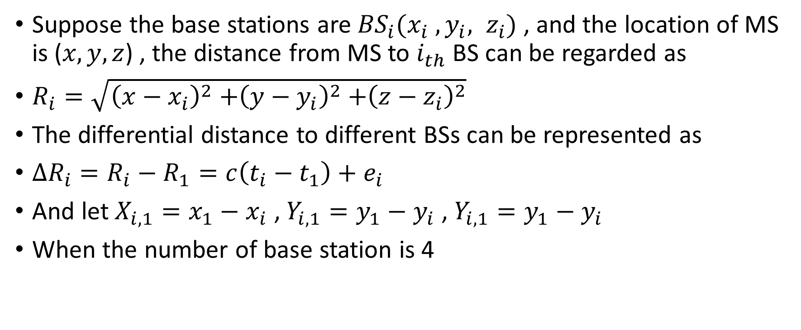
3-dimentional TDOA
Suppose the base stations are ${BS}_{i}(x_{i} , y_{i}, z_{i})$ , and the location of MS is ($x, y, z$) , the distance from MS to $i_{th}$BS can be regarded as
$R_{i}=\sqrt{{\left(x−x_{i}\right)}^{2}{+\left(y−y_{i}\right)}^{2}{+\left(z−z_{i}\right)}^{2}}$
The differential distance to different BSs can be represented as
$∆R_{i}=R_{i}−R_{1}=c\left(t_{i}−t_{1}\right)+e_{i}$
And let $X_{i,1}=x_{1}−x_{i}$ , $Y_{i,1}=y_{1}−y_{i}$ , $Y_{i,1}=y_{1}−y_{i}$
When the number of base station is 4

Slide 11
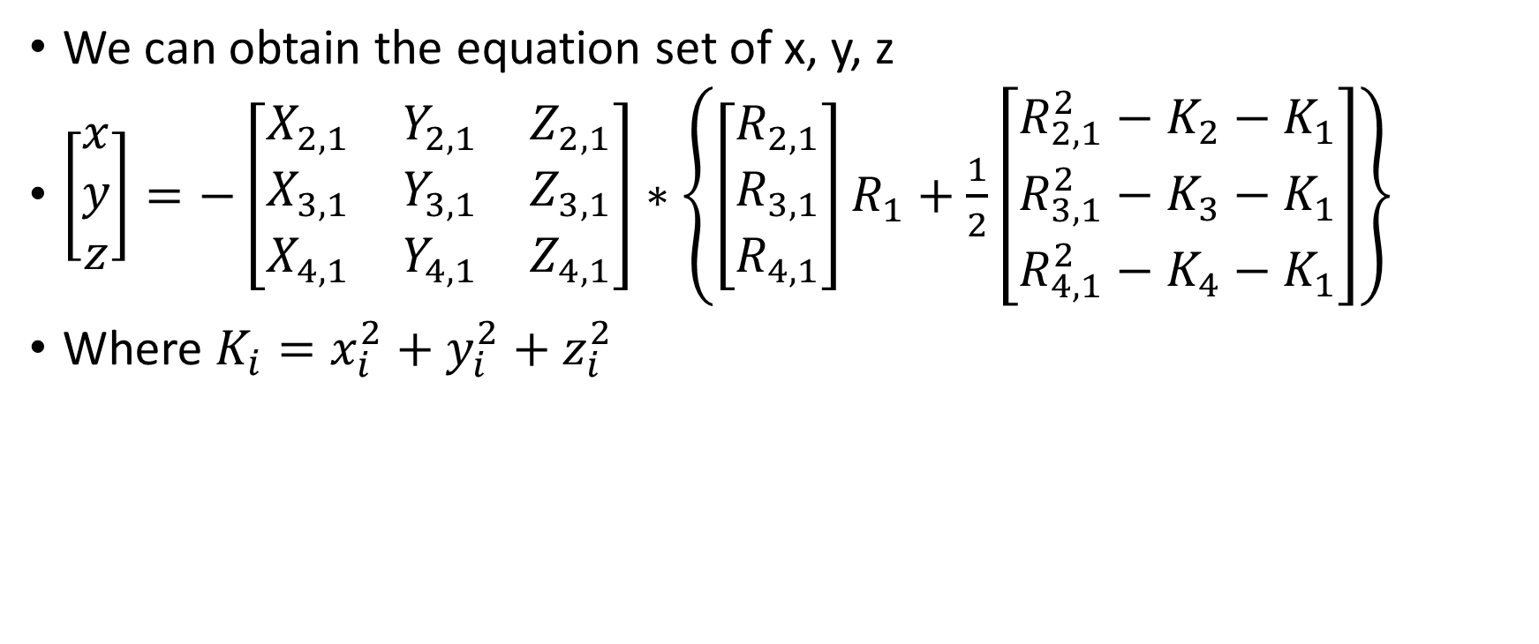
3-dimentional Time Difference of Arrival(TDOA)
We can obtain the equation set of x, y, z
$\left[\begin{matrix}x \\ y \\ z\end{matrix}\right]=−\left[\begin{matrix}X_{2,1} & Y_{2,1} & Z_{2,1} \\ X_{3,1} & Y_{3,1} & Z_{3,1} \\ X_{4,1} & Y_{4,1} & Z_{4,1}\end{matrix}\right]∗\left\{\left[\begin{matrix}R_{2,1} \\ R_{3,1} \\ R_{4,1}\end{matrix}\right]R_{1}+\frac{1}{2}\left[\begin{matrix}R_{2,1}^{2}−K_{2}−K_{1} \\ R_{3,1}^{2}−K_{3}−K_{1} \\ R_{4,1}^{2}−K_{4}−K_{1}\end{matrix}\right]\right\}$
Where $K_{i}=x_{i}^{2}+y_{i}^{2}+z_{i}^{2}$

Slide 12
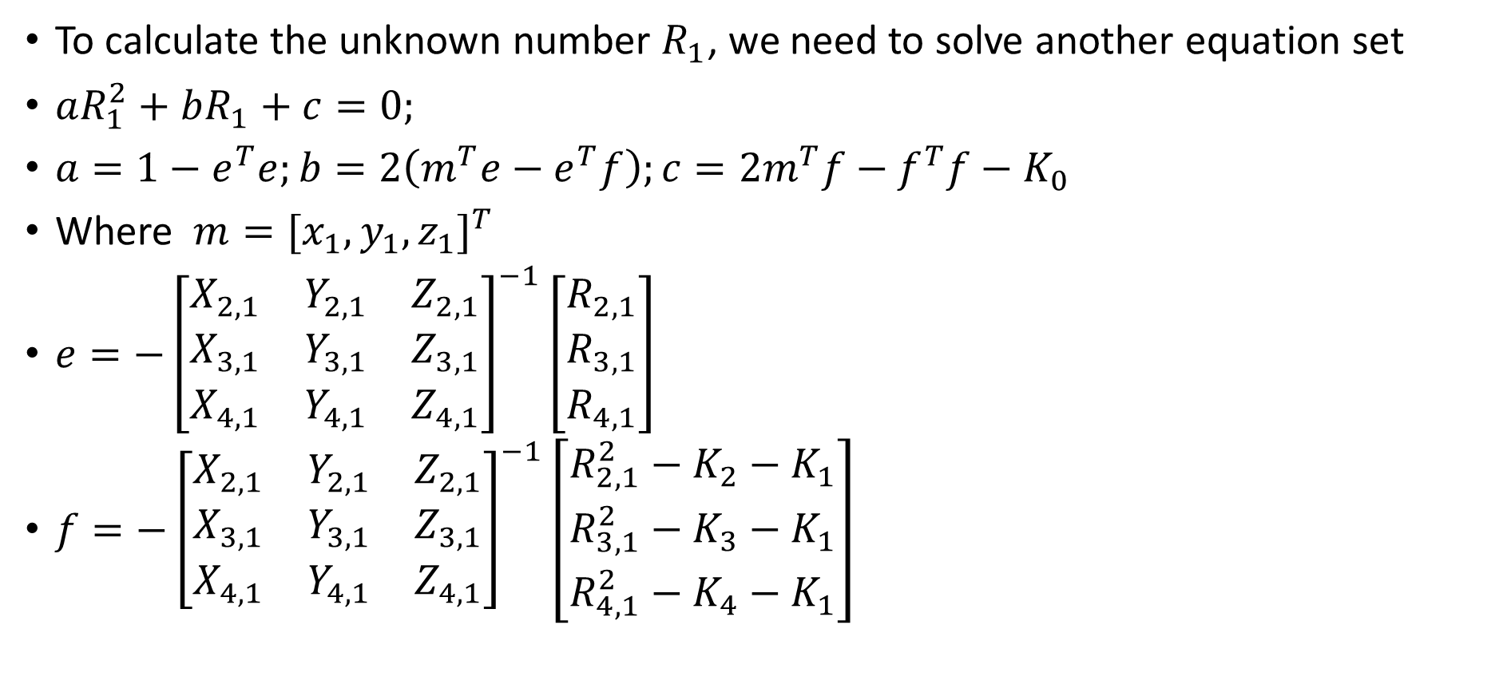
3-dimentional TDOA
To calculate the unknown number $R_{1}$, we need to solve another equation set
$aR_{1}^{2}+bR_{1}+c=0;$
$a=1−e^{T}e;b=2\left(m^{T}e−e^{T}f\right);c=2m^{T}f−f^{T}f−K_{0}$
Where $m=[x_{1},y_{1},z_{1}]^{T}$
$e=−{\left[\begin{matrix}X_{2,1} & Y_{2,1} & Z_{2,1} \\ X_{3,1} & Y_{3,1} & Z_{3,1} \\ X_{4,1} & Y_{4,1} & Z_{4,1}\end{matrix}\right]}^{−1}\left[\begin{matrix}R_{2,1} \\ R_{3,1} \\ R_{4,1}\end{matrix}\right]$
$f=−{\left[\begin{matrix}X_{2,1} & Y_{2,1} & Z_{2,1} \\ X_{3,1} & Y_{3,1} & Z_{3,1} \\ X_{4,1} & Y_{4,1} & Z_{4,1}\end{matrix}\right]}^{−1}\left[\begin{matrix}R_{2,1}^{2}−K_{2}−K_{1} \\ R_{3,1}^{2}−K_{3}−K_{1} \\ R_{4,1}^{2}−K_{4}−K_{1}\end{matrix}\right]$

Slide 13

3-dimentional TDOA
After we get the result of $R_{1}$ ,using chan algorithm to get the final result

Slide 14

Positioning performance evaluation
RMSE
$RMSE=\sqrt{E[{\left(x−x_{k}\right)}^{2}+{\left(y−y_{k}\right)}^{2}+{\left(z−z_{k}\right)}^{2}}$ k=1, … m

Slide 15
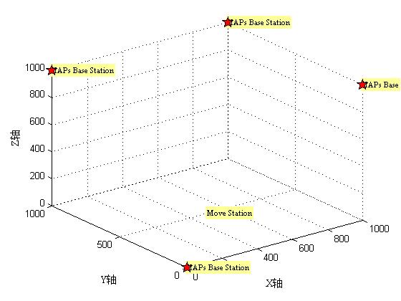
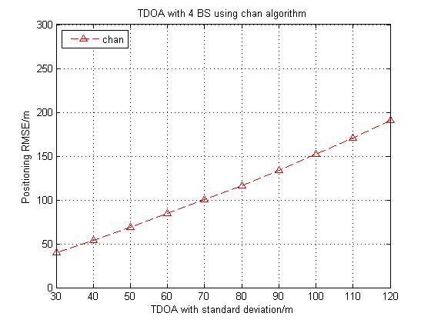
Simulation result

Slide 16
Future plan
Finish the simulation, take the small scale channel model into consideration
Change the algorithm, make it able to cope multi-key issue

Slide 17
Thanks for listening

