Slide 1
Coded Cache Problem
Yuchen Deng 5120309495

Slide 2
OUTLINE
Introduction of coded cache
Uncoded cache
Coded cache
Two models of coded cache
Centralized coded cache
Decentralized coded cache
Coded cache with non-uniform demands
Notes:
介绍ppt内容

Slide 3
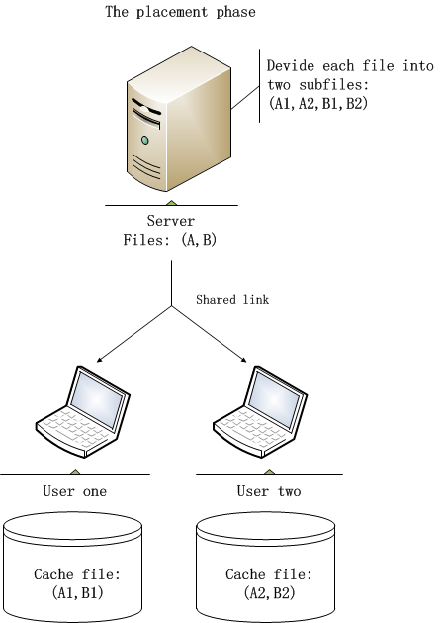
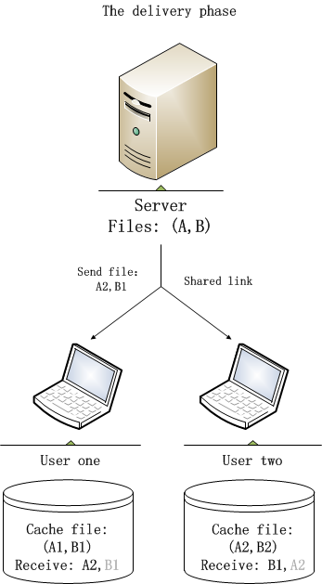
INTRO uncoded cache
Fig. 1 uncoded cache
Notes:
Caching – uncoded caching – coded caching
Coded caching的一般模型是：服务器-共享链路-K个users
附模型图

Slide 4
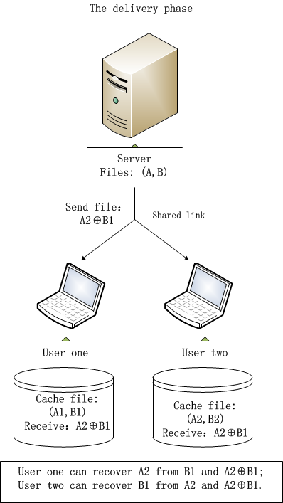
INTRO coded cache
Fig. 2 coded cache
Notes:
Caching – uncoded caching – coded caching
Coded caching的一般模型是：服务器-共享链路-K个users
附模型图

Slide 5
INTRO uncoded cache & coded cache
Server : file A and file B
User one : cache (A1, B1), wants file A
User two : cache (A2, B2), wants file B
Uncoded cache:
In the delivery phase, the server sends A2, B1, total traffic volume is 1 F bits.
Coded cache:
In the delivery phase, the server sends A2⊕B1, total traffic volume is 1/2 F bits.
Notes:
Caching – uncoded caching – coded caching
Coded caching的一般模型是：服务器-共享链路-K个users
附模型图
It is brought by the centralized coded caching mechanism for a single multi-cast transmission can satisfy (1 + KM=N ) user requests simultaneously

Slide 6
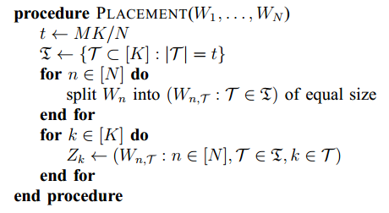
Two models of coded cache
Centralized coded cache
N is file number, each file of size F bits.
K is the user number.
M is the user cache size.
define t = MK/N, t means how many copies of one file can be cached in the global user cache
The placement phase
The delivery phase
Notes:
最先提出的模型：With uniform demand
有两种：
centralized 事先知道用户数量
Decentralized 不知用户数量，用户存储相互独立
Coded cache： N=K=2 M=1 举例，附图（server，2 users， cache content）

Slide 7
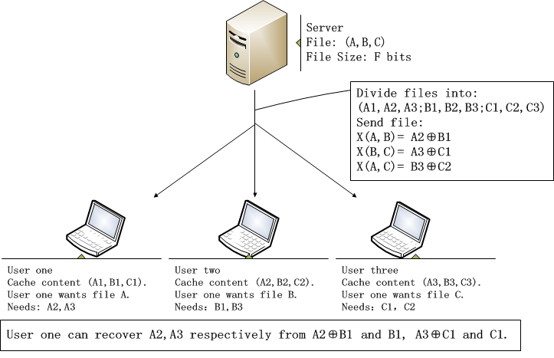
Two models of coded cache
Centralized coded cache
N=K=3，M=1
t = KM/N= 1:
R(M=1)=3/2
Fig. 3 centralized coded cache
Notes:
最先提出的模型：With uniform demand
有两种：
centralized 事先知道用户数量
Decentralized 不知用户数量，用户存储相互独立
Coded cache： N=K=2 M=1 举例，附图（server，2 users， cache content）

Slide 8
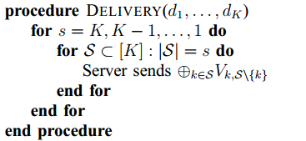
Two models of coded cache
Decentralized coded cache
N is file number, each file of size F bits.
K is the user number.
M is the user cache size.
The delivery phase
The placement phase
One bit in each content to be cached by a specific user has the probability of M/N.
Notes:
最先提出的模型：With uniform demand
有两种：
centralized 事先知道用户数量
Decentralized 不知用户数量，用户存储相互独立
Coded cache： N=K=2 M=1 举例，附图（server，2 users， cache content）

Slide 9
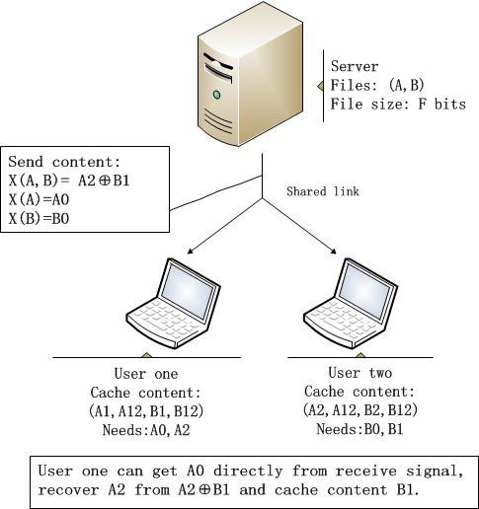
Two models of coded cache
Decentralized coded cache
N=K=2
M=1
Fig. 4 decentralized coded cache
Notes:
最先提出的模型：With uniform demand
有两种：
centralized 事先知道用户数量
Decentralized 不知用户数量，用户存储相互独立
Coded cache： N=K=2 M=1 举例，附图（server，2 users， cache content）

Slide 10
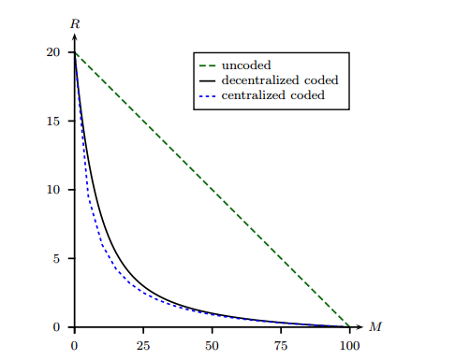
Two models of coded cache
Centralized coded cache and decentralized coded cache have similar performance.
Decentralized is more practical for user number is usually unknown in advance.
Fig. 5 traffic volume comparison between uncoded cache,
centralized and decentralized cache

Slide 11
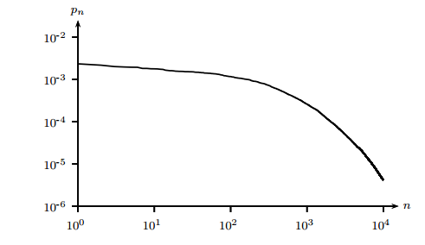
Coded cache with non-uniform demands
Files are with different popularities:
Fig. 6 File popularitiy pn for Netlix movie catalog

Slide 12
Coded cache with non-uniform demands
1. Divide the files into L groups according to the file popularities:
2. Consider the file popularity are the same within one group.
Apply the decentralized coded cache within each file group.
3. Minimize the expected rate over the shared link by optimizing the amount of memory allocated to each group.
Notes:
附图：服务器里的文件流行度不同
流行度不同，被请求的概率不一样，有些文件经常被请求，可以再用户缓存里多存储一些；较少被请求的文件可以少存一些。
有几种机制

Slide 13
Thank you ！

