Slide 1
Topo Sort
on Spark GraphX
Lecturer: 苟毓川5120309391

Slide 2
Outline
Necessary background knowledge on Spark GraphX
Topo sort on stand-alone and Spark GraphX
Distributed topo sort
Lecturer: 苟毓川5120309391

Slide 3
Spark GraphX

Slide 4
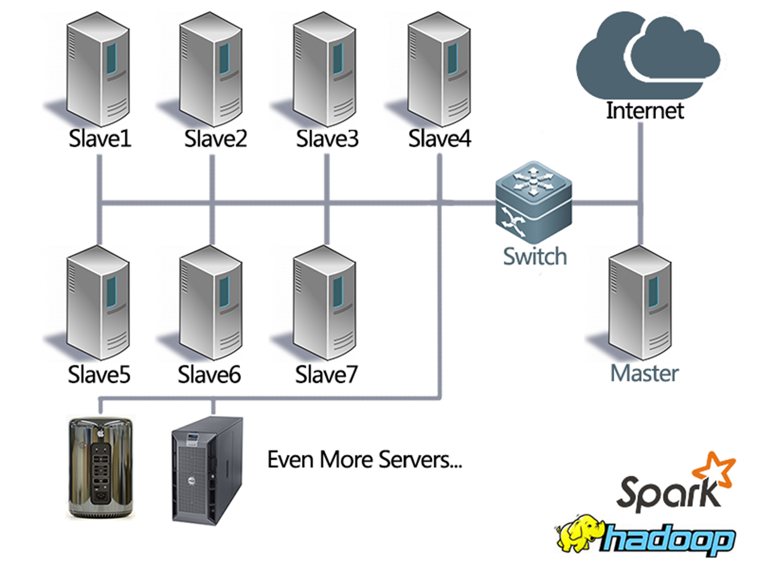
Spark
Spark GraphX
A fast engine for server cluster to process large-scale data.
Server cluster in prof. Wang’s group

Slide 5
A simple example
Spark GraphX
Word count
to understand Spark
text1
computing node1
result1
large text
text2
computing node2
result2
large result
text3
computing node3
result3

Slide 6
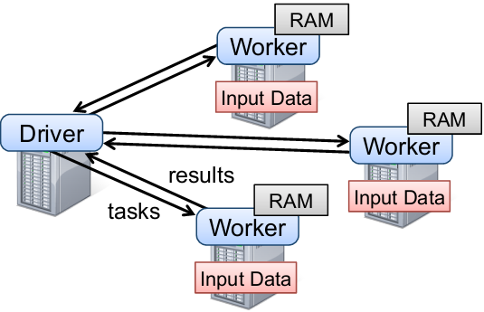
A simple example
Spark GraphX
to understand Spark
Word count

Slide 7
RDD
Spark GraphX
(Resilient Distributed Dataset)
Dataset is partitioned into subsets
Subsets can be sent to any computing node to process
Data can be cached in memory to reuse
We can easily put data into RDD!

Slide 8
Spark
Spark GraphX
high-level tools:
Streaming, Mllib, SQL, GraphX
Spark RDD
Spark
Streaming
Spark
SQL
Spark
GraphX
Spark
MLlib

Slide 9
Spark GraphX
Spark GraphX
A component for graphs and graph-parallel computation
A new graph abstraction(extends the Spark RDD)
A set of basic graph operations and optimized pregelAPI
A growing collection of graph algorithms

Slide 10
Spark GraphX
Spark GraphX
Partition the graph into several subgraphs
Compute the subgraph in a distributed way

Slide 11
Topo sort
(topological)

Slide 12
Motivation
Topo sort
Build a set of graph algorithm such as topo sort on Spark GraphX
Research the graph algorithm in a distributed way
Try to be a contributor to Spark community
Learn Spark Graphx on a base level

Slide 13
What is topo sort?
Topo sort
A DAG (directed acyclic graph)
We can get the topo order as the cource schedule: 2, 5, 3, 7
Maths
2
Data Structure
Program Design
3
5
7
Data Base

Slide 14
The realization on stand-alone
Topo sort
Kahn algorithm

Slide 15
The realization on stand-alone
Topo sort
1. Compute the indegrees of every vertex
Maths
2
Data Structure
Program Design
3
5
7
Data Base

Slide 16
The realization on stand-alone
Topo sort
1. Compute the indegrees of every vertex
Maths
2
0
Data Structure
Program Design
1
3
5
1
2
7
Data Base
indegree of vertex.

Slide 17
The realization on stand-alone
Topo sort
Adjacent matrix(graph)
Vertex1 Vertex2 … VertexN
Vertex1 0/1 0/1 0/1
Vertex2 0/1 0/1 0/1
…
VertexN 0/1 0/1 0/1
Add to get the indegree of vertex1
Edge from VertexN to Vertex2

Slide 18
Topo sort
The realization on stand-alone
2. Output the vertex1 of 0 indegree, and minus the indegree of following vertices
Maths
2
0
Data Structure
Program Design
1
3
5
1
2
7
Data Base
indegree of vertex.

Slide 19
Topo sort
The realization on stand-alone
2. Output the vertex1 of 0 indegree, and minus the indegree of following vertices
Maths
Output the vertex1
2
0
Data Structure
Program Design
1
3
5
1
2
7
Data Base
indegree of vertex.

Slide 20
Topo sort
The realization on stand-alone
2. Output the vertex1 of 0 indegree, and minus the indegree of following vertices
Output the vertex1
Maths
Data Structure
Program Design
2
0
1
-1
1
3
5
1
2
7
Data Base
indegree of vertex.

Slide 21
Topo sort
The realization on stand-alone
2. Output the vertex1 of 0 indegree, and minus the indegree of following vertices
Output the vertex1
Maths
Data Structure
Program Design
2
0
1
1
3
5
1-1=0
2
7
Data Base
indegree of vertex.

Slide 22
Topo sort
The realization on stand-alone
3. Repeat the step2
Output the vertex1
Maths
Data Structure
Program Design
2
0
1
1
3
5
0
2
7
Data Base

Slide 23
Topo sort
The realization on stand-alone
3. Repeat the step2
Maths
Data Structure
Program Design
2
0
1
1
-1
3
5
0
-1
Output the vertex2
2
7
Data Base

Slide 24
Topo sort
The realization on stand-alone
3. Repeat the step2
Maths
2
0
1
Data Structure
Program Design
5
0
2
0
3
1
7
Data Base

Slide 25
Topo sort
The realization on stand-alone
3. Repeat the step2
Maths
2
0
1
Data Structure
Program Design
0
3
5
0
2
-1
Output the vertex3
1
7
Data Base

Slide 26
Topo sort
The realization on stand-alone
3. Repeat the step2
Maths
2
0
1
Program Design
5
0
2
Data Structure
0
7
4
Data Base
3
0
3

Slide 27
Topo sort
The realization on stand-alone
Program:
Use adjacent matrix to reserve the graph
Use array to reserve the vertices and indegrees
Use for-loop to find the 0 indegree vertex
Use array to make a queue for sorting
Maths
2
0
Data Structure
Program Design
1
3
1
5
2
7
Data Base

Slide 28
Topo sort
The realization on Spark GraphX
Program:
Use RDD to reserve the vertices and indegrees
Use RDD to reserve the vertices and adjacent IDs
Use reduce() to find the 0 indegree vertex
Use mapValues() to change the adjacent vertices’ indegree

Slide 29
Topo sort
The performance on Spark GraphX
Not good enough!
My simple test:
For larger scale DAG data, its behavior is a little better than stand-alone.
It runs a little faster.

Slide 30
Topo sort
Why?

Slide 31
Topo sort
Why?
Key step(find the 0 indegree vertex):
Maths
Output the vertex1
2
0
Stand-alone: use for-loop
Spark GraphX: use reduce() in RDD
Data Structure
Program Design
1
3
5
1
2
7
Data Base

Slide 32
Topo sort
Why?
Key step(find the 0 indegree vertex):
Maths
Output the vertex1
2
0
Data Structure
Program Design
We can only process one vertex at a time.
Other vertices must wait until this step has been done.
1
3
5
1
2
7
Data Base

Slide 33
Topo sort
What we need?
Maths
2
0
A more proper algorithm model!
Data Structure
Program Design
1
3
5
1
2
7
Data Base

Slide 34
Topo sort
What we need?
Partition the graph and compute each parts at the same time.
Other vertices don’t need to wait

Slide 35
Distributed topo sort
(D-topo sort)

Slide 36
D-Topo sort
The algorithm
1. Choose the startnode, and send st=1 to all its neighbors
4
2
1
7
5
6
3

Slide 37
D-Topo sort
The algorithm
1. Choose the startnode, and send st=1 to all its neighbors
start
time
4
2
1
(0)
1
7
1
5
6
3

Slide 38
D-Topo sort
The algorithm
1. Choose the startnode, and send st=1 to all its neighbors
start
time
(1)
4
2
1
(0)
1
7
1
5
6
3
(1)

Slide 39
D-Topo sort
The algorithm
2. When a vertex receives a st, st = st+1, and send new st to all its neighbors
(1)
4
2
1
(0)
1
7
1
5
6
3
(1)

Slide 40
D-Topo sort
The algorithm
2. When a vertex receives a st, st = st+1, and send new st to all its neighbors
(1)
4
2
2
1
2
(0)
1
2
7
1
2
5
2
6
3
(1)

Slide 41
D-Topo sort
The algorithm
2. When a vertex receives a st, st = st+1, and send new st to all its neighbors
(1)
(2,2)
4
2
2
1
2
(0)
1
2
7
1
2
(2)
5
2
6
3
(1)
(2,2)

Slide 42
D-Topo sort
The algorithm
3. Repeat step2(receive st and plus 1, then send)
(1)
(2,2)
4
2
2
1
2
(0)
1
2
7
1
2
(2)
5
2
6
3
(1)
(2,2)

Slide 43
D-Topo sort
The algorithm
3. Repeat step2(receive st and plus 1, then send)
(1)
(2,2)
4
2
2
1
2
(0)
1
2
3
7
1
2
3
(2)
5
2
6
3
3
(1)
(2,2)

Slide 44
D-Topo sort
The algorithm
3. Repeat step2(receive st and plus 1, then send)
(1)
(2,2,3)
4
2
2
1
2
(3)
(0)
1
2
3
7
1
2
3
(2)
5
2
6
3
3
(1)
(2,2,3)

Slide 45
D-Topo sort
The algorithm
4. Get the maximum value of all nodes
(1)
(2,2,3)
4
2
2
1
2
(3)
(0)
1
2
3
7
1
2
3
(2)
5
2
6
3
3
(1)
(2,2,3)

Slide 46
D-Topo sort
The algorithm
4. Get the maximum value of all nodes
(1)
(2,2,3)
4
2
(3)
(0)
1
7
(2)
5
6
3
(1)
(2,2,3)

Slide 47
D-Topo sort
The algorithm
4. Get the maximum value of all nodes
(1)
(2,2,3)
4
2
(3)
(0)
1
7
(2)
5
6
3
(1)
(2,2,3)

Slide 48
D-Topo sort
The algorithm
5. Get the sort by the maximum value
(1)
(2,2,3)
4
2
(3)
(0)
1
7
(2)
5
6
3
(1)
(2,2,3)

Slide 49
D-Topo sort
The algorithm
5. Get the sort by the maximum value
(2,2,3)
2
(1)
4
(2)
(3)
(0)
1
3
7
5
(1)
6
(2,2,3)
Topo order

Slide 50
D-Topo sort
Advanatges
Don’t need to repeat the computing to find the 0 indegree vertex
(1)
(2,2,3)
4
2
2
1
2
(3)
(0)
1
2
3
7
1
2
3
(2)
5
2
6
3
3
(1)
(2,2,3)

Slide 51
D-Topo sort
Advanatges
Nodes are able to compute (send st to adjacent nodes) at the same time
(1)
(2,2,3)
4
2
2
1
2
(3)
(0)
1
2
3
7
1
2
3
(2)
5
2
6
3
3
(1)
(2,2,3)

Slide 52
D-Topo sort
Advanatges
Much more faster in a distributed way!

Slide 53
D-Topo sort
Key operation in Spark GraphX
aggregateMessages(sendMsg, mergeMsg)

Slide 54
D-Topo sort
Future work
Finish the D-topo sort on Spark GraphX
Using GraphX to do something in application level such as community detection in social network

Slide 55
Thank you!

Slide 56
Q&A

