Slide 1
Dot matrix barcode
Presented by :Tang Jianlun
Luo Chuhao

Slide 2
Outline
Dot matrix
Motivation
Introduction
Encoding
Introduction
Detection
Introduction
Binarization
Locate Vertex
Affine Transformation
Future work
Notes:
The outline is listed as follows.

Slide 3
Outline
Dot matrix
Motivation
Introduction
Encoding
Introduction
Detection
Introduction
Binarization
Locate Vertex
Affine Transformation
Future work
Notes:
The outline is listed as follows.

Slide 4
Dot matrix-motivation
Traditional barcode has been widely used in many fields: communication
Wechat‘s QR code
QQ’s
QR code

Slide 5
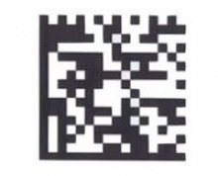
Dot matrix-motivation
PDF 417
Data matrix

Slide 6
Dot matrix-motivation
Current barcode is not friendly to eyes (ugly)
Waste of space for set up more picture

Slide 7
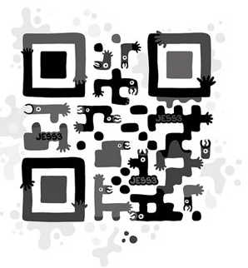
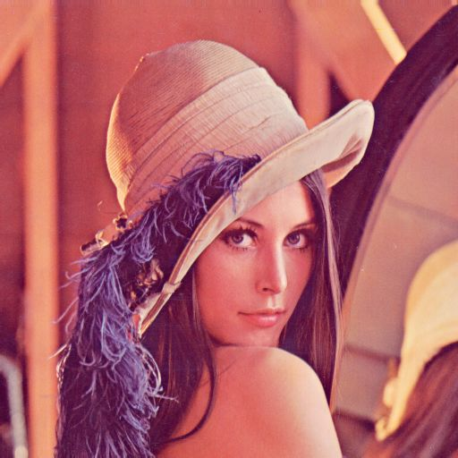
Dot matrix-motivation
Since print the barcode in a plane is a bit ugly, some scheme is proposed, one of them is QR Code Art
VS
How about using a picture?

Slide 8
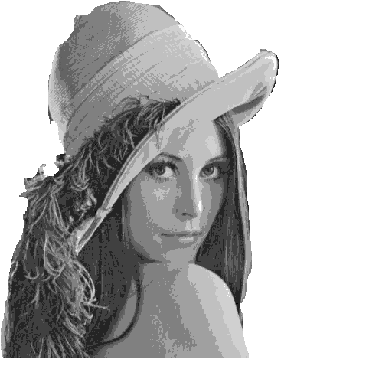
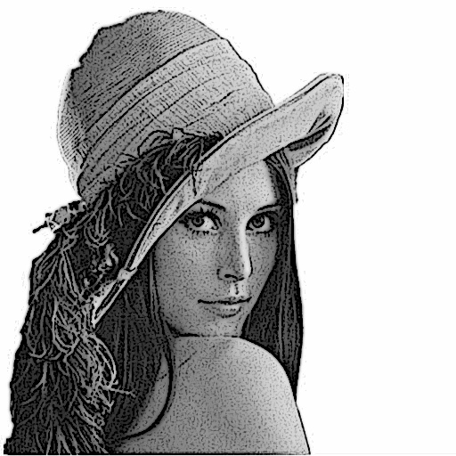
Dot matrix-introduction
We decide to use gray picture, some other preprocess is also needed, like enhancement

Slide 9
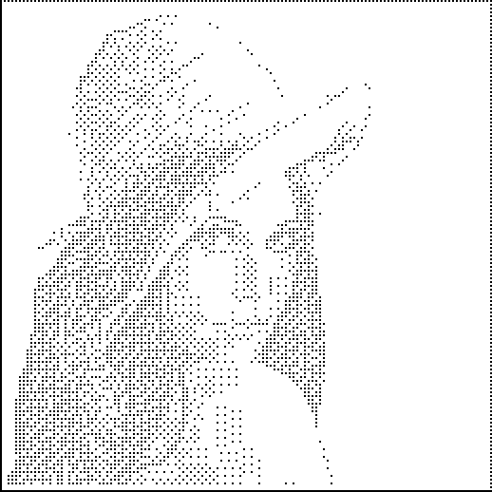
Dot matrix-introduction
Next, we convert the gray picture into dot matrix, which is more suitable for hiding data.

Slide 10
Dot matrix-introduction
Consider dot matrix as a binary image, composed by 0 and 1
Utilizing the idea of binary image, we can contain information in dot matrix

Slide 11
Outline
Dot matrix
Motivation
Introduction
Encoding
Introduction
Detection
Introduction
Binarization
Locate Vertex
Affine Transformation
Future work
Notes:
The outline is listed as follows.

Slide 12
Encoding-introduction
Encoding or data hiding is typically achieved by
altering some nonessential information in the host
message.

Slide 13
Encoding-introduction
We want to keep the basic appearance of the dot matrix as much as possible while hiding data into it.

Slide 14
Encoding-introduction
To achieve hiding information in a binary picture, some details will be illustrated
First, make clear the input of the scheme:
$F$ is the host image(i.e. bitmap), partitioned into blocks of size $m×n$, assume that $F$ is a multiple of $m×n$
$K$ is the key, also a bitmap of size $m×n$
$W$ is a secret-weight matrix, whose size is $m×n$. Its element need to satisfy some requirements
$r$ is the number of bits to be embedded in each $m×n$ block of $F$, satisfy $2^{r}−1≤mn$
$B$ is critical information needed to be hidden

Slide 15
Encoding-scheme
Assume that K and W is $3×3$, also consider a $3×3$ image block $F_{i}$, which is a part of $F$, The purpose is to show how to embed $r=2$ bits of data in $F_{i}$

Slide 16
Encoding-scheme
First a bitwise exclusive-OR on $F_{i}$ and K is performed

Slide 17
Encoding-scheme
First a bitwise exclusive-OR on $F_{i}$ and K is performed ,then weight bitwise element in $F_{i}⊕K$
Summing all elements in the rightmost matrix yields $SUM\left(\left(F_{i}⊕K\right)⊗W\right)=10$

Slide 18
Encoding-scheme
Next, two data bits denoted $b_{1}b_{2}$ are to be embedded into $F_{i}$, assume that $F_{i}$ is transformed to$F_{i}′$, in the proposed scheme, it will ensure the validity of the following invariant
With this invariant, the receiver can derive by computing

Slide 19
Encoding-scheme
Now, in this example, if $b_{1}b_{2}=10$,
$SUM\left(\left(F_{i}′⊕K\right)⊗W\right) mod 4=2$
$F_{i}$ does not need to change. otherwise, some bits in$F_{i}$needed to be changed, specifically, compliment the bit: 0->1, 1->0. then the modular sum will be increased or decreased by $w_{ij}$. For example, if swap ${{[F}_{i}]}_{11}$, the sum will be decreased by $w_{11}=1$, and swap ${{[F}_{i}]}_{12}$, the sum will be increased by $w_{12}=2$

Slide 20
Encoding-scheme
for general case embed r bits $b_{1}b_{2}… b_{r}$, into $F_{i}$ by changing at most 2 bits in $F_{i}$, obtaining $F_{i}′$ . This can ensure that modification to $F_{i}$ is small so that the binary image will not change too much.
I2:

Slide 21
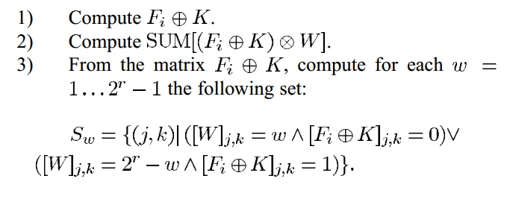
Encoding-scheme
The proposed scheme is processing in the following way:
and
or

Slide 22
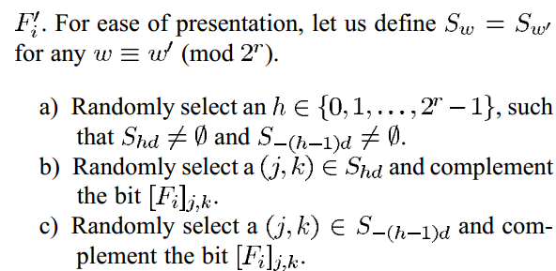
Encoding-scheme
The proposed scheme is processing in the following way:

Slide 23
Encoding-scheme
Results: Given a host image of size $m×n$ , the
proposed scheme can conceal as many as
$\left\lfloor log\left(mn+1\right)\right\rfloor$ bits of data in the image by changing,
at most, 2 bits in the host image.

Slide 24
Outline
Dot matrix
Motivation
Introduction
Encoding
Introduction
Detection
Introduction
Binarization
Locate Vertex
Affine Transformation
Future work
Notes:
The outline is listed as follows.

Slide 25
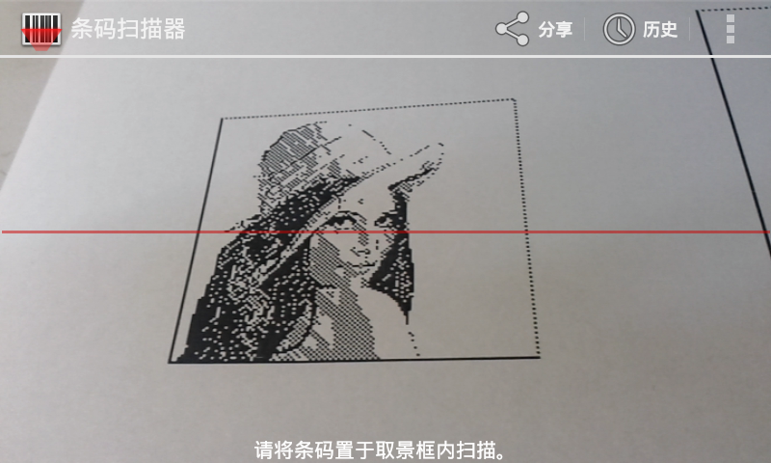
Detection-Introduction
Android-based scanning App

Slide 26
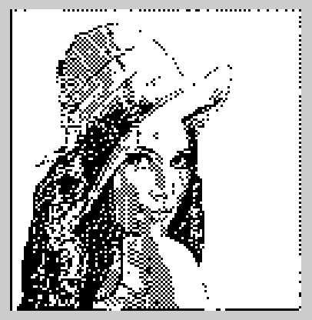
Detection-Introduction
Camera
Binarize
Detect
Bit Stream
Matlab: imshow()
Bit Stream in txt file
Output
Decode

Slide 27
Detection-Introduction
Lena
Lena printed on A4 paper
Lena detected by Detector

Slide 28
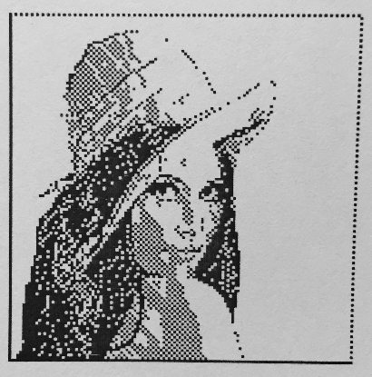
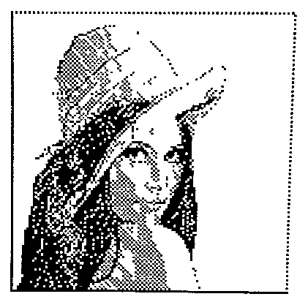
Detection-Binarization
Convert to grayscale image
Calculate the threshold by histogram
Convert to Binary image
Grayscale image
Binary image
Notes:
The outline is listed as follows.

Slide 29
Detection-Locate vertex
Start around the center of the image
Increase the size until it finds a white rectangular region

Slide 30
Detection-Locate vertex
From the corners test inwardly in 45°direction
D
A
C
B
Mark vertex as A B C D

Slide 31
Detection-Locate vertex
Figure out which are the solid black lines by counting transitions
D
Dotted line
A
Dotted line
Solid
C
Solid
B
Sort by number of transitions.
First two will be the two solid sides

Slide 32
Detection-Locate vertex
Intersection of the two solid lines is lower left corner
Solid
Solid
B
Set it to point B

Slide 33
Detection-Locate vertex
Use the cross product to determine the position of the other end on the solid line
If $\vec{BC}×\vec{BA}>0$,
If $\vec{BC}×\vec{BA}<0$,
D
D
A
C
Solid
Solid
C
A
Solid
Solid
B
B
The remaining point must be of the upper right corner

Slide 34
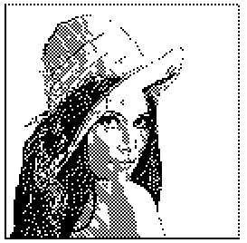
Detection-Affine Transformation
Perspective Transform
D
A
D
A
C
B
C
B

Slide 35
Outline
Dot matrix
Motivation
Introduction
Encoding
Introduction
Detection
Introduction
Binarization
Locate Vertex
Affine Transformation
Future work
Notes:
The outline is listed as follows.

Slide 36
Future Work
Finishing the “decoding” code part
Adding color to dot matrix

Slide 37
Thank you !
Q & A

