Slide 1
The generalized Kelly mechanism used in Resource allocation
F1203024
王思同
5120309650

Slide 2
Outline
Background
The introduction of objects
The main property
Simulations
Future work
References
Thanks

Slide 3
Background
Problem:
How to make a design and implementation of resource allocation which is crucial for system and user performance?
Target:
maximizing the social welfare
(the summation of all user utilities)

Slide 4
Background
Challenge:
The fact that users are autonomous and their utilities are unknown to the system designer.
The original method and the weak point:
Under the Kelly mechanism, users bid and proportionally share resources.
However, under oligopolistic(寡头) competitions, this mechanism might induce an efficiency loss up to 25% of the welfare optimum.

Slide 5
Outline
Background
The introduction of objects
The main property
Simulations
Future work
References
Thanks

Slide 6
The introduction of objects(The Kelly mechanism)
A set of rational users
$N=\left\{1,2,3,…，N\right\}$; N>1;
divisible resource of capacity C
For each user i has a valuation function $v_{i}\left(d_{i}\right)$
the monetary utility to user i when she is given $d_{i}$ amount of the resource

Slide 7
The introduction of objects(The Kelly mechanism)
Max $\sum_{i∈N}{v_{i}(d_{i})}$
Subject to $\sum_{i∈N}{d_{i}≤C}$ $d_{i}≥0 ∀i∈N$
$D=\left\{d | \sum_{i∈N}{d_{i}≤C,and d_{i}≥0 ∀i∈N}\right\}$
We assume each user i submit a bid $w_{i}≥0$, which equals the payment for obtaining a share $d_{i}$of the resource.
We denote $u_{i}$ as the utility of each user i :
$$u_{i}\left(d_{i}\right)=v_{i}\left(d_{i}\right)−w_{i}$$

Slide 8
The introduction of objects(The Kelly mechanism)
given a nonzero bid vector $w= \left\{w_{1},w_{2},…,w_{N}\right\}$
the resource allocation vector d
$$d_{i}=D_{i}\left(w\right)=\frac{w_{i}}{\sum_{j=1}^{N}{w_{j}}}C,∀i∈N$$
As a result of the Kelly mechanism, each user is charged the same unit price of the resource µ
$$μ=\frac{\sum_{j=1}^{N}{w_{j}}}{C}$$

Slide 9
The introduction of objects(The generalized Kelly mechanism)
we consider a strict positive price vector $P=\left\{p_{1},p_{2},…,p_{N}\right\}$
Each user i submits a bid $t_{i}$ ≥ 0 to compete for the resource and the allocation rule is the same proportional rule.
$$d_{i}=D_{i}\left(t\right)=\frac{t_{i}}{\sum_{j=1}^{N}{t_{j}}}C,∀i∈N$$
This generalized mechanism can be imagined as a process where users buy divisible tickets to compete for the resource.

Slide 10
The introduction of objects(The generalized Kelly mechanism)
The utility of each user i :
$$u_{i}\left(t,p\right)=v_{i}\left(d_{i}\right)−p_{i}t_{i}$$
The difference of our generalization from the Kelly mechanism is that each user i pays $p_{i}t_{i}$ amount of money for $D_{i}(t)$ amount of shared resource.
Compared to the Kelly mechanism, the generalized mechanism achieves a similar virtual unit price ν in terms of tickets.
$$ν=\frac{\sum_{j=1}^{N}{t_{j}}}{C}$$

Slide 11
The introduction of objects(Nash equilibrium)
In game theory, the Nash equilibrium(纳什均衡) is a solution concept of a non-cooperative game involving two or more players, in which each player is assumed to know the equilibrium strategies of the other players, and no player has anything to gain by changing only their own strategy. If each player has chosen a strategy and no player can benefit by changing strategies while the other players keep theirs unchanged, then the current set of strategy choices and the corresponding payoffs constitutes a Nash equilibrium.

Slide 12
The introduction of objects(Resource competition game)
For the set of players N , each user i ∈ N tries to choose strategy $t_{i}$ that maximizes the utility,
$$u_{i}\left({t_{i}}^{∗};{t_{−i}}^{∗},p\right)≥u_{i}\left(\hat{t_{i}};{t_{−i}}^{∗},p\right) ∀\hat{t_{i}}≥0$$
Where $t_{−i}$ denotes the strategy profile of users other than i.
We denote the generalized resource competition game as a triple (N , ν, p), and $t^{p}$ as the unique Nash equilibrium of the game (N , v, p)

Slide 13
Outline
Background
The introduction of objects
The main property
Simulations
Future work
References
Thanks

Slide 14
The main property
1.(Uniqueness of the Nash Equilibrium)
For any P, there is a unique Nash equilibrium.
We denote $t^{p}$ as the unique Nash equilibrium of the game (N , ν, p) that satisfies
$$u_{i}\left({t_{i}}^{p};{t_{−i}}^{p},p\right)≥u_{i}\left(\hat{t_{i}};{t_{−i}}^{p},p\right) ∀\hat{t_{i}}≥0$$

Slide 15
The main property
2. (Linear Equivalence)
Given any q = kp for some k > 0, the games (N , v, kp) and (N , v, q) result in the same resource allocation under their unique Nash equilibria.
$$d\left(q\right)=d(p)$$
$$t^{q}=\frac{1}{k}t^{p}$$
$$u_{i}\left(t^{q},q\right)=u_{i}(t^{p},p)$$

Slide 16
The main property
3. (No-Share Equivalence)
For any p , we denote $ε^{p}$ as the set of users who get no resource in equilibrium, defined as $ε^{p}=\left\{i | {t_{i}}^{p}=0\right\}$
Define $Q^{p}=\left\{q | q_{i}=p_{i},∀i∉ε^{p},q_{i}≥p_{i},∀i∈ε^{p}\right\}$
For any $q∈Q^{p}$, the Nash equilibrium $t^{q}$ equals $t^{p}$.

Slide 17
The main property
4. (Bijective Mapping)
We can get P via D, and get D via P.
5. (Conditions of Optimality)
$$p_{i}:p_{j}=C−d_{i}\left(p\right):C−d_{j}(p)$$
Motivated by the above optimality condition, we design a feedback price control mechanism that updates the prices every $Δt$ amount of time by the following equation:
$$p_{i}\left(t+Δt\right)=p_{i}\left(t\right)+(\frac{C−d_{i}\left(p\left(t\right)\right)}{N−1}−\frac{Cp_{i}(t)}{\sum_{jεN}{p_{j}(t)}})Δt$$

Slide 18
Outline
Background
The introduction of objects
The main property
Simulations
Future work
References
Thanks

Slide 19
Simulation

Slide 20
Simulation

Slide 21
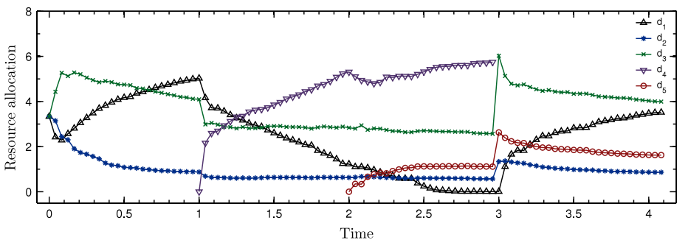
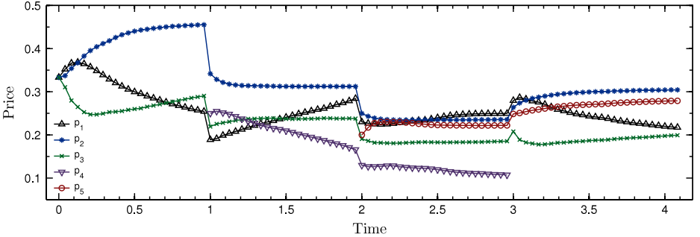
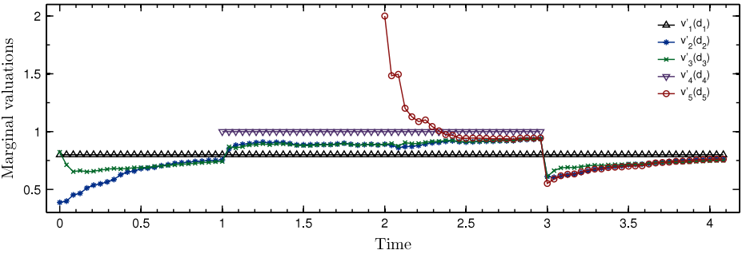
Simulation

Slide 22
Simulation(Conclusion)
When more users join the system, the potential maximum social welfare increases, and vice-versa.
Under the Kelly mechanism, when users adapt to their optimal strategies, the social welfare converges to some suboptimal value;
However, under our feedback price control, users’optimal strategies and the resulting resource allocation drive the social welfare to converge to the global maximum.

Slide 23
Outline
Background
The introduction of objects
The main property
Simulations
Future work
References
Thanks

Slide 24
Future work
1.Other directions
Revenue Maximization
2. Multi-Resource Allocation
CPU time and bandwidth
3.Fairness

Slide 25
Outline
Background
The introduction of objects
The main property
Simulations
Future work
References
Thanks

Slide 26
References
[1]Yudong Yang, Richard T.B. Ma, John C.S. Lui Price differentiation and control in the Kelly mechanism
[2]F.P. Kelly, Charging and rate control for elastic traffic, European Transactions on Telecommunications 8 (1997) 33–37
[3]R. Johari, J.N. Tsitsiklis, Efficiency loss in a network resource allocation game, Mathematics of Operations Research 29 (3) (2004)
[4]R. Johari, J.N. Tsitsiklis, Efficiency of scalar-parameterized mechanisms, Operations Research 57 (4) (2009) 823–839.407–435.

Slide 27
Thanks for listening
Q&A

