Slide 1
Simulation & Analysis of Delay-Aggregation Tradeoff of Mobile Multicast Tree
Jie You

Slide 2
Outline
Introduction
Related Work
Problem Formulation
Simulation & Analysis
Future Work

Slide 3
Introduction
Introduction
What is mobile multicasting?
Our problem & contribution
Related Work
Problem Formulation
Simulation & Analysis
Future Work

Slide 4
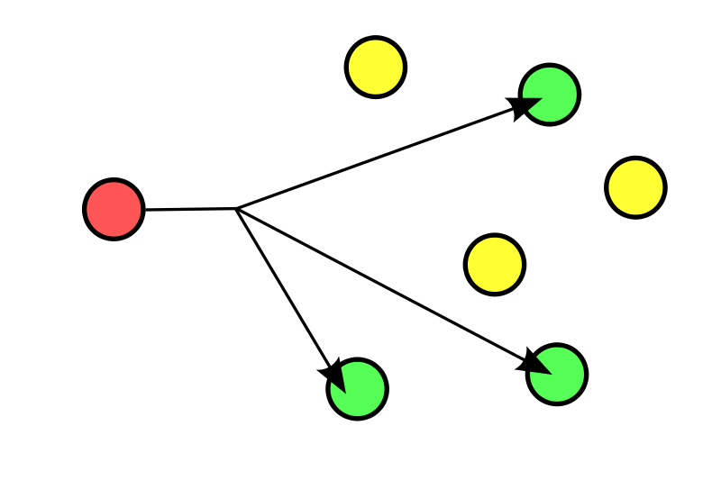
Introduction
---What is Mobile Multicasting
Multicasting
Group communication where information is addressed to a group of destination simultaneously.
Often one-to-many.
Motivation: efficient delivery to multiple destinations.
Mobile Multicasting
Moving nodes (mobility models).
Increased capacity and connectivity[1,2].
Notes:
In computer networking, multicast (one-to-many or many-to-many distribution[1]) is group communication[2] where information is addressed to a group of destination computers simultaneously.

Slide 5
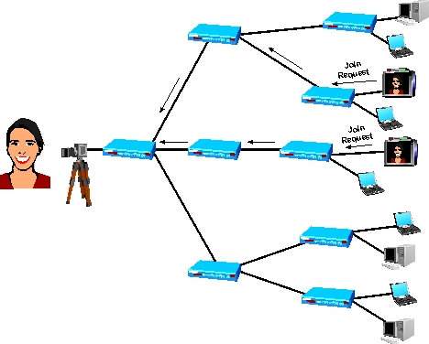
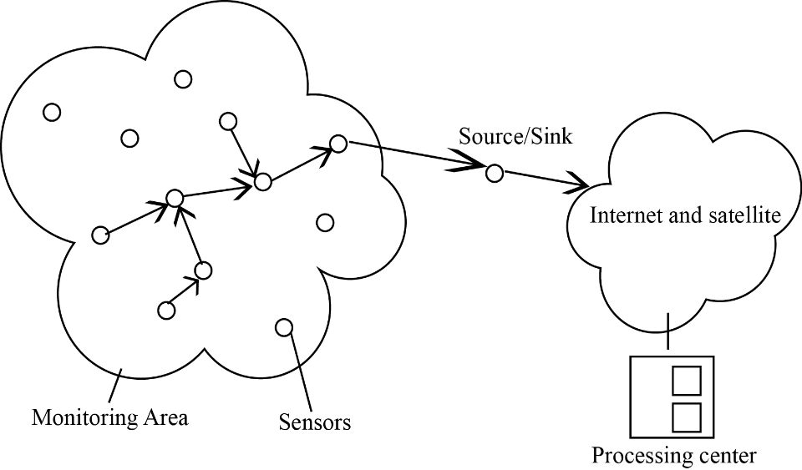
Introduction
---What is Mobile Multicasting
Applications
Wireless Sensor Networks (WSN)
Multimedia Broadcast Multicast Services (MBMS)

Slide 6
Introduction
Introduction
What is mobile multicasting?
Our problem & contribution
Related Work
Problem Formulation
Simulation & Analysis
Future Work

Slide 7
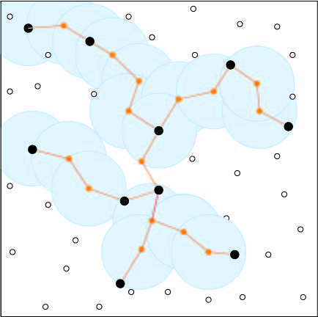
Introduction
---Our problem & contribution
Multicast Tree
Connect a group of nodes
No redundant links
Current method
Minimum Spanning Tree
Core Based Tree
etc.
Only for static network
New approach needed for mobile network!!
What’s a good multicast tree?

Slide 8
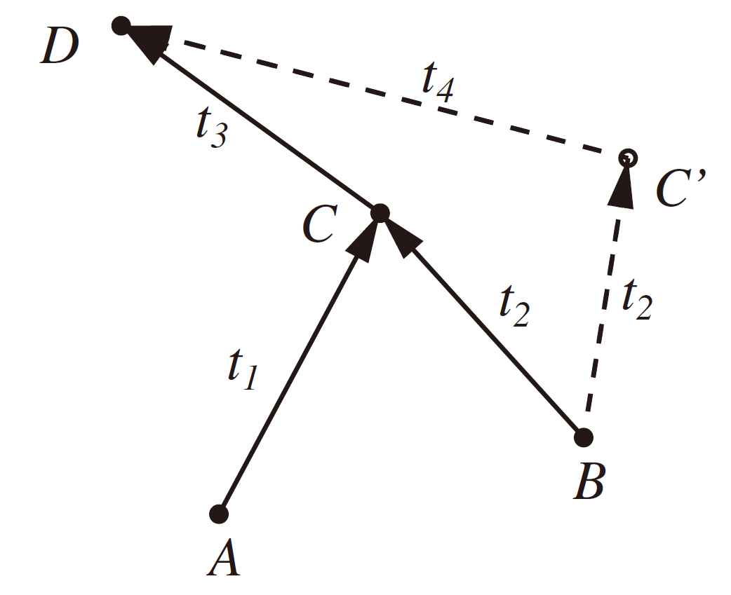
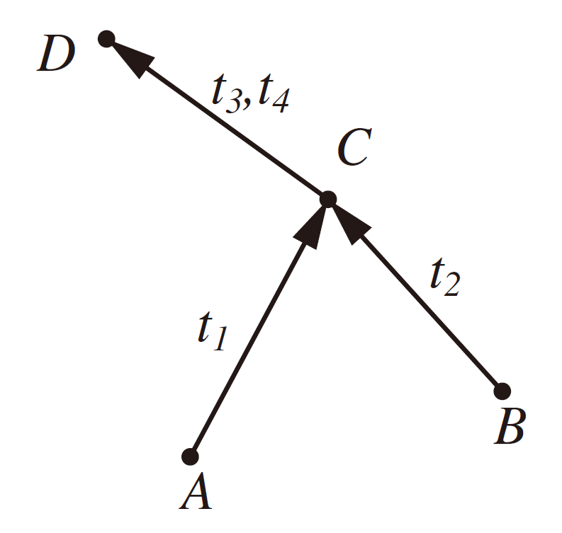
Introduction
---Our problem & contribution
Design goal
Lower energy consumption
Lower routing delay
Data aggregation
Less transmission $→$ less energy
Delay introduced
Notes:
Larger tree length might result in
Higher probability of transmission failure: wireless interference
More energy consumption: more power to transmit messages farther
Longer delay: more time is needed for messages travel for a long distance

Slide 9
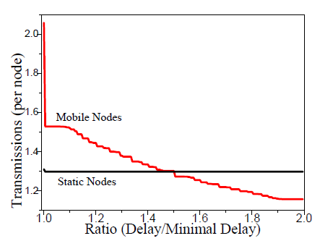
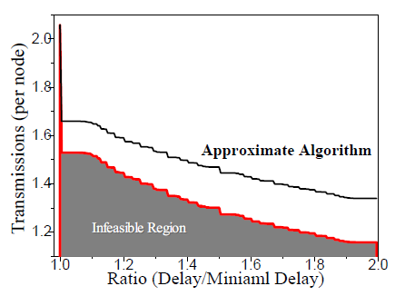
Introduction
---Our problem & contribution
Our contribution
Formulate the tradeoff problem.
Propose algorithms to solve the problem.
Run simulations.
Analyze our results.
Notes:
Larger tree length might result in
Higher probability of transmission failure: wireless interference
More energy consumption: more power to transmit messages farther
Longer delay: more time is needed for messages travel for a long distance

Slide 10
Related Work
Introduction
Related Work
Problem Formulation
Simulation & Analysis
Future Work

Slide 11
Related Work
Delay & Energy efficiency
S. Bai, W. Zhang, G. Xue, J. Tang, C. Wang, DEAR:delay-bounded energy-constrained adaptive routing in wireless sensor networks," in Proc. of IEEE INFOCOM, pp.1593-1601, 2012.
Data aggregation
B. Krishnamachari, D. Estrin, S. Wicker, The impact of data aggregation in wireless sensor networks," in IEEE Distributed Computing Systems Workshops, pp. 575-578, 2002.
Notes:
Here I will briefly introduce some related works. You can check them out for reference if you are interested in our project.
Shi Bai et al. presented a pseudo-
polynomial-time solution to solve a special case of DEAR.
They represented the delay as integers and an (1 + a)-
approximation algorithm is proposed to solve the opti-
mization version of the DEAR problem.
Bhaskar Krishnamachari et al. studied the
impact of source destination placement and communi-
cation network density on the energy costs and delay
associated with data aggregation [15]. They showed
the complexity of optimal data aggregation and pointed
out that polynomial-time special cases exist in this NP-
hard problem.

Slide 12
Problem Formulation
Introduction
Related Work
Problem Formulation
Models
Constraints
Simulation & Analysis
Future Work

Slide 13
Problem Formulation
---Models
Network Model
Topology: Time-varying graph[1] $G=\{V,E,τ,ρ\}$.
$τ$ : snapshot time.
$ρ:E×τ→\{0,1\}$ : presence function.
Assume: equal constant transmission range.
Notes:
We only care about the topology of this graph. So the movements of the nodes in this graph is ultimately converted to the edges’s appearance & disappearances.
Solid dots are their current locations; dashed lines are their motion trail. Solid line is the connection between the nodes.

Slide 14
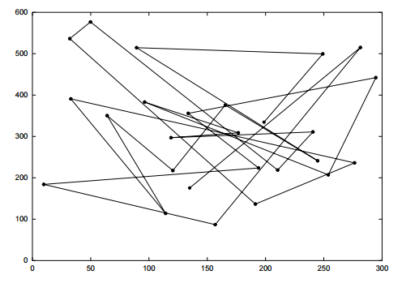
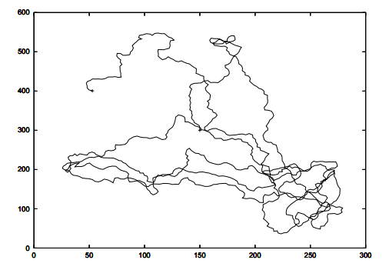
Problem Formulation
---Models
Mobility Model
i.i.d model.
Random Waypoint model.
Gaussian-Markov model.
Notes:
We only care about the topology of this

Slide 15
Problem Formulation
Introduction
Related Work
Problem Formulation
Models
Constraints
Simulation & Analysis
Future Work

Slide 16
Problem Formulation
---Constraints
Minimal delay
No aggregation, no scheduling.
Delay-bounded minimal transmission
Ease the delay constraints by factor $β$.
Find the minimal transmission (NP-hard).
Evaluate the approximation algorithm.

Slide 17
Simulation & Analysis
Introduction
Related Work
Problem Formulation
Simulation & Analysis
Simulation
Analysis
Future Work

Slide 18
Simulation & Analysis
---Simulation
Minimal delay
“fastest-journey” algorithm.
Delay-bounded minimal transmission
Approximation algorithm.
Brutal force algorithm.
Mobility Model
i.i.d model.
Random Waypoint.
Gaussian-Markov model.

Slide 19
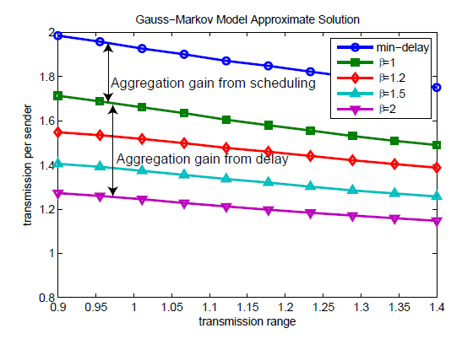
Simulation & Analysis
---Simulation
Results

Slide 20
Simulation & Analysis
Introduction
Related Work
Problem Formulation
Simulation & Analysis
Simulation
Analysis
Future Work

Slide 21
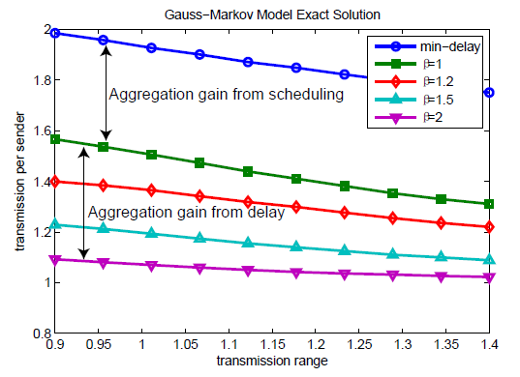
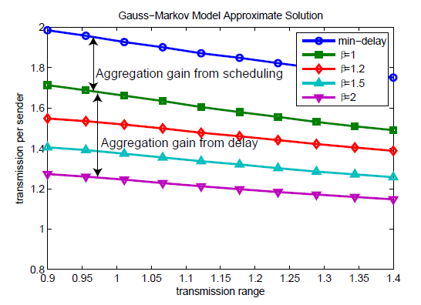
Simulation & Analysis
---Analysis
Minimal delay
Range $↑$ transmission $↓$
Delay-bounded minimal transmission
$β=1→$ minimal delay with scheduling.
$β↑$ transmission $↓$
Approximation ratio $≈1.2$ with 50 nodes

Slide 22
Simulation & Analysis
---Analysis
Mobility
Better with tolerable delay.
Tradeoff
Infeasible region illustrated.

Slide 23
Future Work
Introduction
Related Work
Problem Formulation
Simulation & Analysis
Future Work

Slide 24
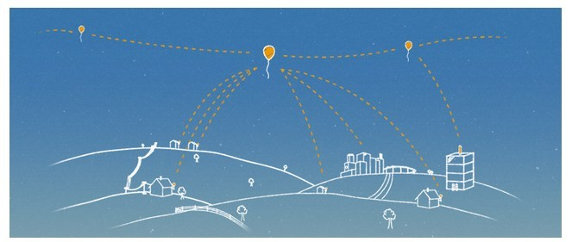
Future Work
Adaptive transmission range control
Reduce energy consumption
Extension to 3-D routing
e.g. Project Loon

Slide 25
Acknowledgements
Prof. Xinbing Wang
Hongyu Gong
Rui Song, Jingmei Hu, Yuting Jia
Institute of Wireless Communication Technology
Notes:
I wish to thank Prof. Xinbing Wang for his supervising and advice for this project as well as senior group member of IWCT, Hongyu Gong for her support. I would like to express my special thanks for Rui Song, who will be discussing the theoretical details of this project. Also many thanks for Jingmei Hu, Yuting Jia for help throughout the project.

Slide 26
Q&A

Slide 27
Thank You!
Jie You
jimmy.you@outlook.com
Notes:
My project can not be clearly illustrated in such a short time.
If you have questions. Contact me.

