Slide 1
Crowdsourcing Based Indoor Localization
Shen Ruofei
2015.3.10--present

Slide 2
Outline
Introduction
Background
Related Work
Motivation
Incomplete Database
Future Work

Slide 3
Background
Wi-Fi fingerprinting based indoor localization
Training Stage
Localization Stage

Slide 4
Related Work
Probabilistic Models Used for Indoor Localization
Crowdsourcing based Indoor Localization
[1] K. Chintalapudi, A. P. Iyer, V. N. Padmanabhan, “Indoor localization without the pain” , in Proc. ACM MobiCom, 2010, pp. 173-184.
[2] Z. Yang, C. Wu and Y. Liu, “Locating in fingerprint space: Wireless indoor localization with little human intervention”, in Proc. ACM MobiCom, 2012, pp. 269–280.
[3] C. Wu, Z. Yang, Y. Liu and W. Xi, “WILL: Wireless indoor localization without site survey”, in Proc. INFOCOM, 2012, pp. 64-72.

Slide 5
Motivation
Previous works are all done over a perfect database, what the results would be if the database is incomplete?

Slide 6
Outline
Introduction
Incomplete Database
System Model
Error Probability
Best Strategy
Future Work

Slide 7




System Model
Received Signal Strength
  : How RSS readings varies with respect to locations
  : Normalized Gaussian additive noise

Slide 8
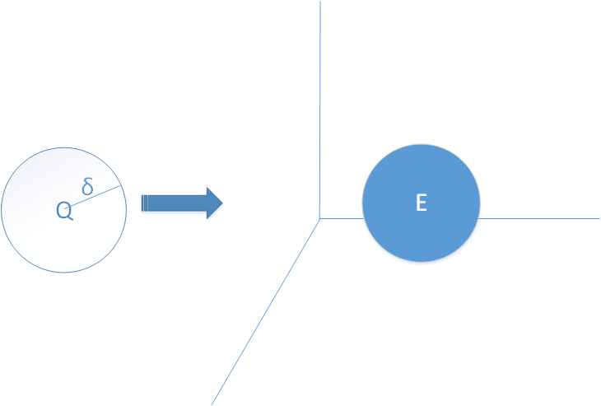
System Model
Sample Space & Physical Space
  physical space:
  Radius: δ
  User’s location: Q
  sample space:
  Event: E(δ)
Physical space
sample space

Slide 9
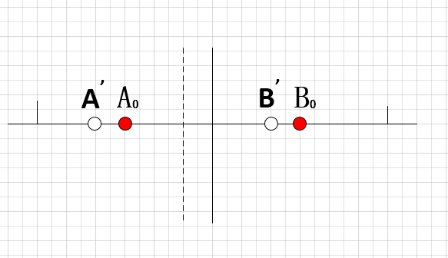
System Model
Data Fluctuation due to the Gaussian Noise one dimension case
Law of large numbers

Slide 10
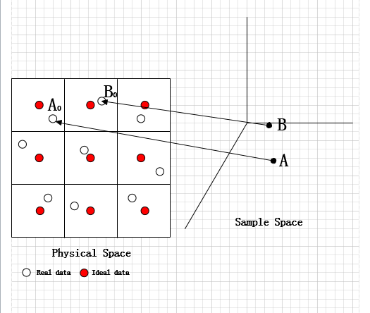
System Model
Data Fluctuation due to the Gaussian Noise
Two dimension case

Slide 11
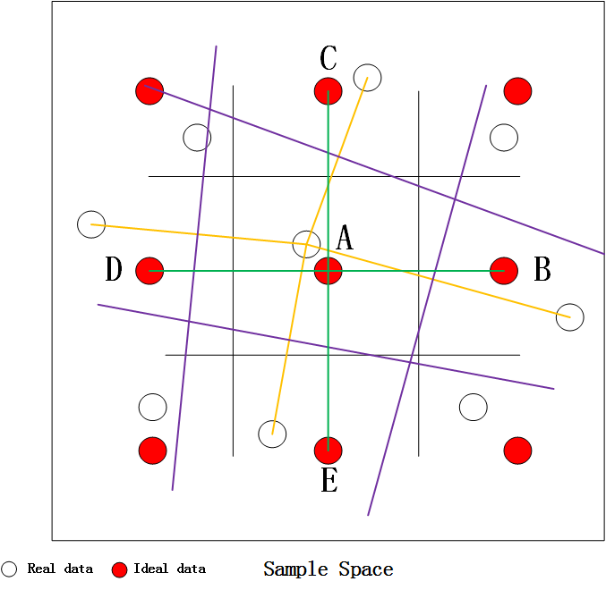
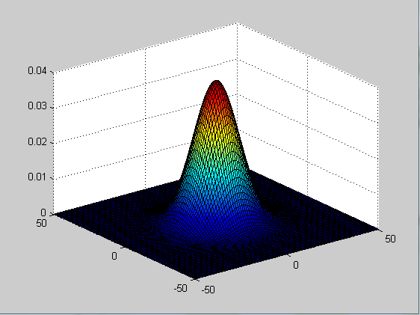
System Model
Real database
n dimensional
Gaussian distribution

Slide 12
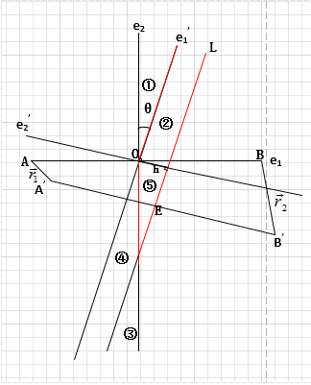
Error Probability
Integration Area
Direct Integration Area:
①+②+③
Indirect Integration Area:
（①+④+③）+（②-④）

Slide 13
Error Probability
Intermediate Integration Results
Some variables

Slide 14
Error Probability
Error Probability

Slide 15
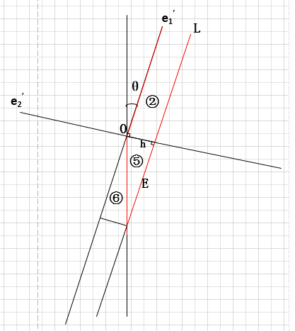
Error Probability
Upper Bound and Lower Bound

Slide 16
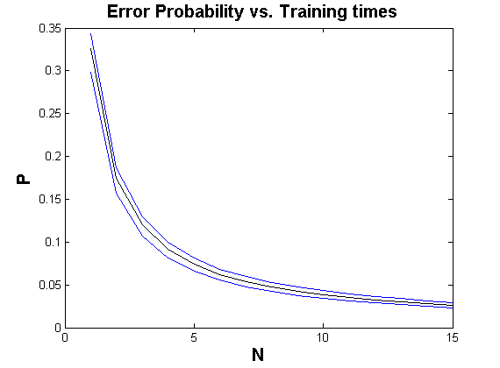
Error Probability
Simulation Results

Slide 17
Best Strategy
After the establishment of database, we should choose which AP RSS data are superior than others

Slide 18
Best Strategy
Greedy Algorithm
Dynamic Programming

Slide 19
Outline
Introduction
Incomplete Database
Future Work
Experiment
Best Strategy

Slide 20
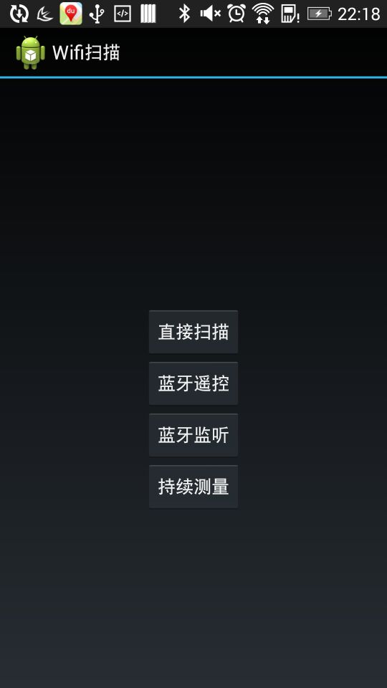
Experiment
Android Application experiment
Use the Android Application to establish a real database to verify our theory work

Slide 21

Experiment
The Marauder‘s Map(活点地图)

Slide 22
Best Strategy
Whether best strategy is a NP question or whether we could use the Dynamic Programming method to solve this problem?

Slide 23
Q&A

Slide 24
Thank You

