Slide 1
Wireless Data Center Network
樊逸群

Slide 2
Outline
Introduction of DCN
Wireless method
Algorithm

Slide 3
Data Center Network
Routers
Load balancer
Switches
Server racks

Slide 4
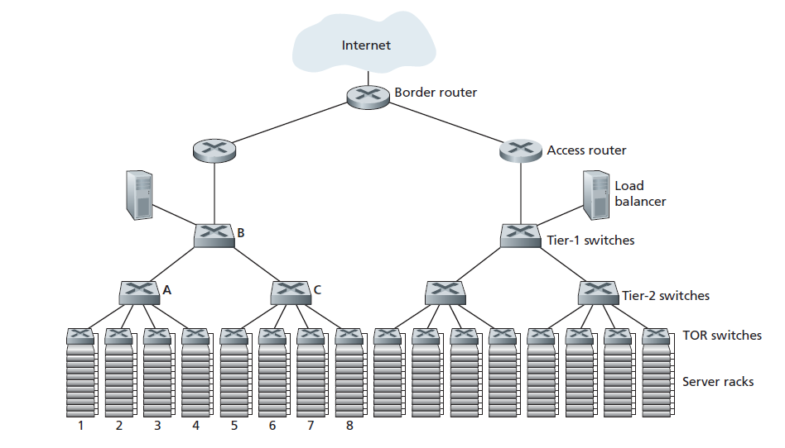
Data Center Network

Slide 5
Patterns
Work-seeks-bandwidth pattern
  Placing jobs within the same server, within servers on the same rack or within servers in the same VLAN
Scatter-gather pattern
  One server pushes (or pulls) data to many servers across the cluster. This reduces primitives underlying distributed query processing infrastructures wherein data is partitioned into small chunks, each of which is worked on by different servers, and the resulting answers are later aggregated

Slide 6
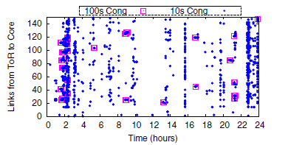
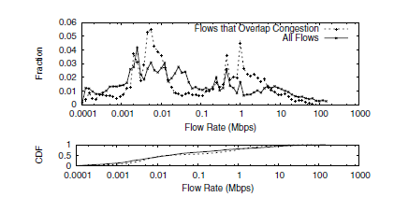
Congestion Within the Datacenter
When and where does congestion happen in the datacenter
What does the congestion affect

Slide 7
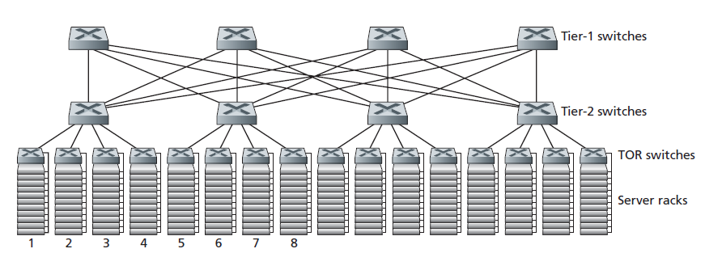
Fat-Tree

Slide 8
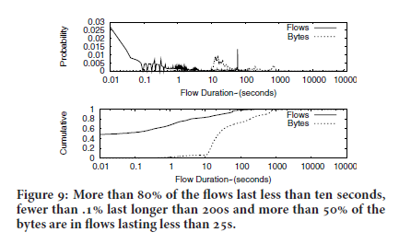
Flow Characteristics
Small flows and large flows can be treated differently.

Slide 9
Wireless method in DCN

Slide 10
Algorithm
Burden allocation
10
10
-20
10
15
-5
5
30

Slide 11
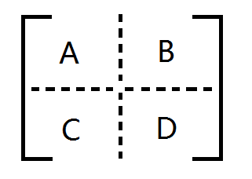
Burden allocation
The simple way
Consider the maximum of allocation

Slide 12
Thank you!

