Slide 1
Activity Recognition Based on Wearable Devices
——A Sparse Way
Presented by: 应海旭

Slide 2
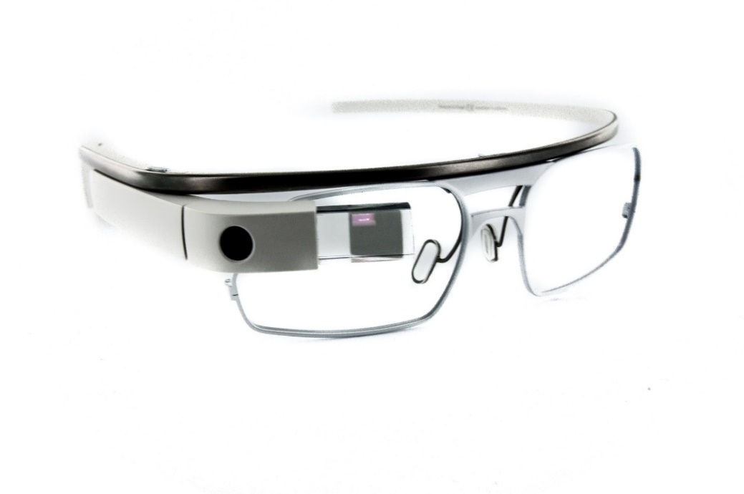
Overview
  Introduction
    Wearable Computing
    Motivation
  System Framework
  Classification
    Sparse Distance Calculation
    Affinity Propagation
  Future work

Slide 3
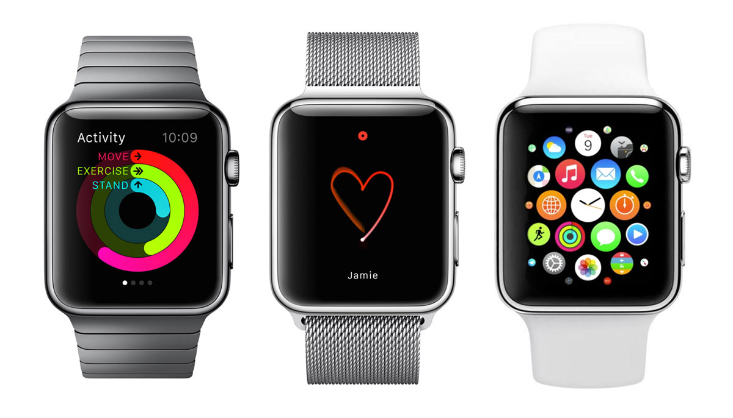

Introduction
What can we do with wearable computing?
Activity Recognition Using Wearable Devices

Slide 4
Motivation
Why we do research into it?
Among present researches, most of them:
Needed training to enable their recognition.
Inconvenient for different people to use.
Difficult to recognize various patterns.
Did not consider energy saving
Energy saving is an important part since the wearable computer is battery-driven.

Slide 5
Overview
  Introduction
    Wearable Computing
    Motivation
  System Framework
  Classification
    Sparse Distance Calculation
    Affinity Propagation
  Future work

Slide 6
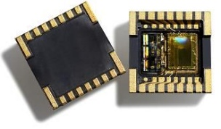
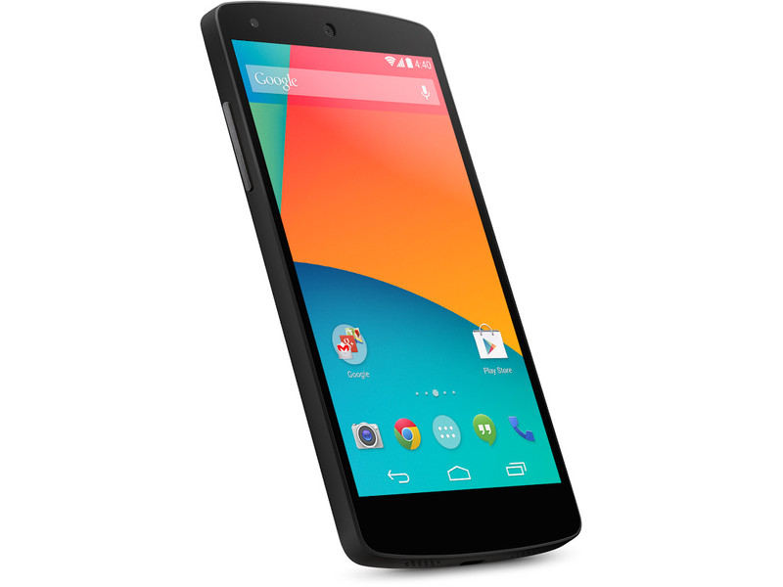
System Framework
Motion Sensors
Classification
Signal Preprocessing
Feature Extraction
Activity-recognition chain
Hardware

Slide 7
System Framework
Motion sensor data

Slide 8
Overview
  Introduction
    Wearable Computing
    Motivation
  System Framework
  Classification
    Sparse Distance Calculation
    Affinity Propagation
  Future work

Slide 9
Classification
To save energy used in transmission, it is preferred to deal with more data on wearable device itself.
The multi-dimensional data requires much time/memory and energy to compute by wearable devices

Slide 10
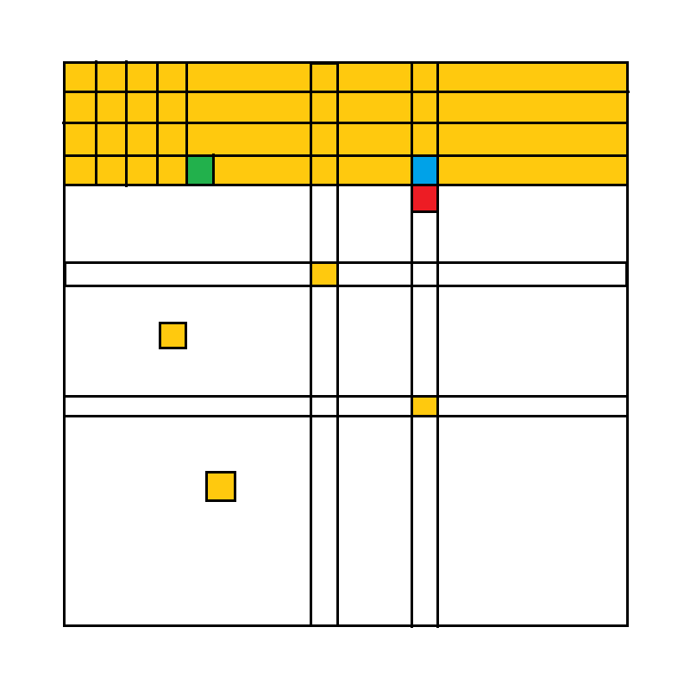
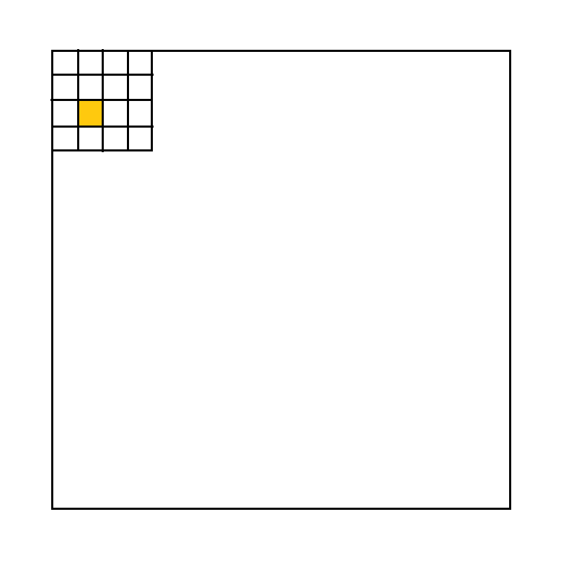
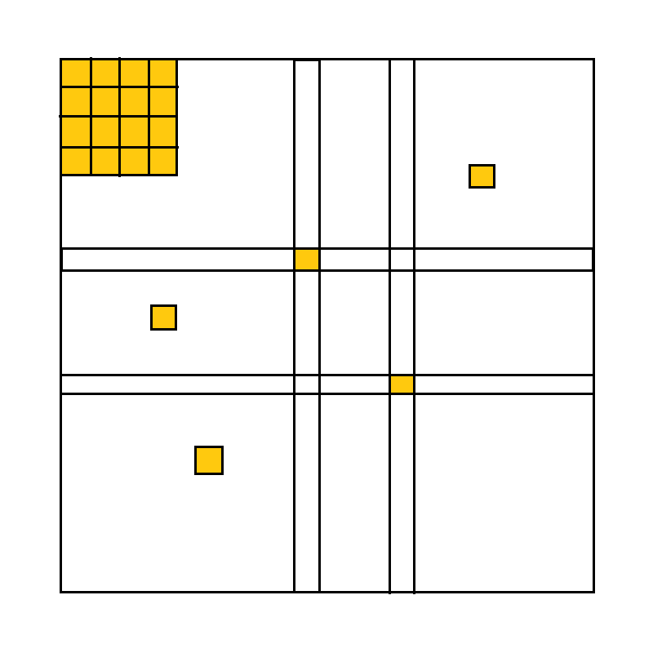
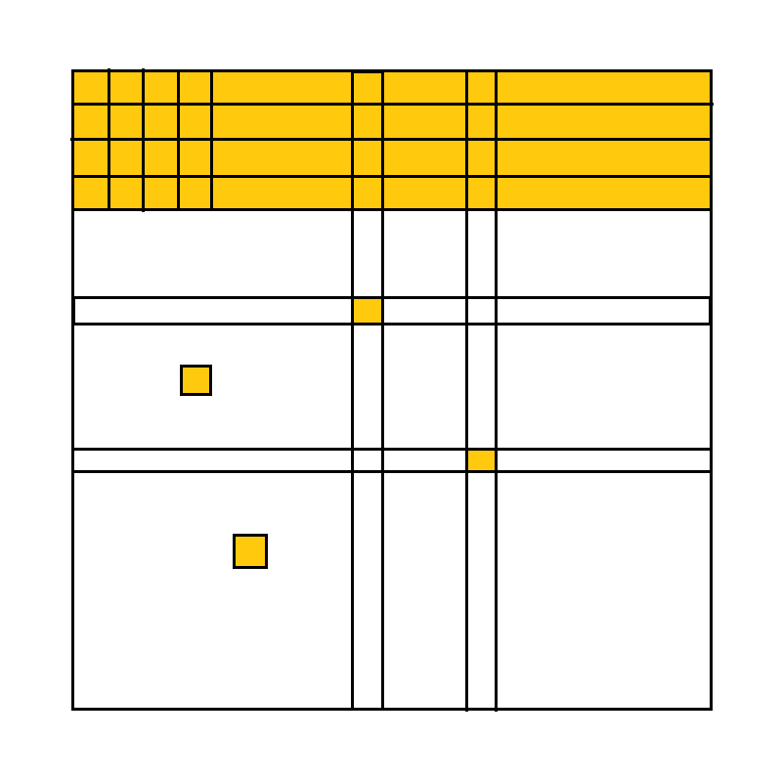
Classification: A Sparse Way
Calculate the distance(difference)
A set of data, a1, a2, …, a1000 to be clustered
a2
a5
a112
<a5, a4>
<a4, a112>
<a5, a112>
a3
a4
a5

Slide 11
Affinity Propagation
Let x1 through xn be a set of data points, and let s be a function that quantifies the similarity between any two points, such that s(xi, xj) > s(xi, xk) iff xi is more similar to xj than to xk.
The "responsibility" matrix R has values r(i, k) that quantify how well-suited xk is to serve as the exemplar for xi, relative to other candidate exemplars for xi.
The "availability" matrix A contains values a(i, k) represents how "appropriate" it would be for xi to pick xk as its exemplar, taking into account other points' preference for xk as an exemplar.

Slide 12


Affinity Propagation
The algorithm then performs the following updates iteratively:
First, responsibility updates are sent around:
Then, availability is updated per

Slide 13
Affinity Propagation
Each point is colored according to the current evidence that it is a cluster center (exemplar).
The darkness of the arrow directed from point i to point k corresponds to the strength of the transmitted message that point i belongs to exemplar point k.

Slide 14
Affinity Propagation
Advantages
Affinity propagation can only exchanges messages between pairs of points when the similarity is not negative infinity
This algorithm's time and memory requirements scale linearly with the number of similarities, which would be NxN if a full set of pairwise similarities is input, but much, much less if the set of similarities is sparse.

Slide 15
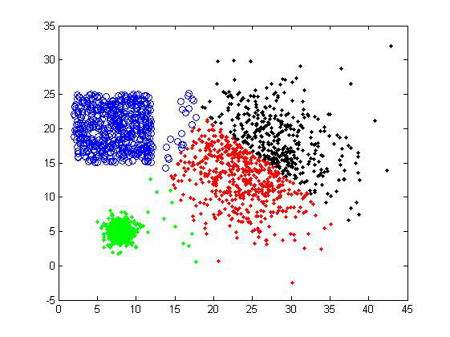
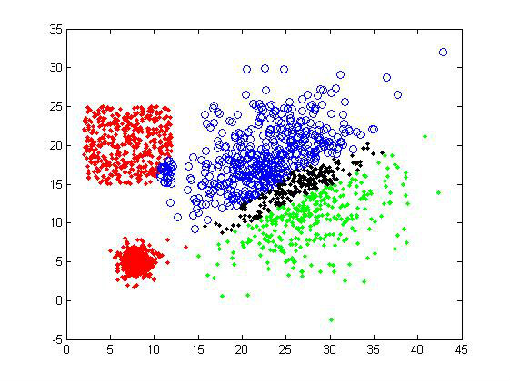
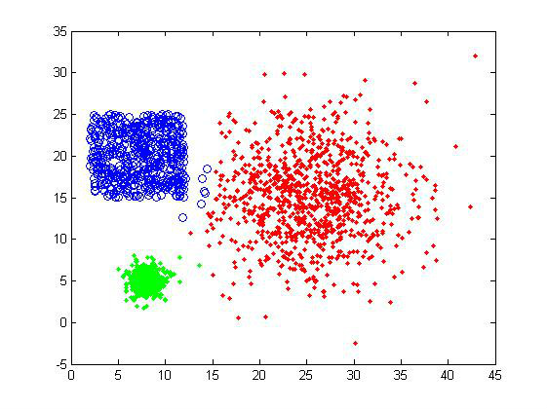
Affinity Propagation
Advantages
Rather than requiring the number of clusters be prespecified, affinity propagation simultaneously
considers all data points as potential exemplars.

Slide 16
Overview
  Introduction
    Wearable Computing
    Motivation
  System Framework
  Classification
    Sparse Distance Calculation
    Affinity Propagation
  Future work

Slide 17
Future work
Enhance feature extraction.
Implement algorithms by application running on wearable devices.
Modify the algorithm to be more suitable for sparse data.

Slide 18
Thank you
Q & A

