Slide 1
Delay-Aggregation Tradeoff in
Wireless Mobile Networks
_{Rui SONG}

Slide 2
Outline
Introduction
Network Model
Problem Formulation
Simulation
Future Work

Slide 3
Outline
Introduction
Network Model
Problem Formulation
Simulation
Future Work

Slide 4

Mobile Internet
consists of many wireless mobile terminals
Mobile part of the Internet often connects physical objects to the Internet
Mobile objects are pervasively distributed.

Slide 5
Energy Efficiency
Many of the mobile objects are battery-powered.
However,
Battery capacities increase slowly by only 5%-8% per year
Large scale network require higher energy efficiency in order to guarantee the system scalability.

Slide 6
Multicast
one-to-many transmission pattern
information dissemination among a group of nodes in the network
Delay and energy consumption are two important measurements of multicast efficiency.

Slide 7
Motivation
What is the minimum possible energy consumption under given conditions in multicasting?
How far a current deployment is away from the optimality in terms of energy saving?
Given certain technology requirements and energy consumption constraints, are we able to design and implement such system?

Slide 8
Outline
Introduction
Network Model
Problem Formulation
Simulation
Future Work

Slide 9
Network Model
Graph model
  Traditional graph: spatial dimension
  Time-varying graph: temporal and spatial dimension
  : vertex set
  : set of connections between nodes
  : time instance
  (presence function) :

Slide 10
Transmission Model
Energy can be estimated by the times of transmission
A successful transmission
  : transmission range
  :time for data to be received completely
  The time interval between which the Euclidean distance between two devices are no larger than is larger than .

Slide 11
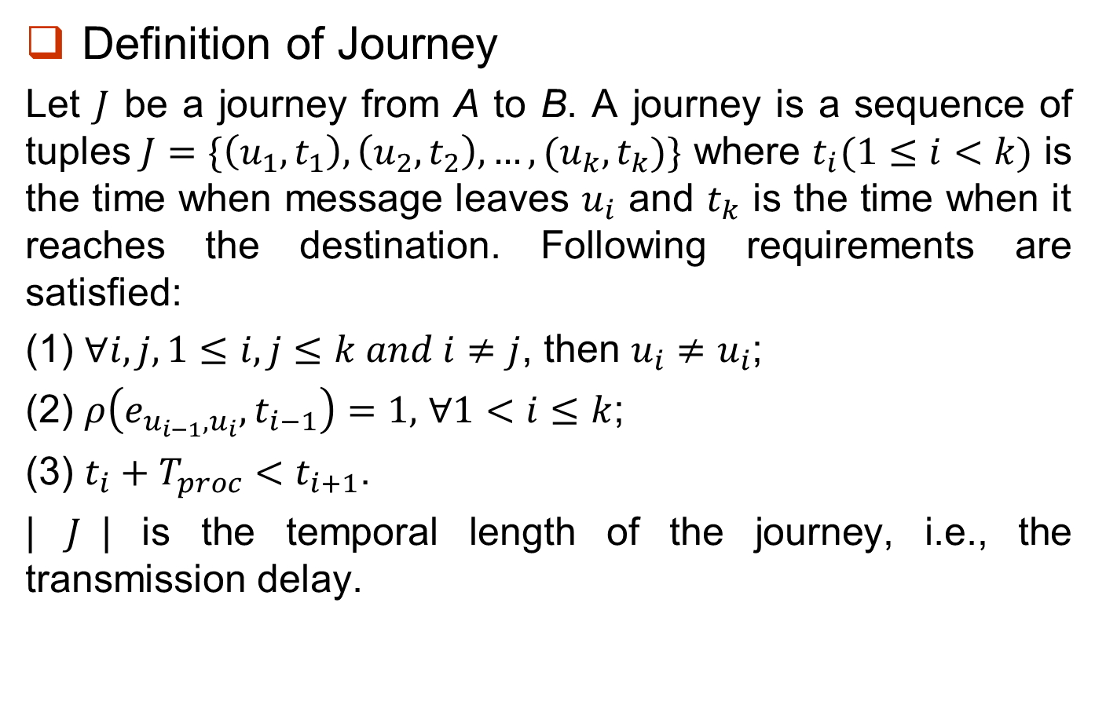
Journey in Dynamic Graph
Definition of Journey
Let $J$ be a journey from A to B. A journey is a sequence of tuples $J=\{\left(u_{1},t_{1}\right), \left(u_{2},t_{2}\right),…,(u_{k},t_{k})\}$ where $t_{i}(1≤i<k)$ is the time when message leaves $u_{i}$ and $t_{k}$ is the time when it reaches the destination. Following requirements are satisfied:
(1) $∀i,j, 1≤i,j≤k and i≠j$, then $u_{i}≠u_{i}$;
(2) $ρ\left(e_{u_{i−1},u_{i}},t_{i−1}\right)=1,$ $∀1<i≤k$;
(3) $t_{i}+T_{proc}<t_{i+1}$.
| $J$| is the temporal length of the journey, i.e., the transmission delay.

Slide 12
Journey in Dynamic Graph
Dest
Dest
h
h
S
S

Slide 13
Data Aggregation
Two sources: S₁ and S₂ , Destination: Dest
Dest
Dest
H
H
S₁
S₂
S₁
S₂
4 Transmissions without data aggregation
3 Transmissions
data aggregation at H
Delay of packets from S₁

Slide 14
Tradeoff between Energy and Delay
Data aggregation decreases energy consumption at the cost of transmission delay
Many applications in Mobile Network:
  hard energy constraints
  delay-tolerant
Tradeoff between energy and delay

Slide 15
Outline
Introduction
Network Model
Problem Formulation
Simulation
Future Work

Slide 16
Problem Formulation
Minimum Transmission Problem (MTP)
  Given a group of sources and a destination
  Delay constraint: d, all message should arrive at the destination within the delay bound
  Definition: find the scheduling so as to achieve the minimum times of transmissions to support many-to-one transmission within the given delay bound

Slide 17
Accurate Algorithm
Reduction from MTP to Minimum Weighted Dominating Set Cover Problem (MWDS)
  Dominating Set: Given a graph , a dominating set is a sub-set such that for all vertices , either or has a neighbor in .
  Minimum Weighted Dominating Set: to find a dominating set such that the total weight of nodes in this set is minimum.

Slide 18
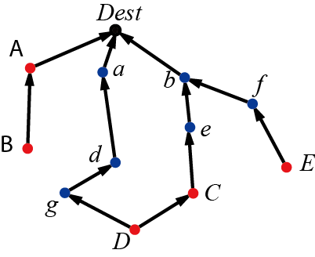
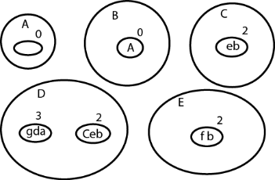
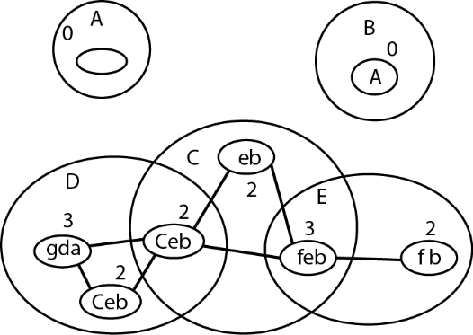
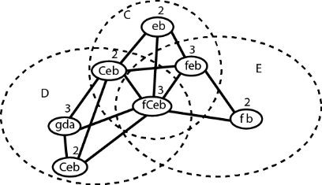
Accurate Algorithm
---------------------------------------------------------------------------
------------------------------------------------------------------------------------------------------------

Slide 19
Fast Approximation
Step 1: For all senders, we find the minimum-hop journeys to the destination.
Step 2: For one-hop journey, we use algorithm to merge journeys with approximation ratio
Step 3: For multi-hop journey, we try to engage the hops that are already used in the one-hop journeys.

Slide 20
Outline
Introduction
Network Model
Problem Formulation
Simulation
Future Work

Slide 21
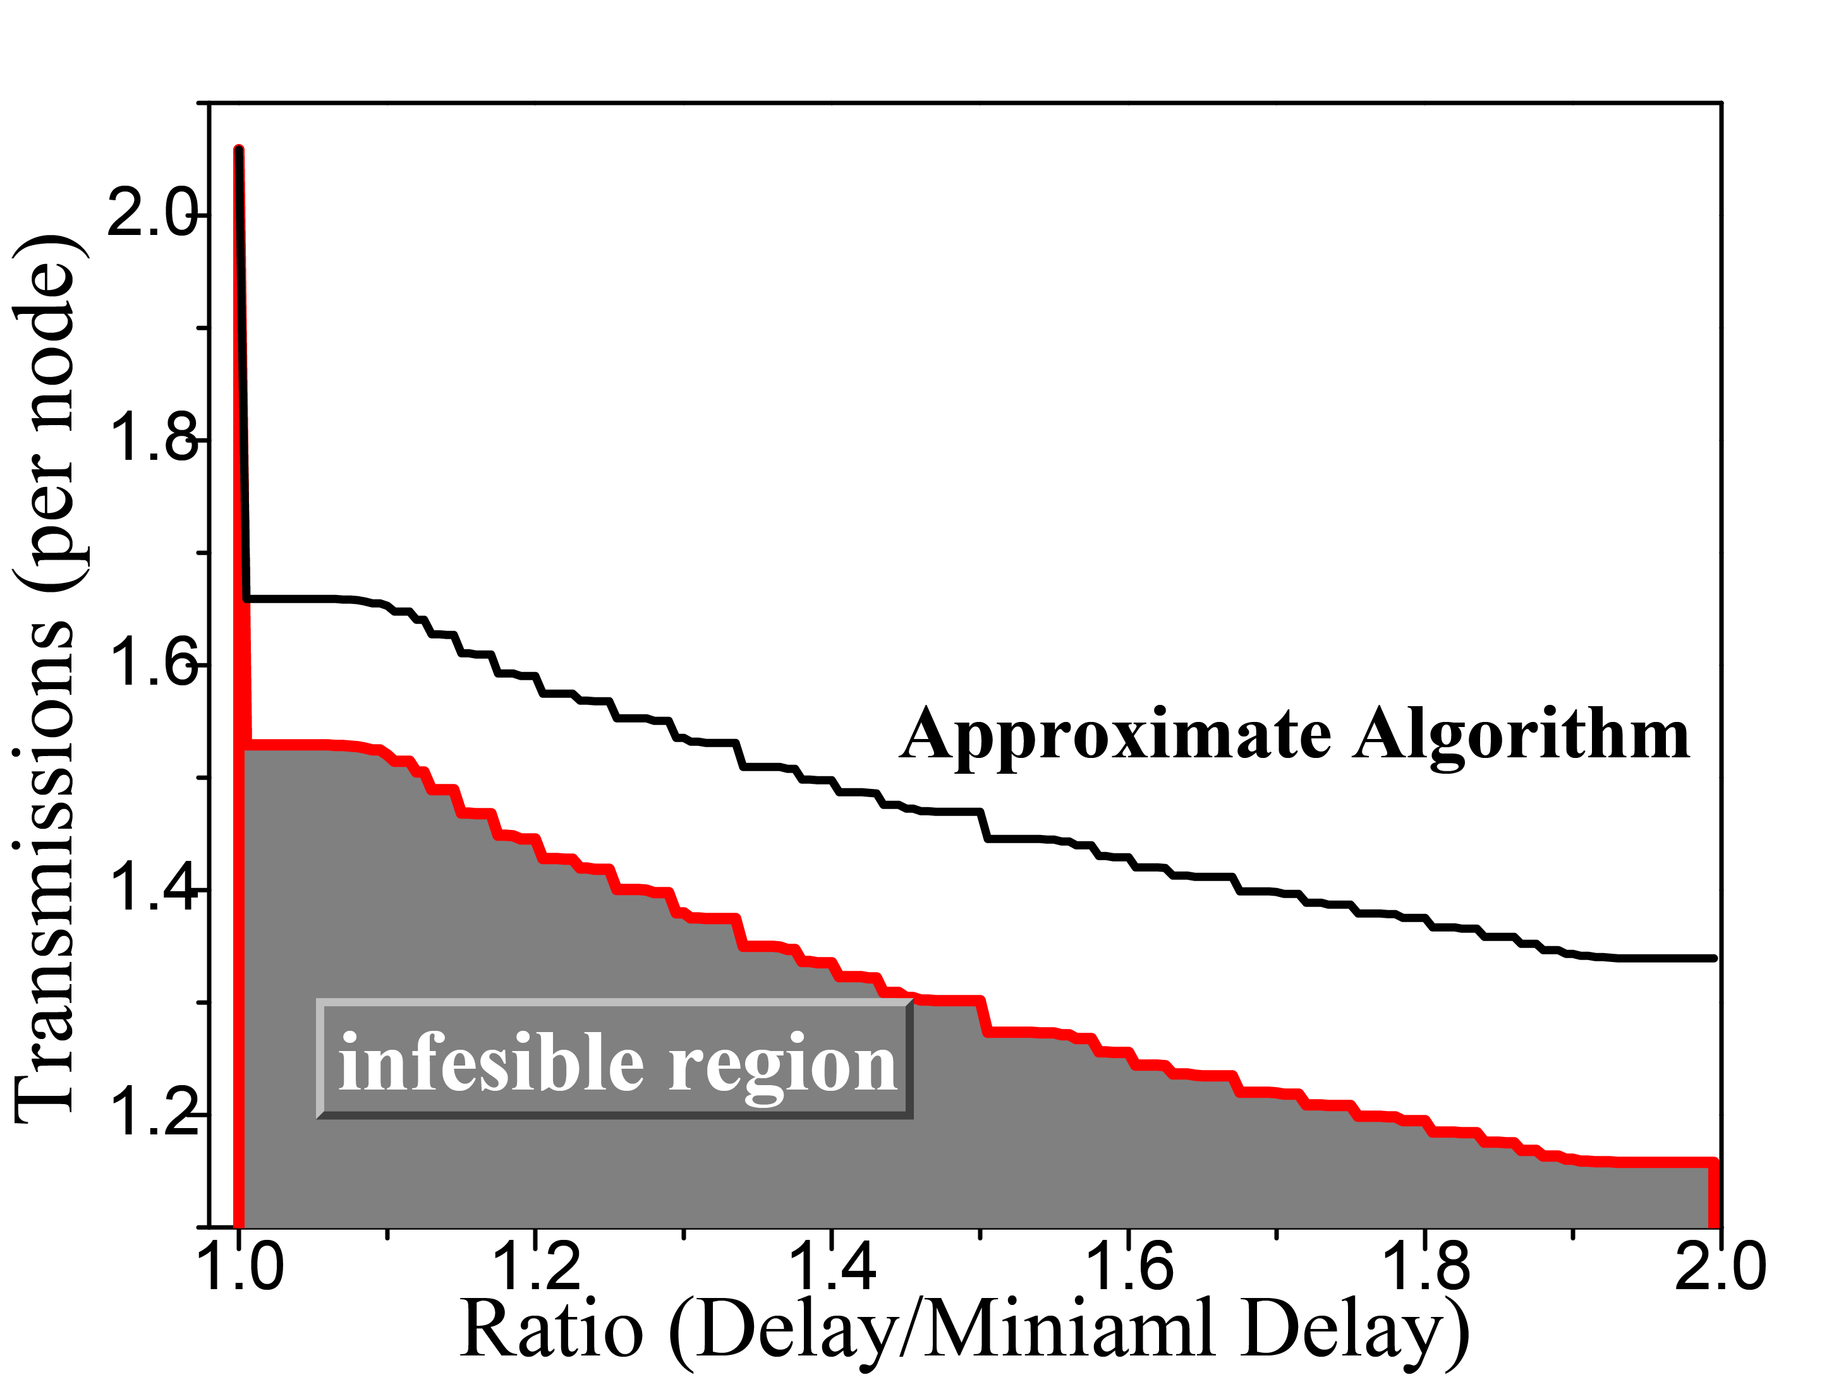
Simulation

Slide 22
Outline
Introduction
Network Model
Problem Formulation
Simulation
Future Work

Slide 23
Future Work
Mobility Prediction
Adaptive Transmission Range Control

Slide 24
Acknowledgement
Special thanks to:
Professor Xinbing WANG, Hongyu GONG
Jie YOU, Jingmei HU, Yuting JIA

Slide 25
_{Thank You!}

