Slide 1
RSS-Based Localization Scheme
in Large Indoor Environment
Zhihao Wu
Shanghai Jiao Tong University
Notes:
Good morning everyone, today my presentation is about localization, academically RSS-based localization scheme in large indoor environment. That sounds a little complicated. Actually, …

Slide 2

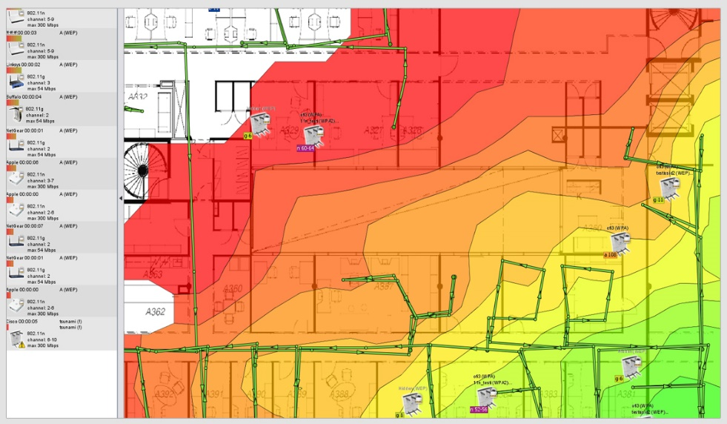
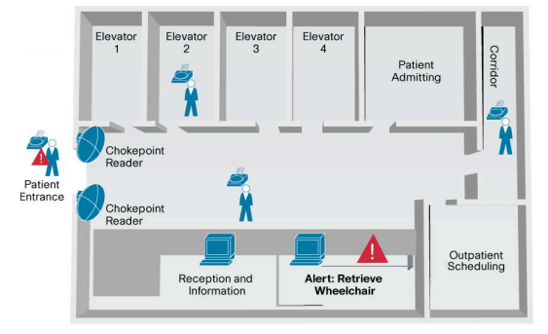
Indoor localization applications
Location-based network
management and security
  Location track
  Site survey & planning
  …
Medicine and health care
Personalized information delivery
Navigation for the disabled
…
Wi-Fi Map
Notification system in the hospital
Notes:
The indoor localization are in wide range of personal and commercial applications. These include location-based network management and security, such as location tracking, site survey and planning, and so on. Also, include the medicine and health care, personalized information delivery, and navigation. At the same time, the localization also faces many challenges.

Slide 3
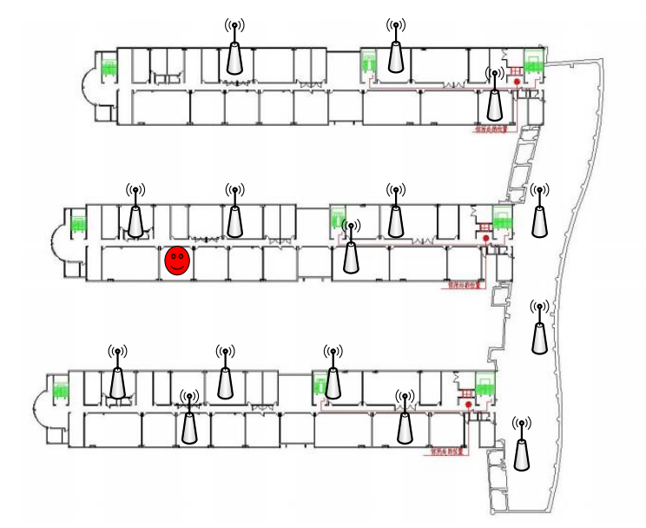

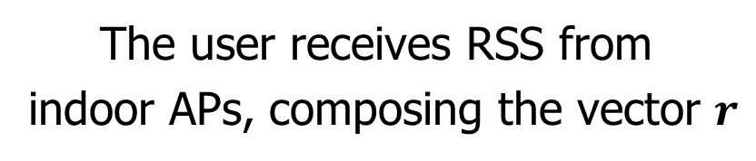

Problem setup
The user receives RSS from
indoor APs, composing the vector $r$
KEY CHALLENGE:
The rule $h\left(∙\right): ℝ^{L}→ℝ^{2},$relating
the $r$ from $L$ APs to a spatial
position in 2D Cartesian coordinates $p=(x,y)$
User location
Free Space: $RSS∝d^{−2},$where d means the
distance to the transmitter
Real Environment: severe multipath,
shadowing conditions, NLOS…
AP
Notes:
Let’s consider this situation In the indoor environment, the user receives RSS from indoor APs, composing the vector r, the key challenge we have is how we find a rule h( ) , relating the RSS vector r from L APs to a spatial position in 2D Cartesian coordinates
In the free space, the RSS falls off inversely proportional to the square of d, where the d is the distance to the transmitter. Unfortunately, in the real environment, the RSS varies more complicated because of severe multipath, shadowing conditions, non-line of sight and so on. So, indoor localization is not that easy you think!

Slide 4

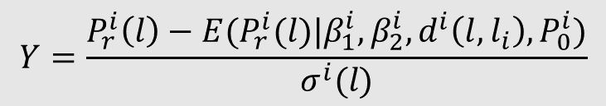


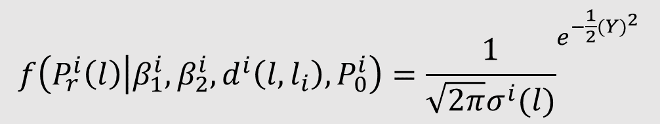
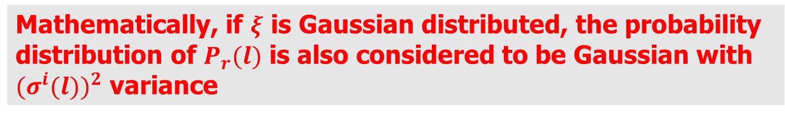
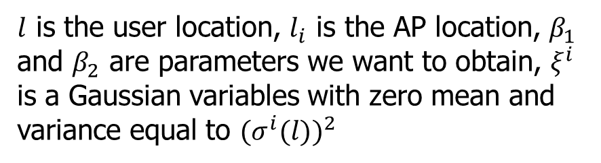

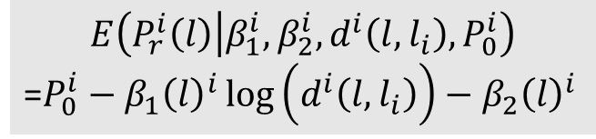
Analyze the propagation model
$$P_{r}$$
Considering the $i^{th}$ access point:
$$P_{0}$$
$$P_{r}^{i}\left(l\right)=P_{0}^{i}−β_{1}{\left(l\right)}^{i}\log\left(d_{i}\left(l,l_{i}\right)\right)−β_{2}{\left(l\right)}^{i}+ξ^{i}$$
$l$ is the user location, $l_{i}$ is the AP location, $β_{1}$
and $β_{2}$ are parameters we want to obtain, $ξ^{i}$
is a Gaussian variables with zero mean and
variance equal to ${(σ^{i}(l))}^{2}$
Mathematically, if $ξ$ is Gaussian distributed, the probability
distribution of $P_{r}(l)$ is also considered to be Gaussian with
${(σ^{i}(l))}^{2}$ variance
$$d$$
$$f\left(P_{r}^{i}\left(l\right) | β_{1}^{i},β_{2}^{i},d^{i}\left(l,l_{i}\right),P_{0}^{i}\right)={\frac{1}{\sqrt{2π}σ^{i}(l)}}^{e^{−\frac{1}{2}{(Y)}^{2}}}$$
$$Y=\frac{P_{r}^{i}\left(l\right)−E(P_{r}^{i}(l)|β_{1}^{i},β_{2}^{i},d^{i}\left(l,l_{i}\right),P_{0}^{i})}{σ^{i}(l)}$$
$$E\left(P_{r}^{i}\left(l\right) | β_{1}^{i},β_{2}^{i},d^{i}\left(l,l_{i}\right),P_{0}^{i}\right)$$
=$P_{0}^{i}−β_{1}{\left(l\right)}^{i}\log\left(d^{i}\left(l,l_{i}\right)\right)−β_{2}{\left(l\right)}^{i}$
Notes:
First, let’s analyze the propagation model. The propagation model describes a relationship between two physical quantities, the RSS and the distance between user and AP. Considering one AP, this equation also known as log-distance propagation model, where … Apparently, we can write the pdf of Pr, and E is the mean of this pdf.

Slide 5
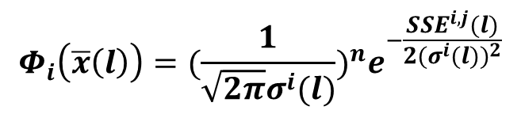

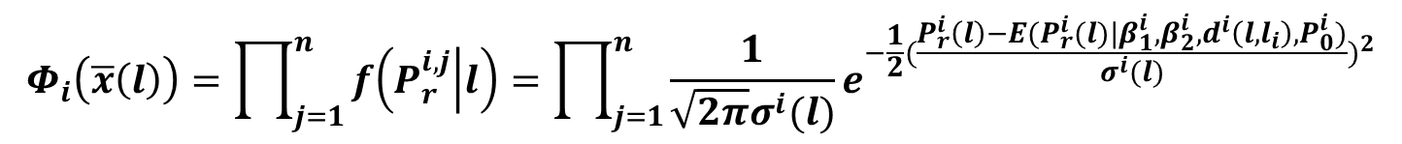
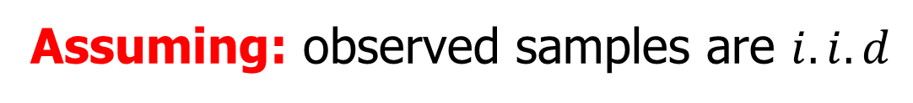


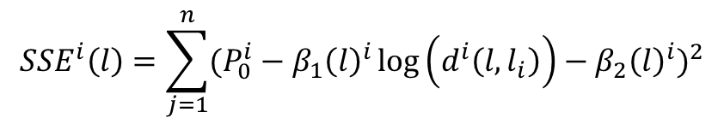
Obtain $β_{1}$ and $β_{2}$
Likelihood function:
$$Φ_{i}\left(\overline{x}\left(l\right)\right)=\prod_{j=1}^{n}{f\left(P_{r}^{i,j} | l\right)=\prod_{j=1}^{n}{\frac{1}{\sqrt{2π}σ^{i}(l)}e^{−\frac{1}{2}{(\frac{P_{r}^{i}\left(l\right)−E(P_{r}^{i}(l)|β_{1}^{i},β_{2}^{i},d^{i}\left(l,l_{i}\right),P_{0}^{i})}{σ^{i}(l)})}^{2}}}}$$
$$where \overline{x}\left(l\right)=(β_{1}\left(l\right),β_{2}(l))$$
Assuming: observed samples are $i.i.d$
$$Φ_{i}\left(\overline{x}\left(l\right)\right)={(\frac{1}{\sqrt{2π}σ^{i}(l)})}^{n}e^{−\frac{{SSE}^{i,j}(l)}{2{(σ^{i}(l))}^{2}}}$$
Then,
$${SSE}^{i}\left(l\right)=\sum_{j=1}^{n}{{(P_{0}^{i}−β_{1}{\left(l\right)}^{i}\log\left(d^{i}\left(l,l_{i}\right)\right)−β_{2}{\left(l\right)}^{i})}^{2}}$$
According to Maximum Likelihood Estimation, we just
need to minimize ${SSE}^{i}$
Notes:
So, next question? How we obtain the $β1$ and $β2$? First, we can write the likelihood function, mathematically speaking, likelihood is nothing but product of the conditional pdf of each observation. So we got this formula. Assuming the observed samples are independent and identical distribution. Then we can rewrite the formula. I believe you guys have already learn maximum likelihood estimation in your probability and statistics class. According to maximum likelihood estimation, we just need minimize SSE to obtain the$β1$ and $β2$.

Slide 6
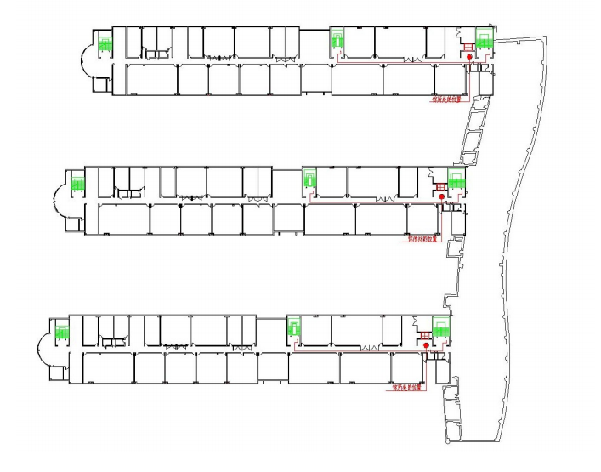
Observed results at one RP
At one certain RP, we can obtain
the RSS variation.
SSID:Lab-328
Frequency
☹
RP(reference point)
dBm
How to mitigate the effects of such deviations ???
Affinity Propagation Model !!! ☺
Notes:
Unfortunately, Since the indoor propagation channel varies over time, RSS values may deviate from those result from propagation model. I have experimented at SEIEE No.3 building and receive the signal from AP: lab-328. The experimental result shows that, the RSS has different value at different time during a day. So, how to mitigate the effects of such deviations? Well, I use one cluster algorithm, affinity propagation model.

Slide 7
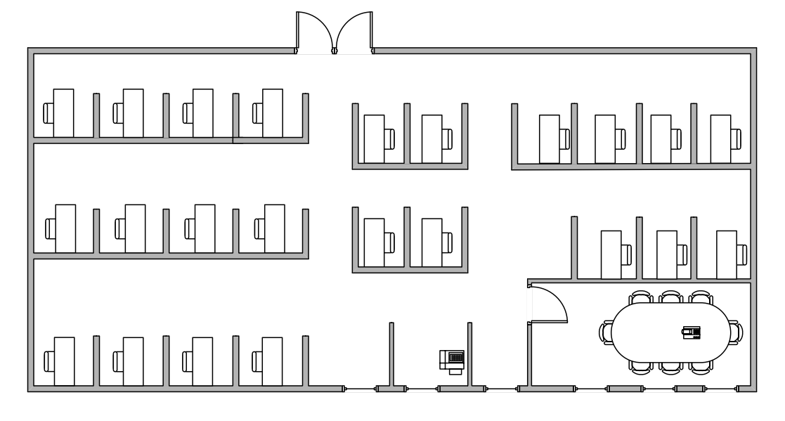
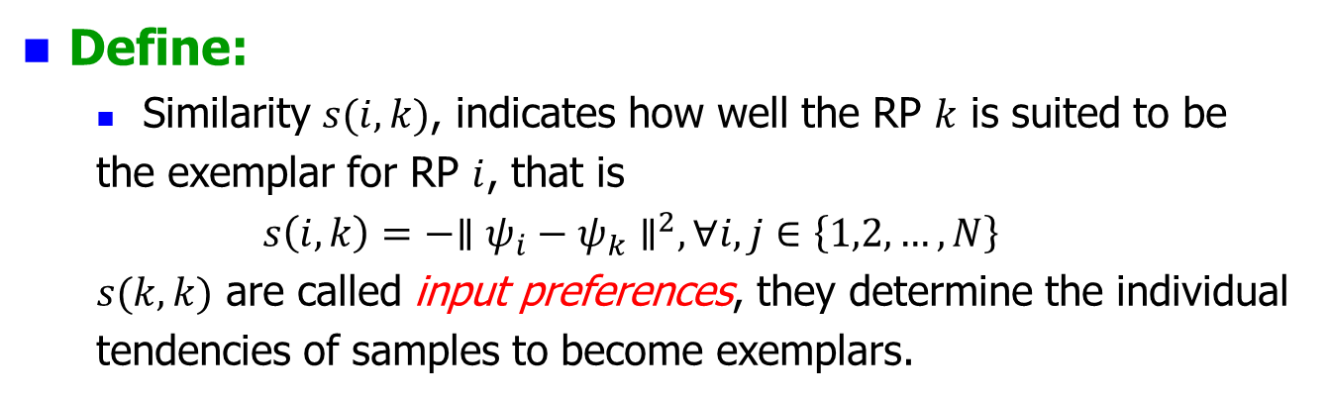
Affinity propagation model
The RPs in a small
region can be
substituted by one
RP, called exemplar
Define:
  Similarity $s(i,k)$, indicates how well the RP $k$ is suited to be
  the exemplar for RP $i$, that is
  $$s\left(i,k\right)=−{∥ψ_{i}−ψ_{k}∥}^{2}, ∀i,j∈\left\{1,2,…,N\right\}$$
  $s(k,k)$ are called input preferences, they determine the individual
  tendencies of samples to become exemplars.
$$s\left(k,k\right)=median\{s\left(i,k\right),∀i,j∈\{1,2,…,N\}\}$$
Notes:
So, what’s affinity propagation model? There are many reference points in the room, actually the reference points in a small region can be replaced by just one reference point, we called exemplar. Then, we can define, the similarity s(i,k)...that is this equation. When i equals to k, we call it input preference, they determine the individual tendencies of samples to become exemplars. In general, we set input preference as median of all similarity.

Slide 8
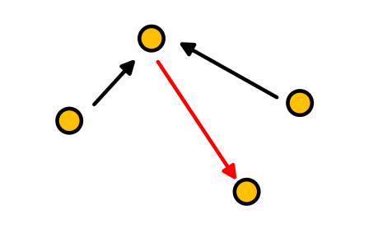
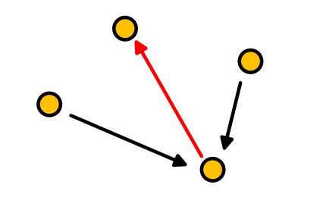
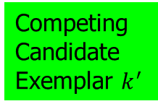
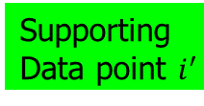

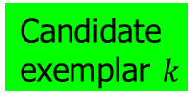
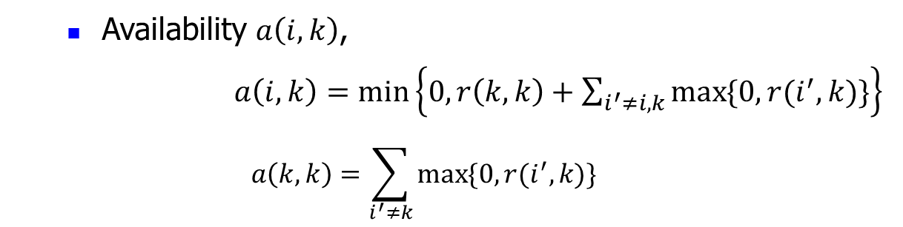




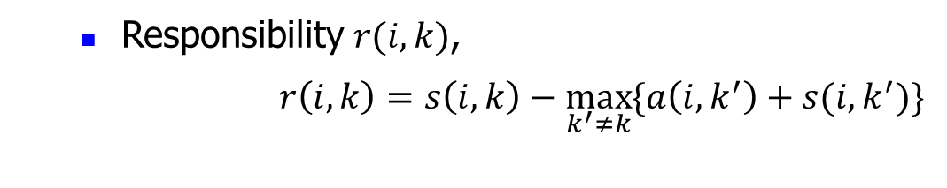


Affinity propagation model
  Responsibility $r(i,k)$,
  $r\left(i,k\right)=s\left(i,k\right)−\max_{k^{′}≠k}{\{a\left(i,k^{′}\right)+s(i,k^{′})\}}$
  Availability $a\left(i,k\right)$,
  $a\left(i,k\right)=\min_{}\left\{0,r\left(k,k\right)+\sum_{i^{′}≠i,k}{\max_{}{\{0,r(i^{′},k)\}}}\right\}$
  $$a\left(k,k\right)=\sum_{i^{′}≠k}{\max_{}{\{0,r(i^{′},k)\}}}$$
Candidate
exemplar $k$
Candidate
exemplar $k$
Competing
Candidate
Exemplar $k^{′}$
$$r(i,k^{′})$$
Supporting
Data point $i^{′}$
$$r(i,k)$$
$$a(i,k)$$
$$a(i,k^{′})$$
Data point $i$
Data point $i$
Notes:
sent from RP $i$ to candidate exemplar RP $k$, reflects
the accumulated evidence for how well-suit RP $k$ is to serve as the exemplar
for RP $i$
sent from candidate exemplar RP $k$ to RP $i$, reflects
The accumulated evidence for how appropriate it would be for RP $i$ to
choose RP k as its exemplar
The responsibility and availability expressions are rules of iteration, after several iterations, we can obtain the cluster results.

Slide 9
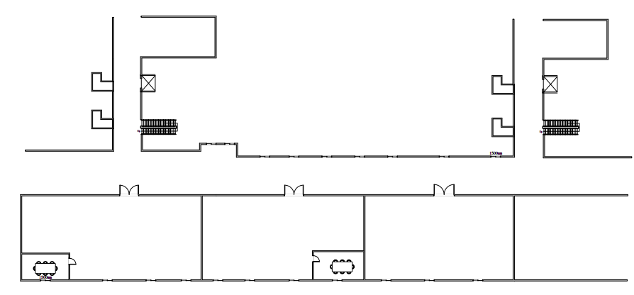
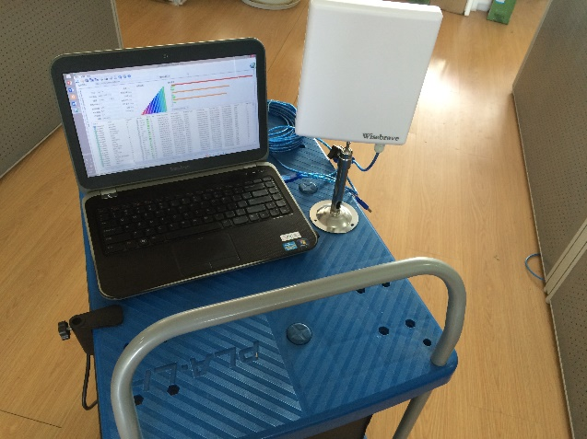
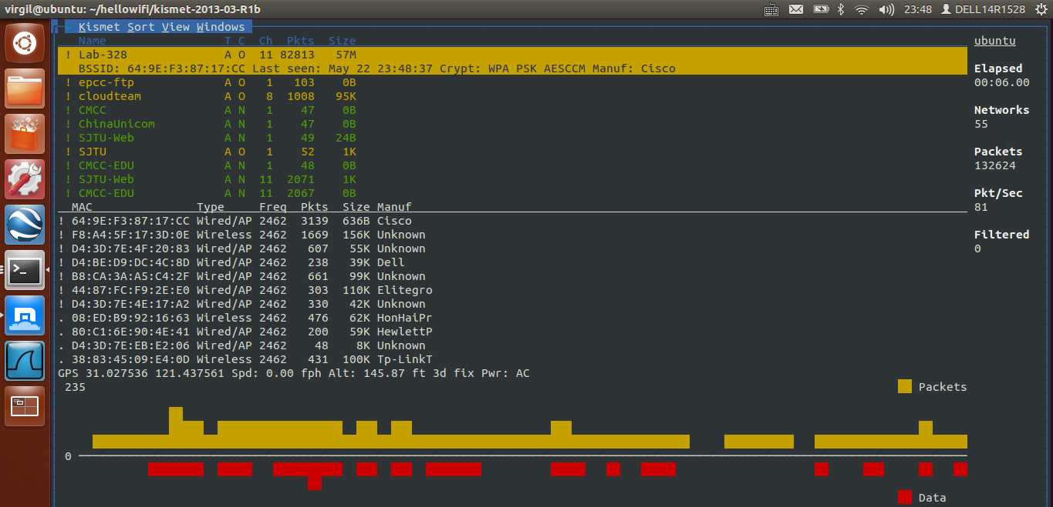
Experiments and results
#3
#2
Environment: SEIEE Building
AP SSID: Lab-328
Total RPs: 101
Period: 10s
OS: Windows 8.1 / Ubuntu 12.04
Setup: Dell14R1528 laptop+wisebrave USB wireless card+trolley
Notes:
To testify the affinity propagation model, I design the experiment. the Real data were obtained from SEIEE buildings, simply, I receive signal from one AP, lab-328. Total RPs is about one hundred, and sampling interval is about 10 seconds. I run my program on windows and Ubuntu. The setup is quite simple, just one laptop, one USB wireless card and trolley.

Slide 10








Experiments and results
No signal !!!
$${RP}_{3}$$
$${RP}_{5}$$
$${RP}_{7}$$
$${RP}_{1}$$
$${RP}_{2}$$
$${RP}_{4}$$
$${RP}_{6}$$
7$≪$100!!!
Notes:
Discard the no signal area, we can obtained results of affinity propagation, there are 7 clusters I obtained, that is to say, in this indoor environment, I just need 7 RPs to build up our database.

Slide 11
Summary
Classical log propagation model badly performed
in RSS-based localization
At one certain RP, the RSS varies over time
Affinity propagation model can efficiently cluster
RPs, reducing computation complexity
Notes:
Until now, what we have known is that,

Slide 12
Acknowledgement
Indoor localization group
Pro. Tian
Pro. Wang
Notes:
Now, I wanna thank indoor localization group, thank Zhehui, and Ruofei, thank for your encouragement and cooperation. Then, I wanna thank Pro. Tian, he is a energetic and excellent teacher ，he always gives me specific advice at weekly meeting. Finally, I wanna thank Pro. Wang, thanks for providing me such a precious opportunity to do my presentation.

Slide 13

Red herring
Website
  http://www.psi.toronto.edu/index.php?q=affinity%20propagation
  http://www.ekahau.com/wifidesign/ekahau-site-survey
Paper
  http://digitalcommons.unl.edu/cgi/viewcontent.cgi?article
  =1059&context=computerscidiss
  http://d-scholarship.pitt.edu/6395/1/dissertation28Feb05
  .pdf
My new personal website(blog)
  http://tinyrookie.me
E-mail:
  mike_mc@163.com
Notes:
If you guys are interested in indoor localization, I have provided some useful website and papers
Of course, you want to communicate with me, welcome to my home page, tinyrookie.me, if you have any problem, you can send email to this address.

