Slide 1
Dot Matrix Barcode
Presented by :Yuting Bao

Slide 2
Outline
Dot matrix
Motivation
Generating dot matrix
Preparation
Dithering algorithm
Flippable pixels
Definition
Criterion
Score
Conclusion
Future work
Notes:
The outline is listed as follows.

Slide 3
Outline
Dot matrix
Motivation
Generating dot matrix
Preparation
Dithering algorithm
Flippable pixels
Definition
Criterion
Score
Conclusion
Future work
Notes:
The outline is listed as follows.

Slide 4
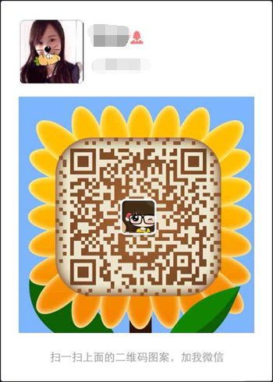
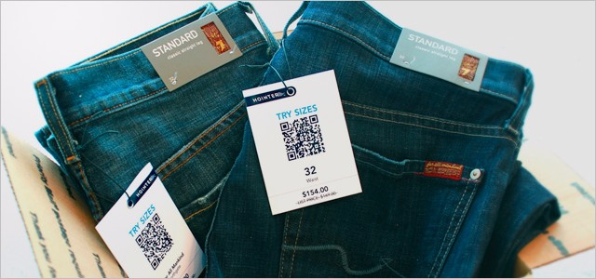
Dot matrix - Motivation
Traditional barcode has been widely used in many fields.
Wechat
Products

Slide 5
Dot matrix - Motivation
Disadvantages of traditional barcode:
Not friendly to eyes (ugly)
Information is not presented vividly

Slide 6
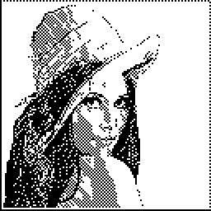
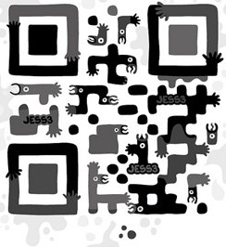
Dot matrix - Motivation
Recently, more and more people start to study QR Code Art.
However, most schemes do not change the form of barcode.
VS
We use a photo of a lady. No patterns any more.

Slide 7
Outline
Dot matrix
Motivation
Generating dot matrix
Preparation
Dithering algorithm
Flippable pixels
Definition
Criterion
Score
Conclusion
Future work
Notes:
The outline is listed as follows.

Slide 8
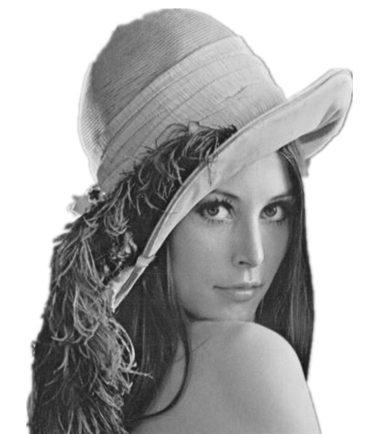
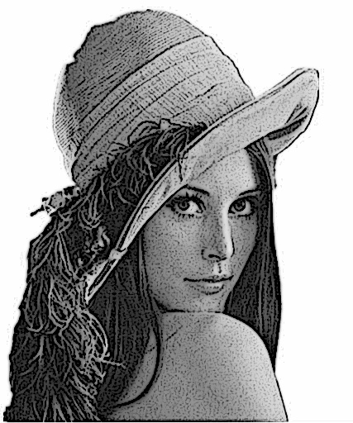
Generating dot matrix - Preparation
We decide to use gray scale image, preprocess is needed, e.g. edge enhancement.
After edge enhancement

Slide 9
Generating dot matrix - Preparation
Steps of edge enhancement
Use Guassian smooth to filter noise
Use Laplace edge detection to figure out the edges in the picture
Minus the multiples of edges from the gray scale image

Slide 10
Generating dot matrix – Dithering algorithm
Next, we convert the gray scale image into dot matrix by using Error Diffusion Dithering.
Error Diffusion can reduce the number of quantization levels in a gray scale image. In the project, we reduce the number of quantization states to two per channel. This makes the image suitable for information hiding.

Slide 11
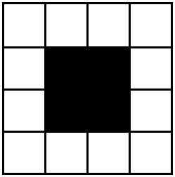
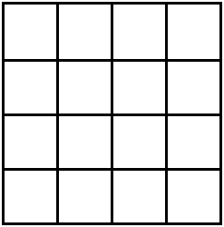
Generating dot matrix – Dithering algorithm
Steps of Error diffusion dithering-Step 1
Add up the gray value of 16 pixels in a 4*4 block.
If the sum is less than a threshold T, we draw four black dots at the center of the block, otherwise, we draw four white dots instead.
Calculate the sum of 16 pixels
Less than T
Larger than T

Slide 12
Generating dot matrix – Dithering algorithm
Steps of Error diffusion dithering-Step 2
Use the following matrix to diffuse the error of a block to its neighborhoods.
"-" denotes the pixel which has already been processed, and "#" denotes the pixel currently being processed. The sum of pixels multiplies by the number inside the matrix and divided by 16, and then add to the respective neighborhoods.

Slide 13
Generating dot matrix – Dithering algorithm
Comparison
Good!
Dot matrix without dithering
Using error diffusion dithering

Slide 14
Outline
Dot matrix
Motivation
Generating dot matrix
Preparation
Dithering algorithm
Flippable pixels
Definition
Criterion
Score
Conclusion
Future work
Notes:
The outline is listed as follows.

Slide 15
Flippable pixels - Definition
We need to find the pixels that whether they are white or black has little effect on the visual quality. Hiding information in these pixels will not cause obvious distortion.

Slide 16
Flippable pixels - Criterion
The pixels in the block divided into two kinds of clusters: white clusters and black clusters. Flipping the center pixel may increase or reduce the number of clusters.

Slide 17
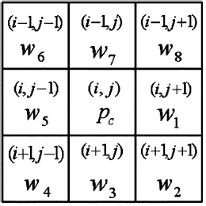
Flippable pixels - Criterion
Let’s use “1” and “0” to denote black and white pixels, respectively. The nine variables are shown below.
Definition 1: The number of uniform white transition N_{vw} and the number of uniform black transition N_{vb} in a 3*3 block along vertical and horizontal directions are collectively defined as “VH Transition” and given by

Slide 18
Flippable pixels - Criterion
Definition 2: The number of the interior right angle transitions N_{ir} in a 3*3 block is defined as “IR Transition” and given by
Definition 3: The number of transitions from the center pixel to the sharp corners N_{c} in a 3*3 block is defined as “C Transition” and given by

Slide 19
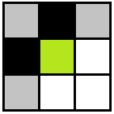
Flippable pixels - Criterion
Flippable pixel: the number of VH transition N_{vw} and N_{vb}, the number of IR transition N_{ir} and the number of C transition N_{c} remain the same before and after flipping the center pixel.
It implies that flipping the pixel will not destroy the connectivity between pixels in the neighborhood and does not change the number of clusters as well.
All the possible cases are here.

Slide 20
Flippable pixels - Criterion
We use the previous method in the dot matrix of Lena, but only find 370 flippable pixels, about 46 bytes. (⊙︿⊙)
To increase the capacity, we consider the flippability score to lossen the flippable criterion.

Slide 21
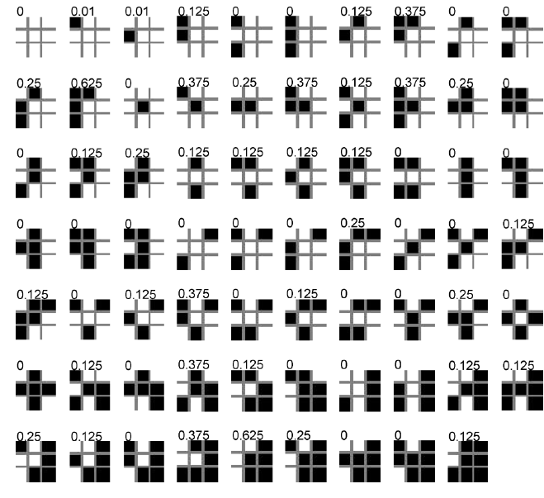
Flippable pixels – Score
One possible flippability lookup table for 3*3 block, excluding the blocks that differ only by rotation, mirroring, or complement.

Slide 22
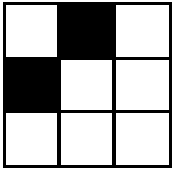
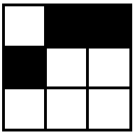
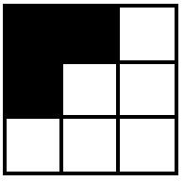
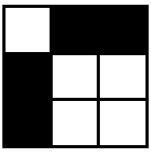
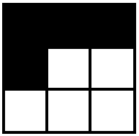
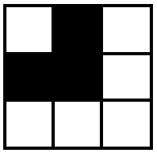
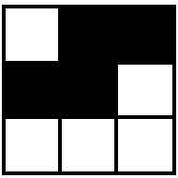
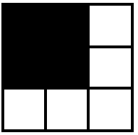
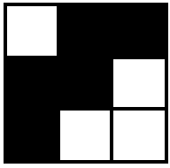
Flippable pixels – Score
The scores of all the cases that satisfy the flippable cirterion are shown below.
0.125 0.25 0.375 0.25 0.625
0.25 0.25 0 0.125 0.625
In general, these blocks have relatively high scores in the lookup table.

Slide 23
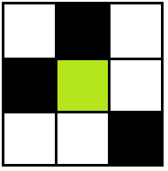
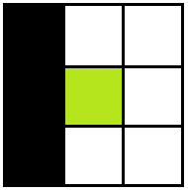
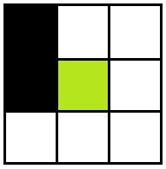
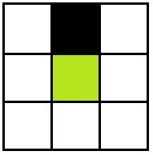
Flippable pixels – Score
To increase the number of flippable pixels, we add the following blocks. Most of them have high scores in the lookup table.
0/0.375 0.125/0.25 0.125/0.25 0.375/0.375 0.25/0.125 0.25/0.25
0.25/0.125 0/0.375 0.375/0.125 0.25/0.375 0.01/0.25 0.25/0.01

Slide 24
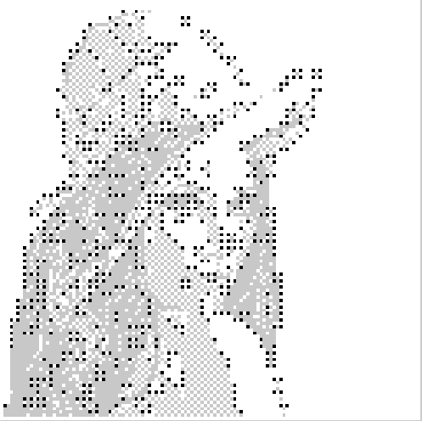
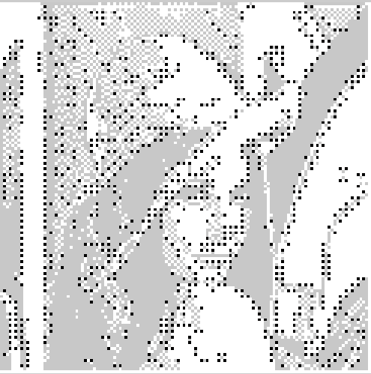
Flippable pixels – Score
Now we have 650 flippable pixels, about 81 bytes. If we use Lena with the background, we have 905 flippable pixels, about 114 bytes.

Slide 25
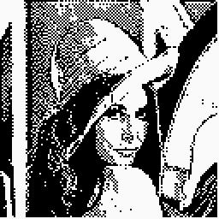
Flippable pixels – Score
All the 905 pixels have been flipped in the right picture!
Can you find any differences between the two images?

Slide 26
Outline
Dot matrix
Motivation
Generating dot matrix
Preparation
Dithering algorithm
Flippable pixels
Definition
Criterion
Score
Conclusion
Future work
Notes:
The outline is listed as follows.

Slide 27
Conclusion
Dithering algorithm can remain most edge information in the gray scale image.
Using flippable criterion and flippability score can increase the capacity of the dot matrix.
Embedding information in flippable pixels will cause little visual distortion of the dot matrix.

Slide 28
Outline
Dot matrix
Motivation
Generating dot matrix
Preparation
Dithering algorithm
Flippable pixels
Definition
Criterion
Score
Conclusion
Future work
Notes:
The outline is listed as follows.

Slide 29
Future work
Find self-adaptive scheme to generate dot matrix
Increase the capacity of barcode

Slide 30
Dot matrix barcode
Q & A

Slide 31
Thank you !

Slide 32
Scan the dot matrix

Slide 33
Flippability score

Slide 34
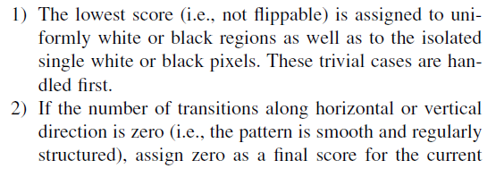
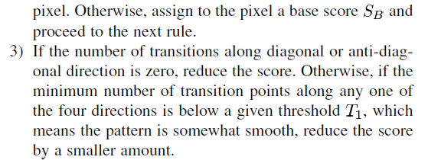
Flippability score

Slide 35
Flippability score

