Slide 1
Wireless VOD—based on popularity
刘思怡 Liu Siyi
5120309667

Slide 2
Catalogue
Introduction
Current architecture
Popularity

Slide 3



What is VOD?
Introduction
Video On Demand

Slide 4


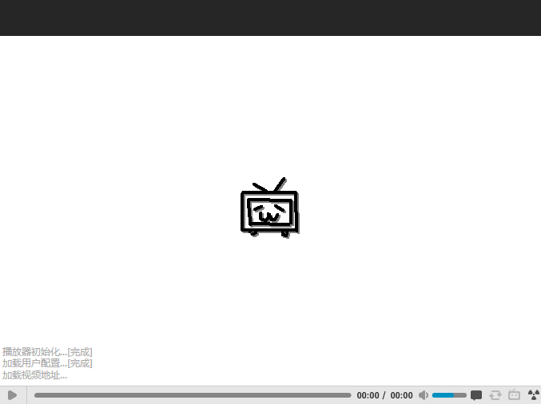
Why study VOD?
Introduction

Slide 5
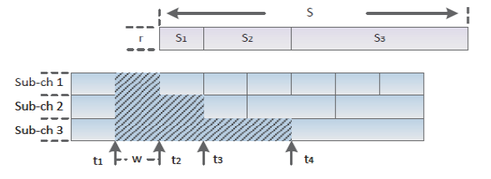
Cable VOD— period broadcasting
Introduction
Cable network, stable bandwidth

Slide 6
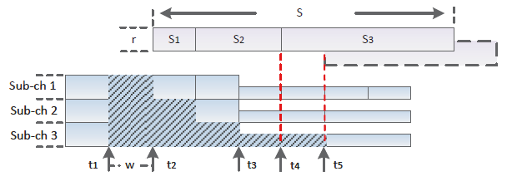
Wireless VOD
Introduction
Wireless network, unstable bandwidth

Slide 7
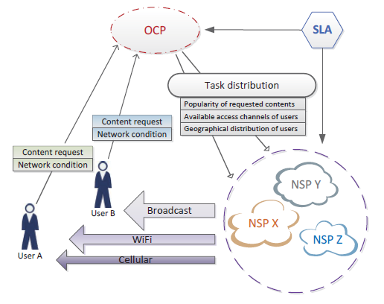
Network Crowdsourcing Architecture
Current architecture

Slide 8


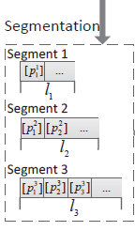

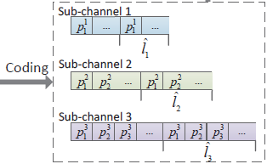
System model
Current architecture

Slide 9
Why introduce popularity?
Popularity
80% of the requests concentrate on 20% videos
The other 20% of the requests scatter among the other 80% videos

Slide 10
Classification
Popularity
Video popularity
Segment popularity

Slide 11
Definition
Popularity
M servers, N videos, For server i and video j, Wi,j , is the weight of j to i. Thus, the popularity of video k is:

Slide 12
Video popularity
Popularity
Set threshold for different kinds of videos
Reserve different amount of bandwidth
Use the idle bandwidth

Slide 13
Segment popularity
Popularity

Slide 14
Flow-process diagram
New request
Calculate video popularity
Meet the threshold
reject
Yes
No
Distribute bandwidth
Enough bandwidth
reject
No
Yes
Calculate segment popularity
Distribute time slot

Slide 15
Thank you!
Thank you!

