Slide 1
Fundamental Limits of Heterogenous Cache: a Centralized Approach
Guanchen He

Slide 2
Roadmap
Introduction of coded caching
System model and problem formulation
Related work
Centralized coded caching under heterogeneous cache set
Numerical results

Slide 3
Introduction of coded caching
1. A network with one server and K users
2. N files of size F bits
3. K users, each with cache size M={M1, M2, …, MK} contents, 0<Mk<N
4. Two phases: placement phase and delivery phase.
1
N
2
Server
Shared link
User 1
User 2
User 3
User K
User
MK
Cache
M1
M2
M3

Slide 4
Why coded caching?
To reduce peak traffic rates on the shared link.
A ₁, A₂
K=2 users user1 user2 cache size F bits
N=2 files file A file B
file size F bits
Server
B₁ , B₂
Shared link
user1
user2
A₁
A₂
B₁
B₂

Slide 5
Types of coded caching
Centralized coded caching
Decentralized coded caching
A ₁, A₂
Server
B₁ , B₂
Shared link
user1
user2
A₁
A₂
B₁
B₂

Slide 6
System model and problem formulation
Network Model with heterogeneous cache set
1. N files of size F bits
2. K users, ordered cache size M={M1, M2, …, MK} contents, 0<Mk<N.
3. Two phases: placement phase and delivery phase.
4. Worst case requirements.
1
N
2
Server
Shared link
User 1
User 2
User 3
User K
User
MK
Cache
M1
M2
M3

Slide 7
Miss of coding opportunities
A₁
B₂
Server
Miss of coding opportunities
user1
user2
A₁
A₂
B₁
B₂

Slide 8
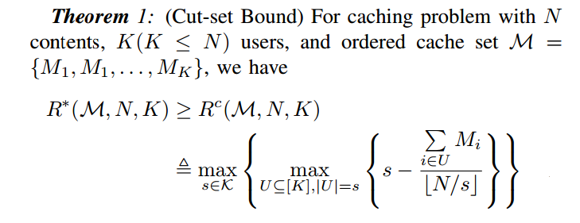

Related work
Result of decentralized coded cache

Slide 9
Centralized coded caching under heterogeneous cache set
Example : K=4 users, N=4 files of F bits each, average cache size is 3F bits.
We use t to represent how many times we can save all the files if we use up all the cache.
So in this example, we need to divide each file into parts. We use
to represent them.

Slide 11
Note: We paddle zeros at the end of the shorter parts of the files.
Problem:
1. Is this ideal solution meaningful ?
All situations are boundary?
We have variables, K equations.

Slide 12
Example : K=3 users, N files, t=2
M₃ – M₂
M₂ – M₁
M₁

Slide 13
Numeral results
1.Set the range of N and K
2.Randomly choose N,K and the cache set
3.Compute R using the equation
When we choose , in my simulation, we reach a order optimum result.

Slide 14
THANKS!
Q&A

