Slide 1
Bluetooth for Ad-Hoc Networking
Foundation of Bluetooth distributed localization system

Slide 2
Ad-Hoc Networking
A decentralized type of wireless network.
It does not rely on a pre existing infrastructure, such as routers in wired networks or access points in managed (infrastructure) wireless networks.

Slide 3
BACKGROUND
Peer-to-peer network location resolution is an emerging market within the wireless communication arena.
For outdoor environments, there are many solutions that can provide very high-resolution location estimates.

Slide 4
BACKGROUND
In building location solutions, however, techniques are still being researched and developed.
Recently, Bluetooth has been considered a viable solution in the quest to define an indoor solution.

Slide 5
Why Bluetooth?
Ad-hoc networks can be formed using many different wireless technologies, but Bluetooth has become almost a household name in the ad-hoc networking world for the numerous advantages it offers over competing technologies.

Slide 6
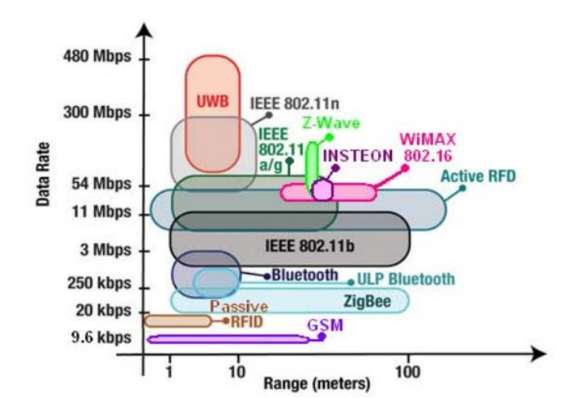
Disadvantages of Bluetooth for Ad-Hoc Networks
Range.
Lack of bandwidth.

Slide 7
Simple in an Ad-Hoc network
The main reason Bluetooth is so popular for ad-hoc networks is that it was specifically designed for use in this fashion.
While Wi-Fi were designed to provide a replacement for wired infrastructure networks.
Bluetooth offers automatic network configuration and service discovery.
Notes:
while the likes of the 802.11 (Wi-Fi) standard were designed to provide a replacement for wired infrastructure networks. While other networks can be configured to operate in an ad-hoc fashion, without any central "controlling" device, Bluetooth offers automatic network configuration, authentication and service discovery; thereby making setting up an ad-hoc network much simpler for the average user, who is unlikely to be familiar with networking protocols and router configuration.

Slide 8
Small, Low-Power and Cheap
Bluetooth was designed to require as little power as possible,
to be implemented in the smallest possible design,
and to be cheap to produce.
Notes:
As wireless technologies imply no fixed wired connections at all, it can be taken for granted that any devices using any wireless technology, be it Wi-Fi, Bluetooth, GSM, etc., will be supplied by an on-board battery. Wi-Fi and other technologies are extremely power-hungry, relative to Bluetooth – Bluetooth operates using just 2.5mW of power, compared to 100mW for Wi-Fi ! Small, low-power, cheap devices meant that they could be integrated into just about every device under the sun allowing them to communicate with one another using a common standard.

Slide 9
Legal
Bluetooth uses the unlicensed 2.4GHz ISM (Industrial, Scientific, and Medical) band.

Slide 10
How Bluetooth Works?
Piconet
Scatternet

Slide 11
Piconet
the basic unit of networking in Bluetooth

Slide 12
A piconet is an adhoc network which links a wireless user group of devices using Bluetooth technology protocols.

Slide 13
A piconet can have only one master and up to seven slave devices.
Why

Slide 14
How to form a piconet?
The master transmits an ID packet.
Devices in the STANDBY state periodically scan for this packet. If it hears it, the device sends its address and timing info to the master. The device then waits for the master to page it.
When the master is satisfied that it has identified all the devices in its range it starts to form the piconet. It pages each device with its own device access code (DAC) using a frequency hopping sequence based on the slaves address.
When the slave hears this it sends a confirmation packet.
On the next slot the master sends the slave the master DAC. The slave then enters the CONNECTION state. The master does this for all the slaves in the piconet then it enters the CONNECTION state itself.

Slide 15
M
S
ID packet
address and timing info
DAC
confirm
CONNECTION

Slide 16
8 devices are not enough?

Slide 17
Scatternet
A type of ad hoc computer network consisting of two or more piconets.

Slide 18
A scatternet is formed when a device is a member of more than one piconet.

Slide 19
What is meant by scatternet?
A device can be a master of only one piconet. The device can, at the same time, also be a slave in another piconet that is within range.
A slave can also participate in two different piconets that are within its range.
However, because the master device determines the hopping pattern used for a piconet, a device cannot be a master of more than one piconet.

Slide 20
A device can be a master of only one piconet. The device can, at the same time, also be a slave in another piconet that is within range.

Slide 21
A slave can also participate in two different piconets that are within its range.

Slide 22
However, because the master device determines the hopping pattern used for a piconet, a device cannot be a master of more than one piconet.

Slide 23
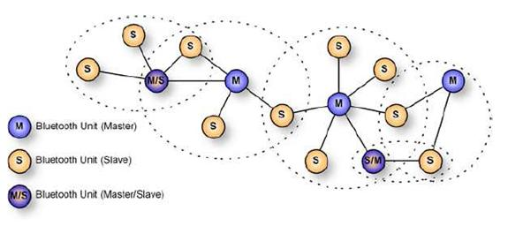
Allow many devices to share same area.
Make efficient use of bandwidth.

Slide 24
Future work
Build a distributed localization system.
The seven wireless devices of the piconet each determine the RSSI data and path loss. One of the seven devices, serving as a super master device, collects all the RSSI info.
Grouping this information on each path gives an improved estimate of the locations of any absorbers within the piconet.

Slide 25
START WITH A PICONET
EACH SLAVE DETERMINES RSSI DATA
MASTER COLLECTS ALL OF RSSI DATA
COLLECT INTERSECTION INFORMATION TO ESTIMATE LOCATION
STOP
Flowchart of localization

Slide 26
Thanks!

