Slide 1
Algorithm Evaluation Platform--SimPOS
---indoor localization system
---黄永铖

Slide 2
THREE METHODS
Wifi Fingerprint
Bluetooth Low Energy
Pedometer

Slide 3
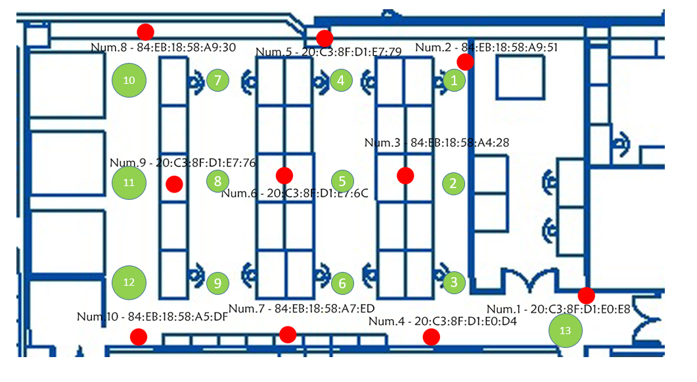
rssi
Received Signal Strength Indication
We need to set Access Point(AP)
Mobile phone receive signal and calculate the position
Pathloss in space
Sometime inaccurate and unstable
Test in Foxconn（富士康）

Slide 5
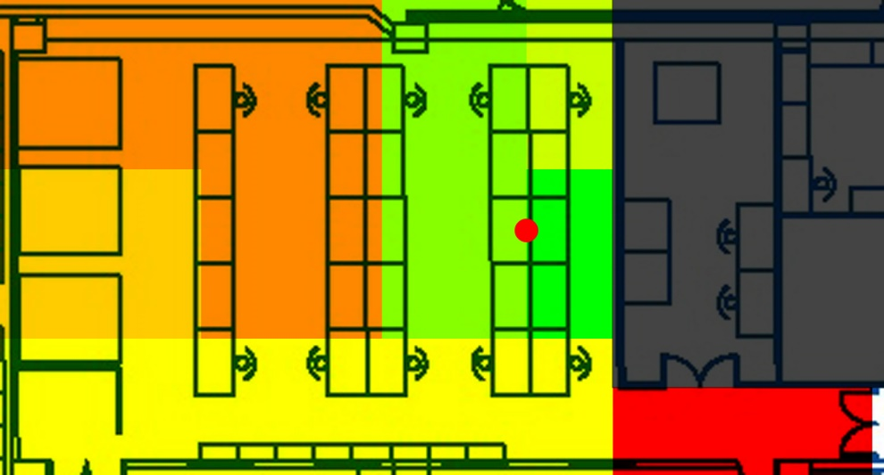
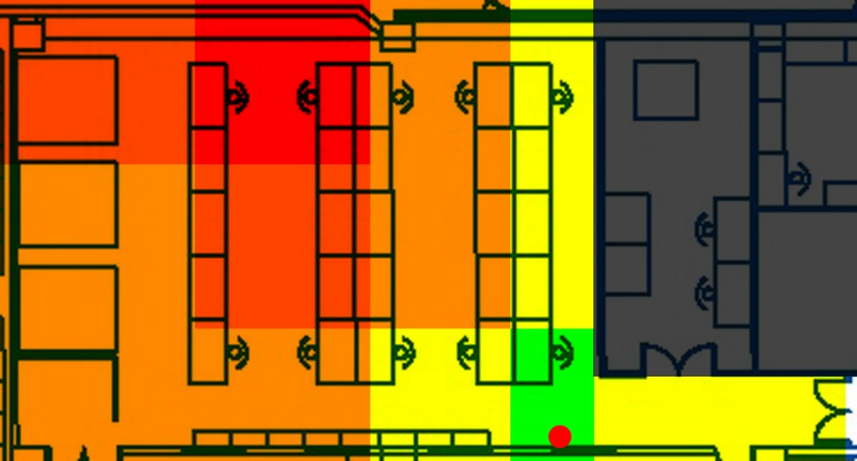
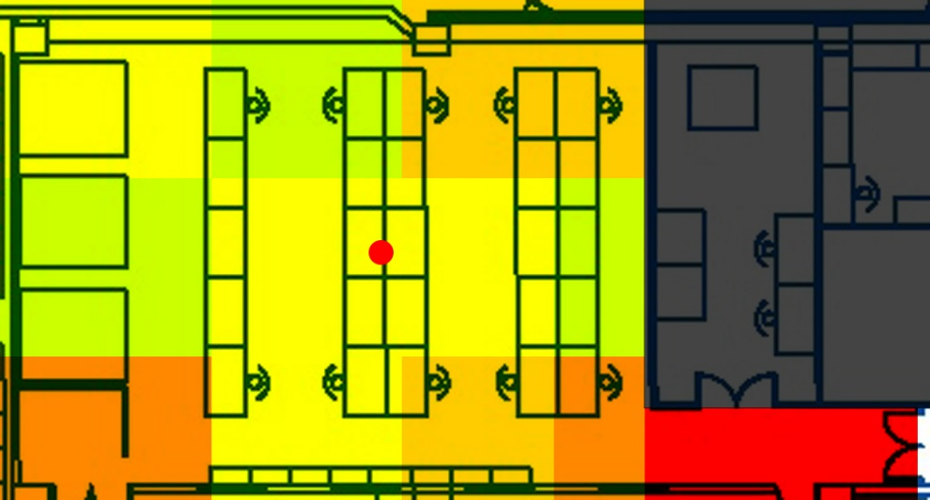

Slide 6
analysis
Sometime not accurate
Restricted by the spatial structure

Slide 7
Without changing the hardware
possible to improve the performance through algorithm
How the Algorithm evaluation platform help us to improve the algorithm

Slide 8
Algorithm Evaluation Platform--SimPOS
3 step
Insert your algorithm into the platform
Input the test data
Simulate!
Extensible and hierarchical

Slide 10
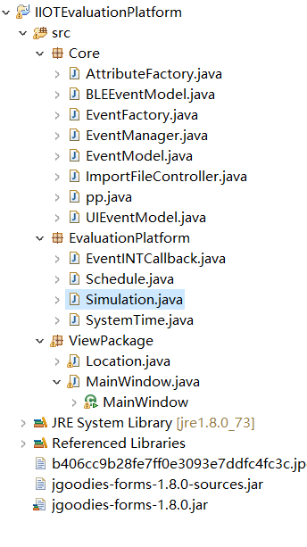
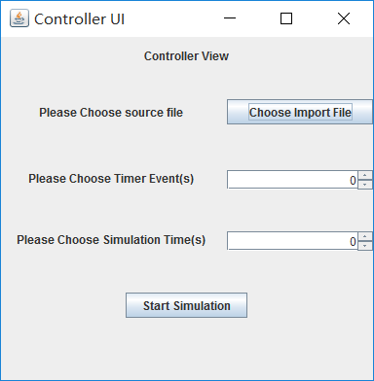

Slide 11
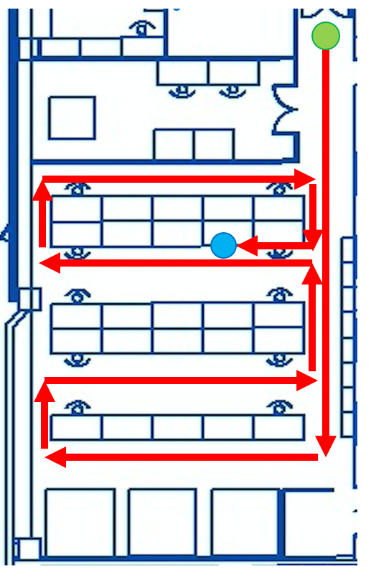
DEMO
The test route
The green point: starting point
The blue point: terminal point
Notes:
green:starting point blue : terminal point

Slide 12
Algorithm class
RSS >=-82 is useful
In 0.5s, every APi with RSS larger than -82 will get a weight Wi. Then we will calculate the predicted position.( The Y coordinate is the same)
we think that the last position have a connection with the present position.
For example, if the sum of weight is larger than 180.

Slide 13
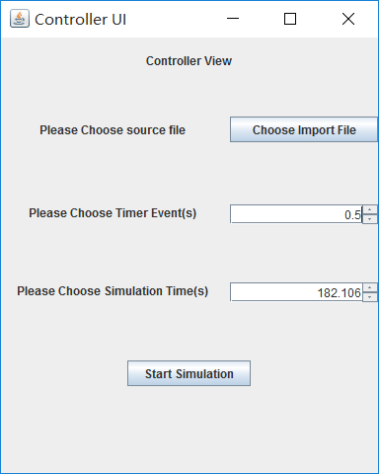

Slide 14
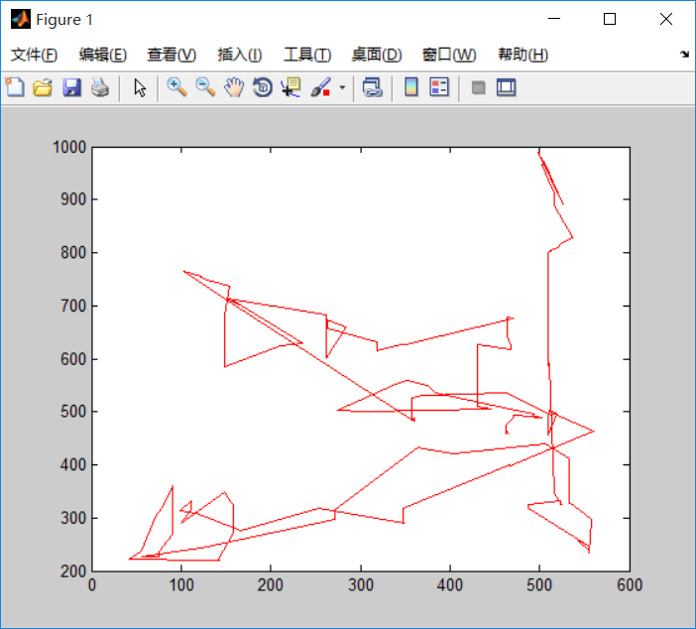
It’s roughly correct but with errors

Slide 15
Future work
Add the LOG class and EVALUATION class.
Add more model to our platform.
Improve the performance of our algorithm.

Slide 16
Thanks
Q&A

