Slide 1
Bluetooth Cochlea
Jiawen Gu, 5130309763
Notes:
Good morning everyone. My name is gujiawen, today i'm gonna talk about the project we do this semester, it's bluetooth cochlear, what we mainly do is verifying some functions of the bluetooth chip, and build a android app as the controller of the cochlear

Slide 2
Content
1
Brief Introduction
2
Project Progress
3
Future Work

Slide 3
Brief Introduction
What are we doing

Slide 4
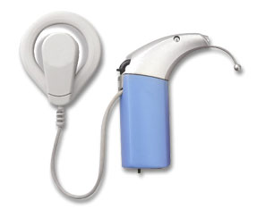
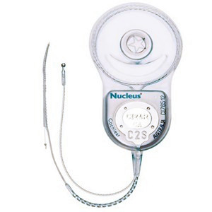
Artificial Cochlea
Extracorporeal Device
Processor
Collect and process the environmental sound
Transfer coil
Transfer the processed signal to implant by RF
②
①
Cochlear Implant
Stimulation Electrodes
Stimulate acoustic nerve ending as sound
Receiving coil
Receive encoded signal and control the electrodes according to preset program
①
②
Notes:
处理包含数字化、滤波、编码（digitalization,filtering and encoding）
Extracorporeal ,ekstrəkɔ:'pɔ:rɪəl

Slide 5
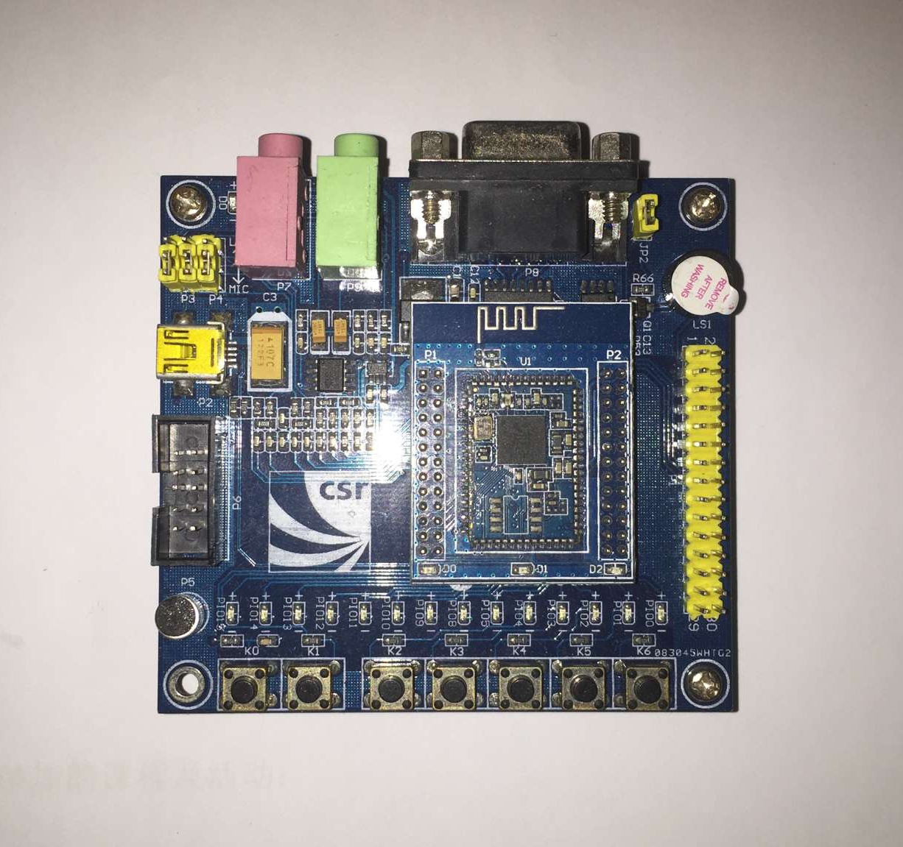
Bluetooth Chip
CSR8670
Widely used bluetooth audio products development board

Slide 6
Control Protocol
Gaia —— Generic Application Interface Architecture
Established on a SPP connection
Implements an end-to-end, host-agnostic ecosystem supporting host application access to device functionality
Command format:
Vendor ID: 16-bit field qualifies the command
Command ID: 16-bit field identifies the individual command
Payload: The payload contains any information required to be passed by a specific command

Slide 7
Project Progress
What we have done

Slide 8
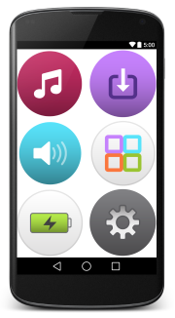
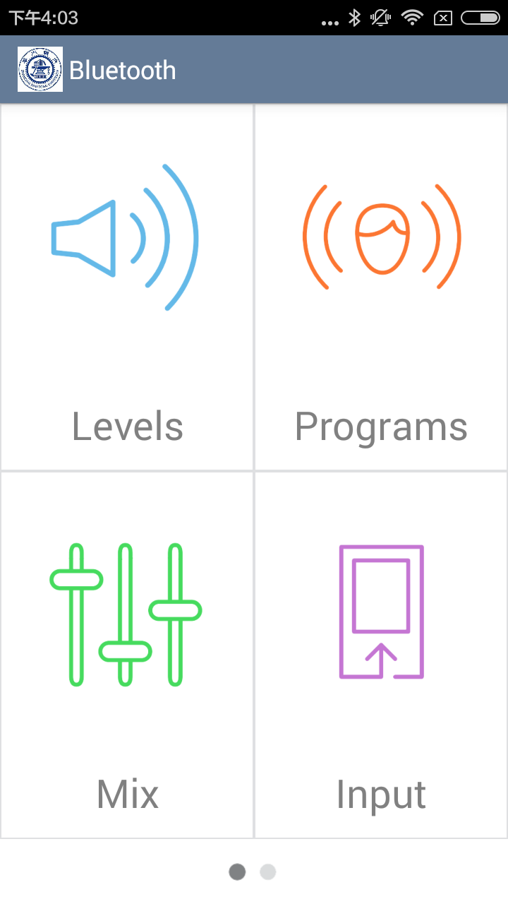
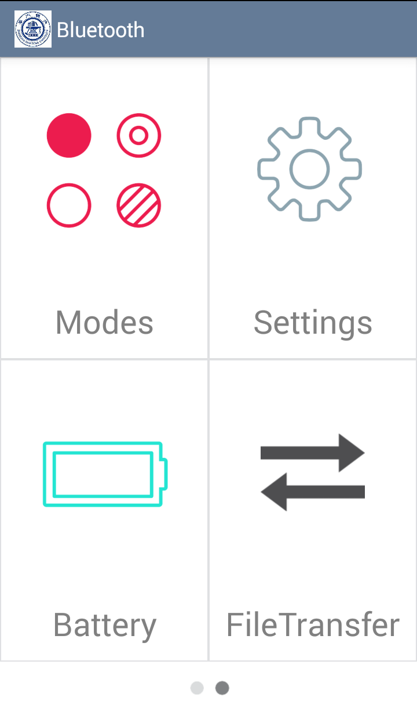
User Interface Optimization

Slide 9
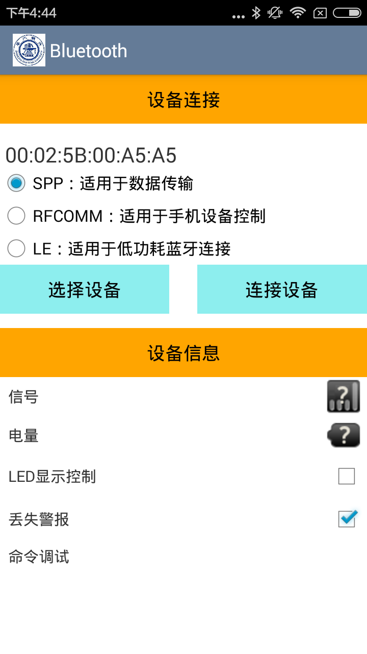
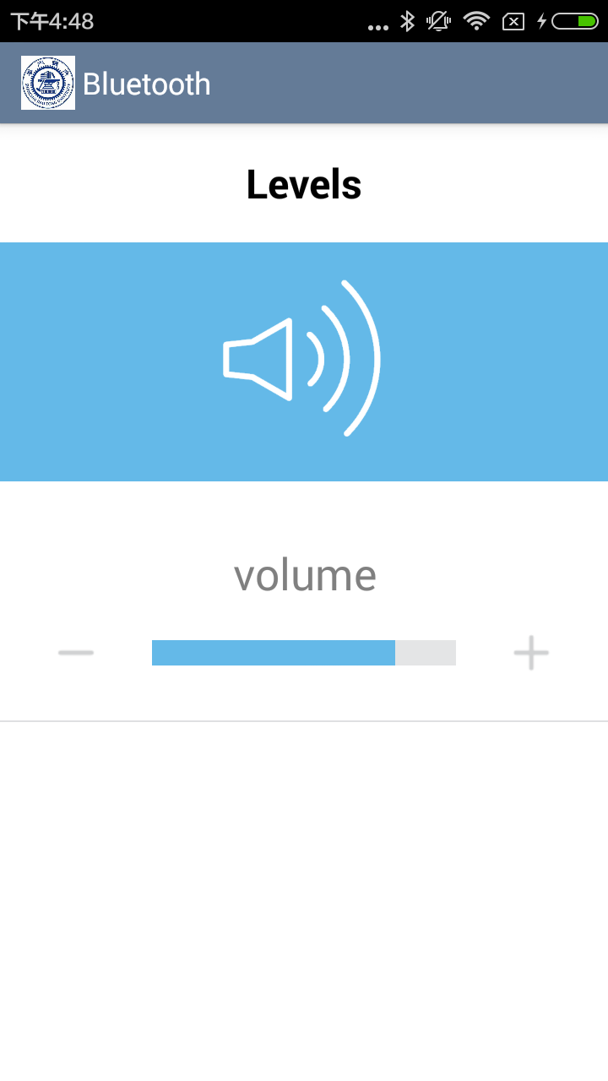
Basic Function of Android APP
Pairing
Device status inquery ( battery, rssi )
Volume control

Slide 10
File Transfer Rate Test
Send packets via Gaia commands ( each packet carries at most 250 bytes )
Result: 2.5KB/s
Very slow!
The chip can process only one gaia command at a time, any packet received while processing will be received and demodulated but not handled. It will be droped before it's delivered to application level.

Slide 11
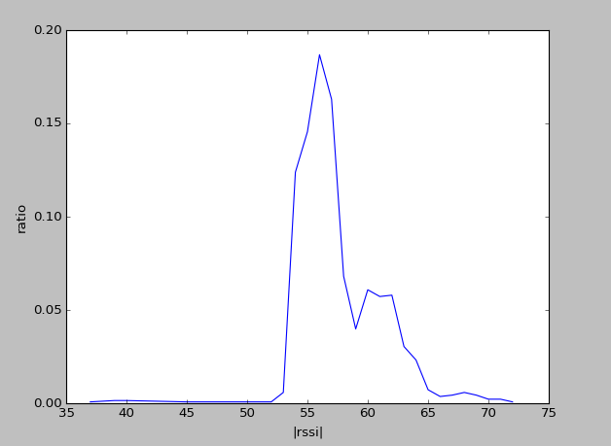
Device Loss Alarm
Very expensive!
The cochlear implant cannot work alone
RSSI (Received Signal Strength Indication)
A: actual value of |RSSI| when d = 1m
n: attenuation factor, in air n = 2.0
Implementation
RSSI fluctuates a lot
Three continuous RSSI smaller than threshold triggers an alarm
Estimate distance with the average value of recent 3 rssi records

Slide 12
Future Work
Problems to be conquered

Slide 13
Future Work
01
02
Scene Recognition
Noise Reduction
Learning based audio scene recognition
Apply different sound process-ing program according to different scene
Greatly improve the performance of artificial cochlea in noisy envi-ronment

Slide 14
THANKS

