Slide 1
A Brief Introduction of Indoor
Localization Algorithms
5130309750 Chen Hongkun
2016/5/23

Slide 2
Introduction
Structure of Indoor Localization Algorithms
Indoor Localization
Range-based
TOA
Fingerprint
UWB
TDOA
RSSI
AOA
GPS
Bluetooth
ZigBee
Wi-Fi
Range-free
Notes:
You can add your own categories and points values to this game board. Enter your questions and answers in the slides we’ve provided.
When you’re in slide show view, select the underlined text to go to that question, then move to the answer slide. Use the left triangle to return to this game board slide.

Slide 3
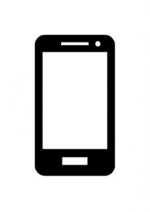
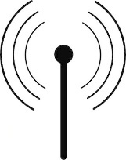
Time of Arrival
TOA
Sometimes called Time of Flight, it is the travel time of a radio signal from a single transmitter to a remote single receiver
The Ap’s position is already known, so the target is on a circle with radius r.
$$distance\left(r\right)=c∗TOA$$
TDOA
AOA
RSSI
r
Fingerprint
Lab
Notes:
You can add your own categories and points values to this game board. Enter your questions and answers in the slides we’ve provided.
When you’re in slide show view, select the underlined text to go to that question, then move to the answer slide. Use the left triangle to return to this game board slide.

Slide 4
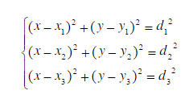
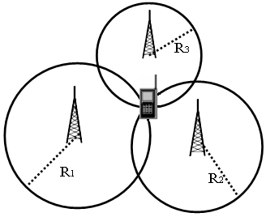
Time of Arrival
TOA
TDOA
AOA
RSSI
Fingerprint
Lab
Notes:
You can add your own categories and points values to this game board. Enter your questions and answers in the slides we’ve provided.
When you’re in slide show view, select the underlined text to go to that question, then move to the answer slide. Use the left triangle to return to this game board slide.

Slide 5
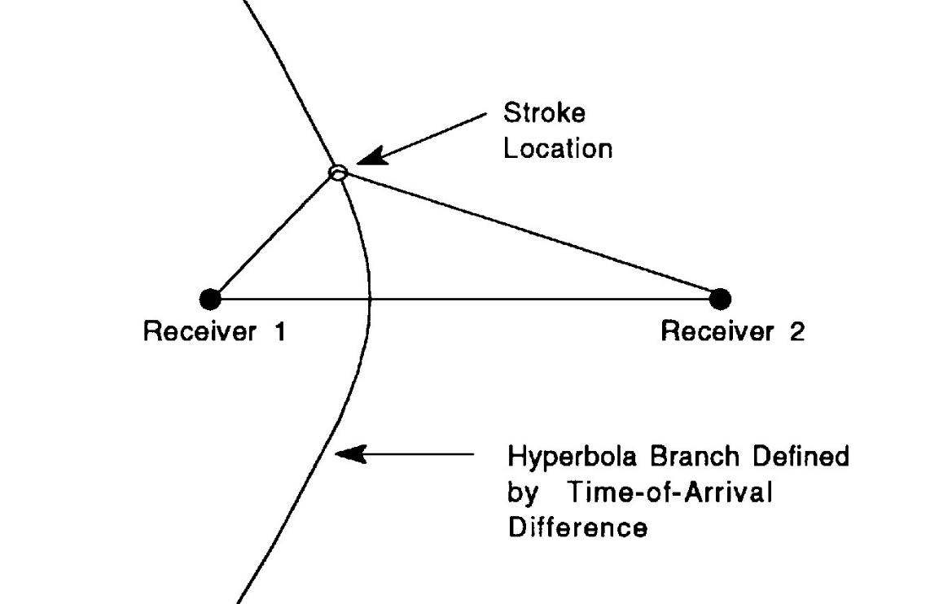
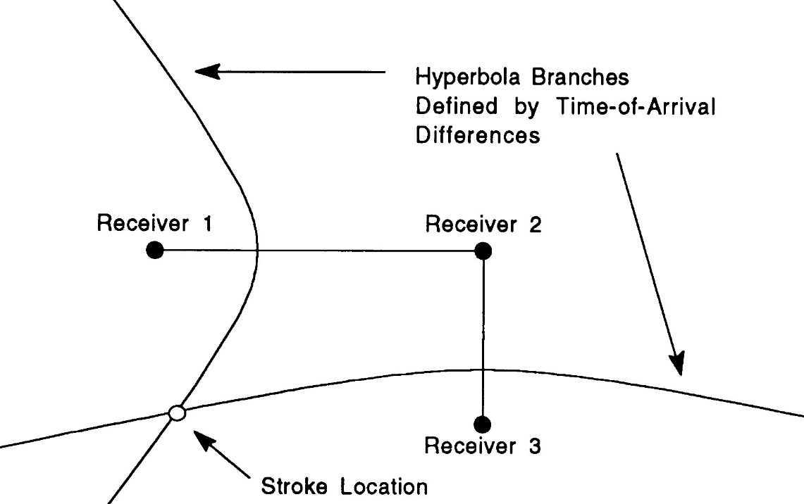
Time Difference of Arrival
TOA
Other than absolute distance, it measures the difference
The receiver(cellphone) is on a hyperbolic curve
Locate the target by finding the intersection
TDOA
AOA
RSSI
Fingerprint
Lab
Notes:
You can add your own categories and points values to this game board. Enter your questions and answers in the slides we’ve provided.
When you’re in slide show view, select the underlined text to go to that question, then move to the answer slide. Use the left triangle to return to this game board slide.

Slide 6
Time Difference of Arrival
TOA
Question:
How to get the value of TDOA (Distance between R1 and T, R2 and T)?
TDOA
AOA
Answer01:
Using TOA
Answer02:
Using……?
RSSI
Fingerprint
Lab
Notes:
You can add your own categories and points values to this game board. Enter your questions and answers in the slides we’ve provided.
When you’re in slide show view, select the underlined text to go to that question, then move to the answer slide. Use the left triangle to return to this game board slide.

Slide 7
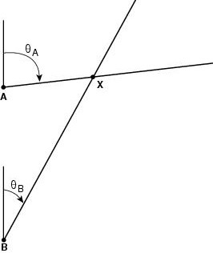
Angle of Arrival
TOA
TDOA
It measures the angle
Receiver is on a line
Finding the intersection
AOA
RSSI
Fingerprint
How to measure the angle ?
Lab
Notes:
You can add your own categories and points values to this game board. Enter your questions and answers in the slides we’ve provided.
When you’re in slide show view, select the underlined text to go to that question, then move to the answer slide. Use the left triangle to return to this game board slide.

Slide 8
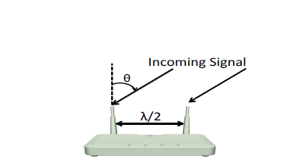
How to measure \theta ?
TOA
TDOA
AOA
d
RSSI
Fingerprint
Lab
‘d’ is what we have measured in TDOA
Notes:
You can add your own categories and points values to this game board. Enter your questions and answers in the slides we’ve provided.
When you’re in slide show view, select the underlined text to go to that question, then move to the answer slide. Use the left triangle to return to this game board slide.

Slide 9
Time Difference of Arrival
TOA
Question:
How to get the value of TDOA ?
TDOA
AOA
Answer01:
Using TOA
Answer02:
Using……
RSSI
Fingerprint
Lab
Notes:
You can add your own categories and points values to this game board. Enter your questions and answers in the slides we’ve provided.
When you’re in slide show view, select the underlined text to go to that question, then move to the answer slide. Use the left triangle to return to this game board slide.

Slide 10
Angle of Arrival
TOA
We can measure phase difference $Δφ$
TDOA
AOA
$$∆d=\frac{λ}{2}sinθ$$
RSSI
d
$$Δφ=2πΔd/λ$$
Fingerprint
Lab
$$θ=arcsin⁡(Δφ/π)$$
Notes:
You can add your own categories and points values to this game board. Enter your questions and answers in the slides we’ve provided.
When you’re in slide show view, select the underlined text to go to that question, then move to the answer slide. Use the left triangle to return to this game board slide.

Slide 11
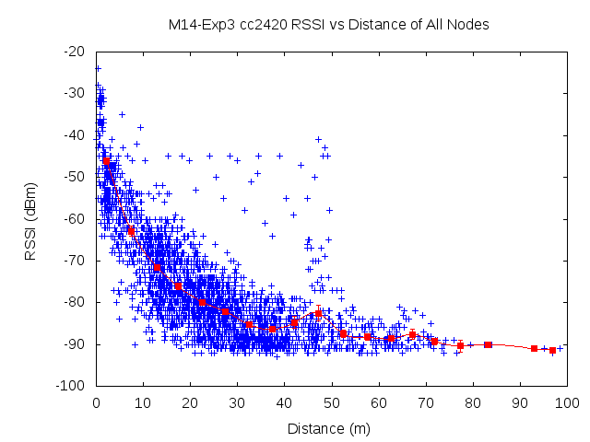
Received Signal Strength Indicator
TOA
DESCRIPTION:
A measurement of the power
RSSI declines with distance
3. Map between RSSI and distance
TDOA
AOA
RSSI
PROBLEM:
Unstable, inaccuracy
Fingerprint
IMPROVEMENT:
Will 2 Aps or more improve the accuracy of location ?
Lab
Notes:
You can add your own categories and points values to this game board. Enter your questions and answers in the slides we’ve provided.
When you’re in slide show view, select the underlined text to go to that question, then move to the answer slide. Use the left triangle to return to this game board slide.

Slide 12
TOA
STEPS:
Record a vector of RSSIs (or other parameters) at a specific location
Compare the measuring vector with recorded vectors and find the optimum one
TDOA
AOA
RSSI
Fingerprint
Lab
Notes:
You can add your own categories and points values to this game board. Enter your questions and answers in the slides we’ve provided.
When you’re in slide show view, select the underlined text to go to that question, then move to the answer slide. Use the left triangle to return to this game board slide.

Slide 13
TOA
STEPS:
Record a vector of RSSIs (or other parameters) at a specific location
Compare the measuring vector with recorded vectors and find the optimum one
TDOA
AOA
RSSI
Fingerprint
Lab
Notes:
You can add your own categories and points values to this game board. Enter your questions and answers in the slides we’ve provided.
When you’re in slide show view, select the underlined text to go to that question, then move to the answer slide. Use the left triangle to return to this game board slide.

Slide 14
TOA
Key Part.
Choose a good matching method.
For example.
Euclidean distance
TDOA
AOA
RSSI
Improvement:
Mean value model
Gaussian model
Fingerprint
Lab
Notes:
You can add your own categories and points values to this game board. Enter your questions and answers in the slides we’ve provided.
When you’re in slide show view, select the underlined text to go to that question, then move to the answer slide. Use the left triangle to return to this game board slide.

Slide 15
TOA
What we have done in the lab:
TDOA
Algorithm: | Fingerprint-based
Size of room | 4m* 5m
Number of samples | 15
Number of Ap | 5
Accuracy | 3m
AOA
RSSI
Fingerprint
Lab
Notes:
You can add your own categories and points values to this game board. Enter your questions and answers in the slides we’ve provided.
When you’re in slide show view, select the underlined text to go to that question, then move to the answer slide. Use the left triangle to return to this game board slide.

Slide 16
Problem 1. Multipath
TOA
TDOA
Q: We suppose the two incoming signals are parallel here, but what if there are more or they are not parallel ?
AOA
RSSI
Fingerprint
Lab
Notes:
You can add your own categories and points values to this game board. Enter your questions and answers in the slides we’ve provided.
When you’re in slide show view, select the underlined text to go to that question, then move to the answer slide. Use the left triangle to return to this game board slide.

Slide 17
Problem 2. Package Detection Delay
TOA
TDOA
Q: Did the package detection delay be counted into TOA ?
AOA
RSSI
$$distance\left(r\right)=c∗TOA$$
Fingerprint
$$1ns∗3×{10}^{8}m/s=0.3m$$
Lab
Notes:
You can add your own categories and points values to this game board. Enter your questions and answers in the slides we’ve provided.
When you’re in slide show view, select the underlined text to go to that question, then move to the answer slide. Use the left triangle to return to this game board slide.

Slide 18
Problem 3. Synchronization
TOA
TDOA
Q: How to make sure the synchronization has a precision of nanosecond level ?
AOA
RSSI
inaccuracy
Fingerprint
$$1ns∗3×{10}^{8}m/s=0.3m$$
Lab
Notes:
You can add your own categories and points values to this game board. Enter your questions and answers in the slides we’ve provided.
When you’re in slide show view, select the underlined text to go to that question, then move to the answer slide. Use the left triangle to return to this game board slide.

Slide 19
Problem 4. Phase difference
TOA
TDOA
Q: Can we distinguish cases when $Δφ=π$ and $Δφ=3π$ ?
When $Δφ=2π+{Δφ}^{′}$……
AOA
RSSI
Fingerprint
Lab
Notes:
You can add your own categories and points values to this game board. Enter your questions and answers in the slides we’ve provided.
When you’re in slide show view, select the underlined text to go to that question, then move to the answer slide. Use the left triangle to return to this game board slide.

Slide 20
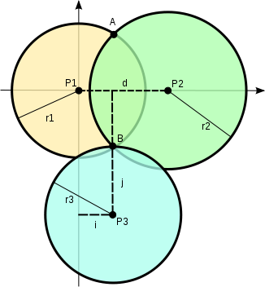
Problem 5. Intersection
TOA
TDOA
Q: What if there are more than three Aps in which case there are more than one intersection ?
AOA
RSSI
Fingerprint
Lab
Notes:
You can add your own categories and points values to this game board. Enter your questions and answers in the slides we’ve provided.
When you’re in slide show view, select the underlined text to go to that question, then move to the answer slide. Use the left triangle to return to this game board slide.

Slide 21
THNAK YOU
Q & A

