Slide 1
Bluetooth Cochlea
Zhao Zijian 5130309770
Notes:
Good morning, everyone.
I am Zhao Zijian, a member of the Bluetooth cochlea group .
Today I would like to introduce my work to you.

Slide 2
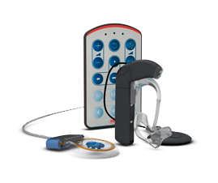
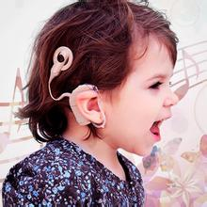
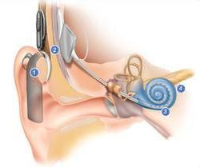
Bluetooth Cochlea
Notes:
First of all, just a brief introduction.
The Bluetooth cochlear is a electronic device implanted in ears to help deaf people to hear voice.

Slide 3
Content
Android Programming
Interface of Scene Selection
Login and Register
Audio Scene Recognition(survey)
Why we need this - Background
What others have done - Product
How we can do this - Algorithm
Notes:
And this is the content of my presentation.
First, I will introduce my programming work. It is mainly android programming.

Slide 4
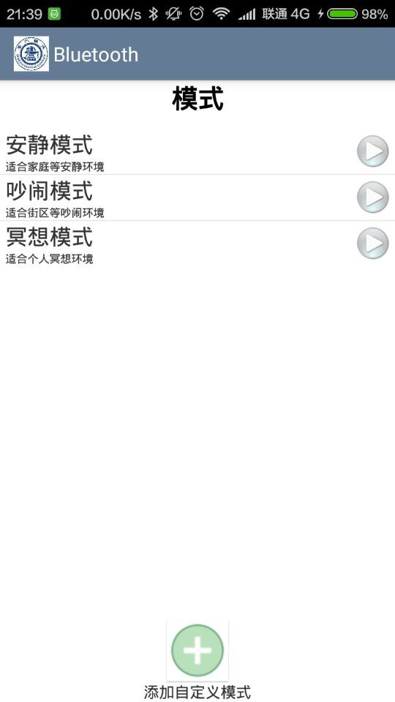
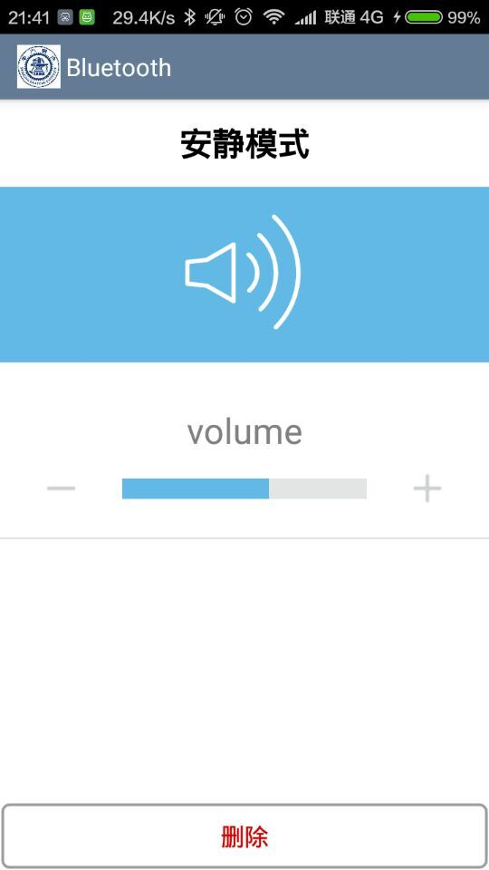
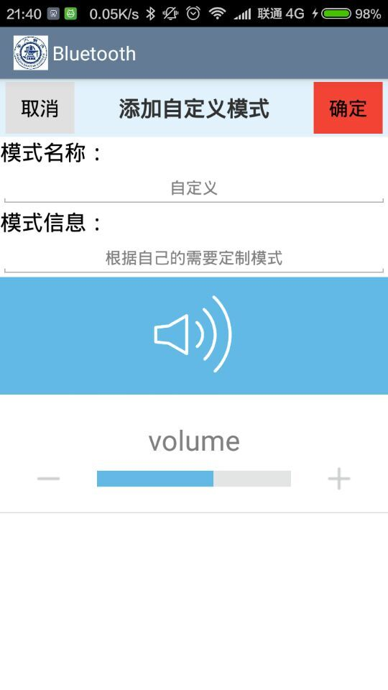
Android Programming
Interface of Scene Selection
Notes:
I implemented the interface of the scene selection.
The users have several different scenes to select. They can edit the detailed settings in the scene.
And they can also add their own customized scenes.

Slide 5
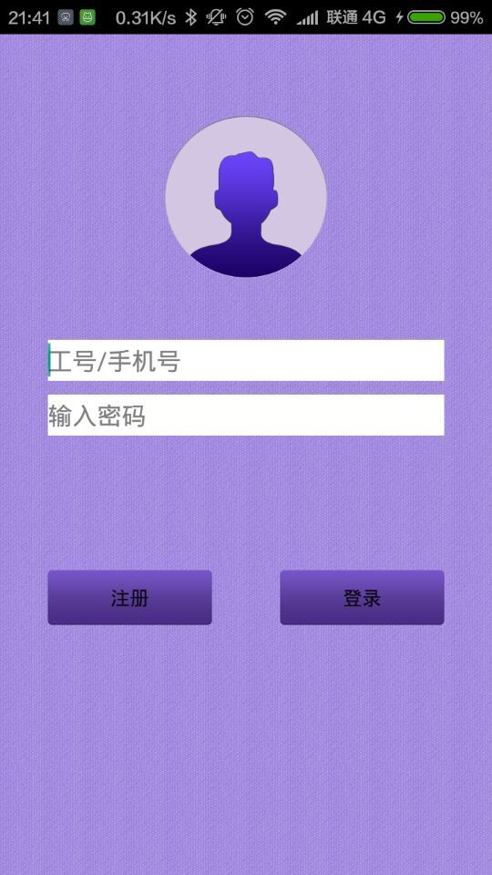
Android Programming
Login and Register
Notes:
I also implemented the login and register function of the application.
But I are not going to introduce the technical details of the programming
Because I don’t think you will enjoy it.

Slide 6
Content
Android Programming
Interface of Scene Selection
Login and Register
Audio Scene Recognition(survey)
Why we need this - Background
What others have done - Product
How we can do this - Algorithm
Notes:
so next I would like introduce some interesting survey about audio scene recognition which will be applied in our application in future.
I will introduce it from three aspects.
Why we need this
What others have done
And how we can do this

Slide 7
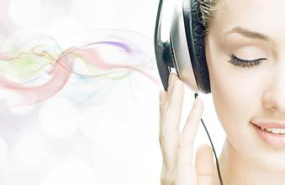
Why we need this - Background
Notes:
Why we need this. Do not forget that our goal is to develop a Bluetooth cochlea to help deaf people hear voice.
To make sure that they can hear clearly in any place, the volume settings must be adapted to the scenes
Although the users can change to different settings according to different scenes, it is annoying for them to manually change frequently.
So to automatically manage the volume settings, we will need audio scene recognition.

Slide 8
What others have done - Product
Australia Cochlear Inc Scene Classifier
America Advanced Bionics Inc Auto Sound
Broadest Input Dynamic Range
Austria Medical Electronic Inc Automatic Sound Management
Broad Input Dynamic Range
Automatic Volume Control
Notes:
And what others have done
There are three most popular artificial cochlea companies in the world. And I’ve researched how they implemented the function of letting people
Hear clearly anywhere.
For the Australia Cochlear Incorporation, they just implemented a scene classifier which provides six scenes. It can automatically recognize scenes and change volume settings. And the users can also manually change the scene setting.
For the American Advanced Bionics Incorporation, they implement an auto sound program which can adapt to any scenes.
And its advantage is the broadest input dynamic range. The input dynamic range is the volume range the processor can collect. The bigger, the better.
For the Austria Medical Electronic Incorporation, it is similar to the American Advanced Bionics incorporation. It also implement
a automatic sound management program. And its advantage is broad input dynamic range and automatic volume control.
Notice that the second and third one benefit from their processors. I have no idea of that. So I will introduce some algorithms for audio scene recognition.

Slide 9
Algorithm – Feature Extraction
Frequency extraction
Mel frequency LPC coefficients
Perceptual linear prediction features
Linear prediction cepstral coefficients
Stationary
frequency-based
Feature Extraction
Wigner-Ville distribution
Short-time Fourier transform
Continuous wavelet transform
Fast discrete wavelet transform
Non-stationary
time-frequency-based
Notes:
Here is a overview.
The first step is always feature extraction.
Feature extraction can be split into two broad types: stationary feature extraction which is frequency-based and non-stationary
Feature extraction which is time-frequency based . Stationary feature extraction produces an overall result detailing the frequencies contained in the entire signal. With stationary feature extraction, no distinction is made on where these frequencies occurred in the signal.
In contrast, non-stationary feature extraction splits the signal up into discrete time units. This allows frequency to be identified
as occurring in a particular area of the signal, helping understand the signal.
And in the right I list some of the methods that can be used in feature extraction.

Slide 10
Algorithm - Classification
Classification
Dynamic time warping (DTW)
Hidden Markov models (HMM)
Learning vector quantization (LVQ)
Self-organizing maps (SOM)
Ergodic-HMMs
Artificial neural networks (ANN)
Long-term statistics
Maximum likelihood estimation (MLE)
Gaussian mixture models (GMM)
Support vector machines (SVM)
Deep neural networks
Notes:
After we have extracted the features, the second step is classification.
There are many classification algorithms. Some of them are listed here.
I will introduce two out of them. One is Dynamic time warping, and the other one is Deep neural networks.

Slide 11
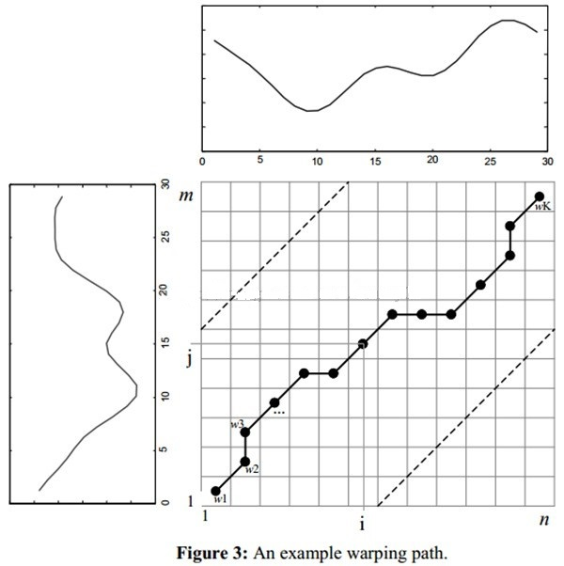
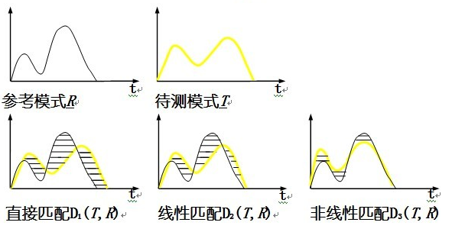
Dynamic time warping(DTW)
Pattern Matching Dynamic Programming
Notes:
Dynamic time warping is a pattern matching method using dynamic programming.
As you can see from the figure, Two signals may be similar, a little different just because some shifting in the time.
if we directly match the two signals or use a linear approach to match them, we won’t get the similarity truth.
So DTW uses a dynamic programming approach to align the length of the signal with the length of the reference signal.
So that we can recognize the similarity between the two signals. To use DTW, feature extraction was first applied to each signal and then the test signal was warped against each of the reference signals and the error between these two signals was recorded. The smallest error was taken to represent the closest class of sound.

Slide 12
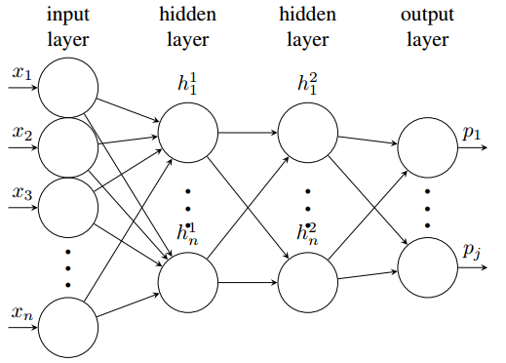
Deep neural network
Pre-training of DNN via DBN
Fine-training of DNN
Input: audio features
Output: audio context class
Dataset: LITIS Rouen audio dataset
2 hidden layer with 50 neurons : 80%
5 hidden layer with 500 neurons: 91.6%
7 hidden layer with 1000 neurons: 92.2%
Reference: DEEP NEURAL NETWORKS FOR AUDIO SCENE RECOGNITION(2015)
Notes:
Next we introduce how the popular Deep neural network can be used to solve this audio scene recognition problem.
Just like what we have talked about, first extract the features and use them as inputs. The output is audio context class.
Then just define a deep neural network to train the model.
And here are some results from the reference paper Deep neural networks for audio scene recognition.
Notice that just 5 hidden layers with 500 neurons already achieve some good result.

Slide 13
How we can do this
Dynamic time warping
Need good patterns
Deep neural network
Need training dataset
Environmental sounds Dataset
http://www.cs.tut.fi/~heittolt/datasets
Method
Use DNN to train a classifier
Use clustering to generate patterns, then use DTW to do pattern matching
Notes:
And finally how we can do this.
The dynamic time warping algorithm is easy to implement. But it needs good patterns.
The Deep neural network is a state-of-the-art technique. But it needs training dataset.
And fortunately, I found a website which lists many accessible environmental sounds datasets.
So , I propose two methods:
The first one is to use DNN to train a classifier
And the second one to use clustering or some other algorithms to generate good patterns, then use DTW to do pattern matching.

Slide 14
Thanks!
Any Questions?

