Slide 1
Overlapping Community Detection in
Temporal Text Networks
Presented by Jia Yuting
May.23, 2016

Slide 2
Outline
Motivation
Existing Model
Our Model(MAGIC)
Experiment Results
Future Work

Slide 3
What can community detection give us?
Help us to know the property of complex network.
How many kinds of nodes in a network.
Which nodes are densely linked to each other.

Slide 4
Existing models
Only when two nodes belong to a same community, it’s possible to link them.

Slide 5
Dataset construction
Microsoft Academic Graph 32 citation networks
Field of Study Ground-Truth Community

Slide 6
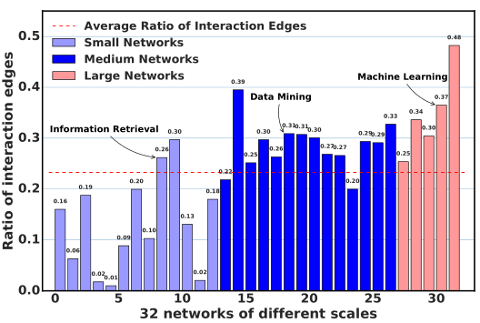
Community interaction

Slide 7
Three properties
Community interaction
Text information
Time information

Slide 8
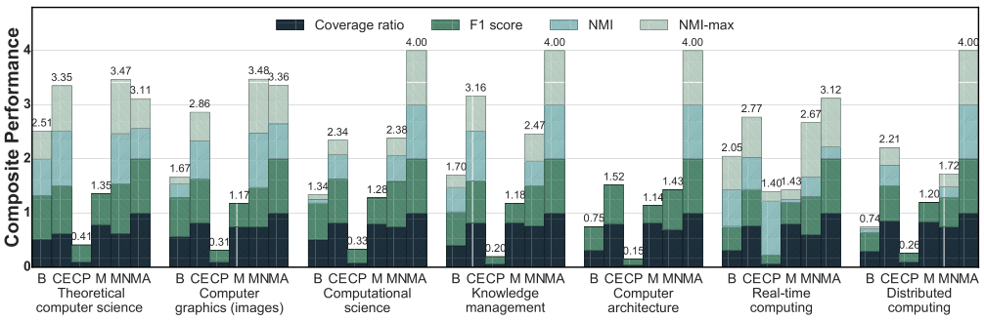
Experiment Results
Experiment on 7 network

Slide 9
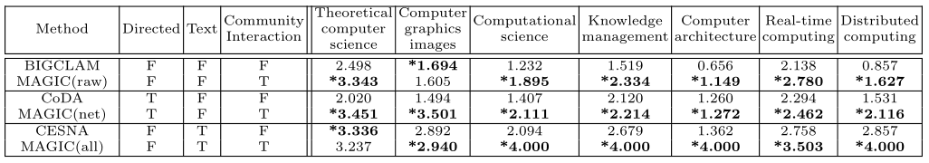
Experiment Results
Experiment for different information using

Slide 10
Future work
Add more information to this network, like author.
Parallel and speedup.

Slide 11
Thank you!

