Slide 1
Topic Analysis
In Acemap
1
Notes:
Good morning, everyone! I’m Cheng Ziming. Today, I’m going to introduce the final project, that is, topic analysis in acemap.
It should be pointed out that this work is done by a group, four people, I, my classmate Shen Yiyi and two other students.
So, I will just talk about the part that is related to me.

Slide 2
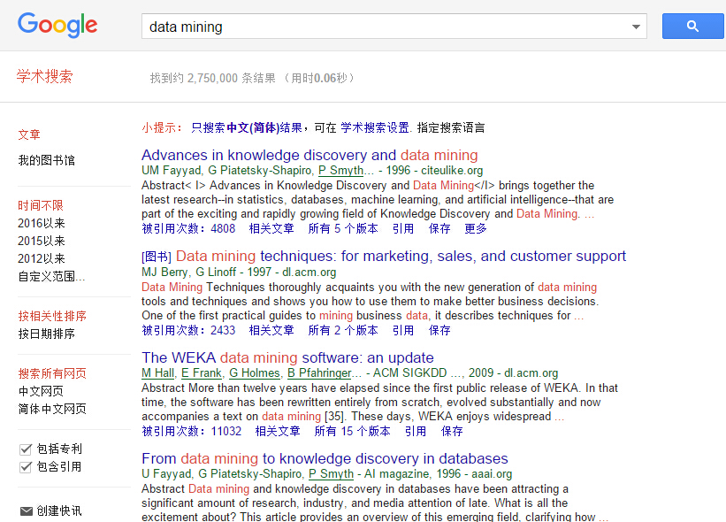
Motivation
Papers
Topics
2
Notes:
Have you ever gotten lost in the large amount of papers during your research?
As new papers are written year by year, it is increasingly difficult for us to see the complete picture.
That problem is what our group try to solve. We are working on generating and analyzing topics
from all papers in acemap.

Slide 3
The General Model
Topic Hierarchy in Database
Preview
Our Model
Topic Analysis
Demo
3
Notes:
Let’s have a preview first. Firstly I will introduce the general model. Then, I will show how we construct our model and do topic analysis. Finally, I will show a demo of my work.

Slide 4
The General Model
Suppose each document $d$ cites a subset of other documents $\left\{c_{t}\right\}$,
where $c_{t}$ is a cited reference.
“Understanding evolution of research themes: a probabilistic generative model for citations”
Xiaolong Wang, Chengxiang Zhai and Dan Roth
Topic sample: $z_{t} \sim D_{doc_topic}(z;d)$
Citation sample: $c_{t} \sim D_{topic_doc}(c;z_{t})$
A probability distribution over topics
conditioned on document $d$.
A reverse conditional distribution of
documents given a topic.
4
Notes:
First, I will introduce the general model of topics. It is from the paper “understanding research themes: a probabilistic generative model for citations”.
Suppose each document d cites a subset of other documents ct. There are two distributions between documents and topics.
One is a probability distribution over topics conditioned on document d.
The second distribution is a reverse conditional distribution of documents given a topic.
In the following presentation, I will mainly talk about the first distribution. And the second one will be introduced by Shen Yiyi in details.
The two distributions can be got by LDA or other models. But it is too complex. Luckily, In our database, we already have much information.

Slide 5
Topic Hierarchy in Database
L0
L1
L2
L3
Psychology
Economics
Mathematics
Computer Science
Biology
……
Geometry
Computer hardware
Finance
Social science
Market economy
……
Digital topology
Product management
Web mining
Virtual reality
Public law
……
Data transmission
Voice
Air pollution
Java
Solar System
……
5
Notes:
In our database, papers have been classified into many topics. And topics are classified into four levels, L0, L1, L2 and L3.
Since topics are already generated in database, it is really a relief to our work. We will use these topics to do the analysis.

Slide 6
Our Model
Topic sample: $z_{t} \sim D_{doc_topic}(z;d)$
Citation sample: $c_{t} \sim D_{topic_doc}(c;z_{t})$
Given a document, according to topics
which its citations belong to, we can get
a probability distribution over topics.
……
6
Notes:
So, we can construct our model from the general one.
We define the first distribution as, given a document, according to topics which its citations belong to, we can get a probability distribution over topics.
The second one will be given in next presentation by my partner.

Slide 7
Topic Analysis-Topic Relation
Topic1
Topic2
?
Citations
7
Notes:
Next, using the first distributions, we can do topic analysis. In my work, I mainly analyze the relation between topics.
Discovering the relation between topics provides a good guidance for users when searching for relevant topics.
Also, understanding the relation through time can give us a whole picture about topic evolution.
So, how do we calculate the relation between two topics? The answer is by citations.

Slide 8
Topic Analysis-Topic Relation
Paper11
Topic2
Paper1
Paper12
Topic3
……
……
Paper21
Topic4
Topic1
Paper2
Paper22
Topic5
……
……
……
8
Notes:
The algorithm is simple. For example, we have a topic1. In this topic, we have many papers, such as paper1, paper2. And these papers will cite other papers. Paper1 cites paper 11, paper 12. And paper2 cites paper 21, paper 22. Then, in our database, we can find which topics these papers belong to.
So, we get the relation between topic1 and topic 2, 3, and so on.

Slide 9
Topic Relation-Demo
Level 2 – Data visualization
Level 2 – Concept mining
Level 1 – Data mining
Level 2 – Big data
……
9
Notes:
Next, I will show a demo of our work. We choose a level 1 topic, data mining.
There are many level 2 topics that belong to it, such as data visualization, concept mining, big data and so on. This demo is about the relation between these level 2 topics.

Slide 10
。。。
THANKS
10

