Slide 1
Algorithm about AP selection
Present by
Wang Hao
5130309794

Slide 2
catalogue
AP selection
The algorithm
Result of test - performance

Slide 3
AP selection
V_{n} is a set of index, a sequence of measurements on APs.

Slide 4
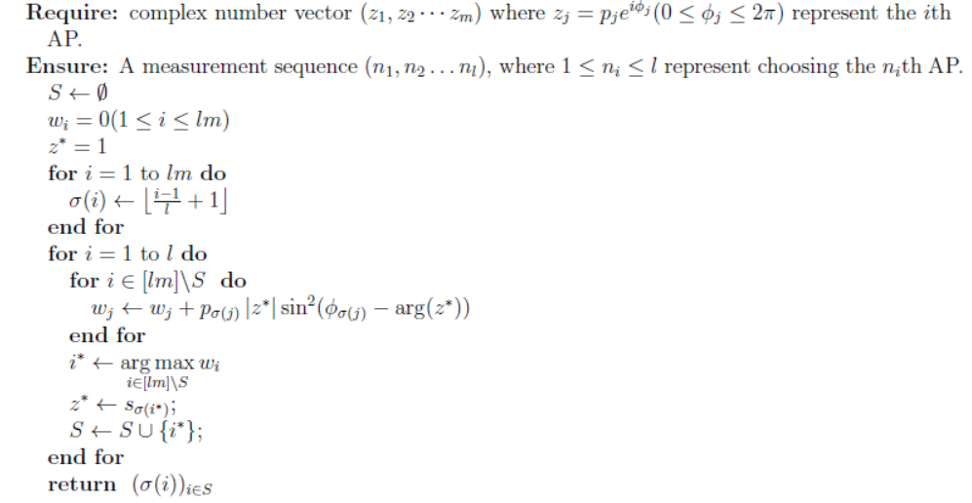
The algorithm

Slide 5
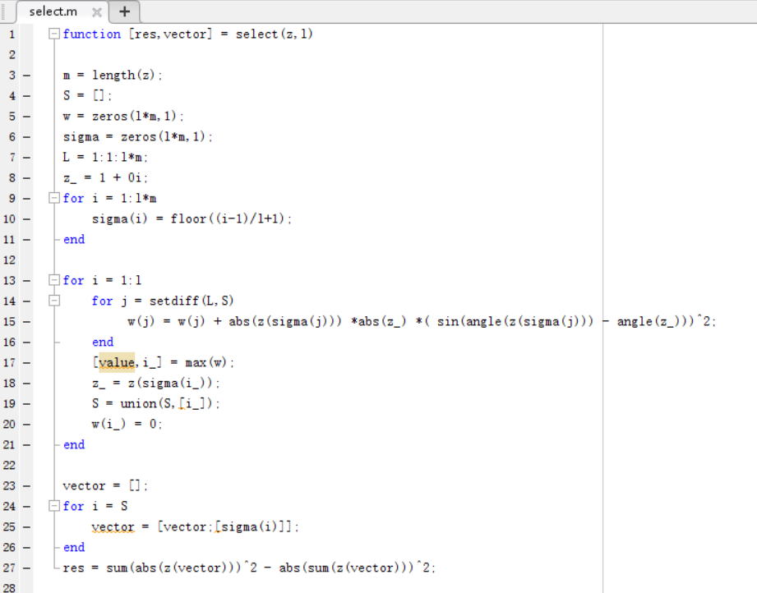
The algorithm

Slide 6
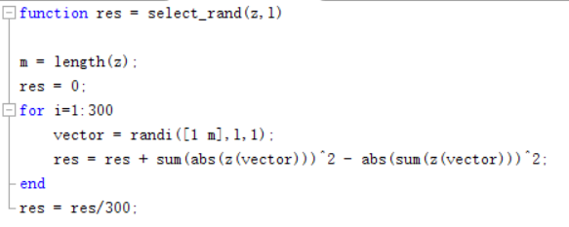
Test
When selecting randomly, we calculate 300 times in order to get more accuracy.

Slide 7
Test
The number of AP: m = 6, 12, 18.
Sequence number l is integer from m/2 to 3m/2.

Slide 8
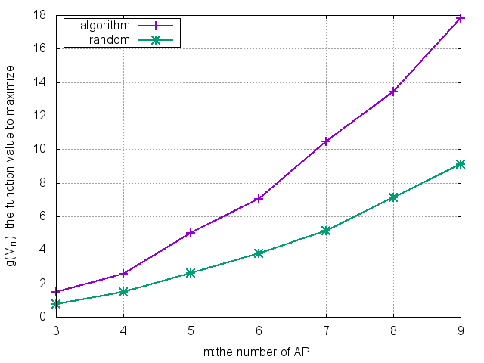
Test

Slide 9
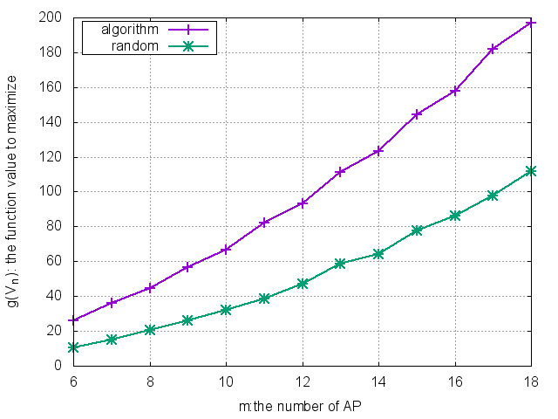
Test

Slide 10
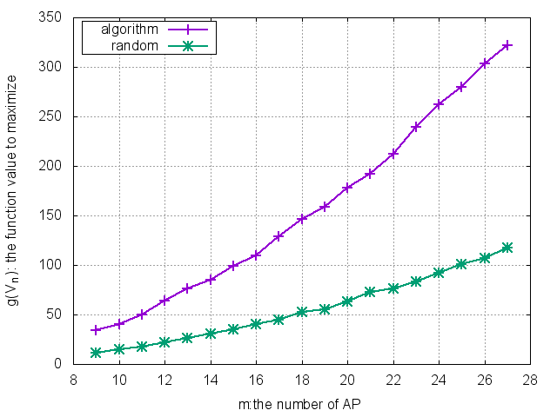
Test

Slide 11
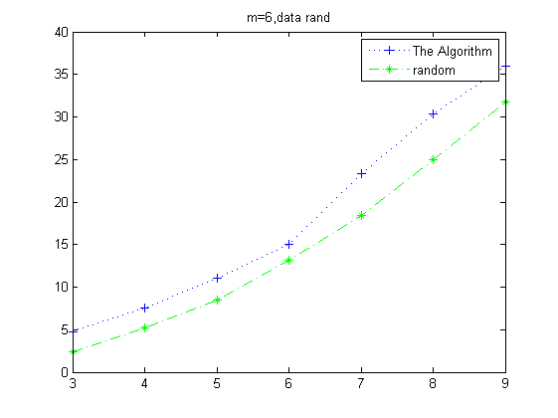
Test
Terriable result when m = 6
Improve:
The initial value of Z* may have influence.

Slide 12
Improve

Slide 13
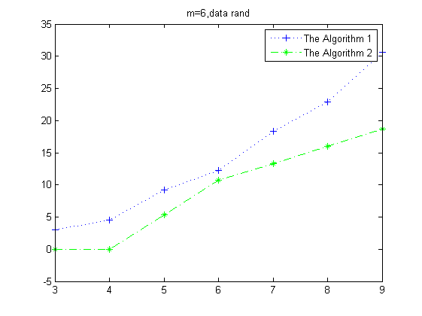
Test

Slide 14
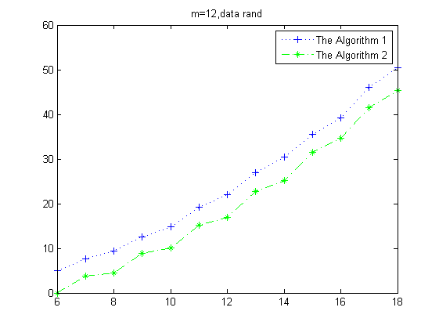
Test

Slide 15
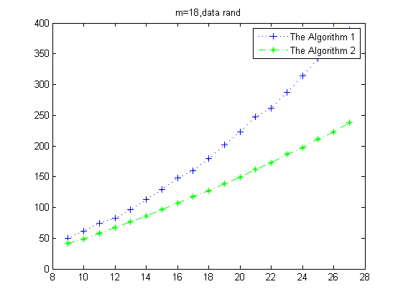
Test

Slide 16
Performance
Obviously, F(Vn) get greater value by our algorithm.
But the revised algorithm cannot get better performance than the original.

Slide 17
Any Questions?

Slide 18
Thank you!

