Slide 1
Recommendation in Scholarly Big Data
Lequn Wang
2016.6.10
Notes:
Hello, everyone. Today, I’m going to present you the project I’ve done in this semester. In this project, I focus on the recommendation in scholarly big data especially for acemap. Since you all attend professor Wang’s lector, I think you are all familiar with acemap, I will not introduce it.

Slide 2
Contents
1
Motivation
2
ZeroRank
3
Recommender System
Notes:
In this presentation, I will fisrt talk about the motivation and then show you the two parts of my work which are ZeroRank and Recommender System.

Slide 3
Motivation
More than 100 million papers in our dataset.
For convenience of the users.
Notes:
As professor Wang says, a researcher can only read thousands of papers, a hard-working professor may read 20 thousand papers. However, there are millions of papers out there.
They have to make a decision on which paper to read. A recommendation provides the efficiency for researchers, especially new researchers to find good, related papers and that is one of the goals of our acemap system.

Slide 4
ZeroRank
Ranking Current Year Scientific Literatures with no Citation
An interesting new question
Notes:
I will first introduce ZeroRank. Here, zero means zero citation. So, our goal is to rank the newly published papers with no citations so as to recommend new papers. We have done a lot of surveys on ranking scientific publications, however none is exactly the same as ranking newly published papers. So, this is a new problem we introduced, and I think it is interesting and useful.

Slide 5
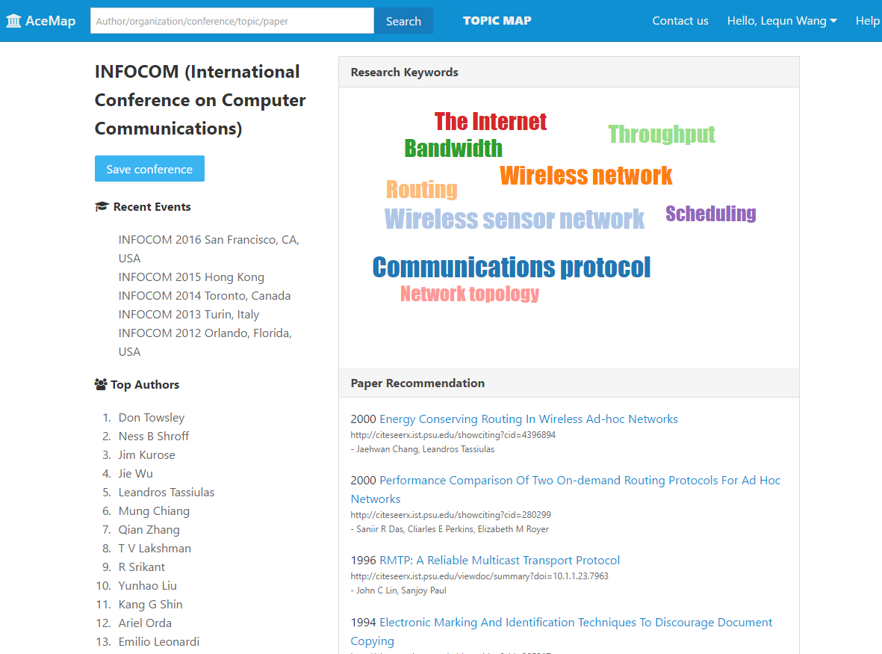
ZeroRank
Notes:
For example, when the results of Infocom come out, researchers in the computer network filed will definitely want to know what new papers published, what others are doing recently and what are the hot topics in the field. However, there are so many papers published in a conference. Our goal is to recommend some new papers that have high potential of getting large number of citations in the future.

Slide 6
How?
What makes a paper gain citations?
Author
Venue
Affiliation
Text ( Diffucult to use)
Notes:
Since these papers do not have citation information. In our model, we use author, venue, affiliation information. We have considered test information, however, it is difficult to incorporate the text information into our model and some researchers even claim that text information is useless in predicting paper’s popularity.

Slide 7
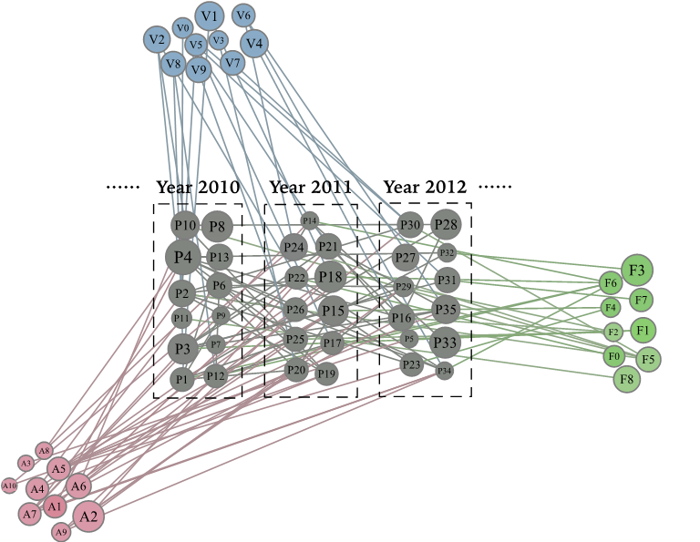
Random Walk
(Like pagerank or HITS algorithm)
Notes:
Our model can be divided into 2 parts. The first part is feature extraction. We perform random walk in this heterogeneous network. The random walk is like pagerank or hits algorithm. After the random walk, for each paper, we can get the scores of the three features.

Slide 8
Learning To Rank
A boosting ranking model
Notes:
In the second phrase , we train a learning to rank model to rank the papers.

Slide 9
Experiment Result 1
What is the performance of our model with other methods?
2 datasets : data mining, database
4 other ranking or citation prediction methods
4 performance metrics
Notes:
We select two subsets from MAG: data mining and database.

Slide 10
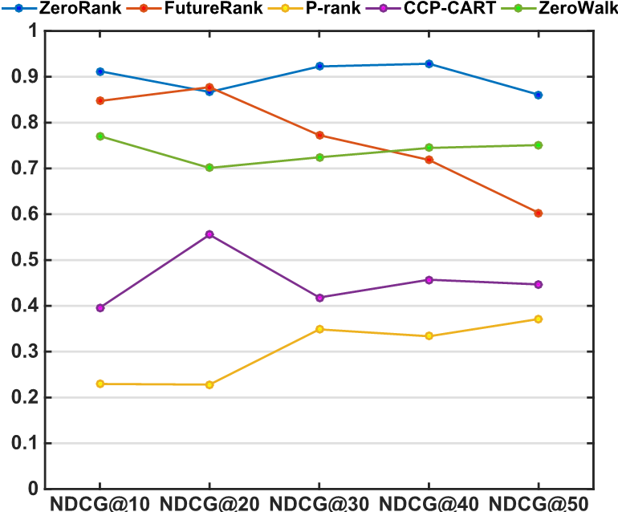
Experiment Result 1
What is the performance of our model with other methods?
Data Mining:
Notes:
This is the comparison using NDCG in data mining dateset. We can see that ZeroRank, represented by the blue line, is the best of the four metohds.

Slide 11
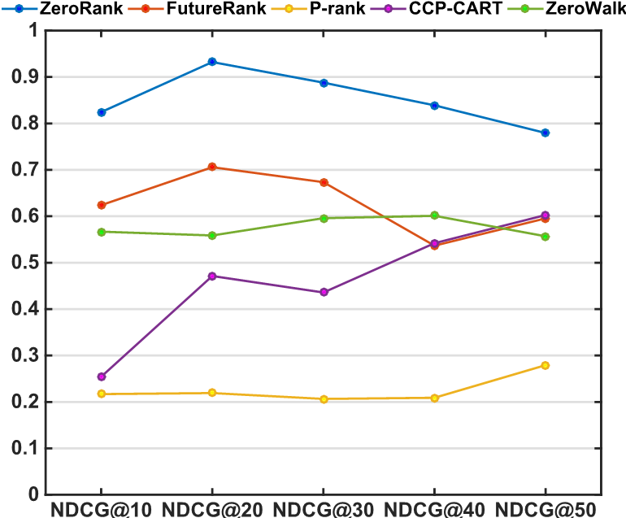
Experiment Result 1
What is the performance of our model with other methods?
Database:
Notes:
This is the comparison in Database dataset.

Slide 12
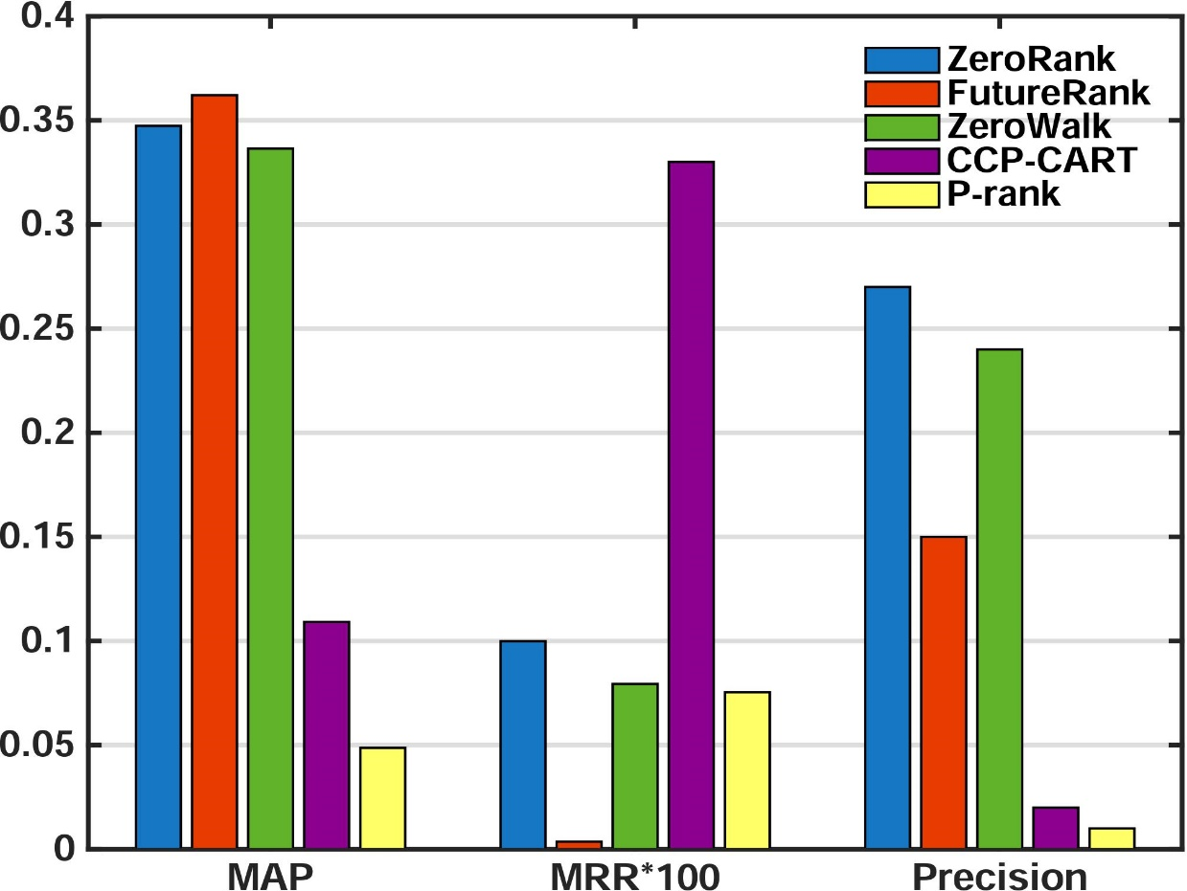
Experiment Result 1
What is the performance of our model with other methods?
Data mining:
Notes:
These are the comparisons of the other three performance metrics in data mining

Slide 13
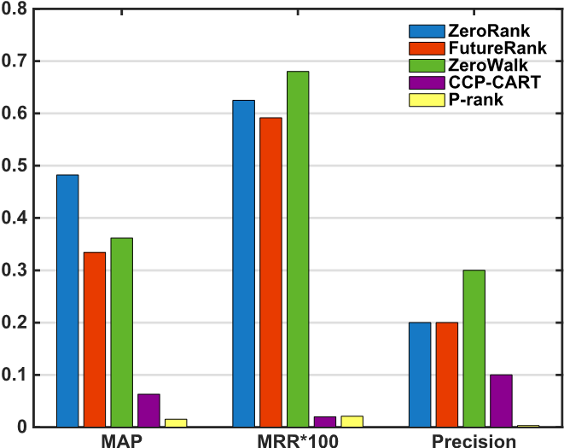
Experiment Result 1
What is the performance of our model with other methods?
Database:
Notes:
And database.

Slide 14
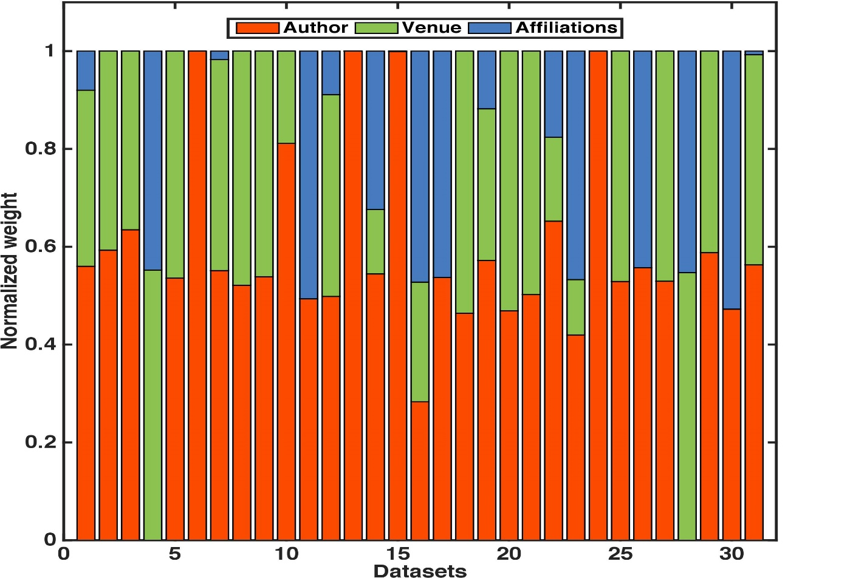
Experiment Result 2
Which feature is the most important?
Notes:
In this experiment, we use learning to rank algorithm to quantitatively measure the importance of different features in determining whether a paper will receive more citations. We select 31 subfields of computer science as our datasets.
We ran zerorank on 31 subfields and the result is shown in the figure. We can see that author feature is the dominant feature which is different from the conclusion by other researchers that conference is the most important.

Slide 15
What I did?
Discuss the design of our model.
Participate in implementing our model.
Implement some of the comparing models.
Do most of the experiments.
Paper writing.
Notes:
We have organized our work into a paper and submitted it to CIKM. In this part of the work, I participated in discussing and implementing our model. Besides, I implemented some comparing models and did most of the experiments. I also write the papers for my part of work and help modify the whole paper.

Slide 16
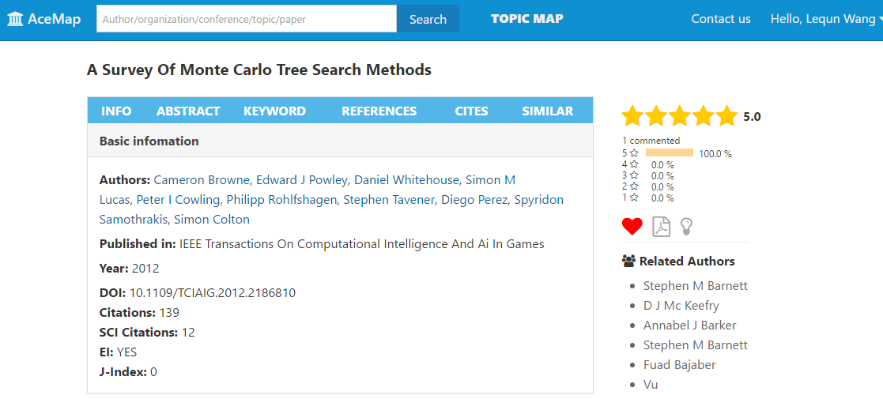
Recommender System
Do personalized recommendation.
Find topic level similarity between users and papers.
Notes:
Now, I will show you the second part of my work – the recommender system. In the acemap system, we have the information of users if they have liked some papers. We wanna use these information to do personalized recommendation to researchers.

Slide 17
Why CTR?
Find topic level similarity between users and papers.
Born to solve the cold start problem.
Notes:
We have surveyed a lot of methods and found that collaborative topic regression CTR matches our system well.
The first reason we use CTR is that is can find topic level similarity between users and papers. Professor Wang has said a lot of times that he wanted our acemap system to have the ability to recommend papers that are not in the same field, but have similar or same ideas or methods. I think this recommender is a first try.
The second reason is that it is born to solve the cold start problem. Because our acemap is new, the user number is small. The traditional methods for recommendation can not deal with the papers that no one likes. In CTR, we can use the text information in these papers to do recommendation.

Slide 18
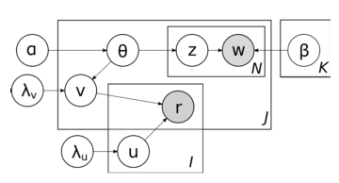
CTR
CTR
Notes:
I will not show you the detail of CTR but the basic idea.

Slide 19
What is CTR?
CTR is a combination of CF and LDA
LDA represents a document as a vector
CF represents each item and each user as a vector.
In CTR, the item vector is generated by both paper content and user preference.
The * between an user-paper pair measures the possibility that the user likes the paper.
Notes:
CTR is a combination of Collaborative filtering and Latent Dirichlet allocation. Read it

Slide 20
Experiment 1
Goal: use field of study information to improve the performance.
Method1: User simulation
Method2: Only recommend the papers with the same field of study.
Notes:
Since we have the field of study information form microsoft, we wanna use it to improve the performance of our the model. We’ve tried 2 methods. One is to simulate users and each user likes a particular field of study and randomly assign some papers in this field of study to him.
The second is to recommend to users the papers that have the same field of study as the papers the users like.

Slide 21
Experiment 1 (failed)
The field of study information is not precise.
Papers have multiple field of study.,
Some papers do not have this information.
Notes:
The results show that both the two methods fail to improve the performance of the model. These are the three reasons I list here that may account for the failure.

Slide 22
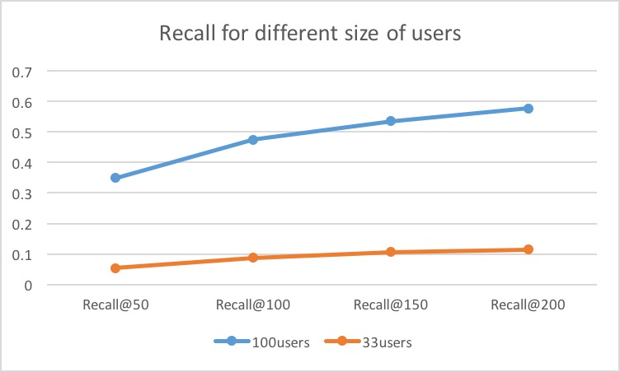
Experiment 2
Notes:
The second experiments which yuning has show is that as the user number grow, the performance of the system will go up dramatically. So as acemap accumulates more users, the recommendation will be better and better.

Slide 23
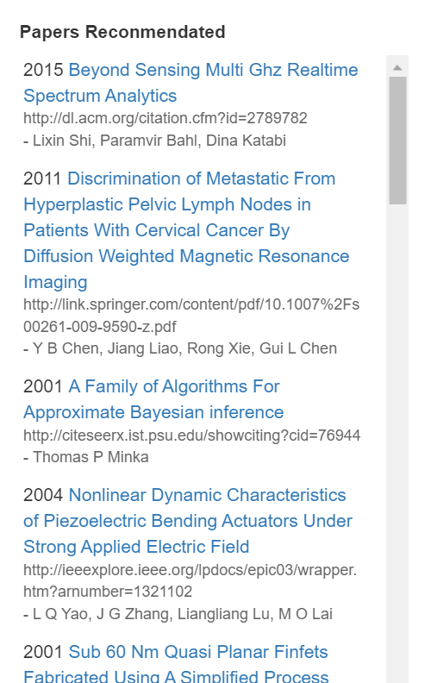
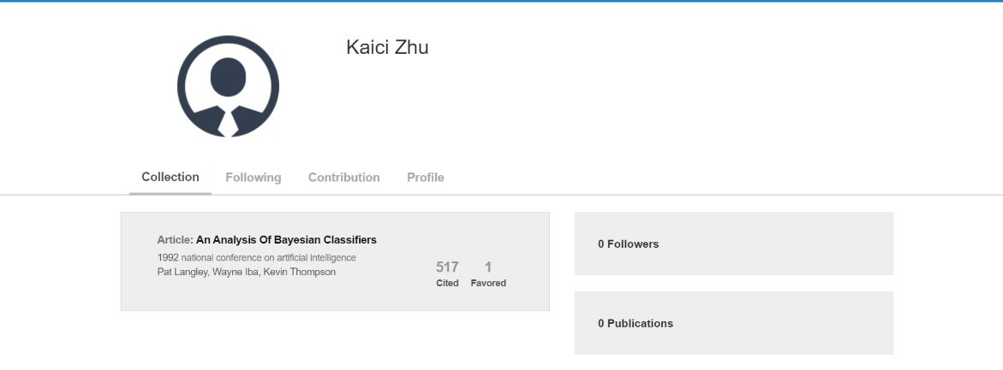
Experiment 3
For real-world system Acemap (using MAG)
Notes:
This is a demonstration also show by Yuning.

Slide 24
What I did?
Participate in doing the survey.
Discuss how to build the system.
Do the experiments..
Give the final results results in acemap.
Notes:
In this recommender system, I’ve surveyed with the group members on how to do recommendation and finally we decide to use CTR in our system. We discussed mostly with Yuning how to process the data, how to tune the parameters of the model. In the experiments and implementation, yuning is in charge of processing the data, he deals with the database. I focus on the model part, to train the model, tune the parameters, get the results and evaluate the results.

Slide 25
Q&A
Notes:
That’s all for today’s presentation, any questions?

