Slide 1
Building Automation Sensor Network
Xiu Di

Slide 2
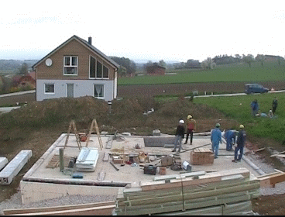
Prefabricated Building
a building that is manufactured and constructed using prefabrication.
It consists of factory-made components or units that are transported and assembled on-site to form the complete building.

Slide 3
Assemble
Human’s work
Automatic
Hands, brains, and eyes?

Slide 4
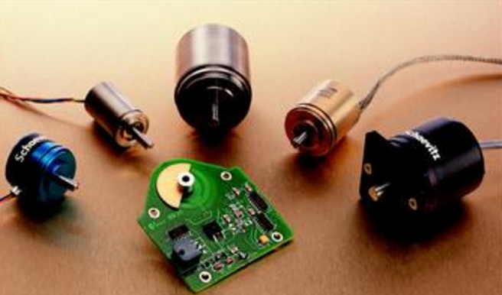
What we do
We select some sensors and put them together to let the object know where is it.
Laser, Infrared, Acceleration, Angle, Ultrasonic…

Slide 5
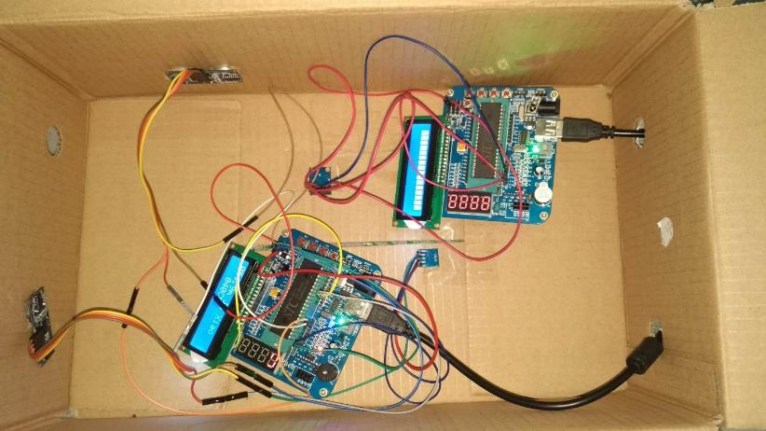
What we have done

Slide 6
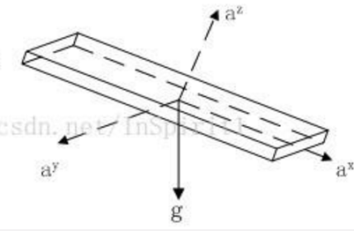
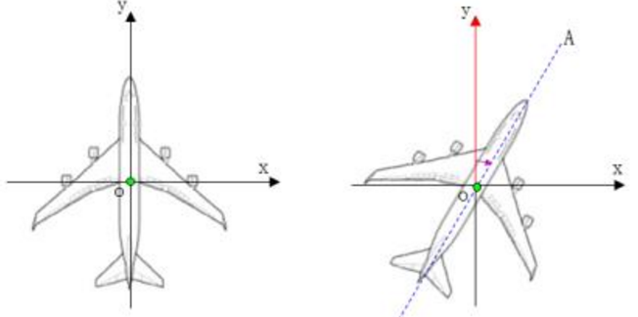
Details-posture
Gravity acceleration component (incline angle)
Geomagnetic field Component
(deflection angle)

Slide 7
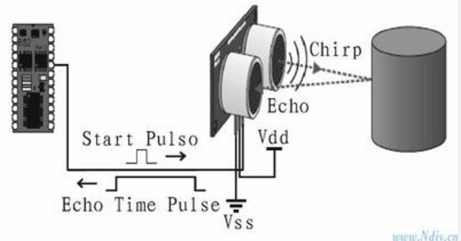
Details-distance
Ultrasonic
Distance = time * velocity / 2

Slide 8
What I do
1.Preliminary investigation
2.Debug (sensors on one MCU)
3.Test
Notes:
Then I am going to talk about what I did in the project , at the first we done a lot of preliminary investigation on different kinds of sensors and searched for the technology that can be used. Laser is expensive but most helpful ,

Slide 9
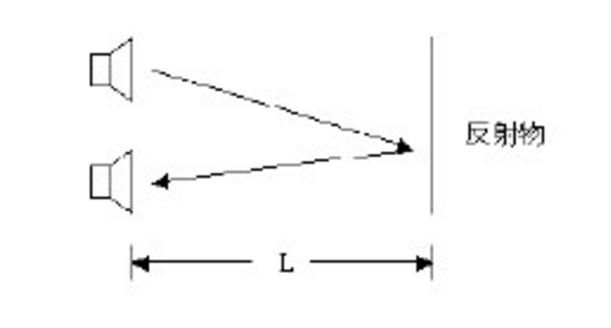
Shortcoming
Something to reflect
How to promise to receive

Slide 10
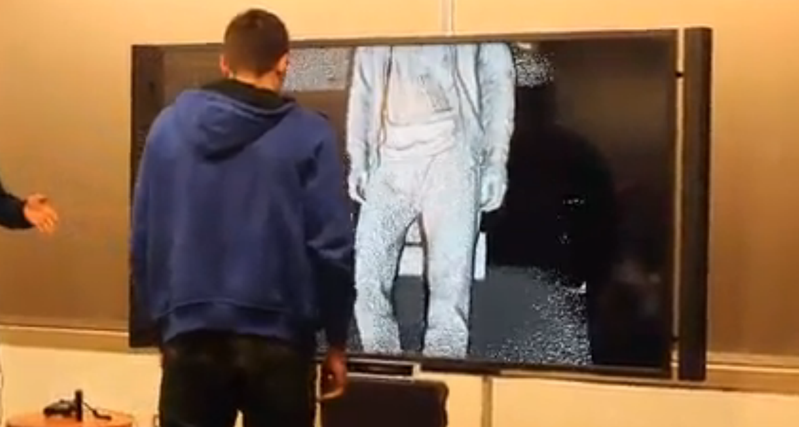
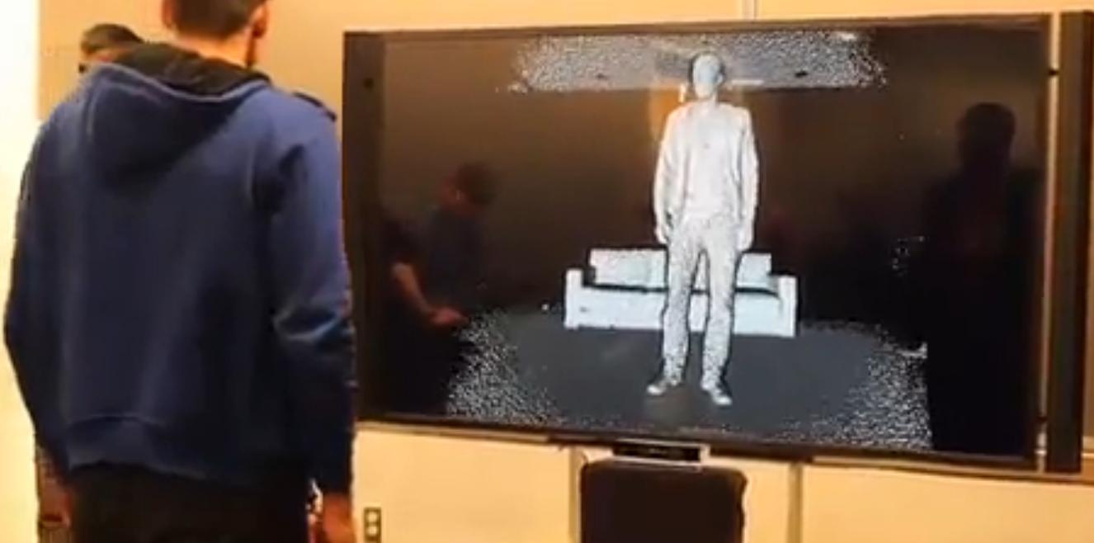
Kinect
It is a kind of motion sensing input device. Although it is usually used to capture human’s movements and gestures as a motion controller for game. We can also regard it as a
depth camera.

Slide 11
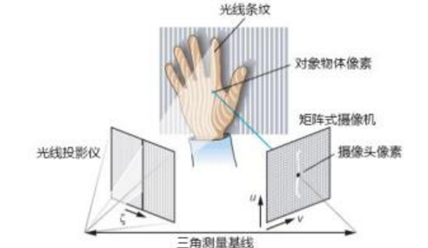
Principle
Light Coding Technology
The process codes the scene with near-IR light, light that returns distorted depending upon where things are. The solution then uses a standard off-the-shelf CMOS image sensor to read the coded light back from the scene using various algorithms to triangulate and extract the 3D data.
Laser diffraction(衍射)
laser speckle(光斑)

Slide 12
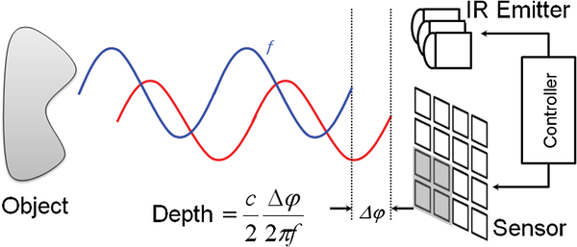
Principle
Kinect 2: Time of flight method
Modulate sine light wave, check phase instead of time

Slide 13
Inspiration
What if we use a laser sender and receiver as eyes and put tags on objects to specify it.
Sender launch different light to space according to the angle. And tag reflects according to what it received and tells receiver ’I am here’.

Slide 14
Thanks!

Slide 15
Q&A

