Slide 1
Incentive Mechanism Design
Crowd Indoor Localization
Chaoyue Niu
Instructors: Li, Tian, and Wang
June 6, 2015
Dept. CSE, IEEE, SJTU

Slide 2
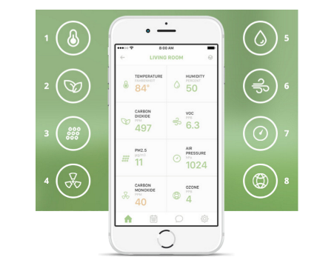
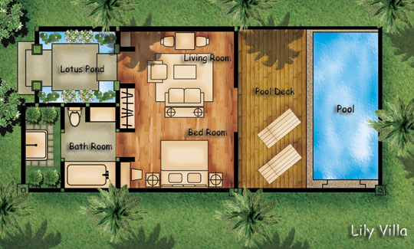
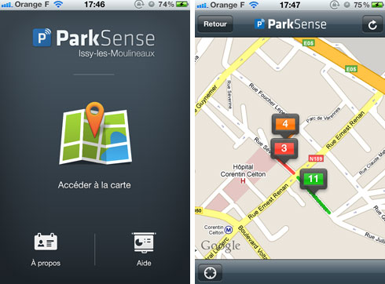
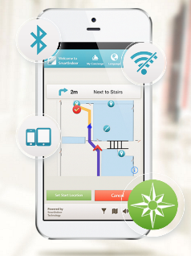
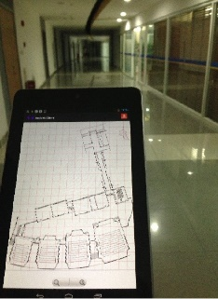
Crowdsensing for Daily Life
A promising research hotpoint
Environmental Monitoring
(Mobisys’09)
Floor Plan Reconstruction
(Mobicom’14)
On-Street Parking
(Mobicom’13)
Indoor Localization
(Mobicom’12, TVT’15)
01

Slide 3
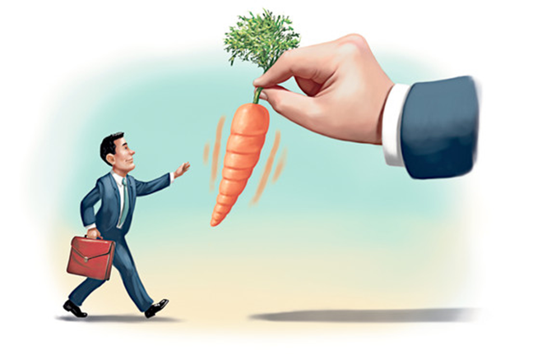
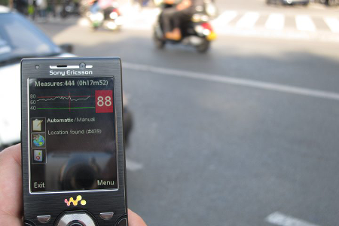
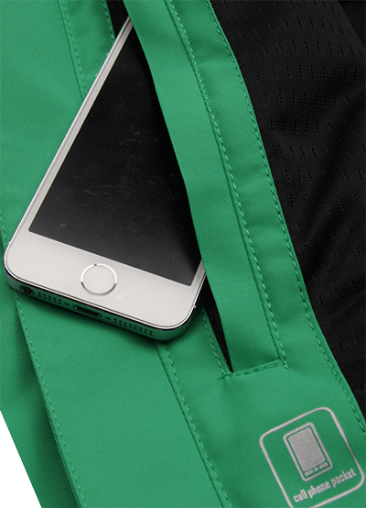
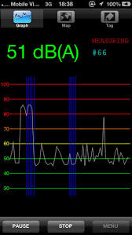
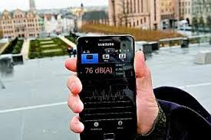



Crowdsensing Vision VS. Reality
Incentive for users’ participation and data quality
Vision
Incentive
Quantity
Quality
large-scale, sustained and reliable participation for high QoS
Reality (sensing data of diverse qualities)
rational participants
time, energy, and resources
different levels of personal efforts
e.g., noise monitoring on campus
02

Slide 4
Online Fingerprints Collection
for Indoor Localization

Slide 5














System Model
Reverse Auction
Crowdsensing based online fingerprints collection
$$x_{n}$$
t_{n}
$$b_{n}$$
$${ p}_{n}?$$
…
    $$M$$
$${ p}_{2}?$$
Time Sequences
RSS
$$b_{2}$$
$$x_{2}$$
t₂
$${ p}_{1}?$$
Fingerprint DB
Data Purchaser
Trading Platform
$$b_{1}$$
$$x_{1}$$
t₁
Notations
    ${ w}_{k}$ $x_{k} { b}_{k}$ ${ p}_{k}$ $M$
    worker data bid payment pricing mechanism
Workers
03
Notes:
The agent is honest-but-curious if she follows the designed protocol but
tries to gather information about other participants.

Slide 6
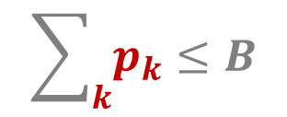

Design Goals
In terms of economic properties
Budget Constraint
Reverse Auction
$$\sum_{k}{p_{k}}≤B$$
Truthfulness
Bid = Cost?
$p_{k}$ $≥b_{k}$
Individual Rationality
04
Notes:
1. Here, individual rationality means that a participant should be rewarded no less than her sensing cost, and the profit of service provider is the difference between the value of crowdsensing based services and the total rewards to recruit participants. Both participants and service provider should be well motivated in a robust crowdsensing market.

Slide 7
Design Goals
In terms of machine learning
Data Pricing
Sequential data arrival and Hypothesis update
Online
Loss function and Regret
Regret Minimization
05

Slide 8
Candidate Solutions
Enlightenment from Top Work

Slide 9
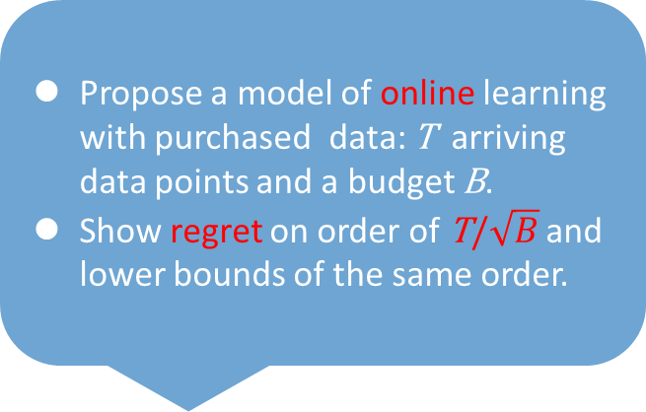
Available Techniques
Propose a model of online learning with purchased data: T arriving data points and a budget B.
Show regret on order of T/$\sqrt{B}$ and lower bounds of the same order.
Intensive Reading, Deeply Thinking and Innovative Mechanism
Truthfulness
Posted-price model:
EC’15 Abernethy & WWW’13 Singla
Individual rationality
Take-it-or-leave-it price offer
Budget & Regret
I
Importance weighted regret bound:
ICML’09 Beygelzimer;
Low-cost learning via active data procurement
EC’15 Abernethy
Budget & Regret II
Multi-armed bandit (MAB):
Tradeoff between Exploration and Exploitation
Budgeted: AAAI’13 Ding, AAMAS’15 Biawas
Truthful: EC’09 Babaioff, WWW’13, AAMAS’14 Jain
Future
Work
Instantiation with indoor localization
MLE with imperfect information
(Infocom’15 Wen; TMC draft by Tian)
OPE, MAC, or signature schemes
06

Slide 10
Reference
Stand on the shoulders of giants
[1] J. D. Abernethy, Y. Chen, C. Ho, and B. Waggoner. Low-cost learning via active data procurement. In EC, 2015.
[2] M. Babaioff, Y. Sharma, and A. Slivkins. Characterizing truthful multi-armed bandit mechanisms: extended abstract. In EC, 2009.
[3] A. Biswas, S. Jain, D. Mandal, and Y. Narahari. A truthful budget feasible multi-armed bandit mechanism for crowdsourcing time critical tasks. In AAMAS, 2015.
[4] W.Ding, T.Qin, X.Zhang, and T.Liu. Multi-armed bandit with budget constraint and variable costs. In AAAI, 2013.
[5] R. Gao, M. Zhao, T. Ye, F. Ye, Y. Wang, K. Bian, T. Wang, and X. Li. Jigsaw: indoor floor plan reconstruction via mobile crowdsensing. In MOBICOM, 2014.
[6] S. Jain, S. Gujar, O. Zoeter, and Y. Narahari. A quality assuring multi-armed bandit crowdsourcing mechanism with incentive compatible learning. In AAMAS, 2014.
[7] H. Lu, W. Pan, N. D. Lane, T. Choudhury, and A. T. Campbell. Soundsense: scalable sound sensing for people-centric applications on mobile phones. In MobiSys, 2009.
[8] P. Mohan, V. N. Padmanabhan, and R. Ramjee. Nericell: rich monitoring of road and traffic conditions using mobile smartphones. In SenSys, 2008.
[9] S. Nawaz, C. Efstratiou, and C. Mascolo. Parksense: a smartphone based sensing system for on-street parking. In MOBICOM, 2013.
[10] A. Rai, K. K. Chintalapudi, V. N. Padmanabhan, and R. Sen. Zee: zero-effort crowdsourcing for indoor localization. In MOBICOM, 2012.
[11] A. Singla and A. Krause. Truthful incentives in crowdsourcing tasks using regret minimization mechanisms. In WWW, 2013.
[12] Y. Wen, J. Shi, Q. Zhang, X. Tian, Z. Huang, H. Yu, Y. Cheng, and X. Shen. Quality-driven auction-based incentive mechanism for mobile crowd sensing. IEEE Transactions on Vehicular Technology, 64(9):4203–4214, 2015.
[13] Y. Wen, X. Tian, X. Wang, and S. Lu. Fundamental limits of RSS fingerprinting based indoor localization. In INFOCOM, 2015.
[14] T. Yan, V. Kumar, and D. Ganesan. Crowdsearch: exploiting crowds for accurate real-time image search on mobile phones. In MobiSys, 2010.
07

Slide 11

Q & A
Your Advice Makes Me Perfect

Slide 12
Acknowledgement to
Li, Tian, Wang, and et al.

Slide 13
Thanks For Watching!
Meet Happy Enjoy!

