Slide 1
Modulation Technology in RFID
Li He

Slide 2
Outline
Motivation
Brief Introduction to RFID
Backscattering Modulation
Digital Modulation
Notes:
Before talking about the technology, let’s take a look at the outline of the presentation.
First of all I want to talk about the motivation of using RFID and then I will give a brief introduction to RFID. As I’m responsible to investigating the modulation technology used in RFID I will mainly talk about it later which includes physical mechanism, that is Backscattering Modulation and digital modulation technology.

Slide 3
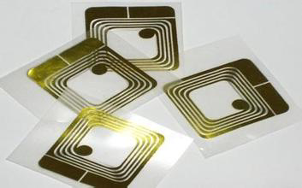
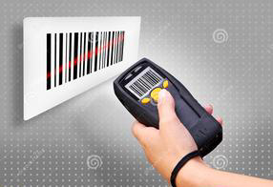
Motivation
RFID is a new technology mainly used for
Item Identification
  not require human intervention
  tag placement is less constrained
VS.
Notes:
When we talk about an unfamiliar technology, first we should know why we want to use and study it. We can find the answer through history
Last century, RFID is invented to identify items automatically. We all know that barcode is used to identify item widely so why do we take effort to invent RFID?
Compared with barcode, RFID has many advantages and here are two major ones.
RFID does not require human intervention, thus it reduces employment costs and eliminates human errors from data collection.
As no line-of-sight is required, tag placement is less constrained.

Slide 4

Motivation
RFID is a new technology mainly used for
Indoor Localization
  No energy source
  More accurate
VS.
Notes:
Later, people find that RFID can also be used in indoor localization.
Comparing RFID with currently used indoor localization technology, like BLE and WIFI, RFID has these superiorities:
All components of BLE need energy source but the tag component of RFID does not need energy source.
Different mechanism makes RFID more accurate than BLE thus it can be used in item-level localization, e.g. localizing books on a shelf.

Slide 5
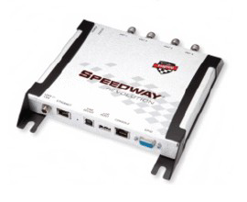

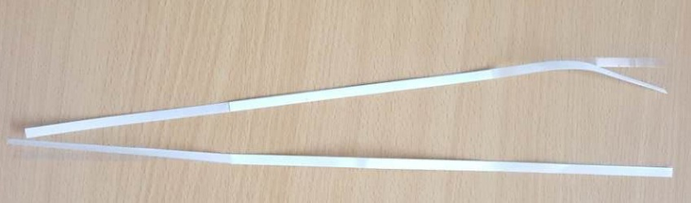
Introduction
RFID = radio frequency identification devices(无线射频识别）
Reader
Antenna
RFID tag
Notes:
Now let me briefly introduce the RFID system.
RFID is short for radio frequency identification devices. The system is usually used for Item Identification and Indoor Localization
Usually a RFID system consists of these major components: Reader, antenna and RFID tag.
Reader and antenna are used to transmit energy to tag and demodulate the signal it received from the tag.
Tag is attached to the item to be localized like book or box. In our project the RFID tag is passive tag, which means it does not need source energy. It can use the energy from the reader to demodulate the command from reader and modulate the data in its memory and backscatter the signal to reader after modulation.

Slide 6
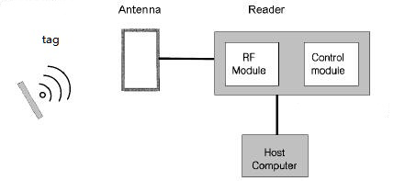
Introduction
Overall structure
Notes:
This is an overall structure of a RFID system.
A host computer or just a microprocessor with corresponding program controls the reader to send specified commands to the tag to read information from tag or write information into it. Receiving the signal from reader, tag will get energy from the signal, demodulate the command and backscatter a signal with information modulated in it.
What information is in the tag is out of my presentation and Li Neng will introduce it later.

Slide 7
Backscattering Modulation
Definition: tag receives energy from reader and backscatter the signal modulated with information in it
Two types of design approaches:
Near-field coupling
Far-field coupling
Notes:
Here comes the detail of the technology.
First let’s look at the definition of Backscattering Modulation……such a process is called Backscattering Modulation
I just talked about that tag can receive energy from reader but how can it do so?
According to the different mechanism used, Two fundamentally different RFID design approaches exist for transferring power from the reader to the tag. They are Near-field coupling and Far-field coupling

Slide 8
Backscattering Modulation
NEAR-FIELD COUPLING:
Mechanism: magnetic induction(Faraday’s principle)
Notes:
The first one is near-field coupling and it use magnetic induction(电磁感应）,and the total system can be seen as a transformer(变压器). Both reader and tag has its own coil[kɔɪl] thus tag can generate current from alternating magnetic field.

Slide 9
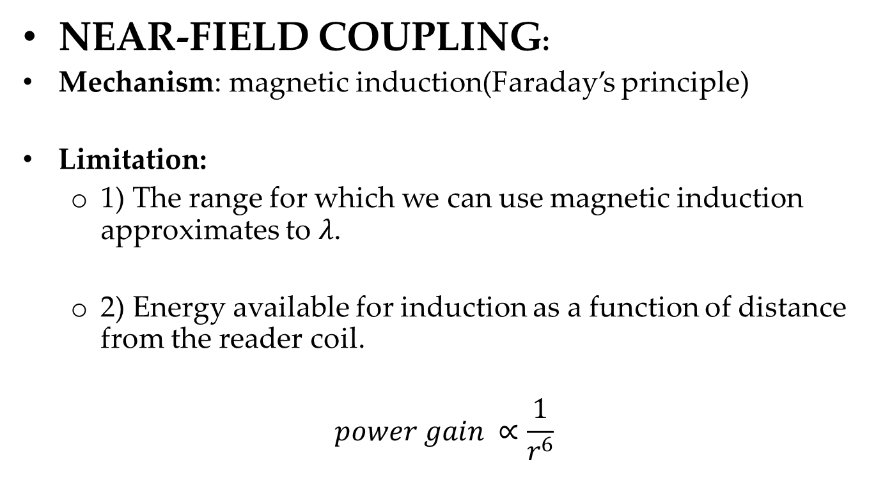
Backscattering Modulation
NEAR-FIELD COUPLING:
Mechanism: magnetic induction(Faraday’s principle)
Limitation:
  1) The range for which we can use magnetic induction approximates to $λ$.
  2) Energy available for induction as a function of distance from the reader coil.
$$power gain ∝\frac{1}{r^{6}}$$
Notes:
Though the design is easy to implement, it has limitation.
One wavelength
Attenuation of power is proportional to $r^{−6}$(r powered minus six)

Slide 10
Backscattering Modulation
FAR-FIELD COUPLING
Mechanism: electromagnetic (EM) wave capture
Notes:
Next is far-field coupling.
RFID tags based on far-field coupling capture electromagnetic waves propagating from a dipole[‘daipəul] antenna(偶极子天线) attached to the reader. A smaller dipole antenna in the tag receives this energy as an alternating potential difference that appears across the arms of the dipole.

Slide 11
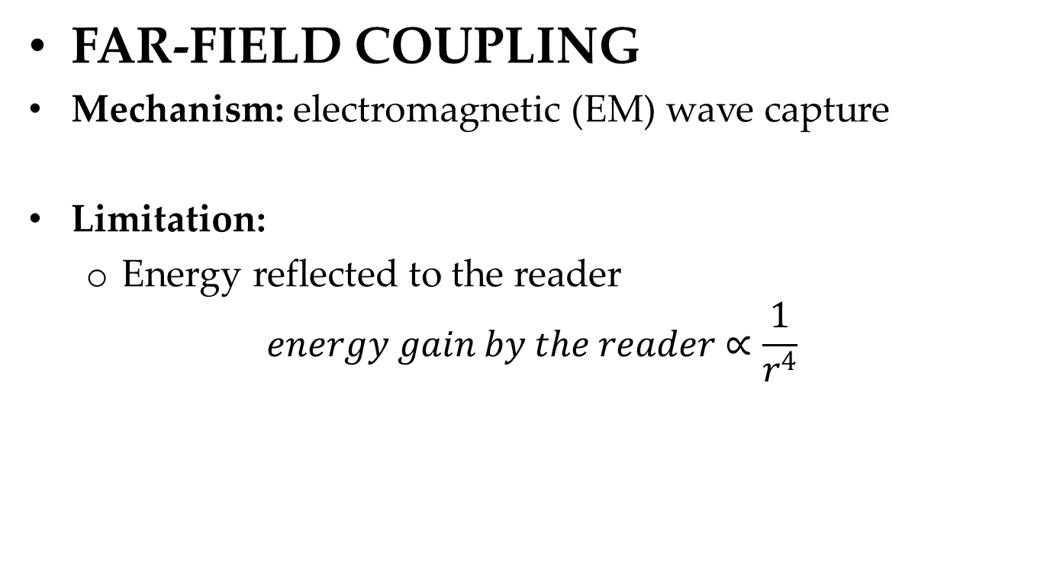
Backscattering Modulation
FAR-FIELD COUPLING
Mechanism: electromagnetic (EM) wave capture
Limitation:
  Energy reflected to the reader
$$energy gain by the reader∝\frac{1}{r^{4}}$$
Notes:
Also the limitation is the range. Energy reflected to the reader is proportional to $r^{−4}$(r powered minus four)
The system of our project uses far-field coupling.
So far we know how the tag receive energy to modulate the signal but we don’t know how to make the signal backscattered to reader carry the information in tag. Next I want to talk about the digital Modulation technologies used in RFID.

Slide 12
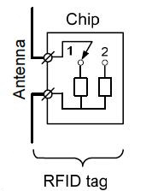
Digital Modulation
Circuit in the tag
Notes:
Briefly the circuit in the tag is like this.
We can see that there are two loads in the chip and their impedance[im'pi:dəns] are different. Thus different impedance makes different current intensity to distinguish one from zero. Thus we can modulate the information on the signal

Slide 13
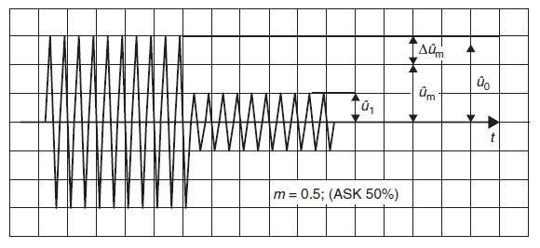
Digital Modulation
ASK: amplitude shift keying(振幅键控)
Pros: provide a high data rate
Circuit easy to implement
Cons: low noise immunity
Notes:
So we get ASK modulation. The different amplitude of the signal forms a bit stream which consist of the information. Reader just need to see whether the amplitude of one cycle is greater than or smaller than a threshold to tell one from zero.
Majority of tags use such a design as it can provide a high data rate and its circuit is easy to implement. But it has low noise immunity.

Slide 14
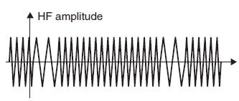
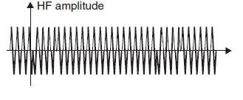
Digital Modulation
FSK
PSK
Notes:
There are some other modulation methods like FSK and PSK.
In the former one, the frequency of a carrier is switched between two frequencies $f_{1}$ and $f_{2}$ by a binary code signal.
As for the latter one, ‘0’ and ‘1’ of signal are converted into corresponding phase states of the carrier.
Every modulation technology has its pros and cons but ASK is almost used by all passive tags as its simple circuit design.

Slide 15
Thanks
Q&A
Notes:
Actually we conduct an series of experiment but limited by time I won’t introduce it, and later someone may talk about it.
So that’s all for my presentation. Thank you.

