Slide 1
A Location System Based on RFID
5130309748 Neng Li
2016/5/30

Slide 2
Outline
Introduction
System
Experiment

Slide 3
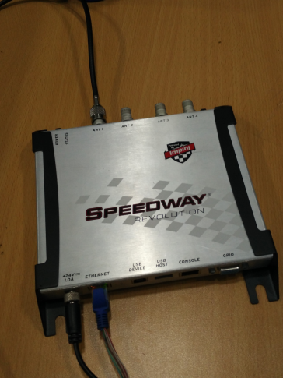
Introduction of RFID
Radio Frequency Identification
Use a radio signal to identify a specific target and read data.
Type of tags: active or passive
Infer distance from phase.
Impinj R420
Reader:
Antenna:

Slide 4
Advantages of RFID
Compared with WIFI location system and bluetooth location system
Higher accuracy
Passive tag
Lower cost
High transmission rate

Slide 5
Outline
Introduction
System
Experiment

Slide 6
Selection of Frequency
UHF RFID System
From 300MHz ~ 1GHz
High transmission rate (100kbps)
3~10m read range (for passive tag)
Microwave RFID System
2.45GHz
High transmission rate (100kbps)
2m read range (for passive tag)
Easily be affected by environment

Slide 7
ISO 18000-6
ISO 18000-6 is a standard for UFH RFID system.
Frequency of ISO 18000-6 standard : 860MHz~960MHz
Reason:
860MHz ~ 960MHz can avoid WIFI’s interference
ISO 18000-6 has a suitable read range

Slide 8
Signal Collision in RFID
Signal collision from readers
When multiple readers read tag simultaneously, the reader can’t judge which response is the one it needs.
Signal collision from tags
The incidence of multiple responses from multiple tags reaching simultaneously to the antenna prevents it of identifying each response individually.

Slide 9
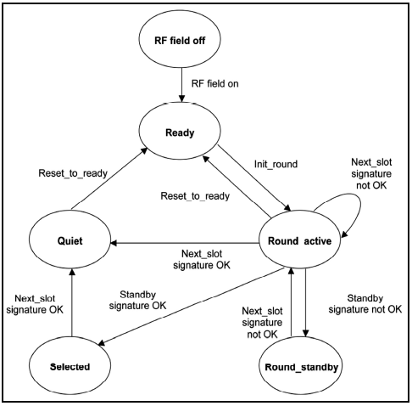
ALOHA algorithm

Slide 10
EPC tags
EPC tag is a read-only tag and can be passively powered.
Each tags contains the identifying information.
Size of EPC tag is quite small

Slide 11
Outline
Introduction
System
Experiment

Slide 12
Refer distance from phase

Slide 13
Future work
Use different frequency to locate a tag away from wavelength.
Improve the accuracy when more than one frequency are used.

Slide 14
Thank you
Q&A

