Slide 1
Wireless Charging Project
Presented by Pei Zhang
2016.5.31

Slide 2
INDEX
Background & purpose
Research steps
Power consumption research
Antenna energy harvesting
Future work

Slide 3
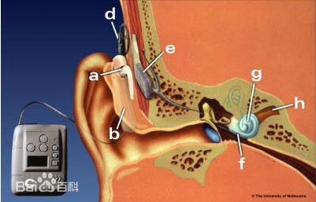
Background & purpose
In the medical field, deaf people need to live with artificial cochlear. The common power is rechargeable battery.
We aim to use antenna to capture the energy of WIFI signal to convert it into the power of our artificial cochlear.

Slide 4
Research steps
1st step: research blue-tooth power consumption
2nd step: antenna circuits(WISP)
3rd step: future work

Slide 5
Blue-tooth power consumption
1、basic piconet channel
is used for two device which have connected.
2、adapted piconet channel
is used for two device which have connected.
3、inquiry scanchannel
is used for finding blue-tooth device
4、page scanchannel
is used for connecting blue-tooth device
Notes:
特定的 specific

Slide 6
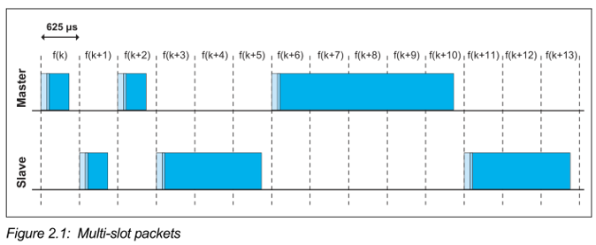
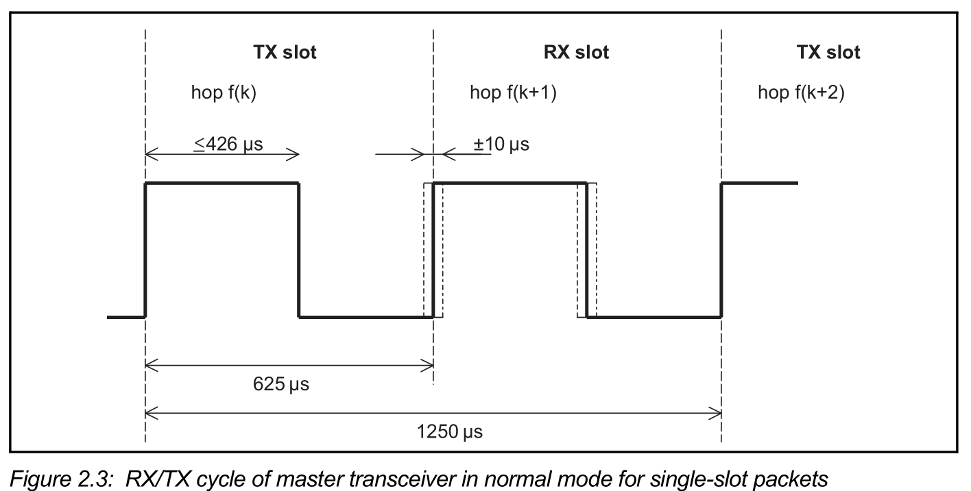
Blue-tooth power consumption
Piconet physical channel timing
Only 3 packet types: 1,3,5 slots
For each slot, the time of broadcast is less than 426μs
Share of broadcasting in total is 68.16%
In Blue-tooth low energy mode
TX mode electric current 16.8mA
RX mode electric current 17.9mA
Notes:
milliampere

Slide 7
Blue-tooth power consumption
PAGE SCAN PHYSICAL CHANNEL
The time of broadcast is less than 68μs
Share of broadcasting in total time is 21.76%
INQUIRY SCAN PHYSICAL CHANNEL
The time of broadcast is less than 68μs
Share of broadcasting in total time is 21.76%
Notes:
micro second

Slide 8
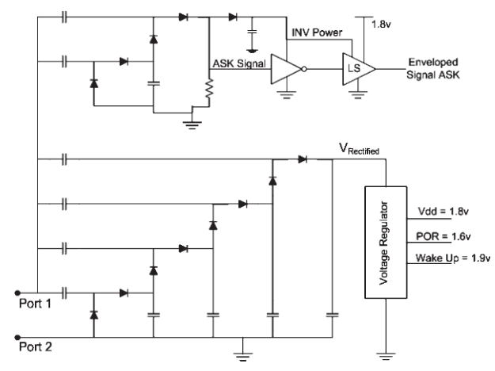
Antenna energy harvesting
We build the Wireless Identification and Sensing Platform(WISP) circuit to expand the signal so that we can capture WIFI signal and amplified it.
impedance matching
WISP
Notes:
circuit diagram

Slide 9
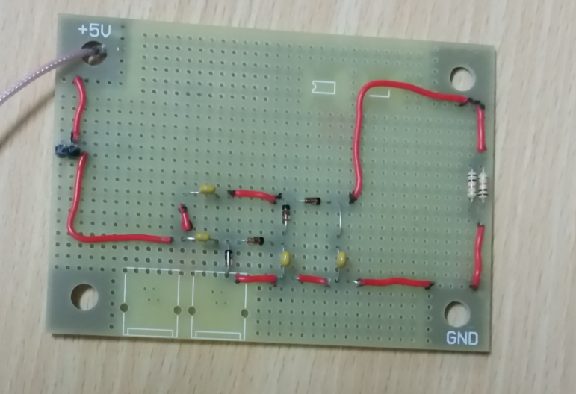
Antenna energy harvesting

Slide 10
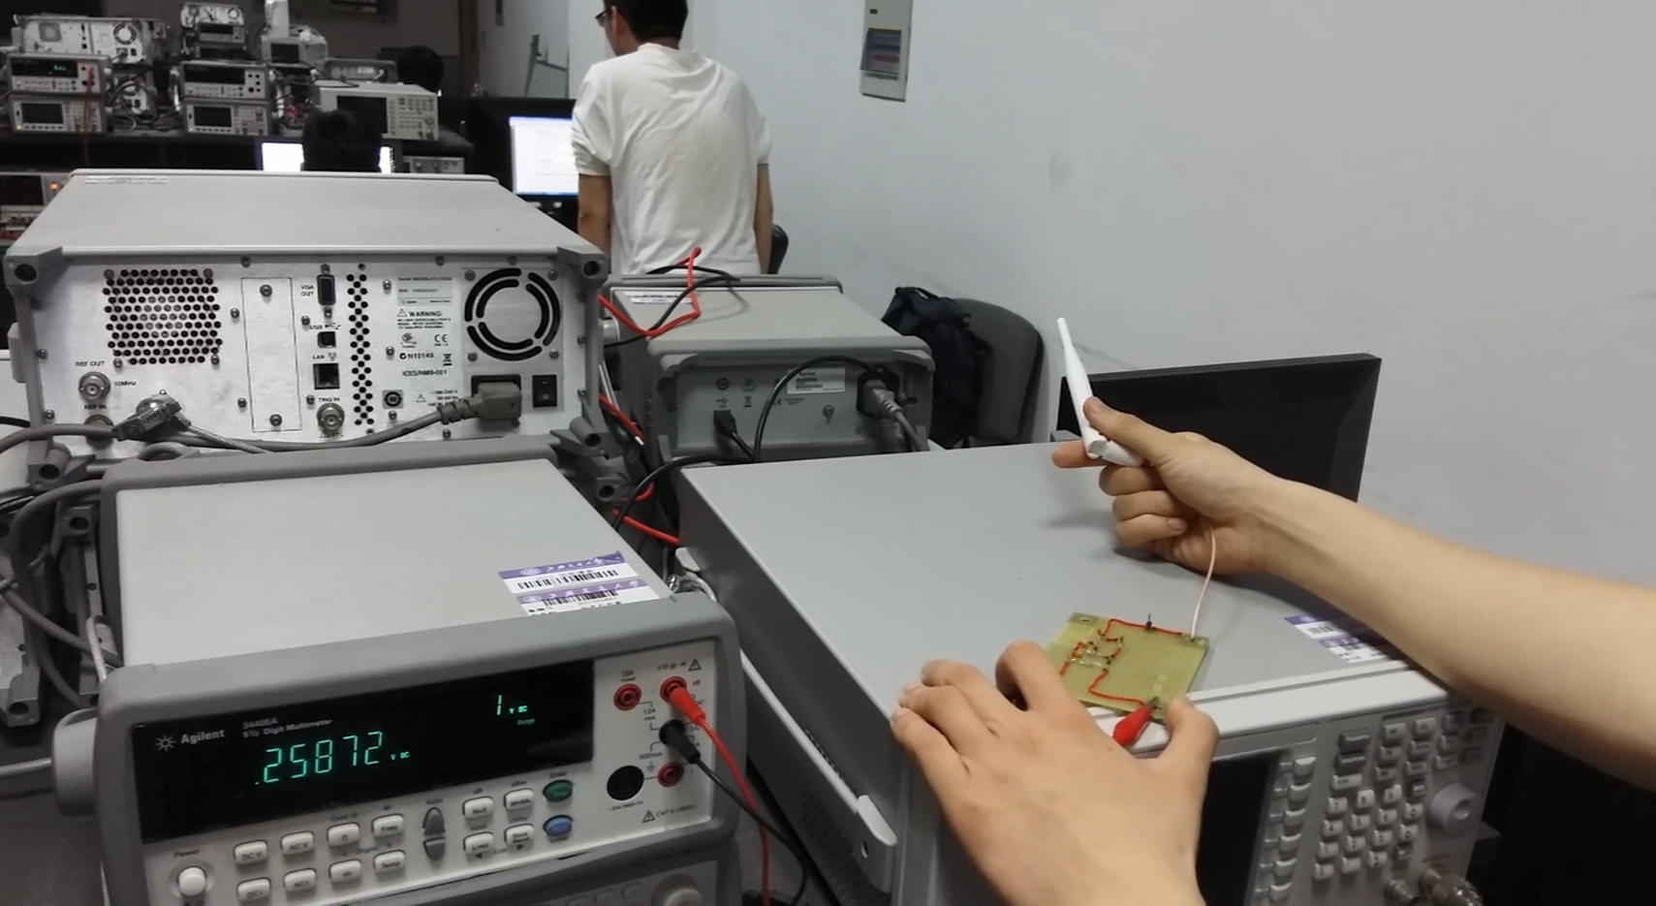
Antenna energy harvesting
Now we have captured WIFI signal so that the voltage can be 260 mV. However, 400 mV is recommended to get.

Slide 11
Problems to be solved
1.We have find the relationship between energy and distance in the paper that
$$E∝\frac{1}{d^{2}}$$
Energy is inversely proportional to the square of the distance.
So we should get close to the WIFI source to improve the voltage. However, we have not found the theoretical value we can get.
2.The antenna we are using now is single-polarity antenna which is not designed for WIFI capture. So we have bought the double dipole antenna.
3.The other way to amplify the voltage is impedance matching. We now cannot build the circuit of impedance matching. When we get the stable load, we will try for the method.
4.To get the highest voltage, we have to rotate the antenna by hand. If we touched the antenna, the voltage value is changing. So we have to find how to using energy to locate the direction of antenna.

Slide 12
Future Work
Now we aim to improve the voltage value we have capture and make the voltage value more stable when antenna’s direction is changed.
The circuit’s impedance is high, and we should decrease the impedance so the change of circuit is necessary.
After that, we have to make the antenna and the circuit smaller. PCB will be a better choice.

Slide 13
Q&A
Thank you for watching!
Presented by Pei Zhang
2016.5.31

