Slide 1
NFV Group Report
--Network Functions Virtualization
LIU XU
→

Slide 2
C A T A L O G U E
1
NFV Introduction
2
Testbed Work
3
What I do ?
4
Future Work

Slide 3
1
PART ONE
NFV Introduction

Slide 4
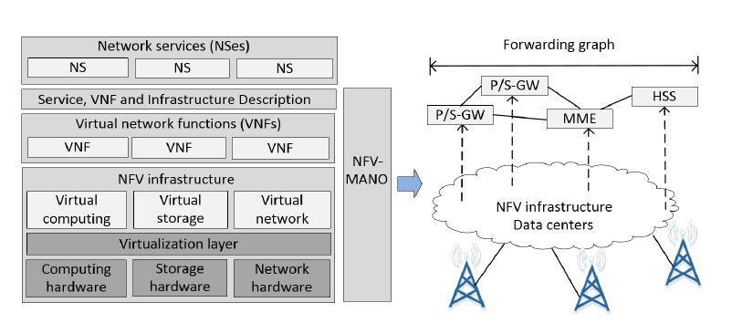
NFV Introduction
-- Network Function Virtualization
NFV & VNF
Network functions virtualization (NFV) architecture consolidates network functions over standard IT hardware by leveraging virtualization technologies, enables quick and cost-effective response of mobile network operators to the new market demands, where the crux is to effectively and efficiently allocate resources to virtual network functions (VNFs). However, a systematical approach for resource allocation in virtualized mobile core network is still unavailable.

Slide 5
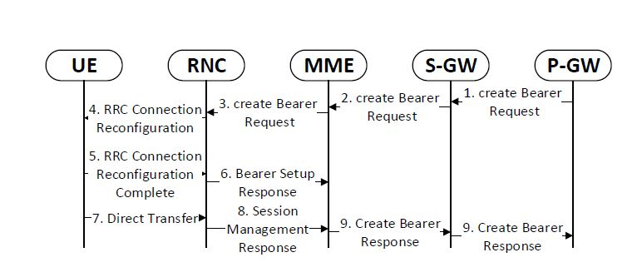
NFV Introduction
-- Network Function Virtualization
NFV & VNF
Network functions virtualization (NFV) architecture consolidates network functions over standard IT hardware by leveraging virtualization technologies, enables quick and cost-effective response of mobile network operators to the new market demands, where the crux is to effectively and efficiently allocate resources to virtual network functions (VNFs). However, a systematical approach for resource allocation in virtualized mobile core network is still unavailable.

Slide 6
2
PART TWO
Testbed Work

Slide 7
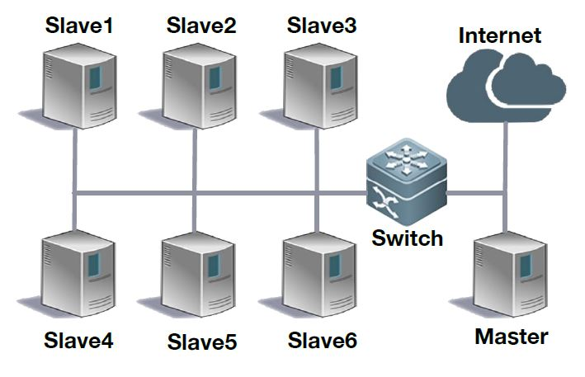
Testbed Work
To demonstrate the effectiveness of our approach, we develop a testbed that performs resource allocation over a simplified UMTS core network. We conduct experiments on the testbed using application and signaling records of millions of real users.
Dell Poweredge R420 servers
4 CPUs and 32GB memory
KVM virtual machines
Ubuntu 14.04.1 LTS
GNU/Linux 3.19.0-28-generic x86_64

Slide 8
3
PART THREE
What I do ?

Slide 9
What I do？
Find methods to realize the migration function of the KVM virtual machines between hosts.
01
02
03
04

Slide 10
What I do？
Find methods to realize the migration function of the KVM virtual machines between hosts.
01
Standardize the naming mode, and create same image file for every VM in every host
02
03
04

Slide 11
What I do？
Find methods to realize the migration function of the KVM virtual machines between hosts.
01
Standardize the naming mode, and create same image file for every VM in every host
02
An optimization method: recycle the VM migration process between hosts to improve robust
03
04

Slide 12
What I do？
Find methods to realize the migration function of the KVM virtual machines between hosts.
01
Standardize the naming mode, and create same image file for every VM in every host
02
An optimization method: recycle the VM migration process between hosts to improve robust
03
Final optimization work: Adding migration process to the resource allocation algorithm
04

Slide 13
4
PART FOUR
Conclusion & Future Work

Slide 14
Conclusion &
Future Work
We compare our model with the blank model under the condition that both models will process the same incoming workload. Specifically, the incoming workload is time-varying and will change according to the number of people accessing the Internet. The blank model will divide the workload equally to 12 sub-jobs and allocate one of them on each VM. In contrast, our dynamic allocation model will assign more jobs to the VM with more resources.
To complete the final optimization work
To test the effect
Another way

Slide 15
THANKS FOR YOUR WATCHING
LIU XU
→

