Slide 1
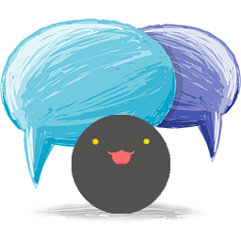
Auto Chat Robot
Lesson final presentation
Group 9
Mingcheng Chen
Jialu Wang
Yichen Zhu
Sicheng Yi 2016.6.7

Slide 2
Contents
Part 1 ：Background & Inspiration
Part 2 ：App show ( UI demonstration )
Part 3 ：Structure & UI Design
Part 4 ：Future exploration

Slide 3
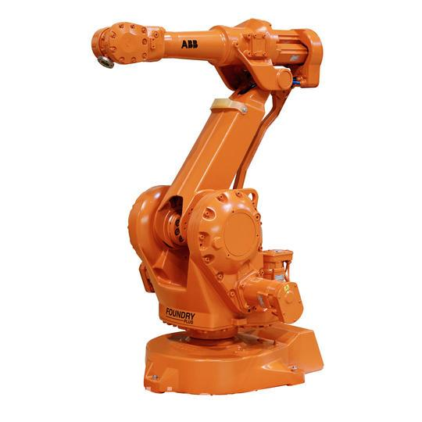
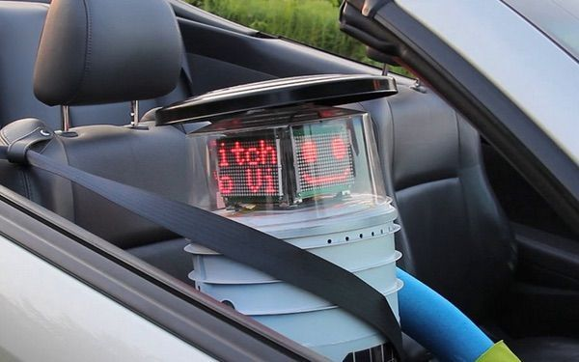
Part 1 ：Background & Inspiration
Artificial Intelligence has already had a significant impact on our world, enabling developments that were unimaginable only a century ago.

Slide 4
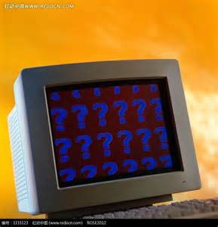
Part 1 ：Background & Inspiration
How can machine be so smart？

Slide 5
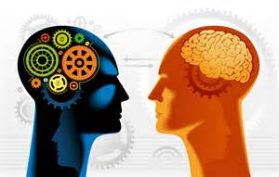
Part 1 ：Background & Inspiration
Turing test
Yeah , it is a test for machine intelligence .And to pass through it ,we use autochat script.

Slide 6
Part 1 ：Background & Inspiration
Now , what we want to introduce you is something like Eugene Goostman , its name is AutoChatRobot.

Slide 7
Contents
Part 1 ：Background & Inspiration
Part 2 ：App show ( UI demonstration )
Part 3 ：Structure & UI Design
Part 4 ：Future exploration

Slide 8
Part 2 ：App show ( UI demonstration )
Play

Slide 9
Contents
Part 1 ：Background & Inspiration
Part 2 ：App show ( UI demonstration )
Part 3 ：Structure & UI Design
Part 4 ：Future exploration

Slide 10
Part 3 ： Structure & UI Design
3.1 Structure
3.2 UI Design
3.1.1 Start Activity
3.1.2 Service Activity

Slide 11
Part 3 ：Structure & UI Design

Slide 12
Part 3 ： Structure & UI Design
3.1 Structure
3.2 UI Design
3.1.1 Start Activity
3.1.2 Service Activity

Slide 13
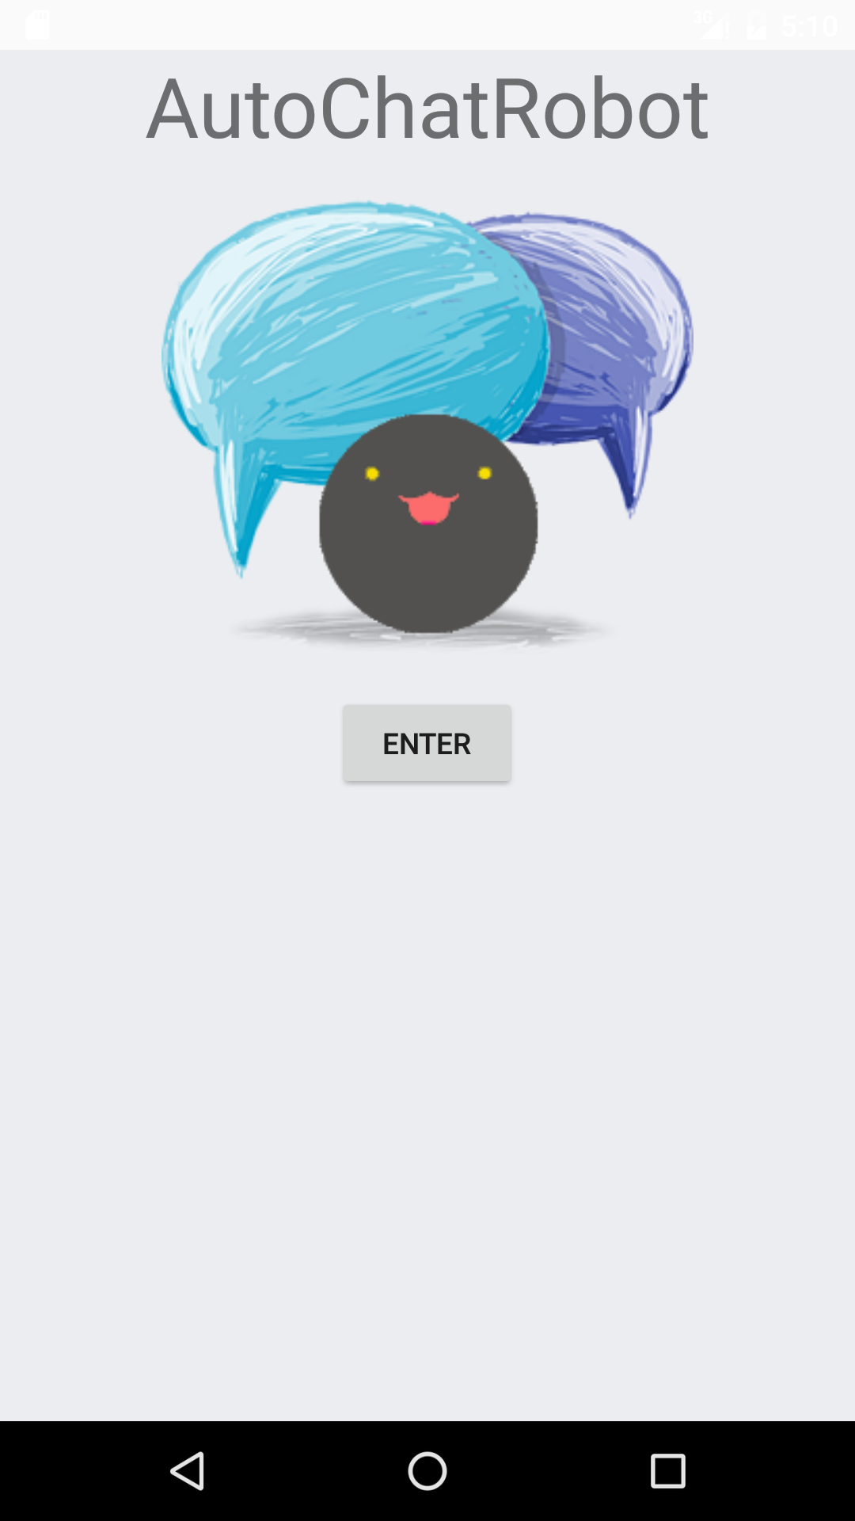
1.Name 2.Icon 3.Two ways to enter: Waiting for 5 seconds Pressing the <Enter> button
3.1.1 Start Activity

Slide 14
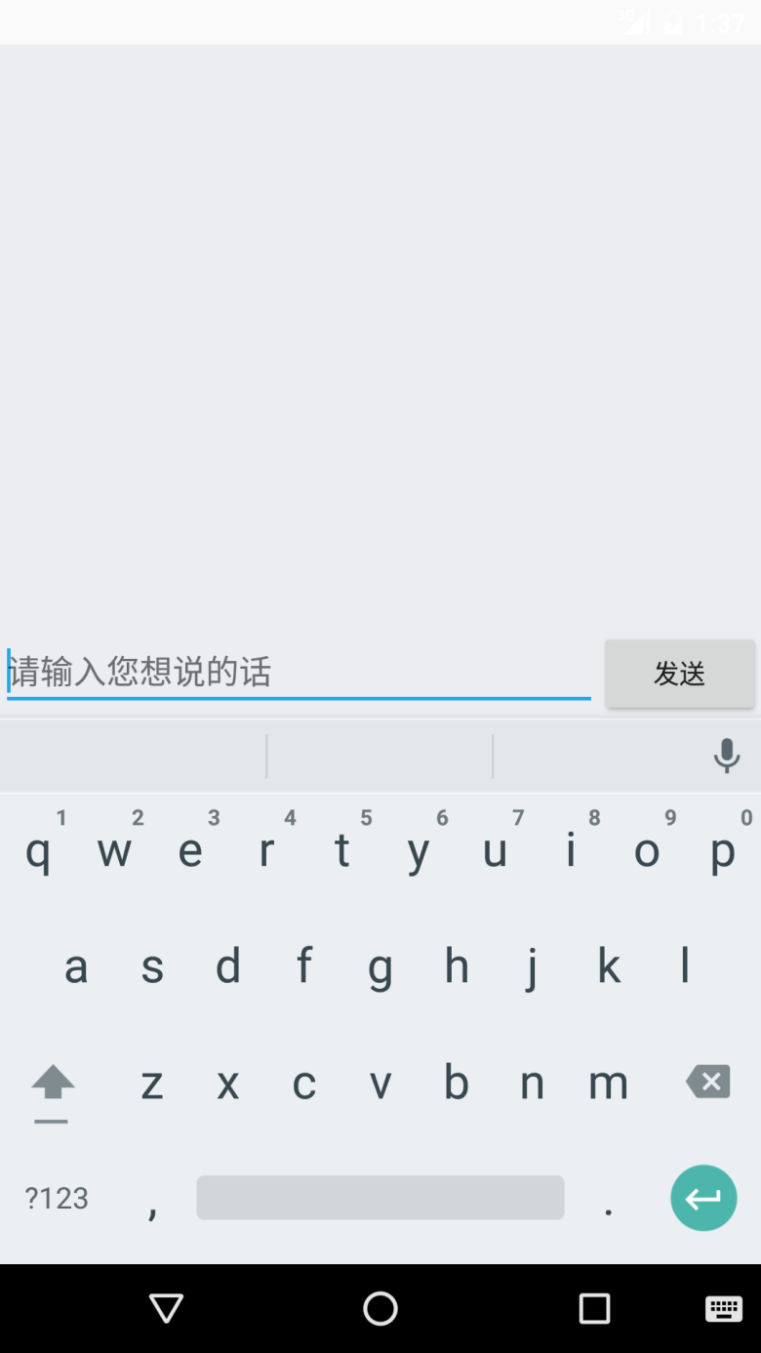
Part 3 ： Structure & UI Design
3.1 Structure
3.2 UI Design
3.1.1 Start Activity
3.1.2 Service Activity

Slide 15
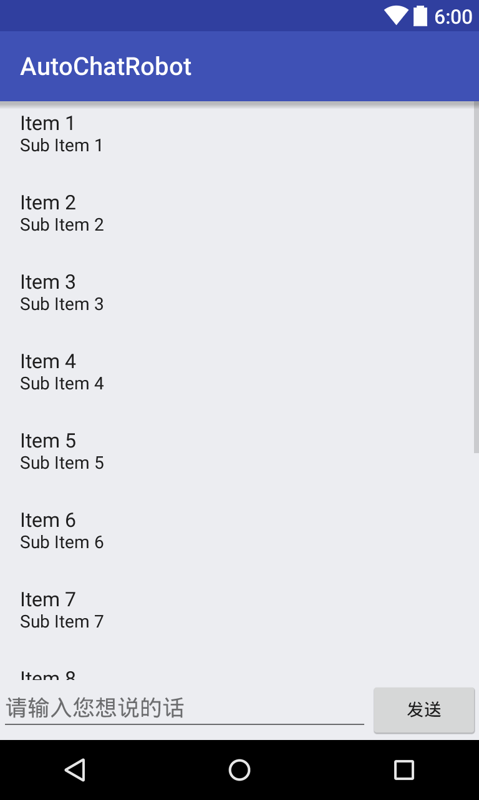
Part 1 UI Design Section 2 Service Activity
1、Use ListView layout to divide the screen for message displaying.

Slide 16
Part 1 UI Design Section 2 Service Activity
2、Draw the bubble by using special
Android Tools.

Slide 17
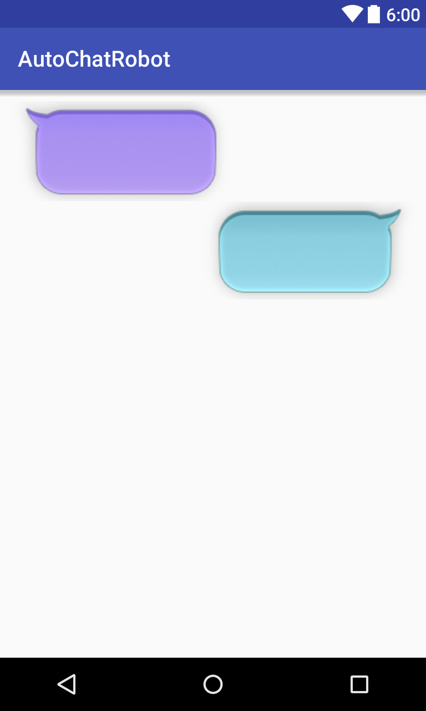
Part 1 UI Design Section 2 Service Activity
3、Two types of message， will be arranged in different ways.

Slide 18
Contents
Part 1 ：Background & Inspiration
Part 2 ：App show ( UI demonstration )
Part 3 ：Structure & UI Design
Part 4 ：Future exploration

Slide 19
Part 4 ：Future exploration
Finally, I shall give you some future expectation of our APP.
Added into Wechat to realize auto reply.
Develop voice recognition.
Much space for improvements of our user interface and algorithm.

Slide 20
Thanks
Q & A

Slide 21
1896
1920
1987
2006
E N D

