Slide 1
Machine Reading Comprehension
2019年5月
张平越 517030910388

Slide 2
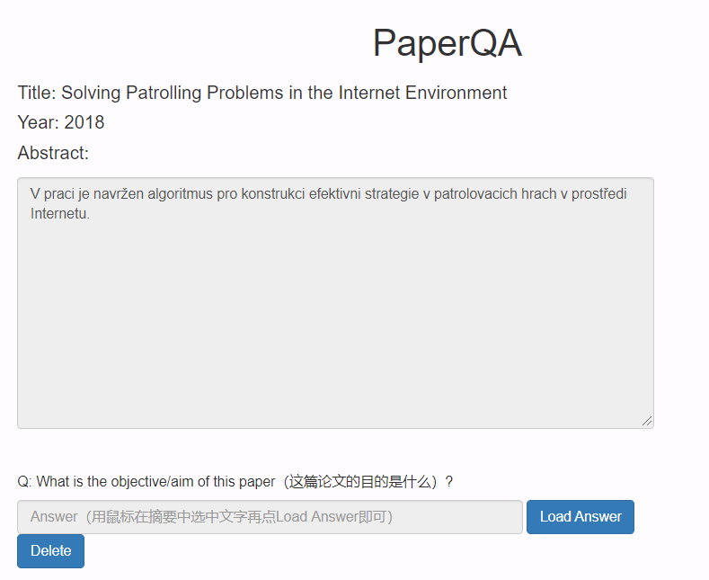
Introduction & Motivation
Machine Reading Comprehension (MRC), or the ability to read and understand unstructured text and then answer questions about it remains a challenging task for computers. MRC is a growing field of research due to its potential in various enterprise applications, as well as the availability of MRC benchmarking datasets, such as CNN/Daily Mail, SQuAD.
With the development of the deep learning, more and more MRC work turns to “Neural Reading Comprehension”, which has been proven much more effective than non-neural, feature-based models.
Today’s topic mainly focuses on discussion on several different models I propose, including their performance, their training (inference) speed.
Notes:
机器阅读理解，一般来说就是教机器阅读并理解文章，然后再利用一些特定的问题判断理解程度。
深度学习
机器阅读理解的应用：比如搜索交大的面积，搜索引擎不止会返回所有可能的结果，还会将最有可能的置顶突出，这既是基于对问句的理解
在学术领域机器阅读理解同样很有作用，比如从论文提炼中心，寻找关键句等。

Slide 3
目录 Contents
1
Problem Type
2
Problem Formulation
3
Task Specification
4
Results & Future Work

Slide 4
目录 Contents
1
Problem Type
2
Problem Formulation
3
Task Specification
4
Results & Future Work

Slide 5
Problem Type: Cloze Type
Document: ( @entity5 ) the owner of a @entity3 restaurant in @entity4 , @entity0 has been arrested following an uproar over its policy of banning @entity9 customers at night , according to reports . owner @entity11 was arrested for operating a restaurant without a valid license shortly after local press ran a story alleging that @entity0 reporters were turned away from the restaurant -- for being @entity9 . @entity0 's @entity19 newspaper carried a story monday that its reporters had been barred entry to the restaurant , being told by a guard at the entrance that " the time for @entity9 is over " when the journalists arrived at 7 p.m. only locals accompanied by @entity3 , @entity31 or @entity32 patrons would be admitted , the newspaper reported . … . @entity3 is the largest outside investor in @entity9 economies but resentment against @entity3 in @entity0 and other @entity9 nations is significant as many @entity9 often regard @entity3 businesses as , in the words of one @entity3 journalist , " resource predators " or " environmental vandals . " one @entity0 reporter commenting on the restaurant 's ban likened the policy to a new form of colonialism in @entity9 . there is this @entity3 restaurant next to @entity4 hospital and my two colleagues @entity114 and @entity117 and ...
Question: a @entity3 - owned restaurant in @entity4 was criticized for having discriminatory policies banning black @placeholder
Answer: @entity9
The example is from CNN dataset
Notes:
“完形填空”式的阅读理解，问题中有一个词被挖掉用占位符替代，需要从文章中选一个单词填空。

Slide 6
Problem Type: Multiple Choice
Document: James the Turtle was always getting in trouble. Sometimes he'd reach into the freezer and empty out all the food. Other times he'd sled on the deck and get a splinter. His aunt Jane tried as hard as she could to keep him out of trouble, but he was sneaky and got into lots of trouble behind her back. One day, James thought he would go into town and see what kind of trouble he could get into. He went to the grocery store and pulled all the pudding off the shelves and ate two jars. Then he walked to the fast food restaurant and ordered 15 bags of fries. He didn't pay, and instead headed home. His aunt was waiting for him in his room. She told James that she loved him, but he would have to start acting like a well-behaved turtle. After about a month, and after getting into lots of trouble, James finally made up his mind to be a better turtle.
Question: What is the name of the trouble making turtle:
A) Fries
B) Pudding
C) James
D) Jane
Answer: C)
Notes:
“多项选择”：在阅读文章后，问题是一个多项选择题。

Slide 7
Problem Type: Span Prediction
Document: In meteorology, precipitation is any product of the condensation of atmospheric water vapor that falls under gravity. The main forms of precipitation include drizzle, rain, sleet, snow, graupel and hail... Precipitation forms as smaller droplets coalesce via collision with other rain drops or ice crystals within a cloud. Short, intense periods of rain in scattered locations are called “showers”.
Question: Where do water droplets collide with ice crystals to form precipitation?
Answer: within a cloud
Notes:
“定位”：一般问题的答案是文章中的一小段文字。

Slide 8
Problem Type: Free Form
Document: James the Turtle was always getting in trouble. Sometimes he'd reach into the freezer and empty out all the food. Other times he'd sled on the deck and get a splinter. His aunt Jane tried as hard as she could to keep him out of trouble, but he was sneaky and got into lots of trouble behind her back. One day, James thought he would go into town and see what kind of trouble he could get into. He went to the grocery store and pulled all the pudding off the shelves and ate two jars. Then he walked to the fast food restaurant and ordered 15 bags of fries. He didn't pay, and instead headed home. His aunt was waiting for him in his room. She told James that she loved him, but he would have to start acting like a well-behaved turtle. After about a month, and after getting into lots of trouble, James finally made up his mind to be a better turtle.
Question: Who is James?
Answer: James is a turtle
Notes:
“随便问”：对问题没有约束。

Slide 9
目录 Contents
1
Problem Type
2
Problem Formulation
3
Task Specification
4
Results & Future Work

Slide 10
Problem Formulation
Generally the task of machine reading comprehension can be formulated as a supervised learning problem. The training samples can be viewed as triplet: where d represents the document, q is the corresponding question, and a is the answer to q.
Let , , where is the pre-defined vocabulary.
And the form of the answer a can be different among different tasks.

Slide 11
目录 Contents
1
Problem Type
2
Problem Formulation
3
Task Specification
4
Results & Future Work

Slide 12
CNN/Daily Mail Dataset
Task: It’s a cloze-style dataset.
Train Samples: 380,298
Dev Samples : 3,924
Test Samples : 3,198
Document Length: 760
Question Length: 12.5
Entity Number: 580
Some words in the document are replaced by @entity, the task is to choose one @entity to fill in the blank identified as @placeholder.
Document: ( @entity5 ) the owner of a @entity3 restaurant in @entity4 , @entity0 has been arrested following an uproar over its policy of banning @entity9 customers at night , according to reports . owner @entity11 was arrested for operating a restaurant without a valid license shortly after local press ran a story alleging that @entity0 reporters were turned away from the restaurant -- for being @entity9 . restaurant 's ban likened the policy to a new form of colonialism in @entity9 . there is this @entity3 restaurant next to @entity4 hospital and my two colleagues @entity114 and @entity117 and ...
Question: a @entity3 - owned restaurant in @entity4 was criticized for having discriminatory policies banning black @placeholder
Answer: @entity9
Notes:
在这个数据集里，有一些单词会被某个entity替换，问题中需要回答的用占位符标注，答案是文章中某一个entity

Slide 13
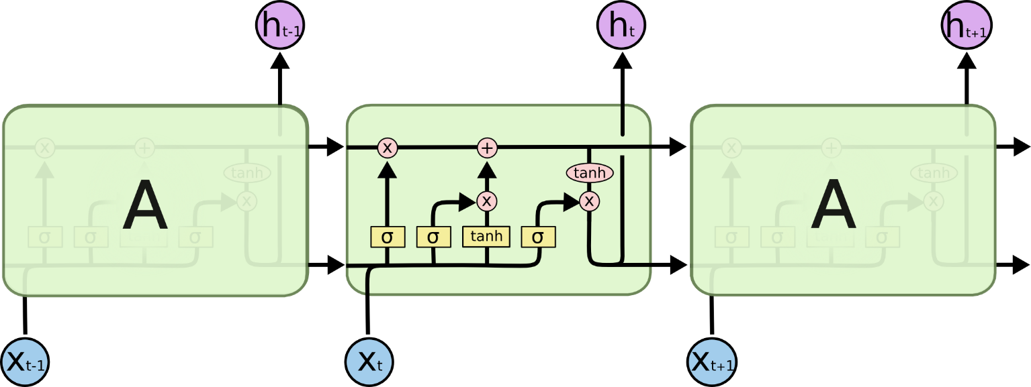
Model: LSTM
An artificial recurrent neural network (RNN).
Well-suited to classifying, processing and making predictions based on time series data
Very popular in NLP
Length of data sequence is proportional to the training time
Notes:
LSTM，作为一种RNN模型，非常适合处理序列数据，因此在NLP中应用十分广泛。

Slide 14
Attention
Simple Attention
Bilinear Attention
DotProduct Attention
Gated Attention
Notes:
Attention机制跟人类阅读文章时候的思路有些类似，其可以看作一种加权操作，以表明注意力集中在什么地方。常常被用于RNN输出的pooling function
Simple Attention使用一个简单的线性映射计算每个输入q_i权重，对输入进行加权和。
DotProduct Attention 利用点积计算q_i与可以看作是参考的p计算相似度。P可以看作是一个参考
Bilinear Attention：是DotAttention的一种改进，如果令W为单位阵，则可以达到dot attention的效果，当两个元素的范围不一样时，W可进行范围的变换。当然如果两个元素尺度相同，可以用dot attention 代替bilinear attention，减少参数的数量。
Gated Attention 是另一种处理方法。

Slide 15
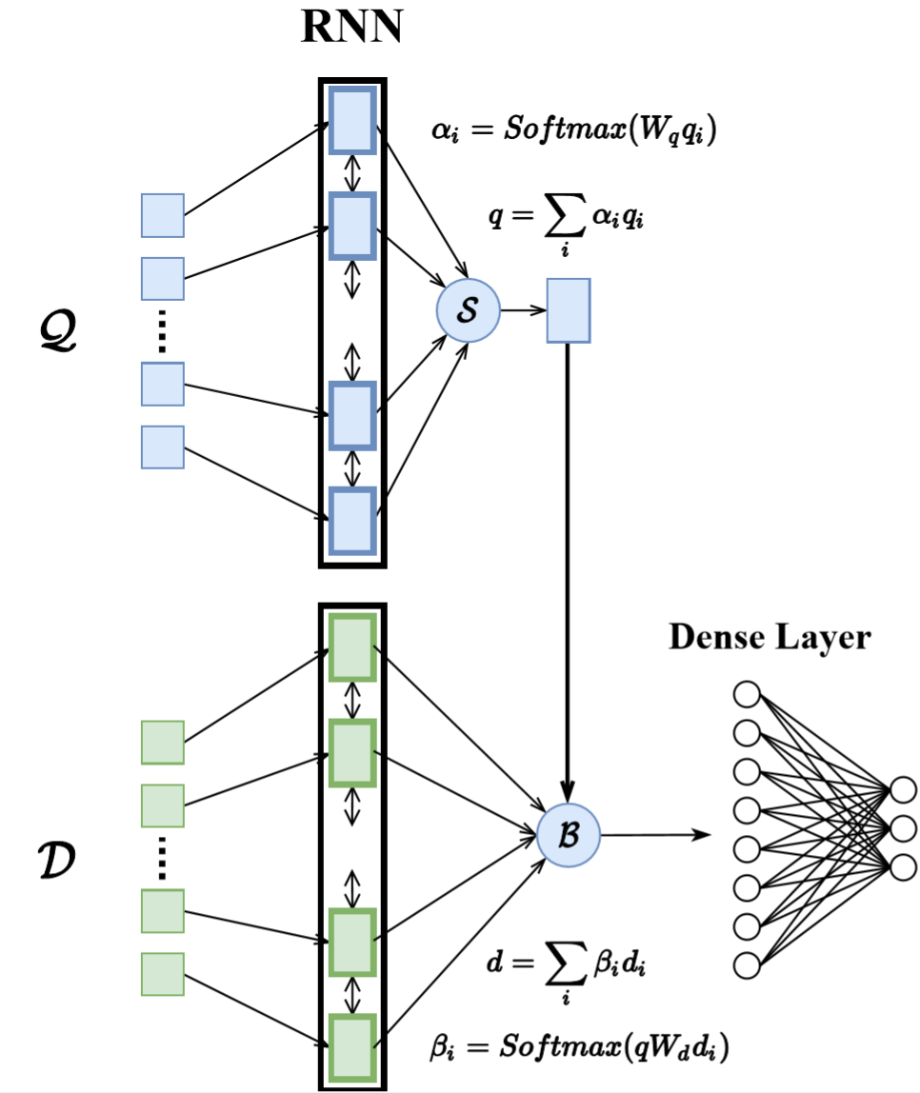
Model: Origin Model
The origin model is a normal one, two RNNs (LSTM) model the document and the question separately. Then for question output, the Simple Attention is applied as the pooling function. Then the weighted sum of the question output is used to perform Bilinear Attention with the outputs of the documents. Then the dense layer will map the final output to the classification dimension.
Notes:
首先是最原始的模型，也是最常见，最容易想到的模型，利用两个LSTM分别建模document以及question，对question的输出做simple attention 的pooling，得到一个加权和。
然后再将这个加权和作为一个参考，对document的输出做Bilinear Attention。最后对输出利用线性层以及softmax映射到每个类的概率值。
这样做是模拟“带着问题找答案”的效果，当你知道了问题想问什么的时候再去看文章。

Slide 16
Problem: What if you can not understand a single word
Document: Je vais construire un grand mur - et personne ne construit des murs mieux que moi, croyez-moi - et je vais les construire très peu de frais. Je construirai un grand, grand mur sur notre frontière sud et je ferai payer le Mexique pour ce mur. Écoutez-moi bien.
Question: Je vais construire un grand @placeholder

Slide 17
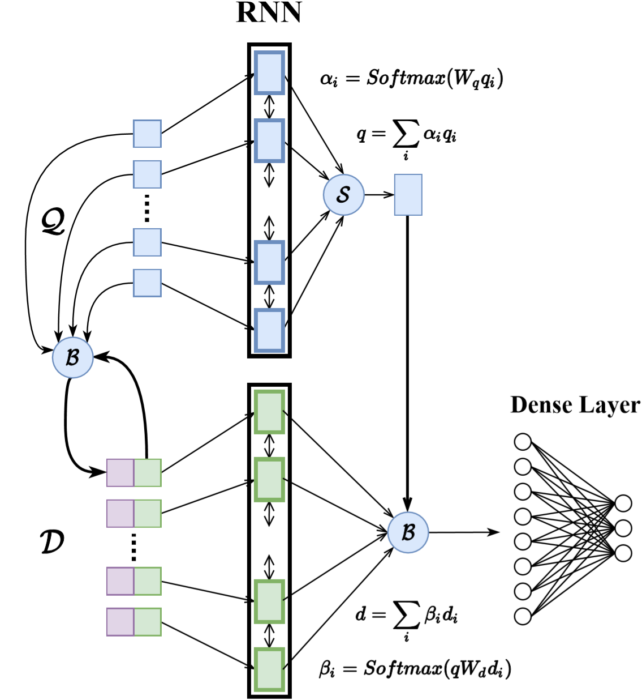
Model: Modified Model
Motivation:
Document: Je vais construire un grand mur - et personne ne construit des murs mieux que moi, croyez-moi - et je vais les construire très peu de frais. Je construirai un grand, grand mur sur notre frontière sud et je ferai payer le Mexique pour ce mur. Écoutez-moi bien.
Question: Je vais construire un grand @placeholder
Notes:
改进模型的出发点就是将文章的每一个单词作为一个参考，用问题和它计算bilinear attention，以获取新的信息。
并且很重要的一点是，新获得的信息和原输入信息是拼接在一起的，这样做可以避免原始信息的丢失。

Slide 18
Problem: What if you are not sure
Document: ( @entity4 ) in @entity3 's polarized political environment , support for @entity1 has been a rare area of bipartisan cooperation -- at least until now . @entity1 prime minister @entity8 's speech to @entity9 on tuesday threatens to undermine the nearly 67 - year tradition of bipartisan support that has endured since president @entity12 became the first head of state to recognize @entity1 . @entity8 is driven not only by his concerns about @entity16 's nuclear threat -- the topic of his address -- but also by domestic political considerations . @entity1 will hold its national elections just two weeks after his visit to @entity3 . @entity8 is fighting for his political life as he faces a tougher than expected re-election campaign . he has been widely blamed at home for having failed to lower the high cost of living , an issue that his rivals have eagerly exploited . @entity8 has tried to offset some of this criticism by focusing on his perennial issue : @entity16 . a major televised address in @entity3 concerning @entity16 's threat , interrupted only by standing ovations from @entity35 lawmakers , has the potential to be far more effective than any campaign ad in projecting gravitas , reinforcing his security credentials and reminding voters of his vast experience -- in contrast to his rivals ' inexperience -- in foreign affairs . yet @entity8 's speech , while possibly giving him a short - term boost at home , will harm @entity50 's relations with @entity3 , not @entity16 's nuclear program . speaker @entity53 's late - january invitation to @entity8 to address a joint session of @entity9 was coordinated with neither the @entity55 nor the @entity56 . it was , in essence , a political ploy aimed at undermining president @entity59 as he strives to reach a historic deal over @entity16 's nuclear program . in defiance of the @entity59 administration , and rejecting advice from leading figures in @entity1 and key supporters of @entity1 in the @entity35 , @entity8 accepted the invitation . by antagonizing the @entity55 , @entity53 and @entity8 have put @entity69 members of @entity9 in a bind , forcing them to choose between two unenviable options : either attend the speech out of respect for a close ally , but in so doing flout the president -- their party leader -- or demonstrate loyalty to @entity59 by snubbing the leader of a major @entity35 ally . two senior @entity80 with sterling pro-israel credentials , @entity82 and @entity83 , tried to diffuse this latest crisis between @entity3 and @entity50 by offering to meet with the @entity1 premier behind closed doors but were rebuffed by @entity8 . @entity83 had previously noted that an invitation to address @entity9 during the @entity1 election period was " highly inappropriate . " in politicizing his visit to @entity3 , @entity8 has allowed his bad blood with @entity59 to spill over into his government 's increasingly complicated relationship with the @entity69 . @entity8 no doubt believes that @entity59 is misguided about the pending deal with @entity16 . indeed , there are good reasons to be skeptical of any agreement with a regime that has long engaged in deception and concealment with respect to its nuclear program . less than two weeks ago , the @entity102 reported that @entity16 was continuing to evade questions about evidence of past work on designing nuclear weapons . yet @entity8 's move is counterproductive . @entity80 on @entity108 who were inclined to support additional sanctions on @entity16 now feel compelled to back the president . in a rare move , five former @entity1 ambassadors have publicly called on @entity8 to cancel his speech . former @entity116 chief @entity115 has accused @entity8 of having caused @entity1 " heavy strategic damage on the @entity16 issue " by antagonizing the administration . @entity8 's foray into partisan politics is hardly a new phenomenon . he has never hid his preference for the @entity124 . during his first term in office , @entity8 irked president @entity127 by meeting with the rev. @entity128 , then - house speaker @entity129 and other detractors of the president a day before coming to the @entity55 . a key @entity8 supporter is @entity35 casino magnate @entity133 , a major @entity124 donor who also owns the @entity135 newspaper @entity134 . during the 2012 presidential campaign , @entity133 poured millions into @entity124 challenger @entity138 's coffers , saying he was willing to spend $ 100 million to defeat @entity59 . that july , @entity8 's senior adviser , @entity139 , helped orchestrate @entity138 's visit to @entity1 in what amounted to an implicit endorsement of @entity59 's rival . @entity144 , a former @entity35 citizen who once worked for @entity124 pollster and political consultant @entity146 , is @entity1 's current ambassador to the @entity35 . it is @entity144 who coordinated the invitation to @entity8 with @entity53 but never mentioned the invitation to secretary of state @entity150 when they met a day before @entity53 's announcement . this time , @entity8 may have gone too far . national security adviser @entity153 did not mince words when she called @entity8 's latest move " destructive to the fabric of the relationship " between the @entity35 and @entity1 . although the @entity35 - @entity1 relationship is strong and resilient , rooted in common values and shared interests , @entity8 is subjecting it to an unnecessary test with unknown consequences by choosing to play partisan politics .
Question: @entity165 : by injecting himself into @entity35 politics , the @placeholder prime minister puts at risk a 67 - year relationship between two countries

Slide 19
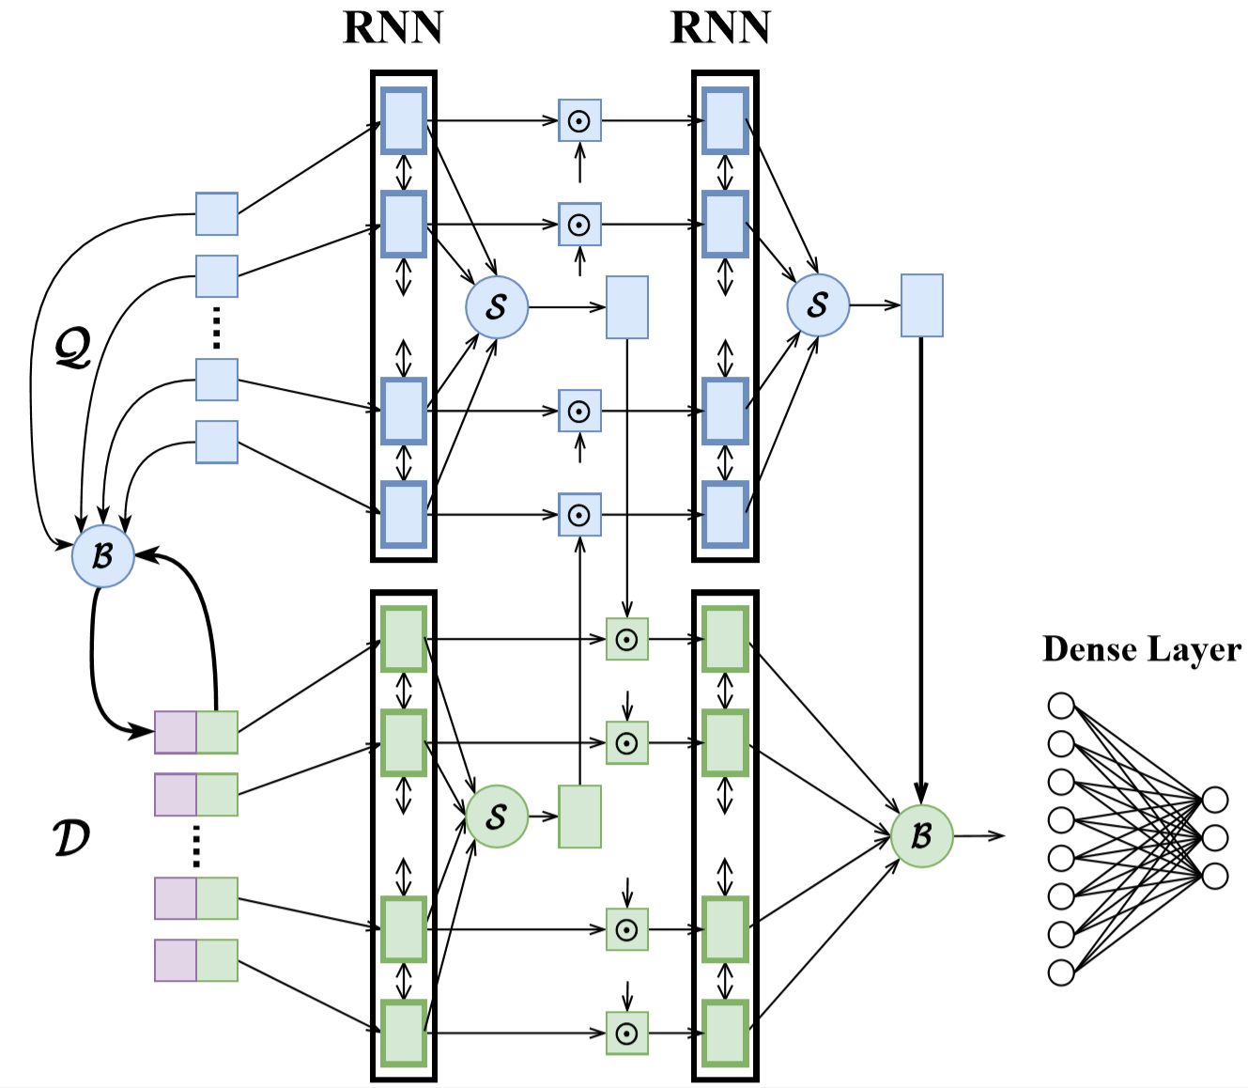
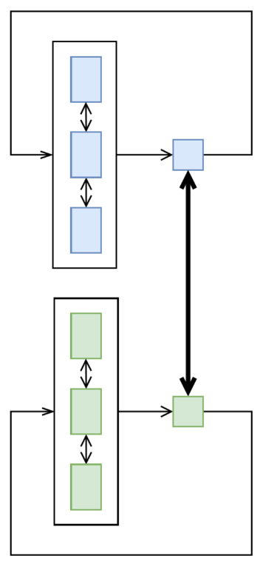
Model : ReReader
Simplified:
Notes:
这种“读多次”的机制催生出了这个模型。
除了读多次以外，还需要document网络与question网络交换信息，带着问题去阅读，或者读完文章有印象的看问题。

Slide 20
Model: ReReader
Motivation:
A person may have to read a document for several times to fully understand the meaning. Once he finishes reading document/question, he will has some knowledge when he continues to read the question/document.
Problems:
The sequence is still too long, as a result, the training process will takes too long.
The long-term memory may be forgotten by the LSTM.
Notes:
训练时间长，且长期记忆有可能遗忘。
因此接下来的改进思路就是缩短序列长度。

Slide 21
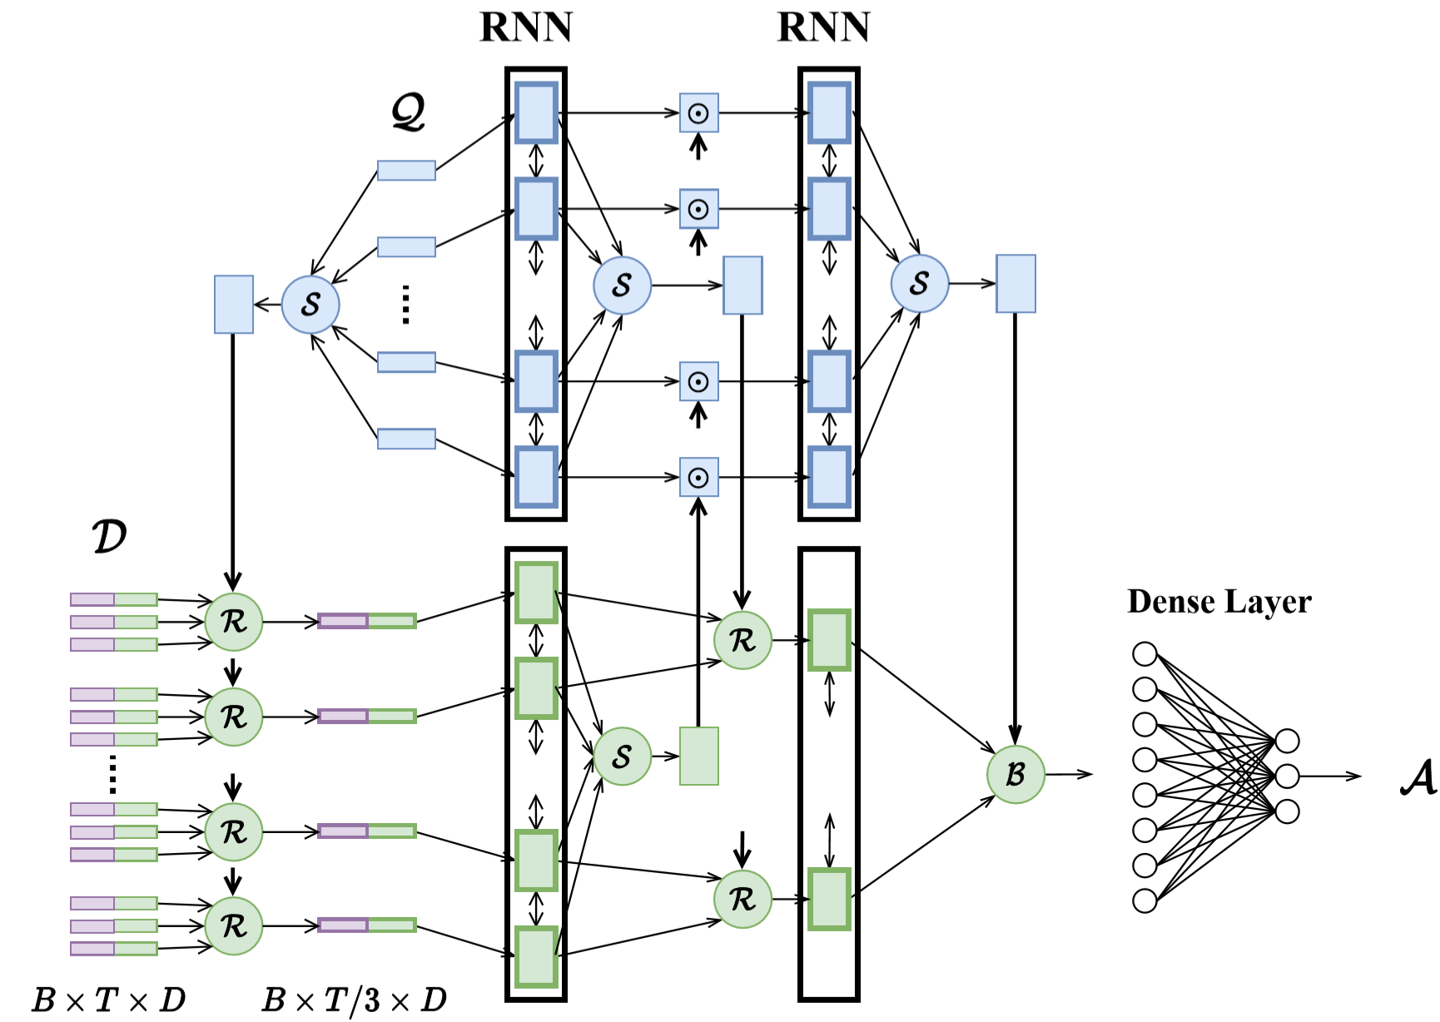
Model: ChunkReader
Refine Attention:
Reduce the length, shorten the training time as well as the inference time
Refine useful information from the input sequences
Notes:
这个模型主要就是想去解决序列过长的问题。
如图中所示是三个序列为一块，利用Refine Attetion从一块精选出一个。既可以提炼有用信息，也可以缩短序列长度。
这里的Refine Attention包括Bilinear attention以及simple attention。
Bilinear Attention利用question做参考，simple attention则是self-attention，保留原本信息，最后拼接。

Slide 22
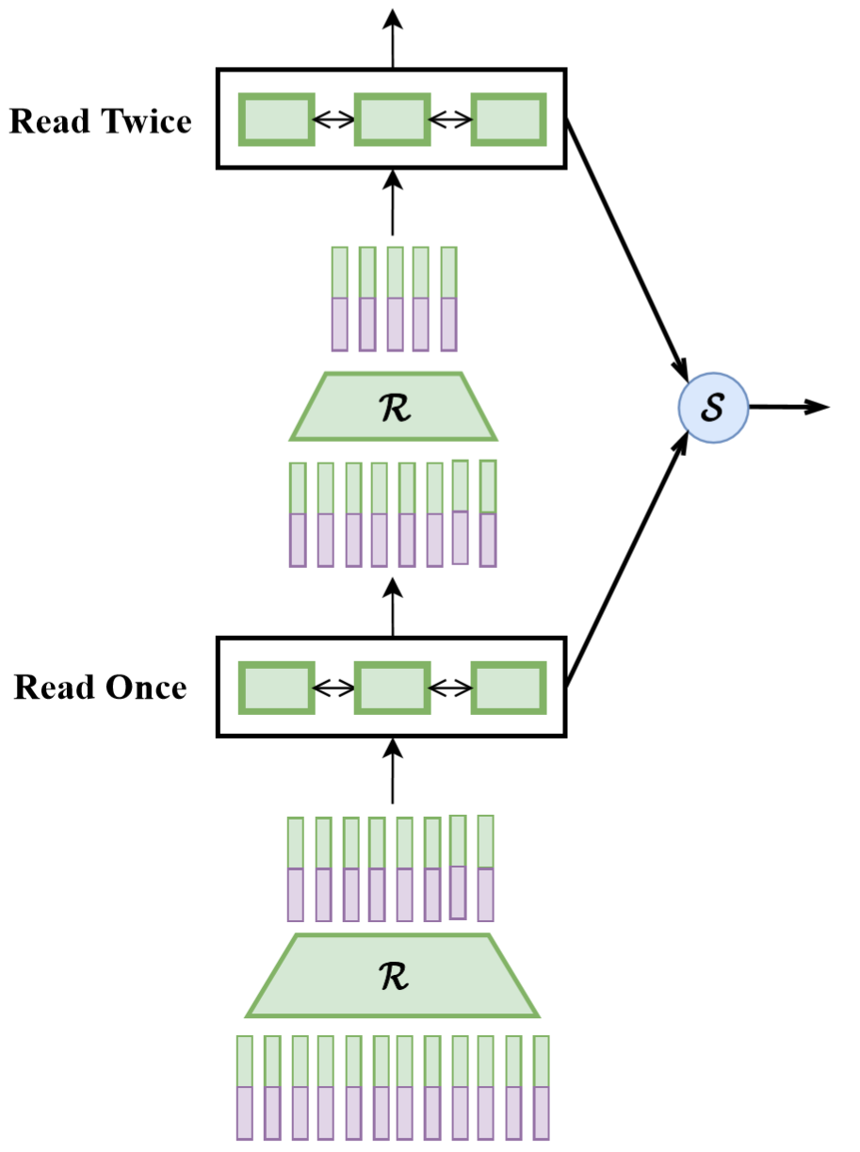
Model: ChunkReader
Notes:
机器并不知道哪一次阅读的输出比较有用
因此将每一个输出都放在一起进行加权。

Slide 23
Configuration
Task: The task I perform is mainly the cloze style. Some entities in the document is replaced by @entityX, and the question contain one entity which needs to be predicted by reading the document, this entity is marked as @placeholder.
Dataset: CNN dataset
Embedding Method: GLoVe
Loss Function: CrossEntropyLoss
Optimizer: SGD with learning rate 0.1
Vocabulary Size: 50000
Notes:
Embedding 相当于一种先验知识

Slide 24
目录 Contents
1
Problem Type
2
Problem Formulation
3
Task Specification
4
Results & Future Work

Slide 25
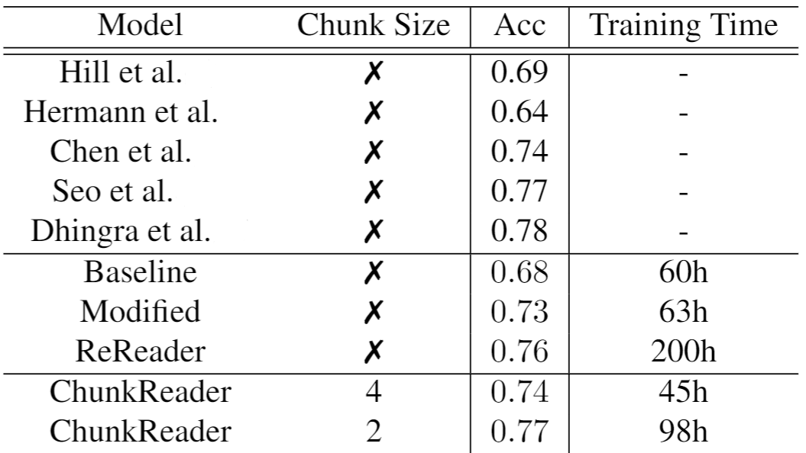
Results
Notes:
Tradeoff

Slide 26
Possible Future work
Task: Extend to Span Prediction
Dataset: SQuAD dataset
Different Embedding Method
Finish the training of the model ReReader
Also I plan to investigate further the refine function in the ChunkReader model.

Slide 27
谢谢！

