Slide 1
EE447 Mobile Internet
Academic Papers Recommendation
with Paragraph Vector and Paper Rank
Group Members:
朱子杰 517030910389
张孟天 517030910387

Slide 2
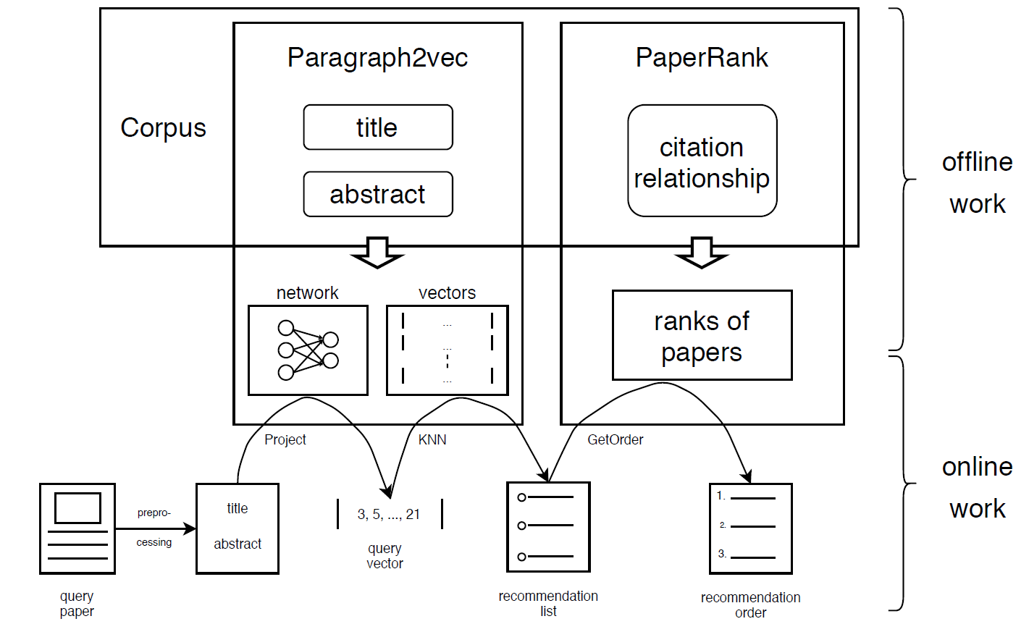
System Architecture Overview
Paper Preprocessing
01
Paragraph2vector
02
Paper Rank
03
04
Website Construction

Slide 3
Paper Preprocessing ---- Dataset
ACL Anthology Reference Corpus
This is the home page of the ACL Anthology Reference Corpus, a corpus of scholarly publications about Computational Linguistics. (https://acl-arc.comp.nus.edu.sg/)
This corpus is a canonicalized subset of the ACL Anthology, consisting of 10,921 articles.
The PDF files and text files of the papers.
The title of each article.
Interlink data of papers.

Slide 4
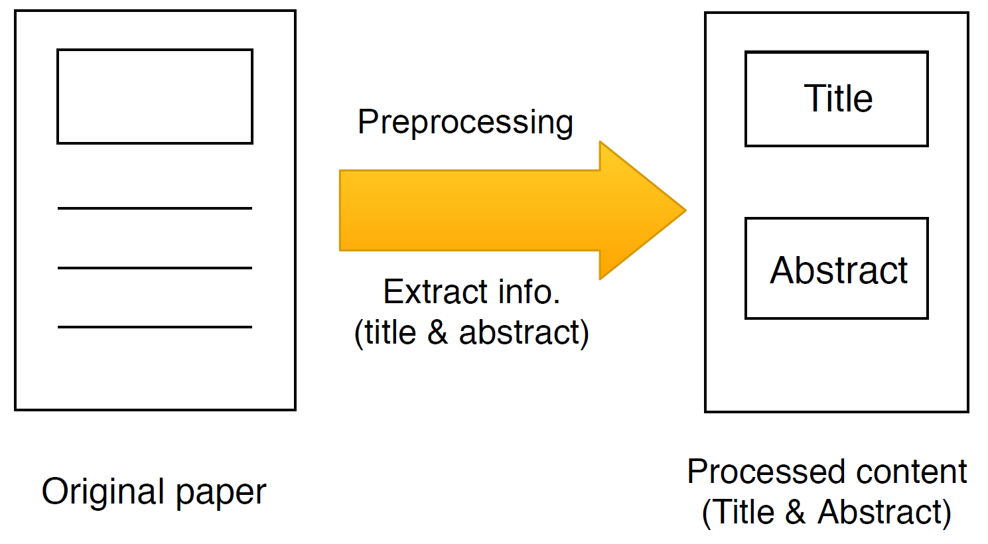
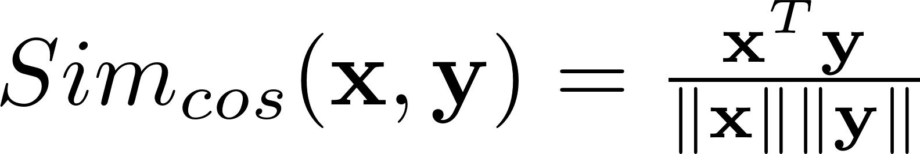
Paper Preprocessing ---- Abstract Extraction
Split the paragraph into sentences
Transfer sentences into vectors
Calculate similarity matrix using cosine distance
Score sentences according to the similarity
Select top n sentences as abstract.

Slide 5
Three paragraph similarity methods
Bag of words (BoW)
Word2vector
Paragraph2vector

Slide 6
Three paragraph similarity methods
Paragraph is represented as the bag of its words, disregarding grammar and even word order but keeping multiplicity.
Simplicity, efficiency and often surprising accuracy.
Word order is lost.
Data sparsity and high dimensionality.
The model have very little sense about the semantics of the words or more formally the distances between the words.
Bag of
words
Tidy a room , A tidy room
“powerful,” “strong” and “Paris”

Slide 7
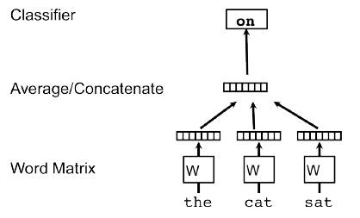
Three paragraph similarity methods
Word 2
vector

Slide 8
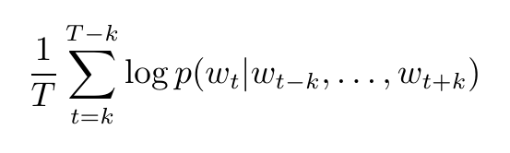
Three paragraph similarity methods
given a sequence of training words w_1; w_2; w_3;… ; w_T
maximize the average log probability:
Word 2
vector

Slide 9
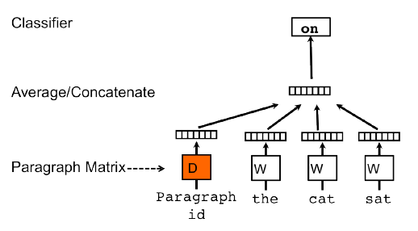
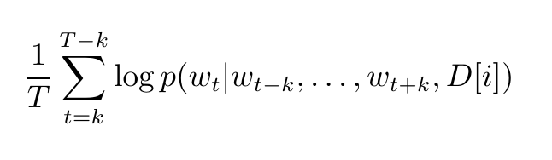
Three paragraph similarity methods
Para 2
vector

Slide 10
Paragraph to Vector
Two stage:
Training to get word vectors W and paragraph vectors D on already seen paragraphs.
Predict stage: To get paragraph vectors D for new paragraphs, with W fixed.
A Method for Automatic Evaluation of Machine Translation → [-0.52, -0.36]
Machine Translation Method Using Inductive Learning with Genetic Algorithms → [-0.57, 0.21]
Tagging French comparing a statistical and a constraint based method → [0.88, -0.04]

Slide 11
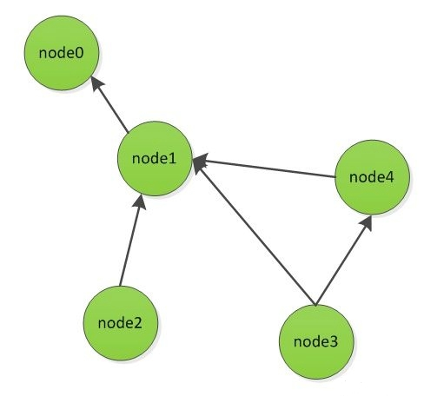
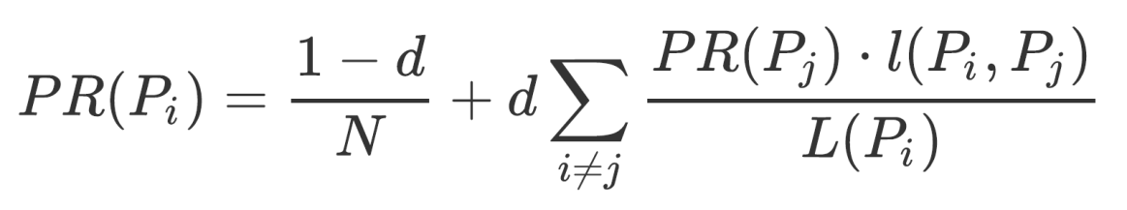
PAPER RANK
01
· Similar to Page Rank
02
· To find out authoritative articles in the field in order to fill the deficiency of CBF only examining content similarity.
03
· Considering a network of citation relationships between articles, we hope to attach a higher rank value to articles with higher influence. The more influential an article cites, the higher its contribution to the article is.

Slide 12
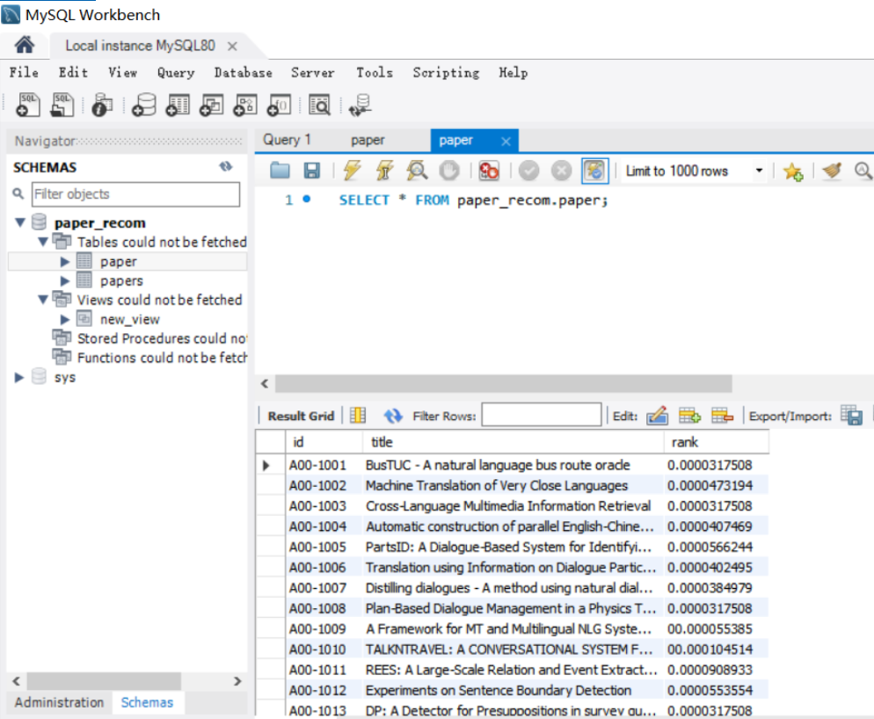

DATABASE
Use MySQL to store the ID, title and rank values of each article

Slide 13
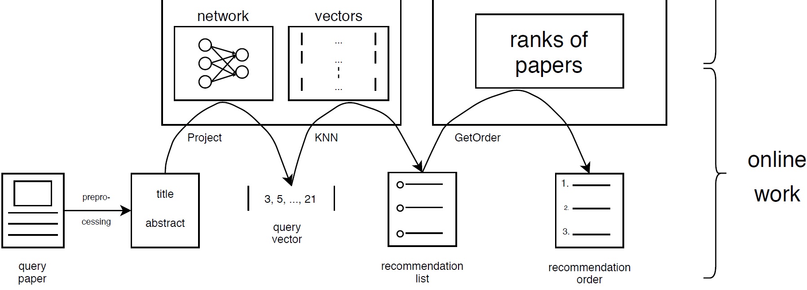
ONLINE WORKFLOW

Slide 14

WEBSITE CONSTRUCTION
Lightweight
Concise
Strong Expansibility
Based on Werkzeug and jinja2
Achievement
Display

Slide 15
2020
Mobile Internet
THANK YOU

