Slide 1
Rumor Source Detection
with GCN
517030910360 郑龙杰
517030910307 刘雅新

Slide 2
目录
01
Background
02
Proposed Method
03
Experiments
04
Future Work

Slide 3
01
Background

Slide 4
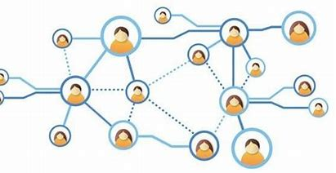
Background
In general, most of the studies related to rumor defeating are divided into two categories. One is the content-based rumor identification, which mainly focuses on building multiple features of rumor content, such as rumor text, spreading model or user behavior etc. In this way, an automatic classifier is usually trained to distinguish whether a given text is a rumor or not.
However, it is difficult to locate the propagation source of rumor, which is a significant task in rumor detection on social network.

Slide 5
02
Proposed Method

Slide 6
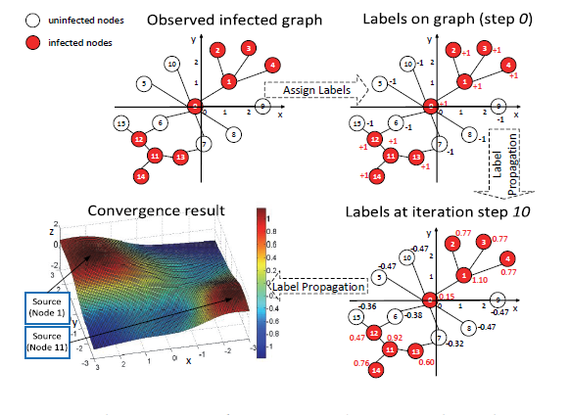
Proposed Method
LPSI
LPSI is the first attempt on this problem, which propagates integer labels in network and predicts the rumor sources based on the convergent node labels.

Slide 7
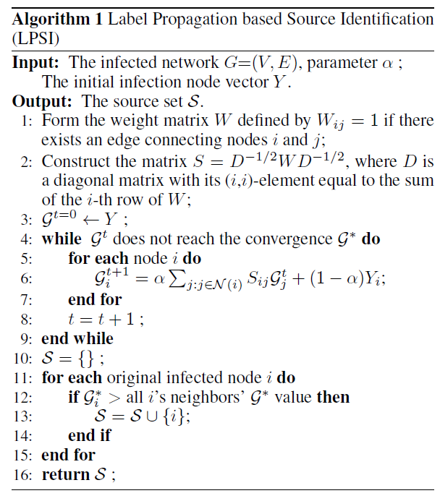
LPSI
The iteration equation of the label propagation will converge to :
And the process of LPSI could be briefly summarized as following two steps.
Assign labels to the partially infected network
Label propagation on the network

Slide 8
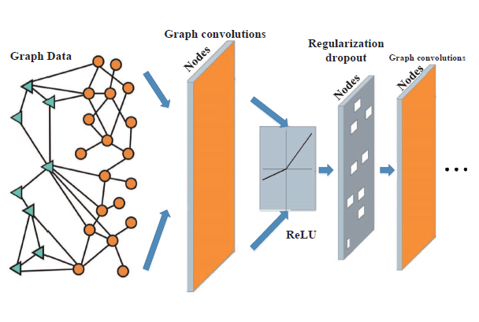
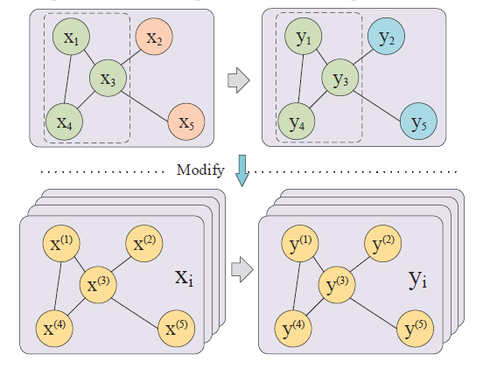
Graph Convolutional Networks (GCN)
Inspired by traditional neural network and extends traditional deep learning
Originally designed for semi-supervised learning
And cannot be directly applied for the supervised learning based source detection problem.

Slide 9
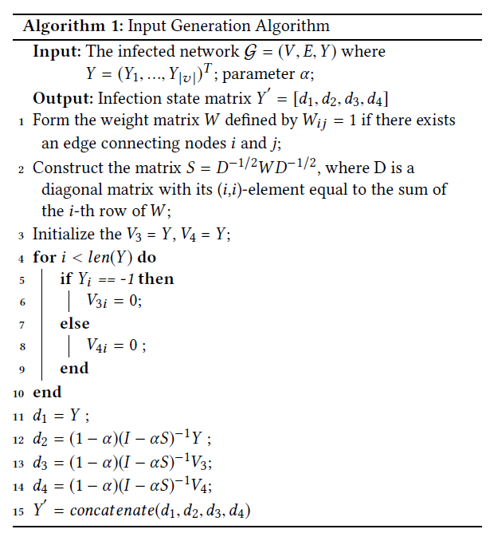
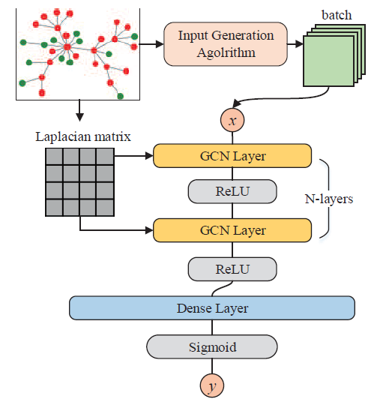
GCN
Data Pre-processing
Network Structure

Slide 10
03
Experiments

Slide 11
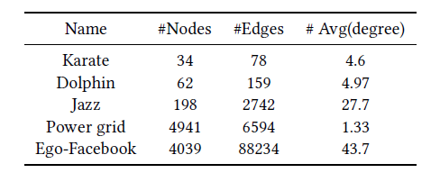
Datasets
Karate
A social network of friendships between 34 members of a karate club.
A classic dataset.
1
Dolphin
An undirected social network of frequent associations between 62 dolphins in New Zealand.
Power grid
An undirected unweighted network
representing the topology of the Western States Power Grid.
2
4
3
Jazz
A network of Jazz bands performing from 1912 to 1940.
5
Ego-Facebook
Contains social circles from Facebook.

Slide 12
We randomly sample thousands of partial infection state on each dataset as training data, and use f1 score as evaluation metric of performances of LPSI and GCN.
As we could see from pictures above, smaller graph and larger number of rumor sources lead to better result.

Slide 13
04
Future Work

Slide 14
Demo
Flask
D3
HTML

Slide 15
Future Work
apply GCN
into content-based rumor
identification
Try larger networks
Enrich our website
Explore better hyperparameters

Slide 16
谢谢

