Slide 1
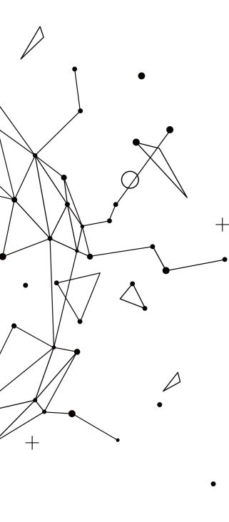
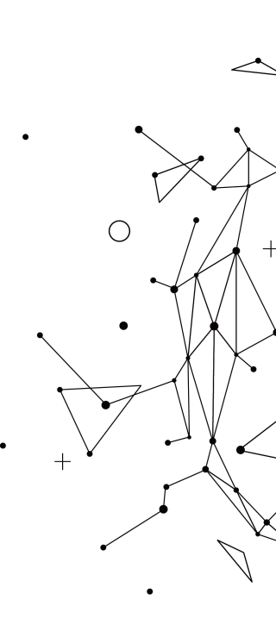
Towards the stock market under the influence of COVID-19
Zhiyuan Qu, Zihan zhou
Under the influence of the epidemic, the stock market underwent severe shocks. We tried to explore the stock market's response to the virus situation.

Slide 2
Introduction
1
Data Visualization
2
CONTENTS
Data Processing
3
Machine Learning Techniques
4

Slide 3
1
Introduction

Slide 4
01
Introduction
We collected stock and epidemic data and processed them in several ways.
We visualized stock market data combined with epidemic data to analyze its possible impacts .
We applied machine learning techniques to explore the relations between stock market and COVID-19.
We built a web app to show our results.
http://123.57.246.36:5001/

Slide 5
2
Data Visualization

Slide 6
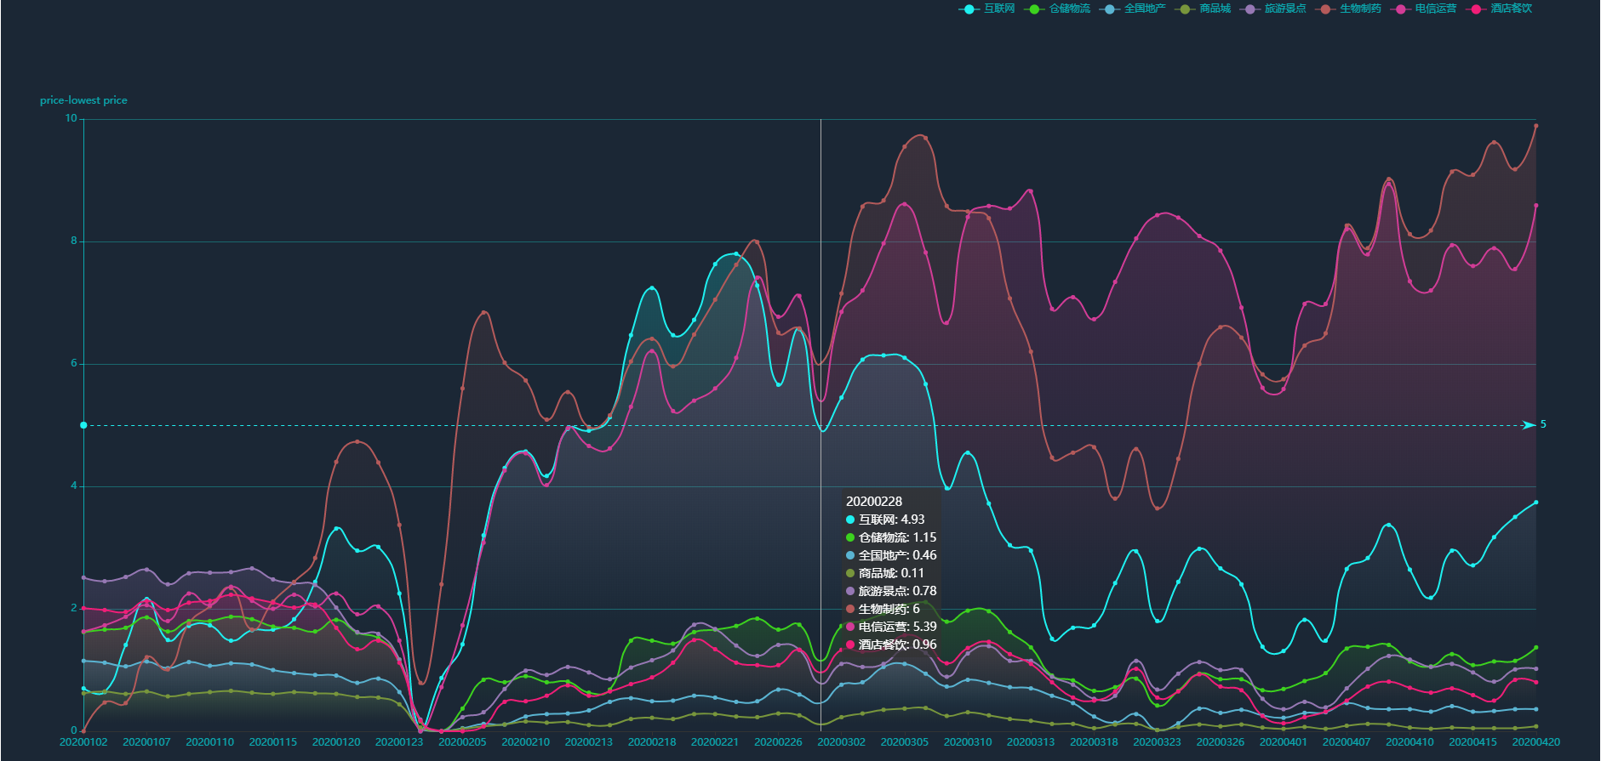
02
Impact on some typical industries
Visualization
When COVID-19 was almost under control in China, pharmaceuticals and telecom stocks ended up a new high, while the Internet stocks raised only a little despite its strong performance in Feb.
The city of Wuhan was locked down, which symbolized the deterioration of the epidemic.
The US equity melted down four times, and China officially closed to foreigners with valid visa.

Slide 7
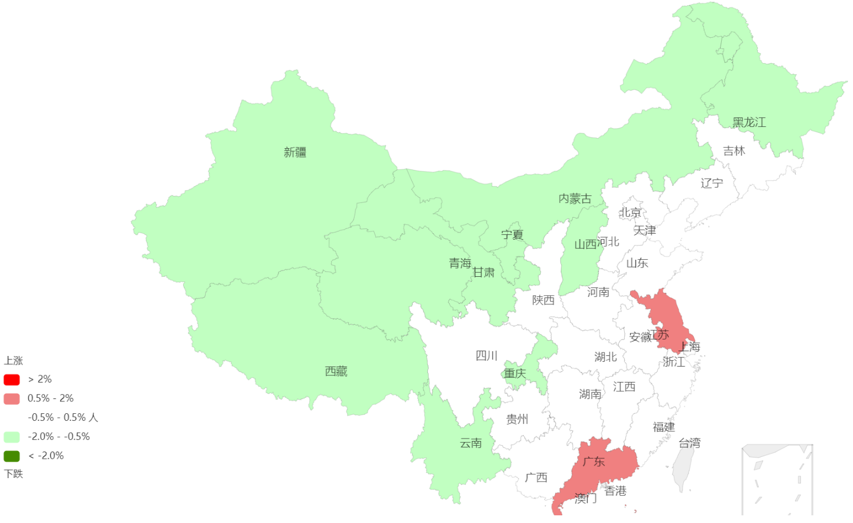
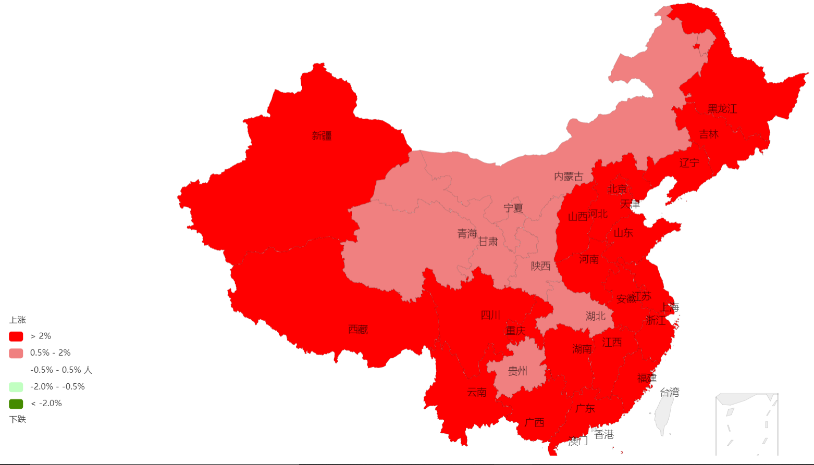
02
Stock Trend of Companies Registered in Each Province
Visualization
1/22
3/25
Stock market of china is under strong influence of our government’s policy against the virus, so most provinces have the same trend.
Also, the market can be impacted by some local virus situation and local policies.

Slide 8
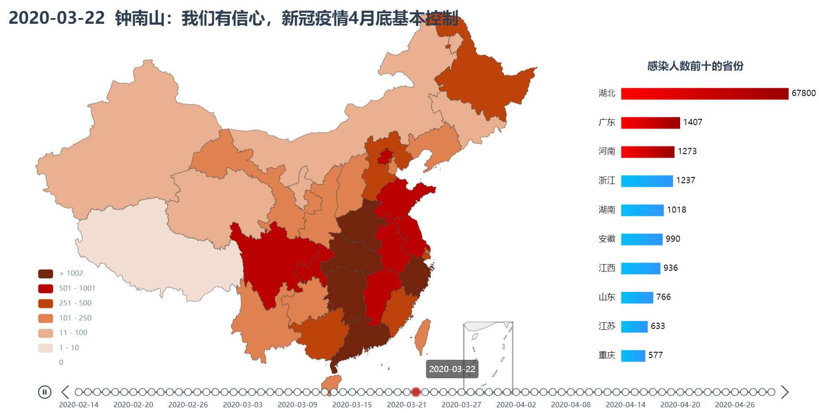
02
Epidemic Map Timeline with Significant Events
Visualization

Slide 9
3
Data Processing

Slide 10
03
Data Processing
Introduction
We used flask to provide API service.
API test: 123.57.246.36:5000
High concurrency: gevent
Data collecting
Stock: stock info, company info, daily info, weekly info, monthly info, money flow info(Tushare).
Epidemic: area daily info(Tencent).
Data processing
Stock area data.
Stock industry data.

Slide 11
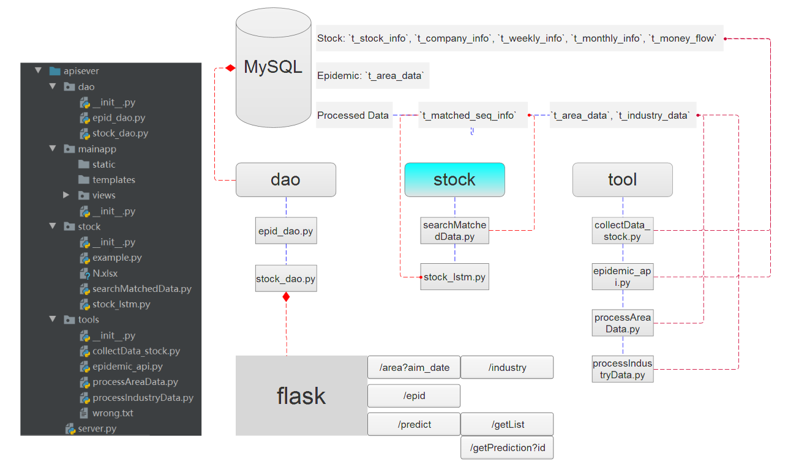
03
Data Processing

Slide 12
4
Machine learning

Slide 13
04
Machine learning
We have seen significant volatility in the stock market as a result of the outbreak. And now the stock market downturn has basically passed, the market is overall stable. The rise of some industries could be caused by special events, or the correction conducted by the government. It has become a topic of concern whether to continue to hold positions after a big growth.
We modeled this situation and grabbed the data.
We built a machine learning model to predict this situation.
We showed the results on our website.
future
Notes:
我们发现，在疫情的影响下，股市出现了大幅动荡的情况。而现在基本已经度过了股市的低迷期，整体市场稳中向好。无论是特殊事件引起的某些行业拉升，还是政府控制下的版块回调，大幅增长后是否应当继续持仓成为了人们关注的话题。

Slide 14
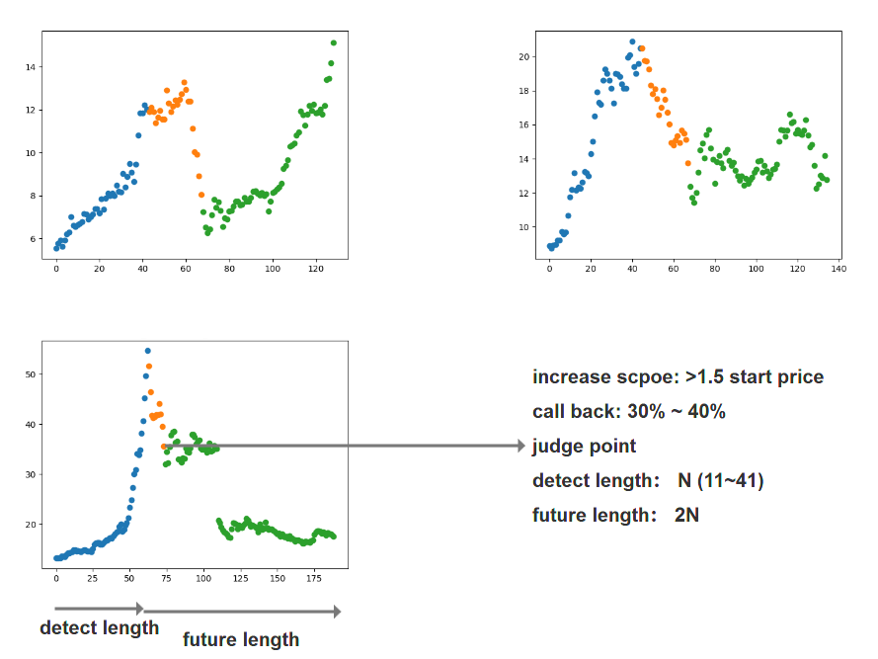
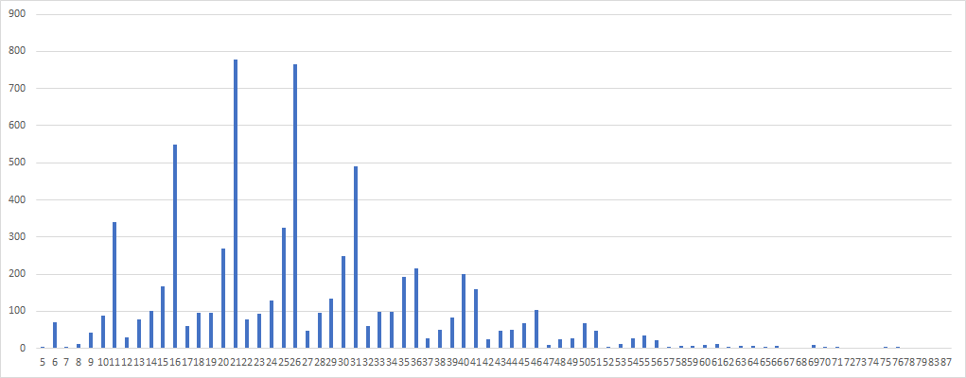
04
Machine learning

Slide 15
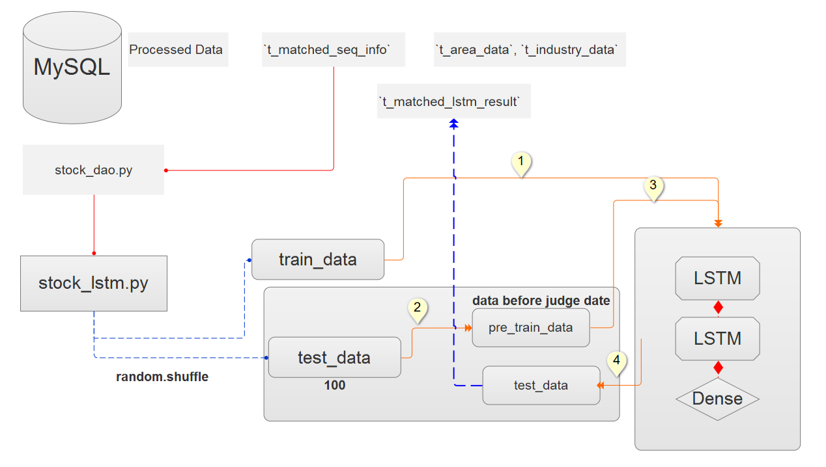
04
Model structure

Slide 16
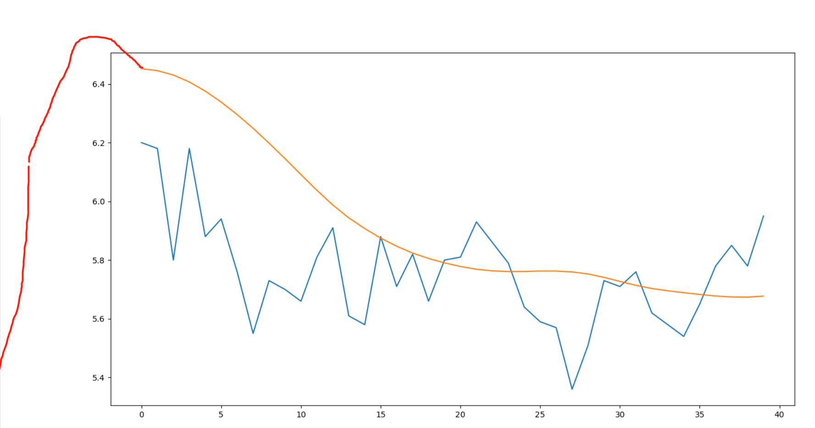
04
Result
more sensitive
better handle virtual callbacks

Slide 17
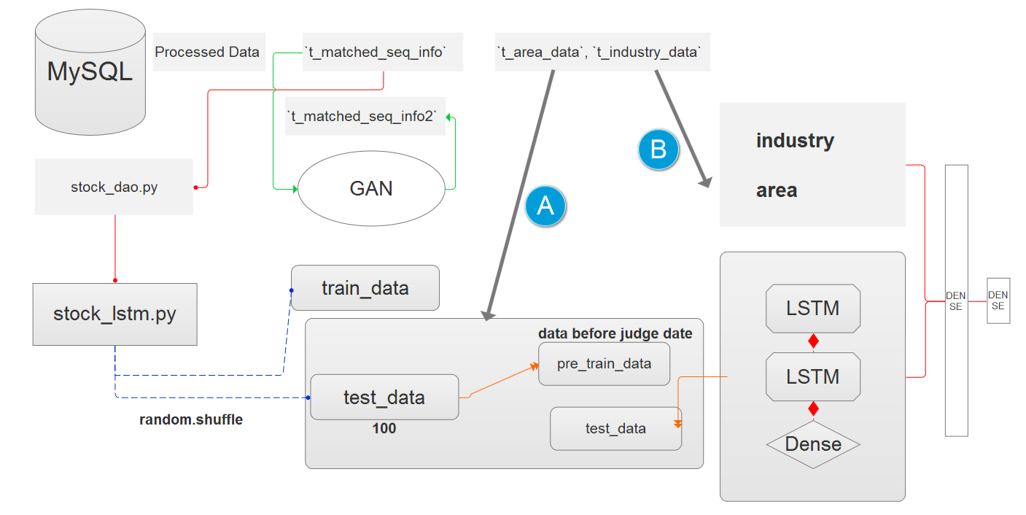
04
Future model

Slide 18
THANK YOU
.
.
.

