Slide 1
Secure connectivity determination
under the risk of adversarial model
薛冯晨

Slide 2
目录
1. modeling
2. algorithm
3. analysis

Slide 3
目录
1. modeling
2. algorithm
3. analysis

Slide 4
1. modeling
Who is attacker?
How defender works?
Failure probability
Evolution of network ✔
attacker
S
D
attacker

Slide 5
1. modeling
From defender’s perspective:
Network structure
Modeled failure probability $p_{e}$ for each edge
Action: select some edges to protect
Aim: keep s and d connected
S
D

Slide 6
目录
1. modeling
2. algorithm
3. analysis

Slide 7
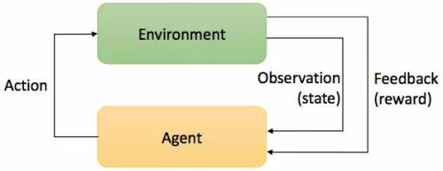
2. algorithm
Reinforcement learning:

Slide 8
2. algorithm
Adversarial Multi-armed bandit problem
Exploitation VS. Exploration
EXP3 algorithm
A
B
C
D

Slide 9
2. algorithm
Aim: Select some edges to protect
Graph structure!
How dose optimal algorithm work?
S
D

Slide 10
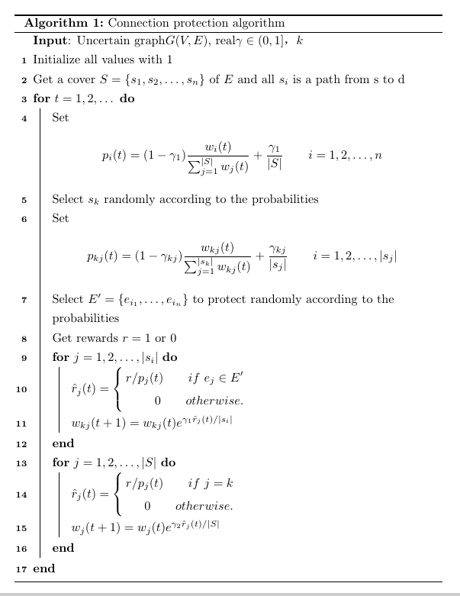
2. algorithm
Get a cover S of edge set E
Regard each path as an arm and transform this problem into MAB model
Select some edges similarly in this path to protect
This algorithm is based on EXP3 algorithm.

Slide 11
目录
1. modeling
2. algorithm
3. analysis

Slide 12
3. analysis
Define regret $R\left(t\right)=G\left(t\right)−G_{min}\left(t\right)$
And in some condition
$R_{1}\left(t\right)=\sum_{s_{i}∈S}{G_{i}(t_{i}) }−G_{min}\left(t\right)$ where $∑t_{i}=t$
$=$ $\sum_{s_{i}∈S}{[G_{i}\left(t_{i}\right)−G_{min}\left(t_{i}\right) ]}$
$=$ $\sum_{s_{i}∈S}{R_{i}(t_{i})}$

Slide 13
3. analysis
For any $γ_{i}∈\left(0,1\right]$,
$$R_{i}\left(t\right)≤\left(e−1\right)γ_{i}(t−{G_{i}}_{min})+\frac{\left|s_{i}\right|\ln\left|s_{i}\right|}{γ_{i}}$$
holds for any assignment of rewards and for any $t>0$
Auer, Peter, et al. "The nonstochastic multiarmed bandit problem.“
SIAM journal on computing 32.1 (2002): 48-77.

Slide 14
3. analysis
For any $t>0$, assume that $g_{i}≥t−{G_{i}}_{min}$ and
$$γ_{i}=\min{\{1,\sqrt{\frac{\left|s_{i}\right|\ln\left|s_{i}\right|}{\left(e−1\right)g_{i}}}\}}$$
Then $R_{i}\left(t\right)≤2\sqrt{e−1}\sqrt{g_{i}\left|s_{i}\right|\ln\left|s_{i}\right|}=O(\sqrt{g_{i}\left|s_{i}\right|\ln\left|s_{i}\right|}$)
$R\left(t\right)≤O(\sqrt{g\left|S\right|\ln\left|S\right|}$)
Auer, Peter, et al. "The nonstochastic multiarmed bandit problem.“
SIAM journal on computing 32.1 (2002): 48-77.

Slide 15
3. analysis
So we have
$$R_{1}\left(t\right)=\sum_{s_{i}∈S}{R_{i}(t_{i})}=O(\left|S\right|\sqrt{g_{i}\left|s\right|\ln\left|s\right|}\text{)}≈ O(\sqrt{g\left|E\right|\ln\left|s\right|}\text{)}$$
And obviously $g≤t$, so$R\left(t\right)=O(\sqrt{t\left|E\right|\ln\left|s\right|}\text{)}\text{+}O(\sqrt{t\left|S\right|\ln\left|S\right|}\text{)}$

Slide 16
谢谢

