Slide 1
Secure Connectivity with RL under Adversarial Model
Yuhao Lu
2020/5/20

Slide 2

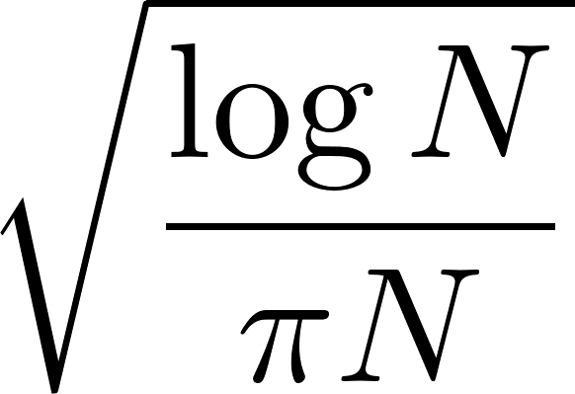
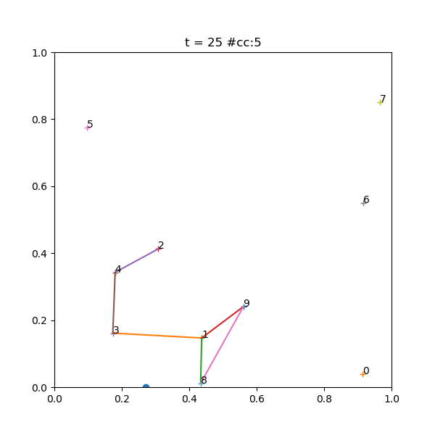
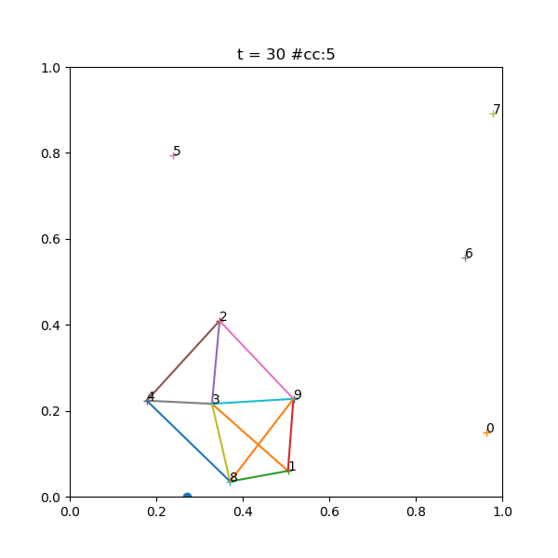
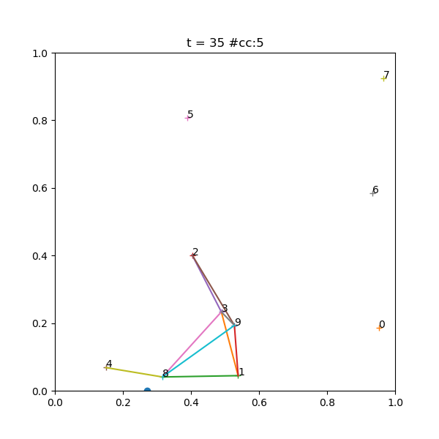
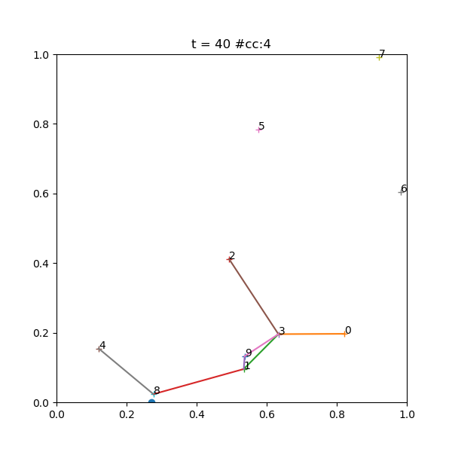
Introduction
A mobile network with a defender and an attacker.
Attacker aims to reduce the connectivity (inc # cc) of the network.
Defender aims to protect the network from attack.
A unit square playground with nodes.
Every node has a maximum velocity and acceleration (random).
Two nodes are connected if their distance under .

Slide 3
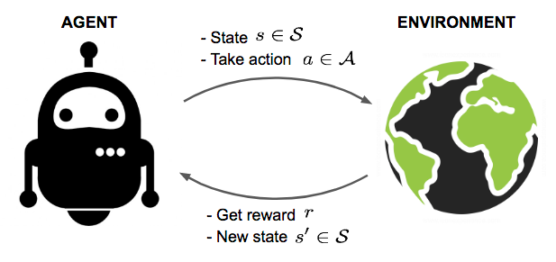
Introduction
Involve an agent and an environment.
  Agent observes the state and takes an action.
  Environment returns a reward and transit into the next state.
  Go to 1. until environment signals a “done”.
Agent wants to maximize the total rewards.

Slide 4

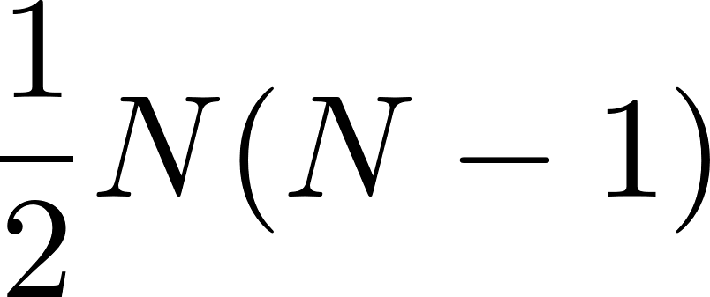
Introduction
Environment: The playground with nodes.
Agents: Two rl agents for defender and attacker respectively.
State: Flattened reduced adjacent matrix.
Action: A set of edges chosen from all possible edges.
  Defender set edges to defend every time slot.
  Attacker is not aware of which edges are defended, i.e. receive exactly the same state as the defender. If the any of the attacked edges is not defended, it will be removed. Otherwise, nothing happens.
Reward:
  Delta = # cc after attack - # cc before attack
  Punishment = # edges selected but not exist
  Attacker: Delta - Punishment
  Defender: -Delta - Punishment
Why?
The adjacent matrix of a simple undirected
graph contains redundant information. Only
the half above the main diagonal is enough.
With nodes, there are a total of
possible edges. Then we vectorize the top
half to feed into the neural networks.

Slide 5
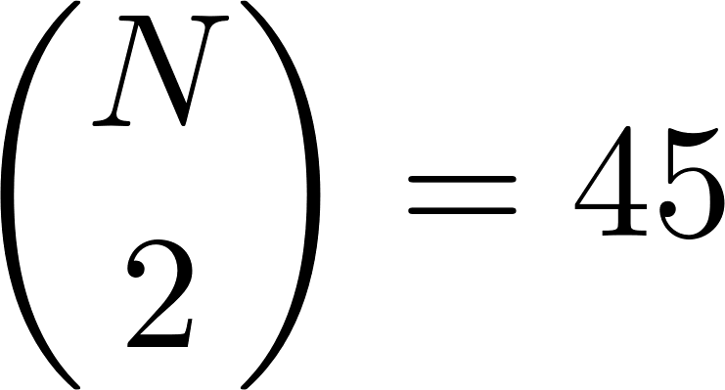
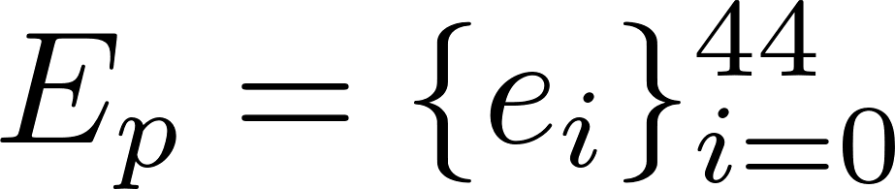
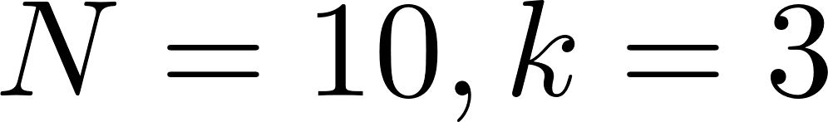
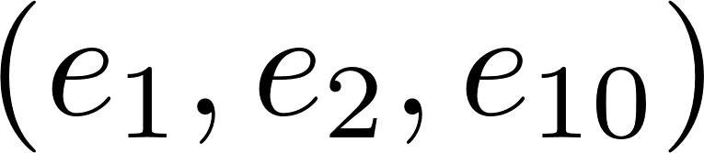
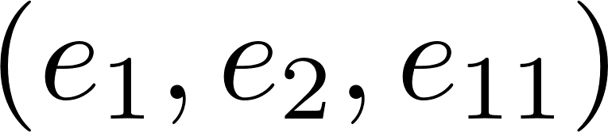
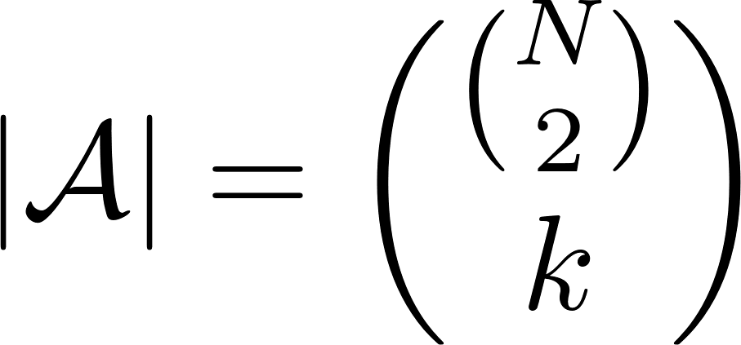
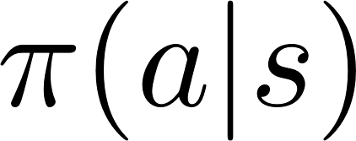


Difficulty
Combinatorial action space
  Say , we have a total of possible edges and note that and are two different actions.
  Therefore, given nodes and let action contains edges, the size of action space is given by
  Value-based algorithms like DQN are not applicable.
  Policy-based algorithms like A2C, PPO all require agents to compute , probability of choosing action in state .

Slide 6
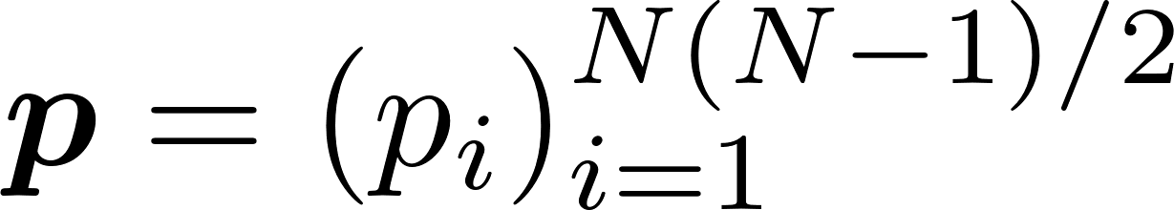
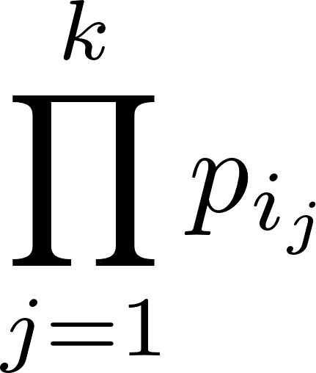
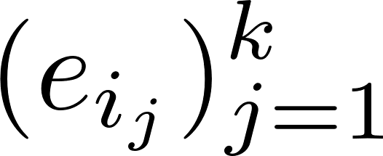
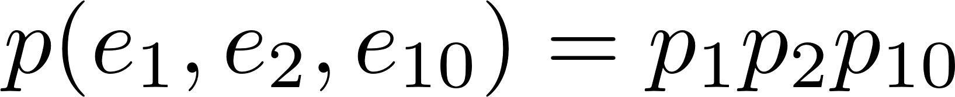
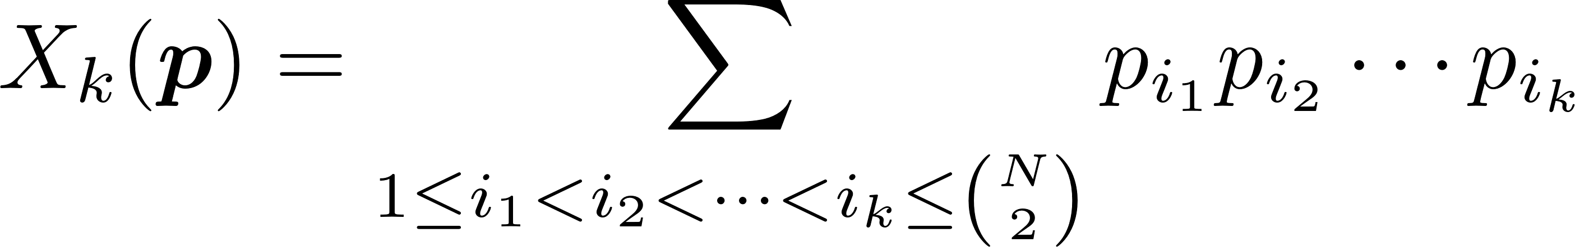
Solution
We can output a vector (after softmax) corresponding to all possible edges (can be interpreted as probability). A natural idea would be to assign to action , e.g. set the probability of action . Now the problem is that the probability of all actions does not sum to 1. Here follows another natural idea, we can divide the pseudo probabilities by a normalizer given by
E.g. , then the normalizer is

Slide 7
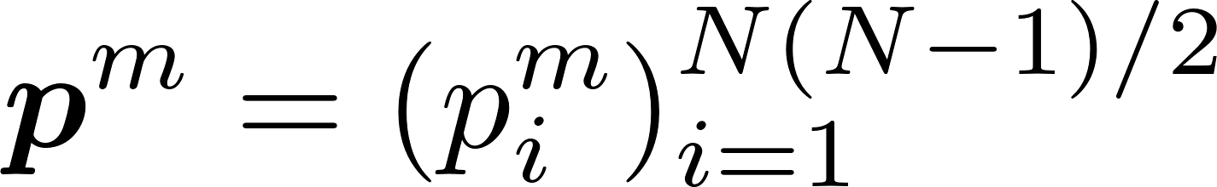
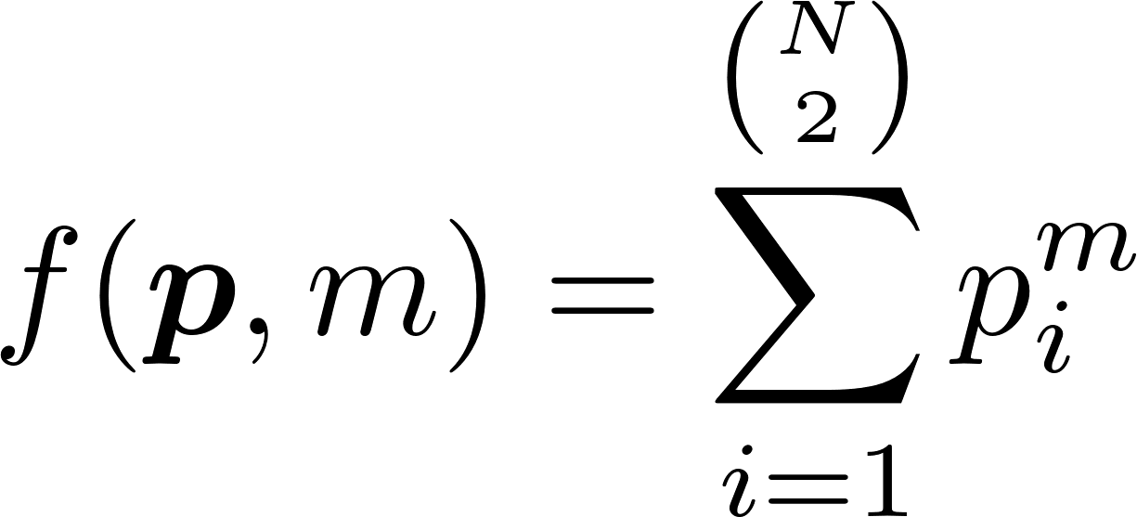
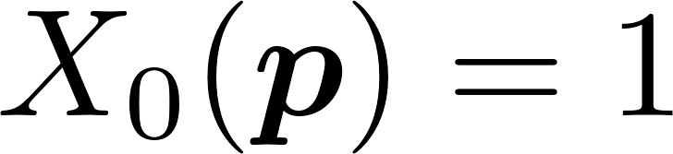
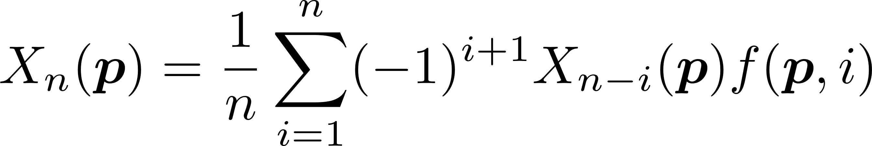
Solution
What we have is or is what we can easily get in python.
Define
We can get the following recursive equation

Slide 8
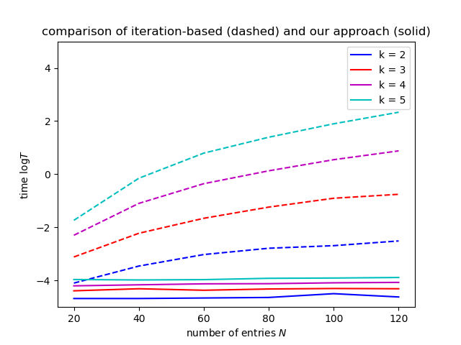
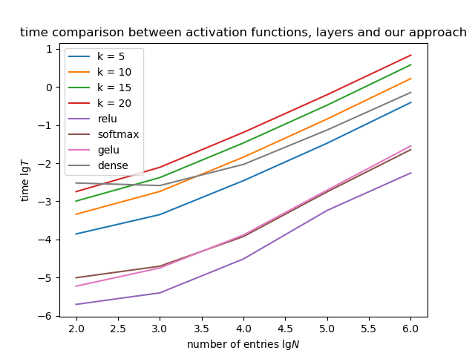
Performance
We implement the equation in a iteration-based manner inspired by the optimization of computing Fibonacci numbers.

Slide 9
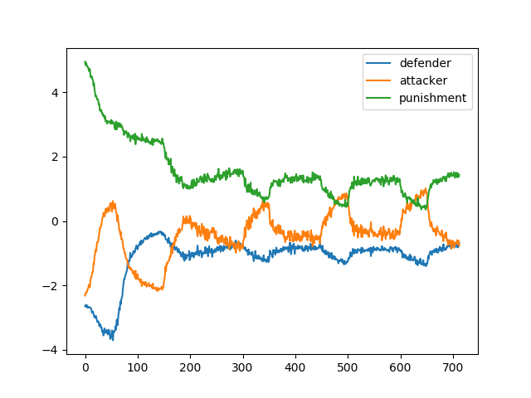
Algorithm
We choose Proximal Policy Optimization (PPO) for each agent.
We adversarially train the defender and attacker.

Slide 10
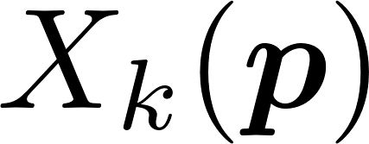
Future Work
Test the rl-trained attacker/defender against other (random, rule-based) defender/attacker.
Derive a direct expression for the normalizer .

Slide 11
Thank you.

